Slide 1
Music Lesson 2

Slide 2
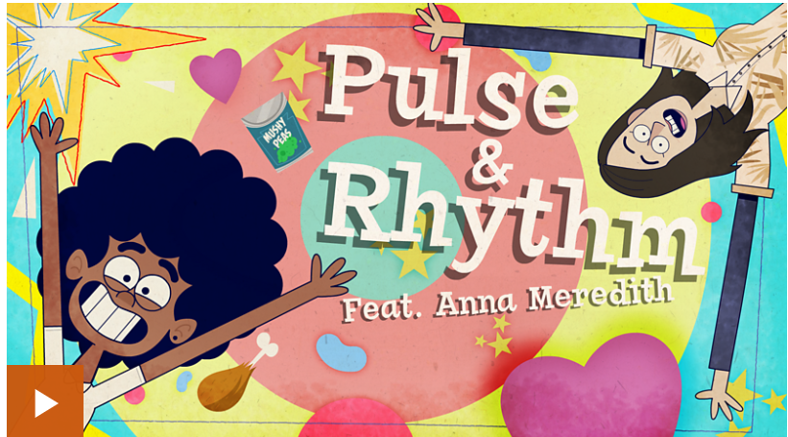
BBC BITESIZE – Pulse and Rhythm
https://www.bbc.co.uk/bitesize/topics/zcbkcj6/articles/z2mqw6f

