Slide 1
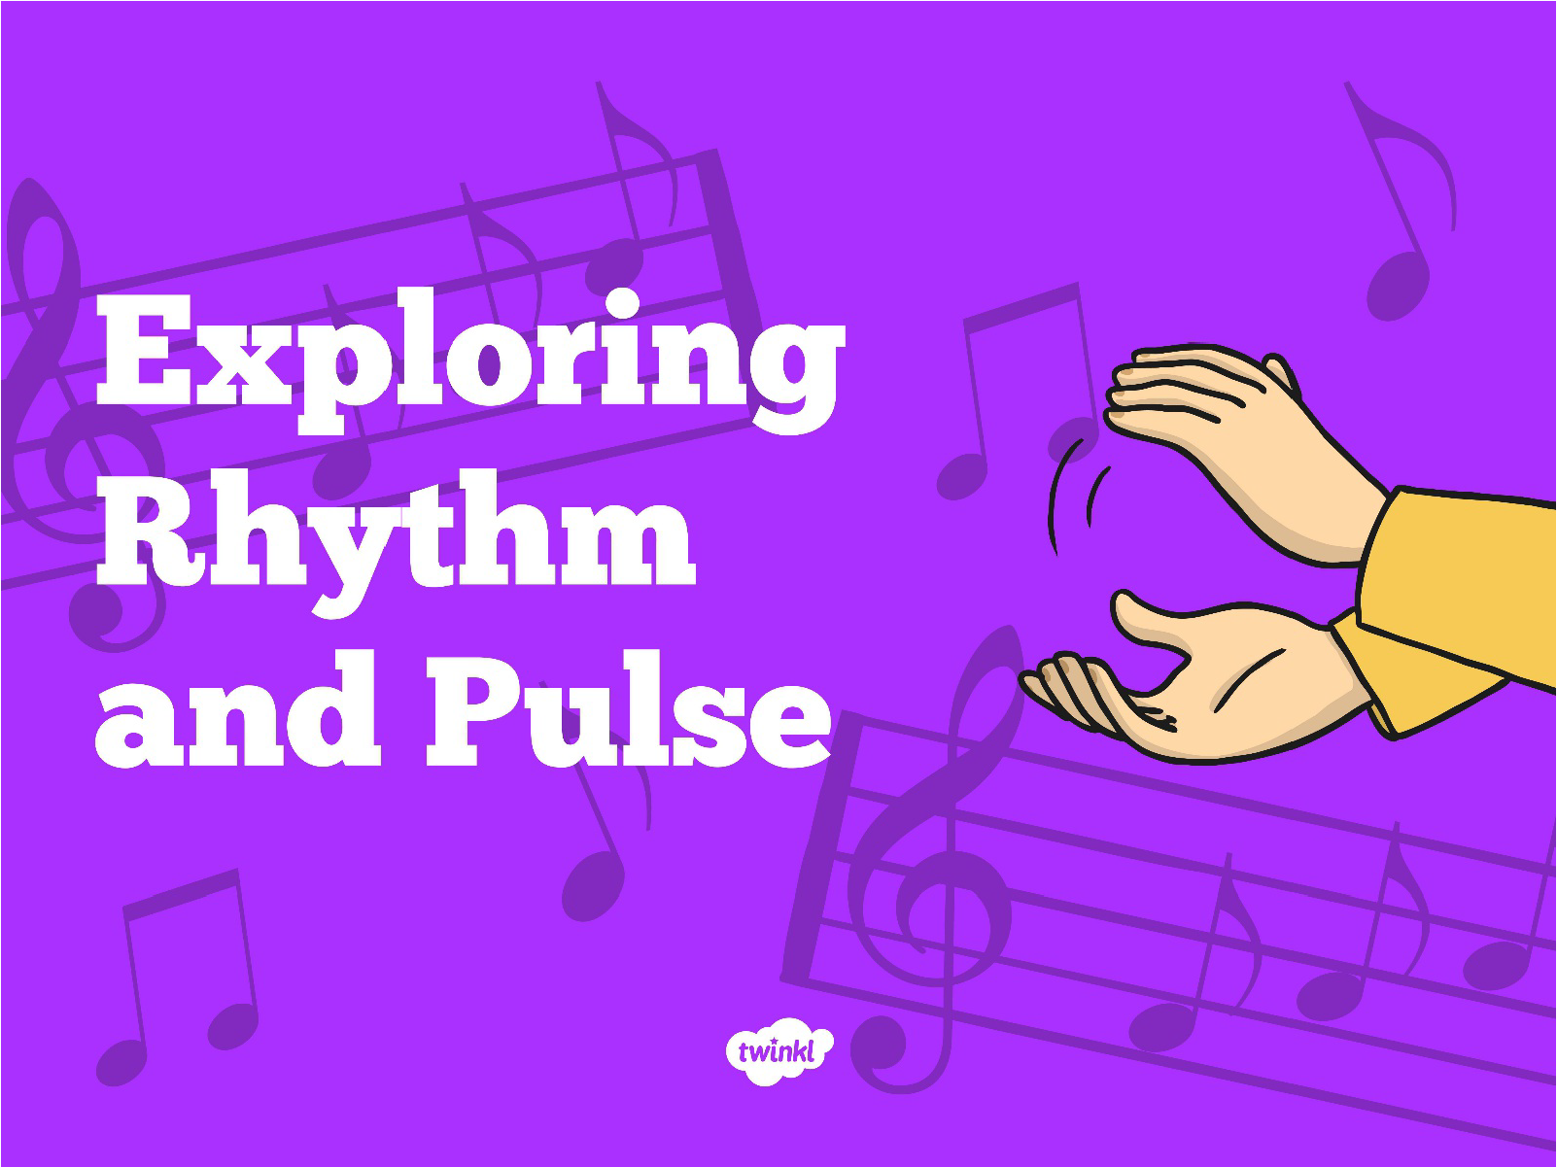

Slide 2
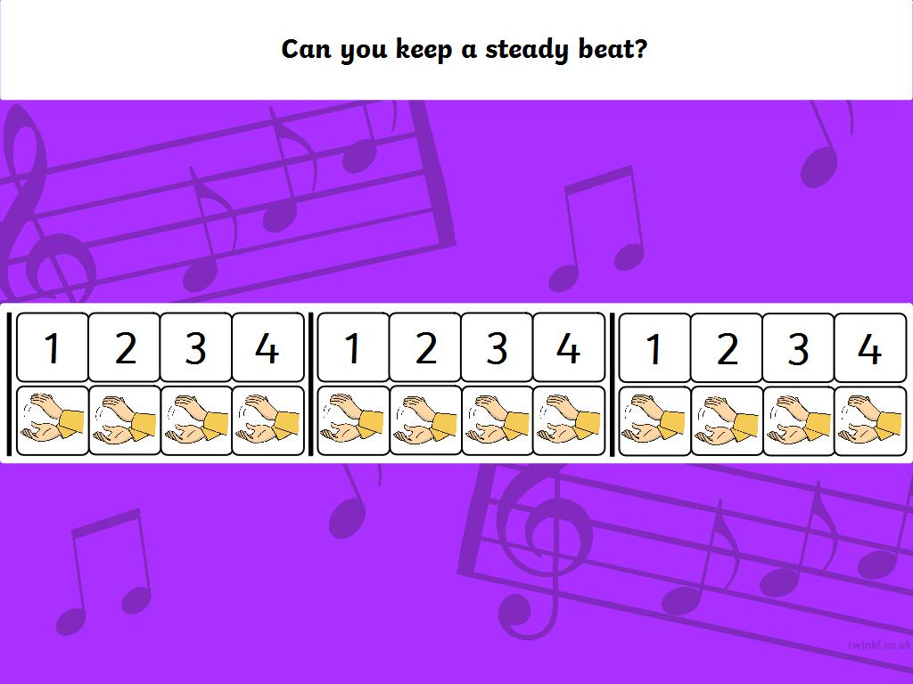

Slide 3
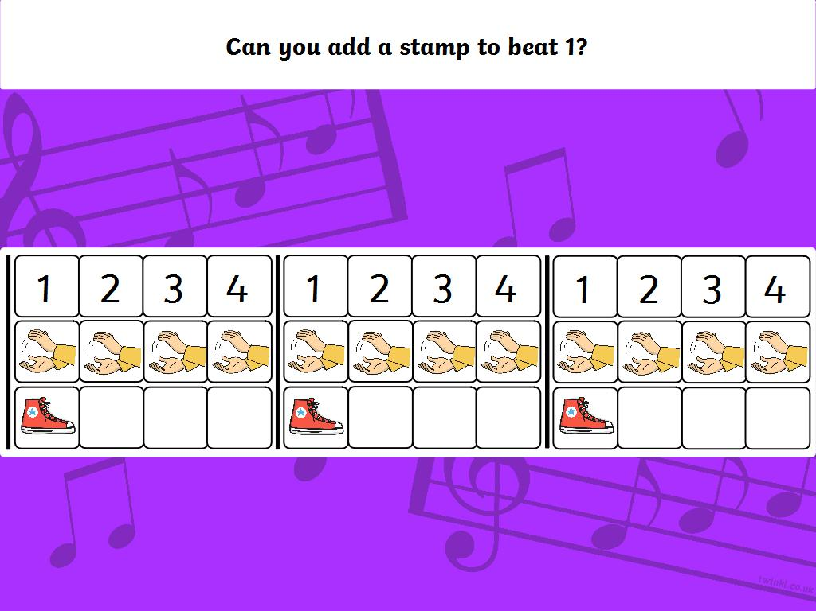

Slide 4
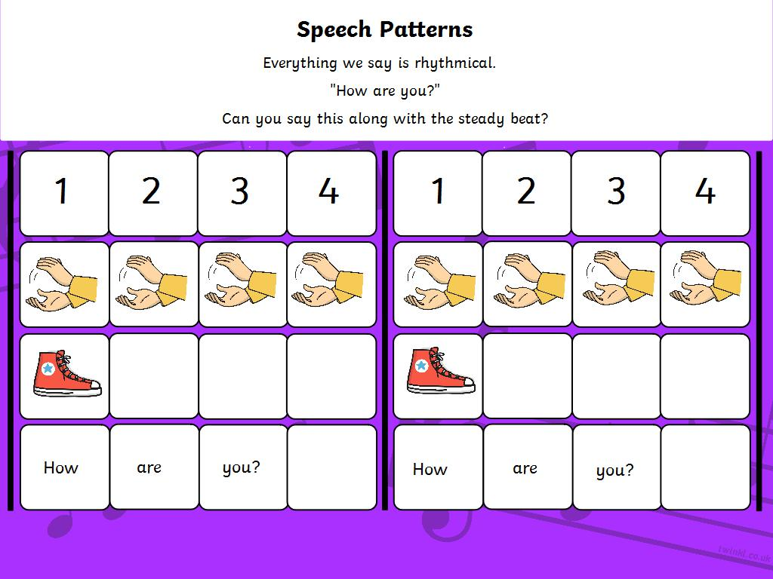

Slide 5
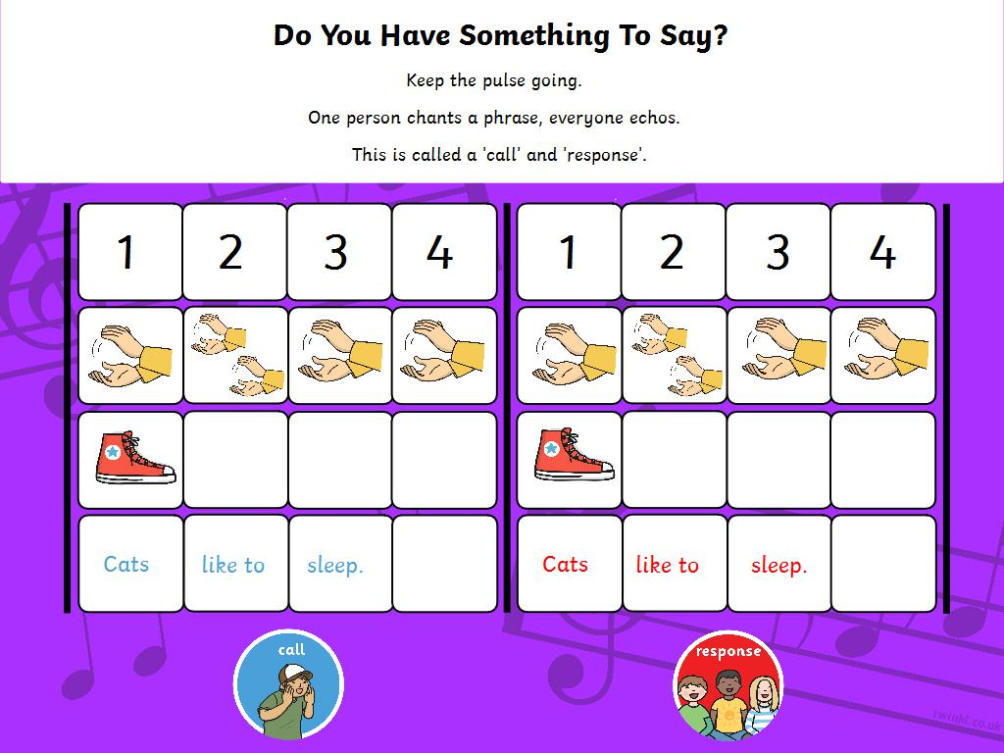

Slide 6
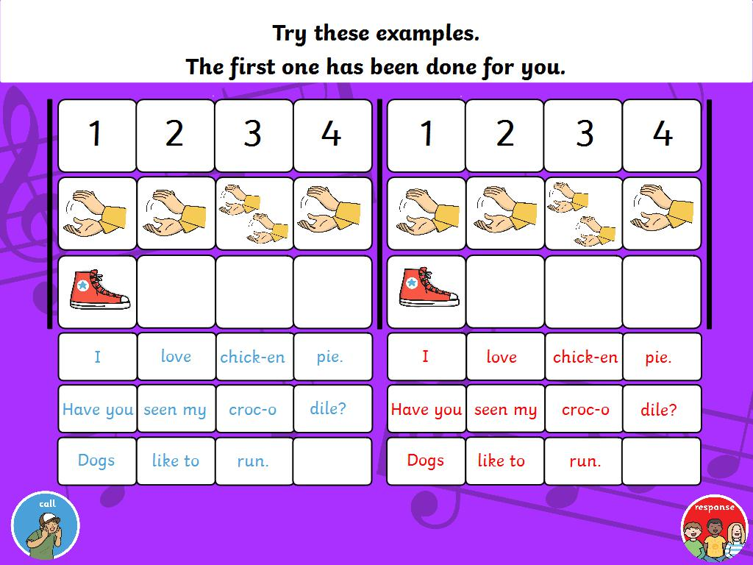

Slide 7
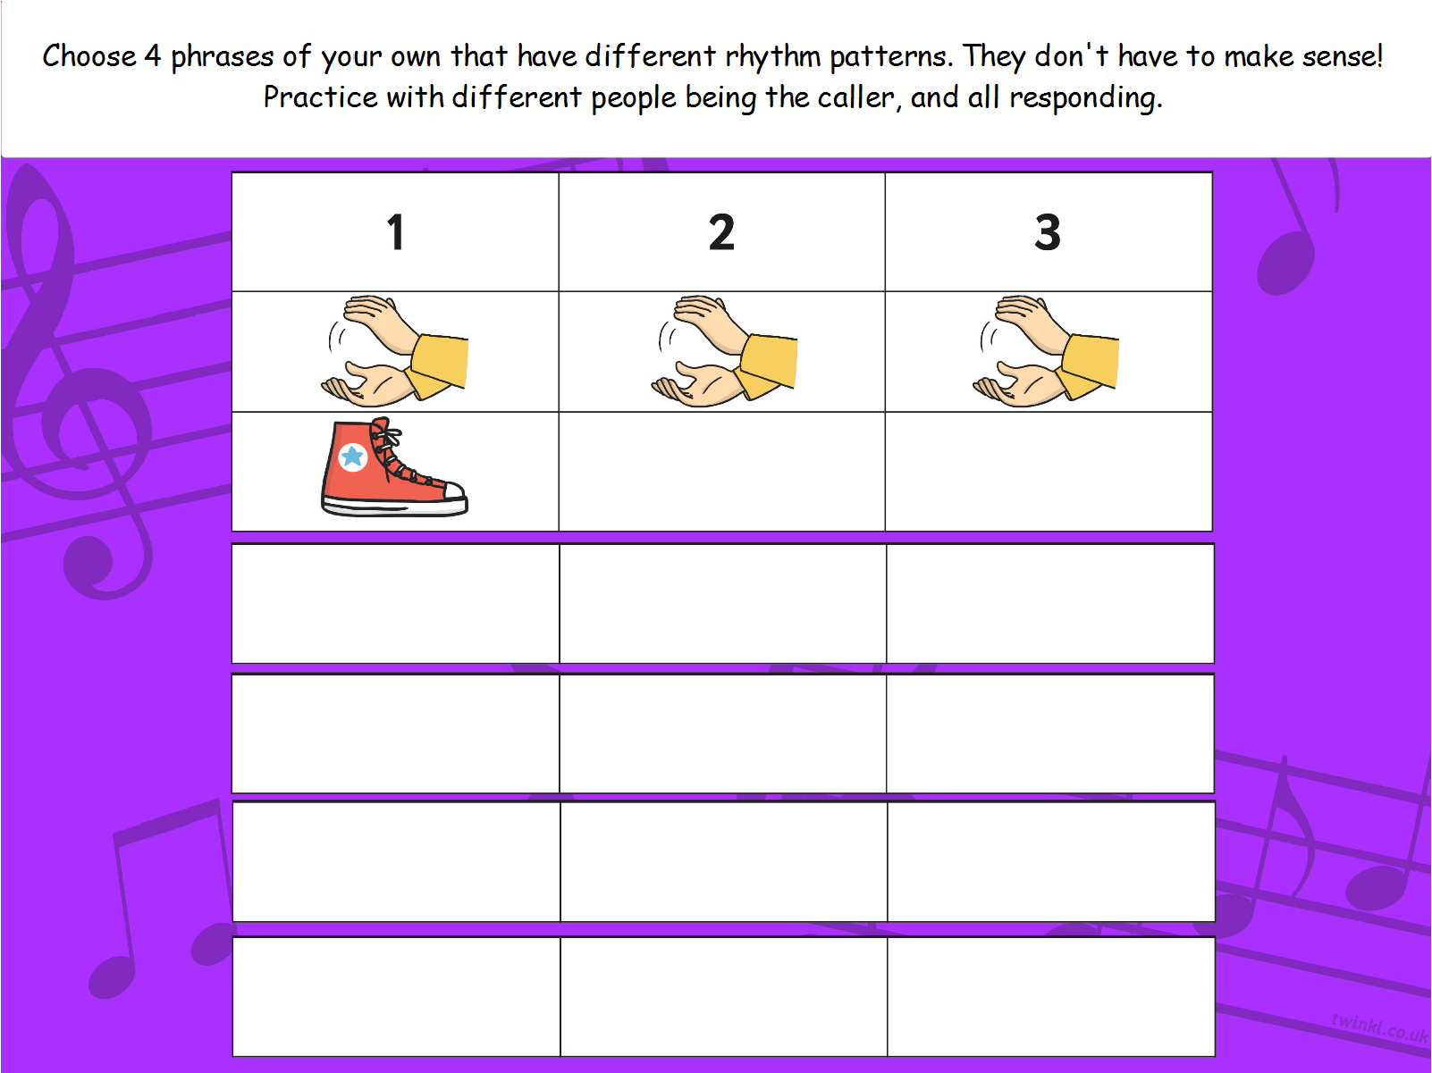


Choose 4 phrases of your own that have different rhythm patterns. They don’t have to make sense! Practise with different people being the caller, and all responding.
1 | 2 | 3 | 4
Place text here
Place text here
Place text here
Place text here

Slide 8


