Slide 1
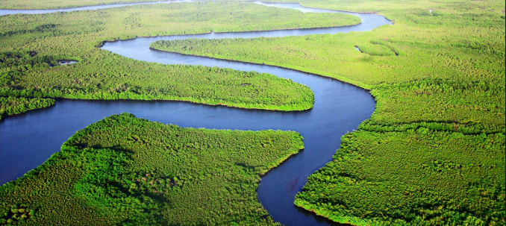
Rivers
Lesson 1

Slide 2
LO: I am learning about the features of a river.
Task 1
Draw a mind map or list everything you know about rivers
(think about….the names of rivers you know, the features of rivers, how they are made, why they are important, what are they used for).
Extension - what synonyms can you think of for the word river?
(top tip – you use an online thesaurus to help)

Slide 3
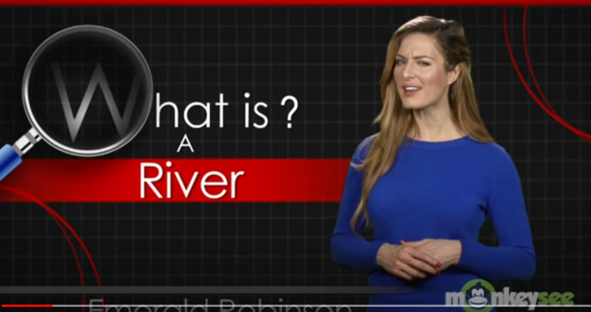
What is a river?
Play this video - https://www.youtube.com/watch?v=7kgQNRQjIUU
Task 2 – As you watch the video:
  Write up to 3 things that you knew already
  Write up to 3 things that you found out
  Write 1 thing that surprised you
Extension – Write a question about rivers that you want to find the answer to.

Slide 4
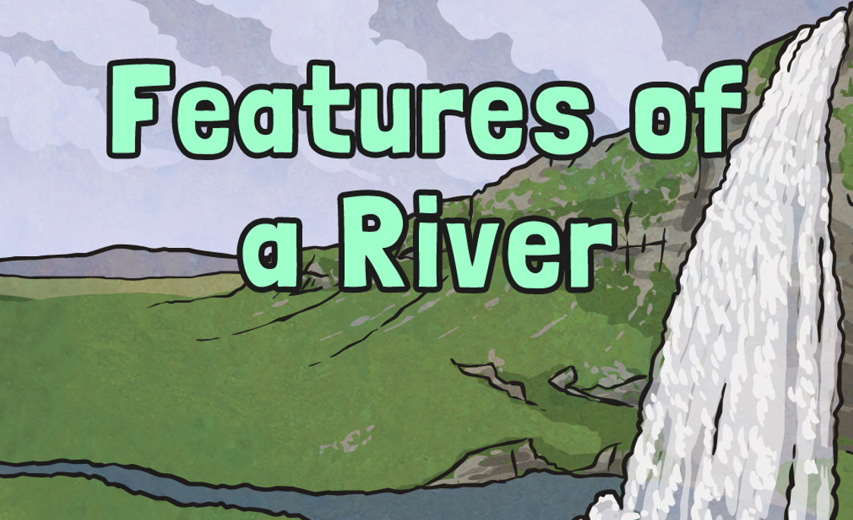

Slide 5
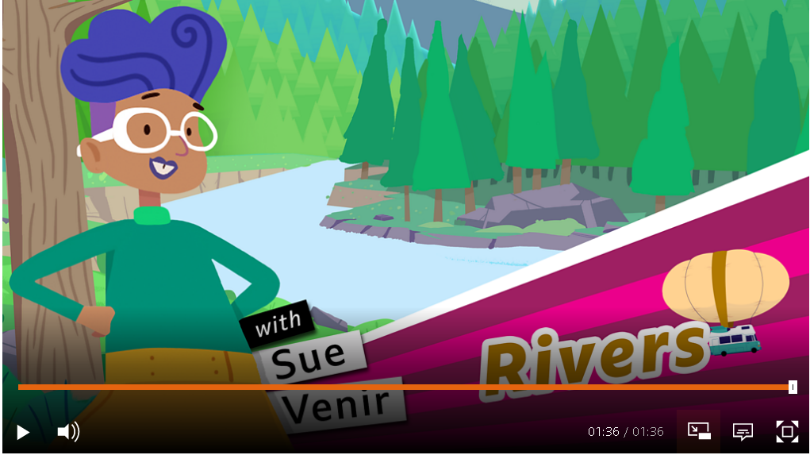
Watch this video on BBC Bitesize
Add to your list of things that you’ve found out about rivers
https://www.bbc.co.uk/bitesize/topics/z849q6f/articles/z7w8pg8

Slide 6
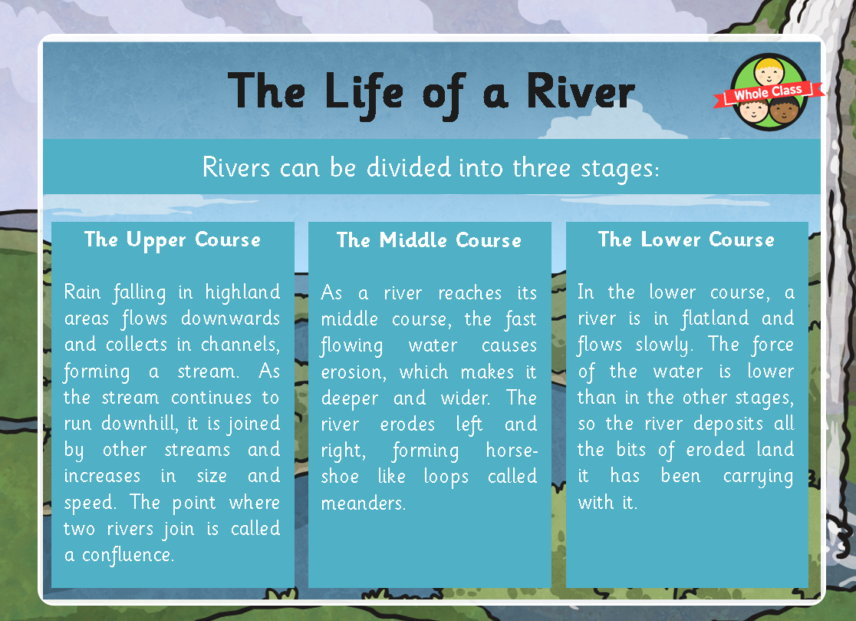

Slide 7
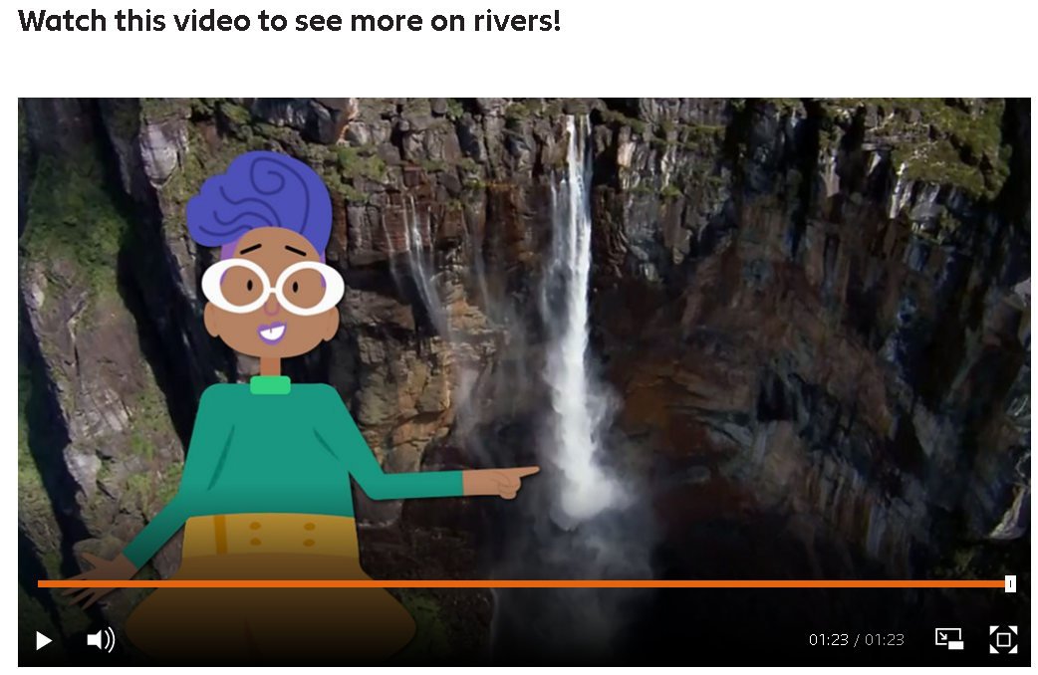
Watch this video on BBC Bitesize can you identify the difference courses of the river?
https://www.bbc.co.uk/bitesize/topics/z849q6f/articles/z7w8pg8

Slide 8
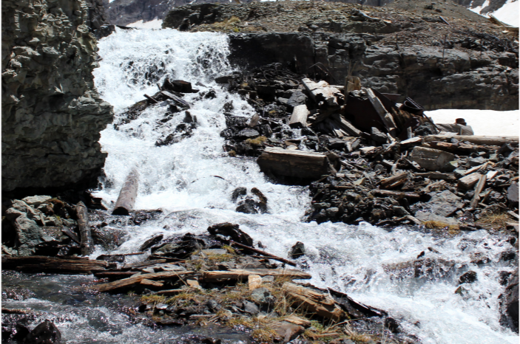
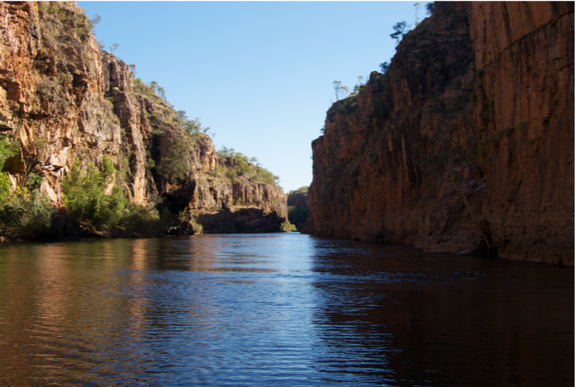
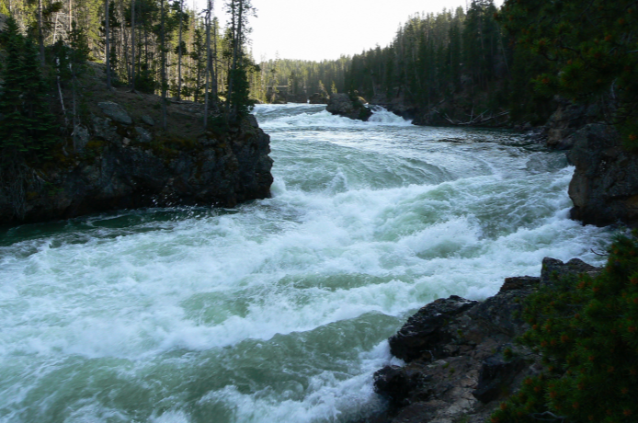
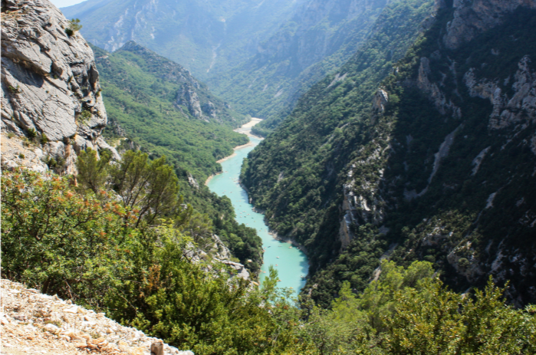
A river’s upper course
Play video to see a river’s upper course
https://youtu.be/XOqxrfiBr0w
Task 3 – Discuss or write
How would you describe the river here?

Slide 9
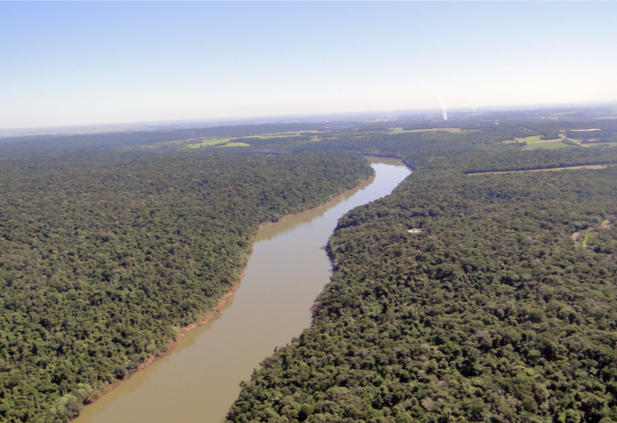
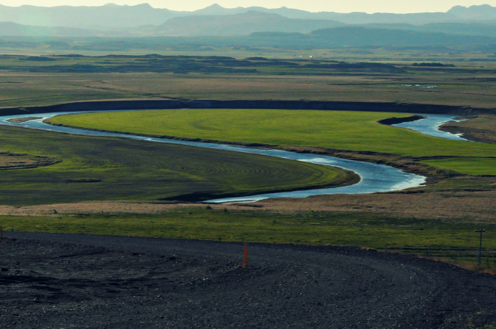
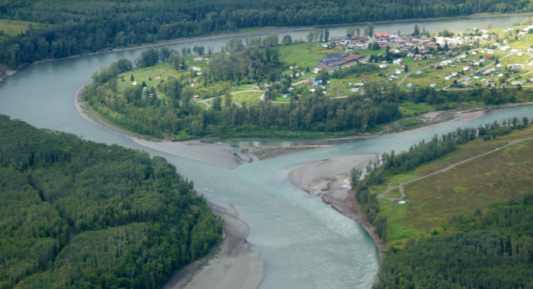
A river’s middle course
Play video to see a river’s middle course
https://vimeo.com/93022030
Task 3 – Discuss or write
How would you describe the river here?

Slide 10
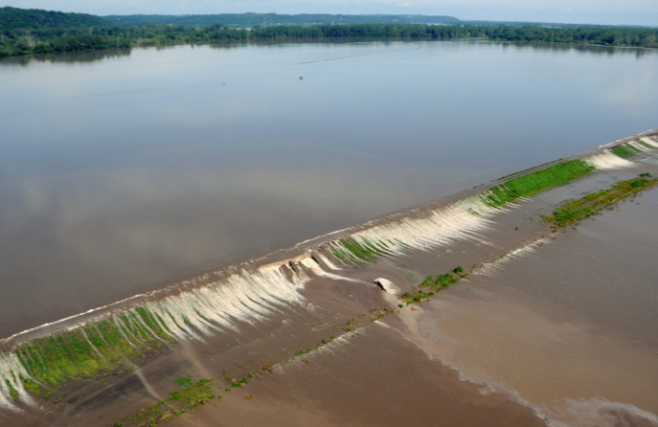
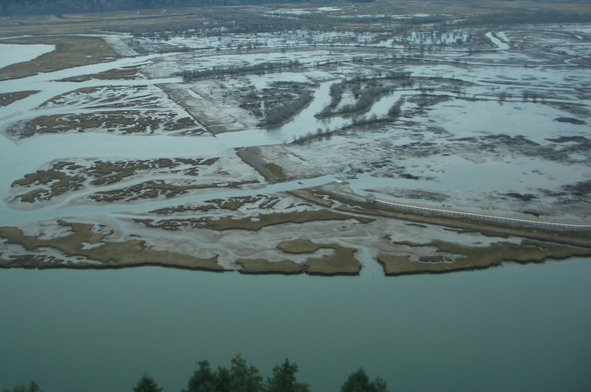
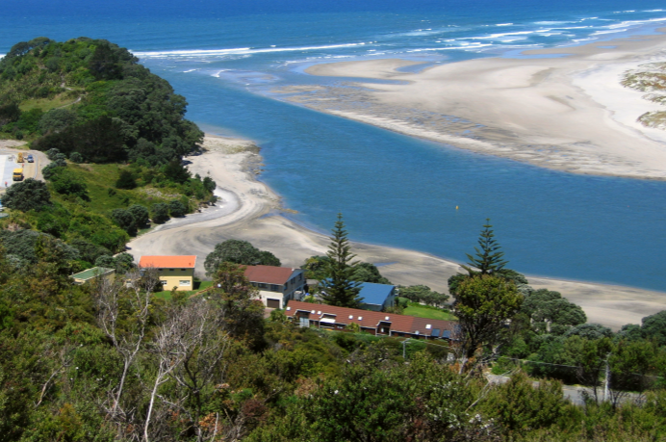
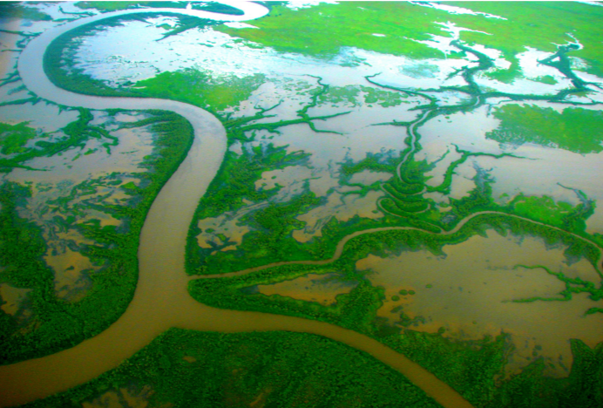
A river’s lower course
Task 3 – Discuss or write
How would you describe the river here?

Slide 11
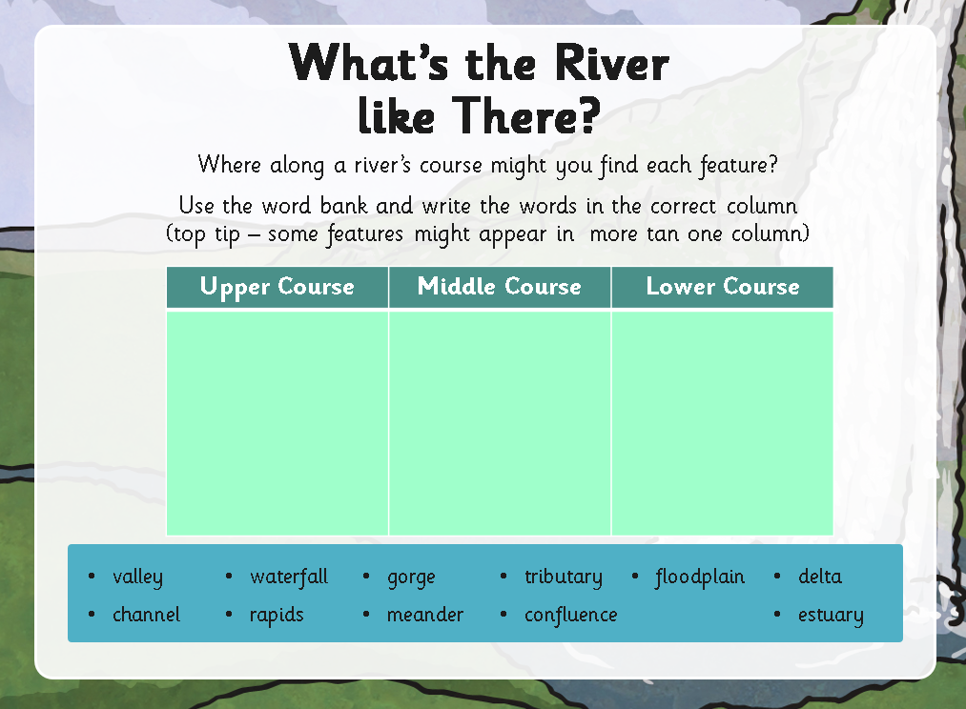
Task 4

Slide 12
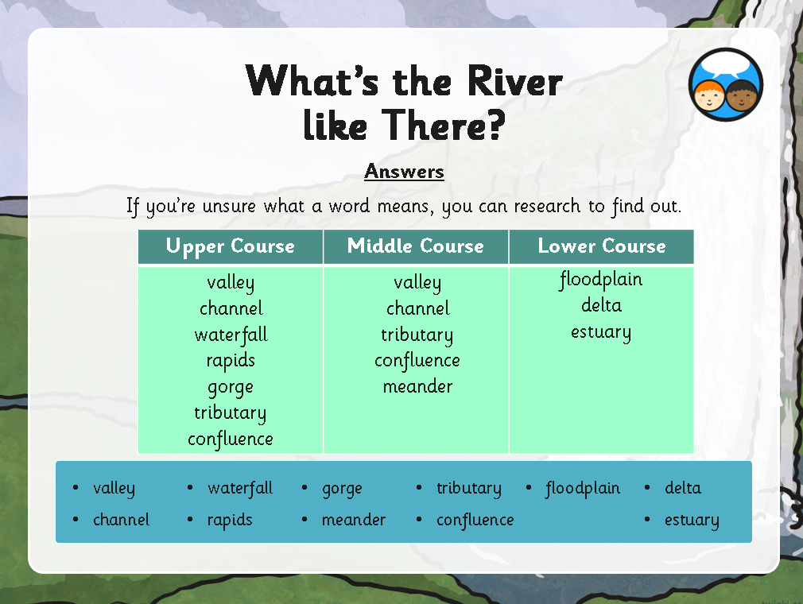
Task 4 - answers

Slide 13
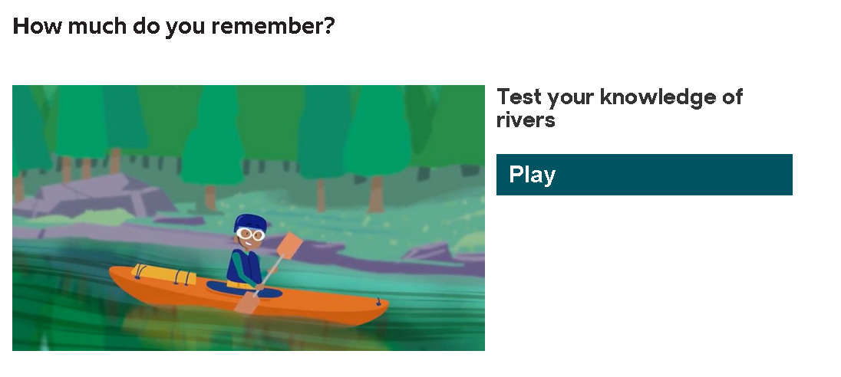
Challenge: How much do you remember?
Answer the questions in the quiz from the BBC Bitesize website.
https://www.bbc.co.uk/bitesize/topics/z849q6f/articles/z7w8pg8

Slide 14
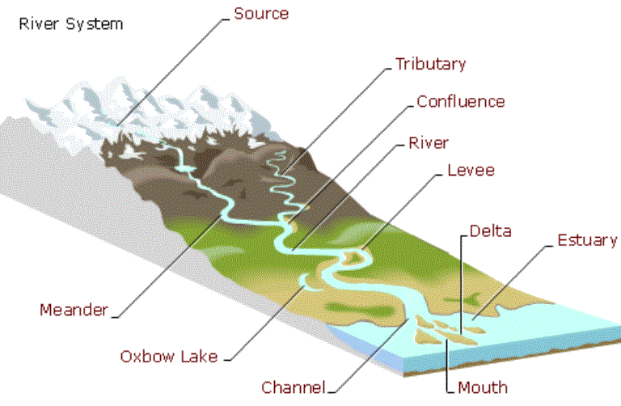
Task 6: Draw and label your own river and include as many features as you can
Your river MUST have:
  an upper, middle and lower course.
  Source
Your river can include:
  Tributary & confluence (smaller rivers and streams that join your river
  Waterfalls, channels, valleys, gorges
  Rapids
  Meanders
  Delta, estuary

