Slide 1
History
WWII

Slide 2

Click on the image and watch the video up to 2.46mins to recap the lead up to WW2.

Slide 3
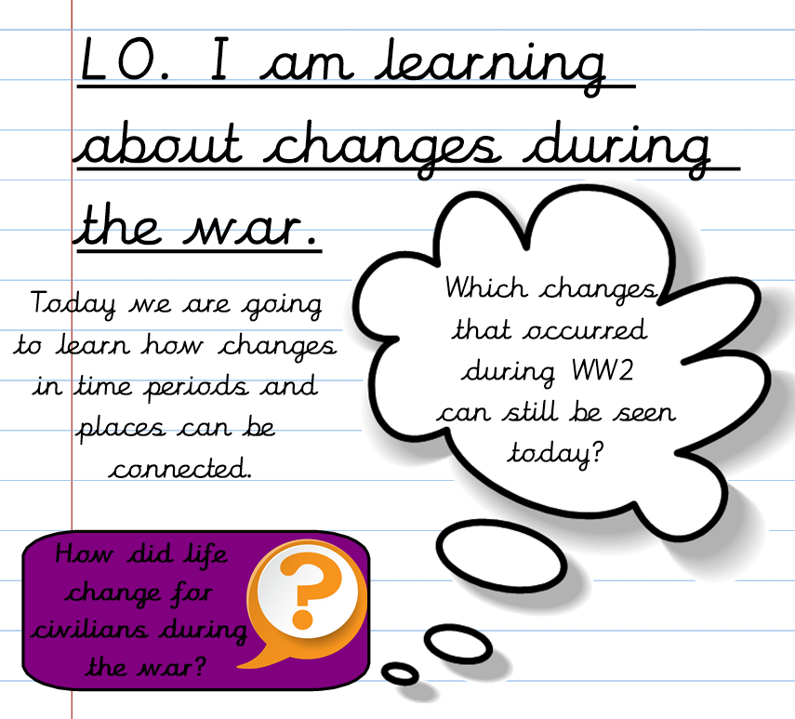
Civilians = the people not on the front line fighting in the war.

Slide 4
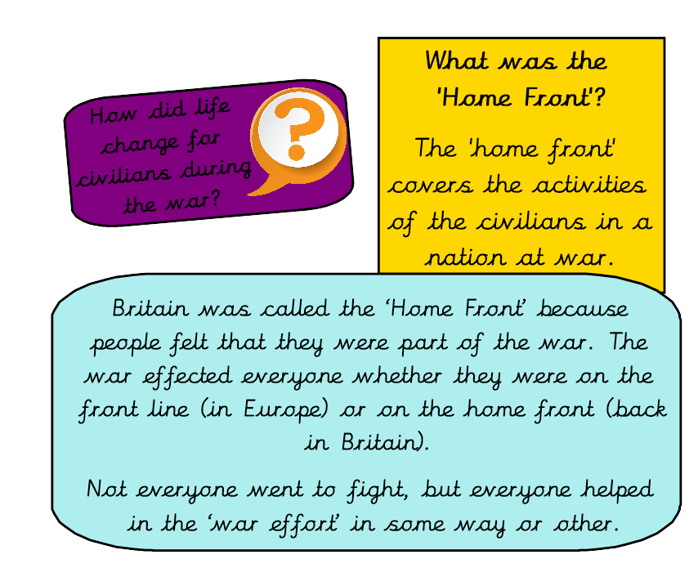

Slide 5
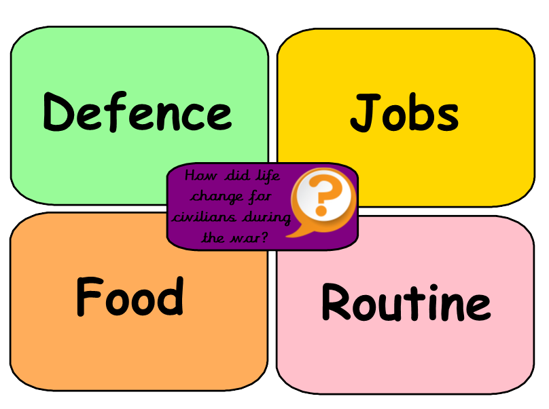
Choose one of the following topics.
Use the research resources to find out how life changed for civilians during the war.
Record your findings in a creative way.

Slide 6
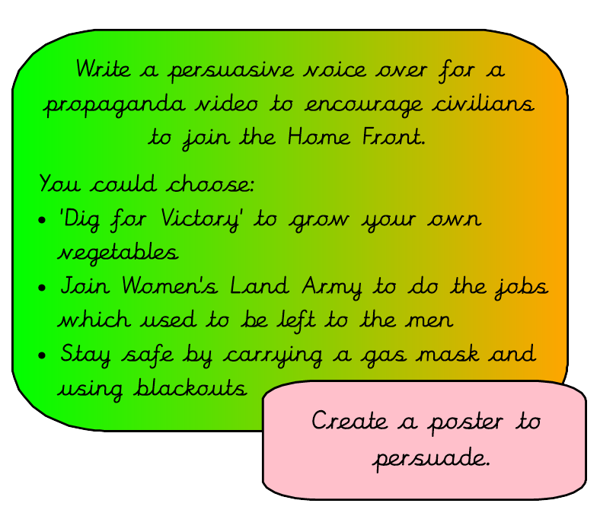

‘Propaganda’ is speeches, adverts, posters to persuade the public towards a certain way of thinking.
Click on the image to watch an example of a propaganda video from WW2.

Slide 7


