Slide 1
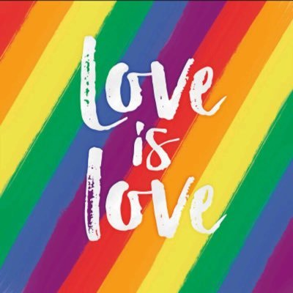
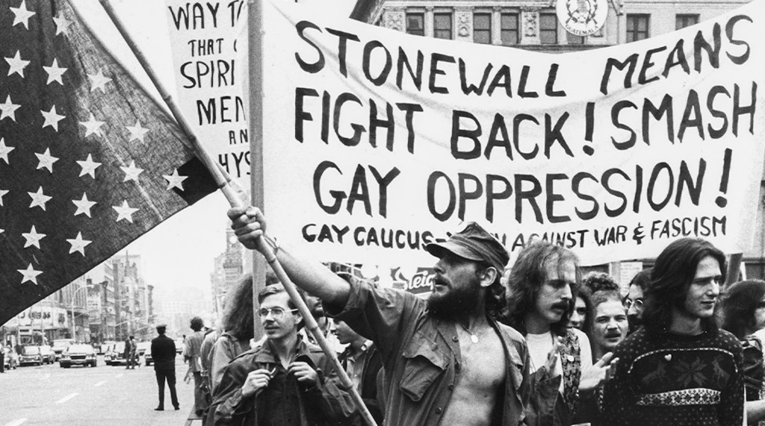
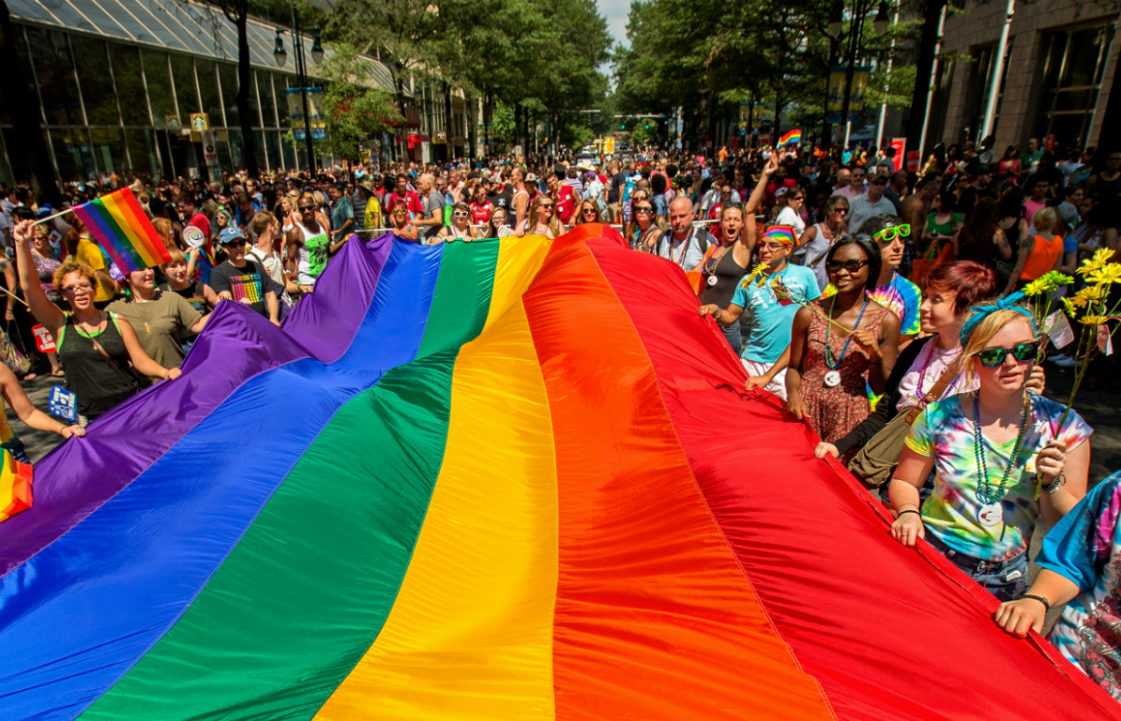
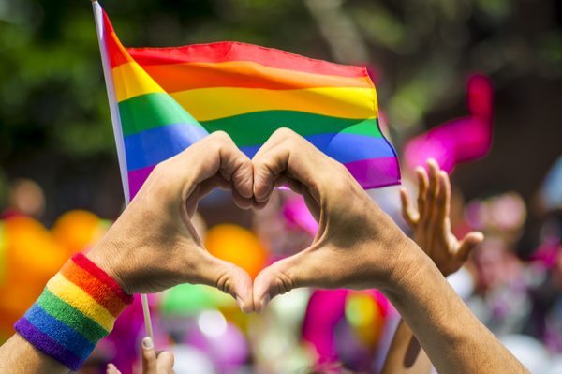
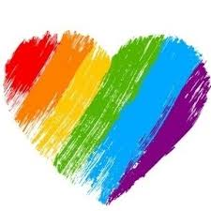

Slide 2
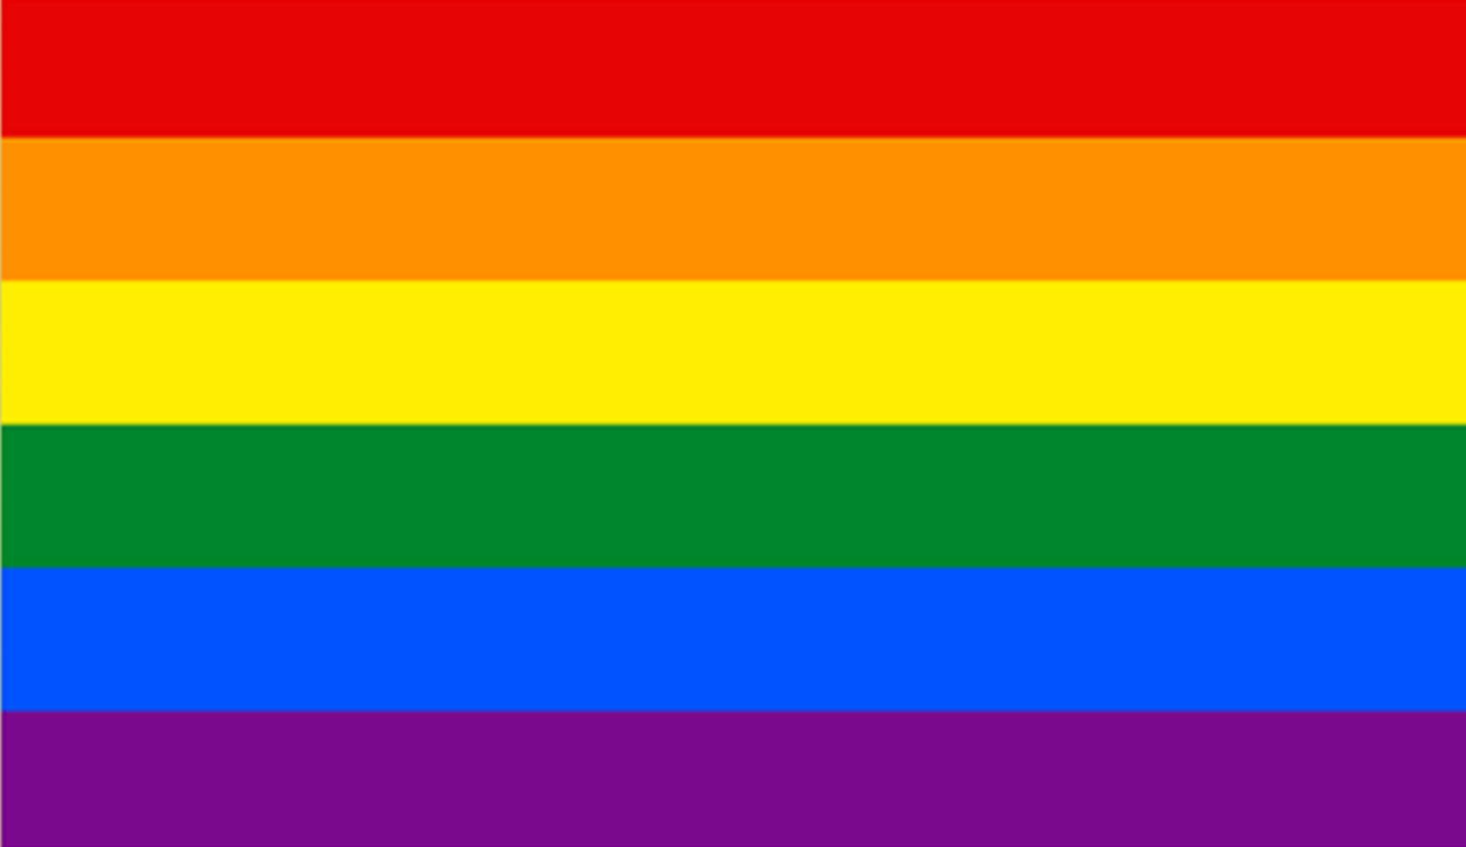
Stonewall riots
Pride events/parades/marches celebrate the LGBTQ+ community. They celebrate social and self acceptance, achievements, legal rights and of course… pride!
But pride isn’t just a parade – Most pride events occur annually to commemorate the Stonewall riots in 1969, New York City. An important moment in LGBTQ+ history.
Stonewall riots took place on June 28, 1969, between police and gay rights activists outside the Stonewall Inn, a gay bar in New York City. As the riots progressed, an international gay rights movement was born.
In 1969 being LGBTQ+ was illegal in New York City. Gay bars were places of refuge for people to get safety from public harassment. Many of those bars were, however, subject to regular police harassment.

Slide 3
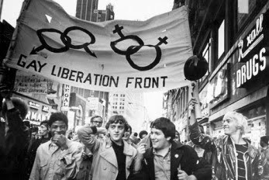
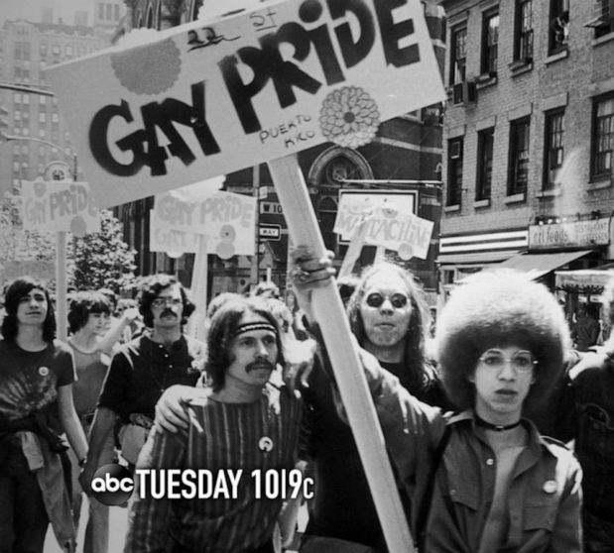
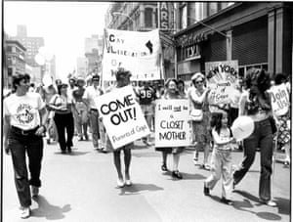
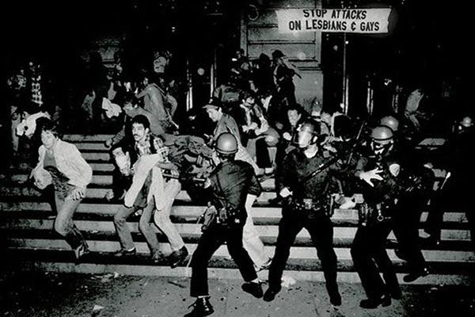
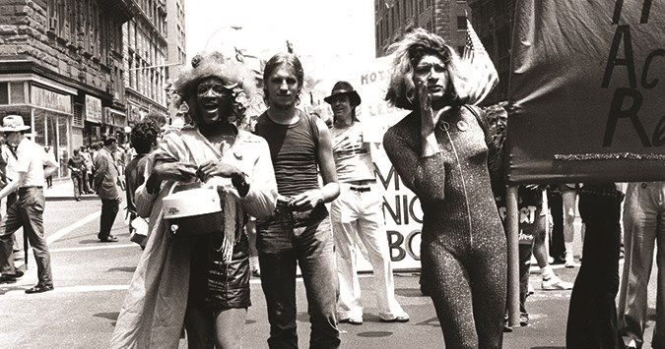

Slide 4
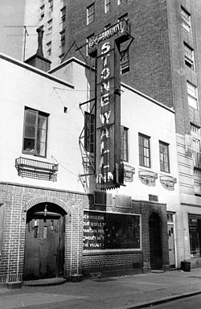
On Saturday, June 28, 1969, policemen entered the Stonewall Inn and arrested a large number of people for not wearing at least three articles of gender-appropriate clothing.
It was the third such raid on Greenwich Village gay bars in a short period.
Fed up with constant police harassment and social discrimination people hung around outside of the bar rather than disperse. At one point, an officer hit a lesbian over the head as he forced her into the police van— she shouted to onlookers to act, inciting the crowd to begin throw pennies, bottles, cobble stones and other objects at the police.

Slide 5
Within minutes, a full-blown riot involving hundreds of people began.
The police, a few prisoners and a Village Voice writer barricaded themselves in the bar, which was then set on fire. Police reinforcements arrived and extinguished the fire, and they eventually dispersed the crowd.
However, the riots outside the Stonewall Inn continued for the next five days and became an incredibly important moment in history.

Slide 6
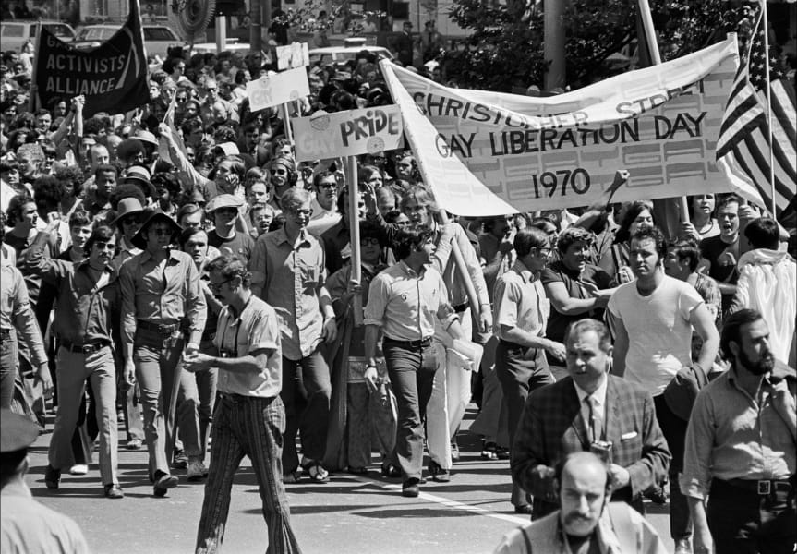
On the one-year anniversary of the riots on June 28, 1970, thousands of people marched in the streets of Manhattan from the Stonewall Inn to Central Park in what was then called “Christopher Street Liberation Day,” America’s first gay pride parade.
The parade’s official chant was: “Say it loud, gay is proud.”

Slide 7
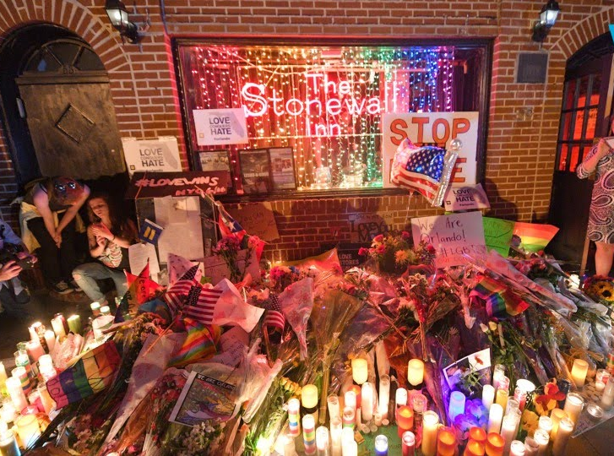
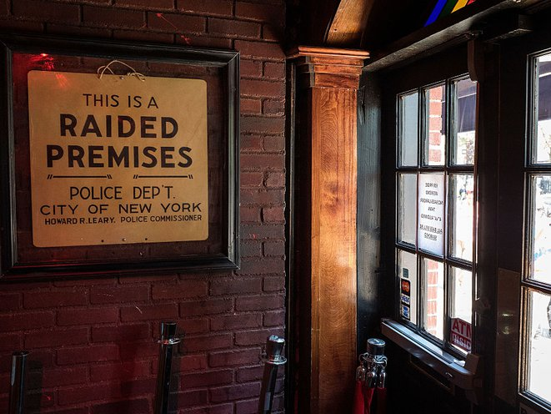
In 2016, then-President Barack Obama designated the site of the riots—Stonewall Inn, Christopher Park, and the surrounding streets and sidewalks—a national monument in recognition of the area’s contribution to gay rights.

