Slide 2
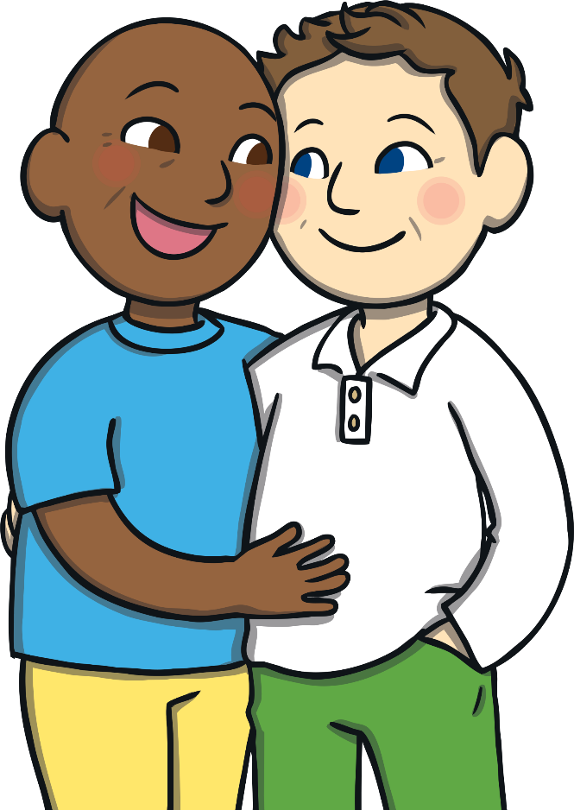
Aim
To learn what the letters LGBT+ stands for.
To learn about LGBT+ History Month and how it is celebrated.

Slide 3
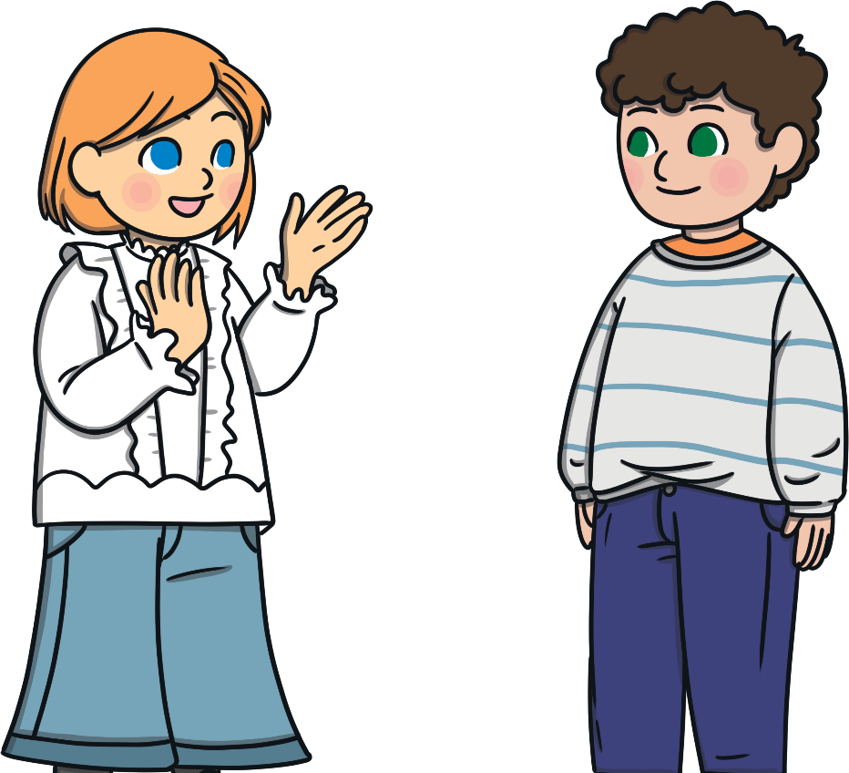
Different and the Same
Talk About It
Think about your class and all the people in it. How are you the same? How are you different?

Slide 4
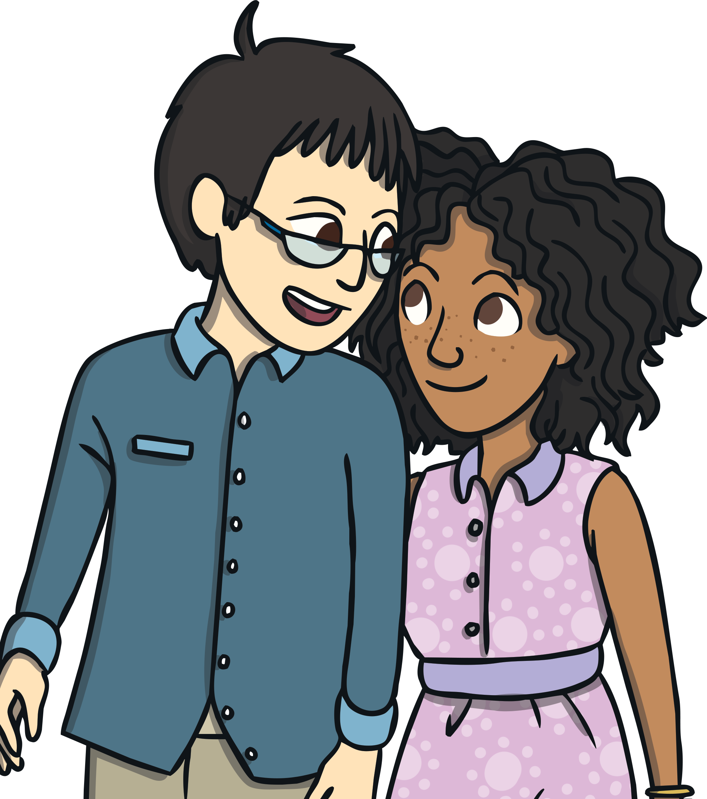
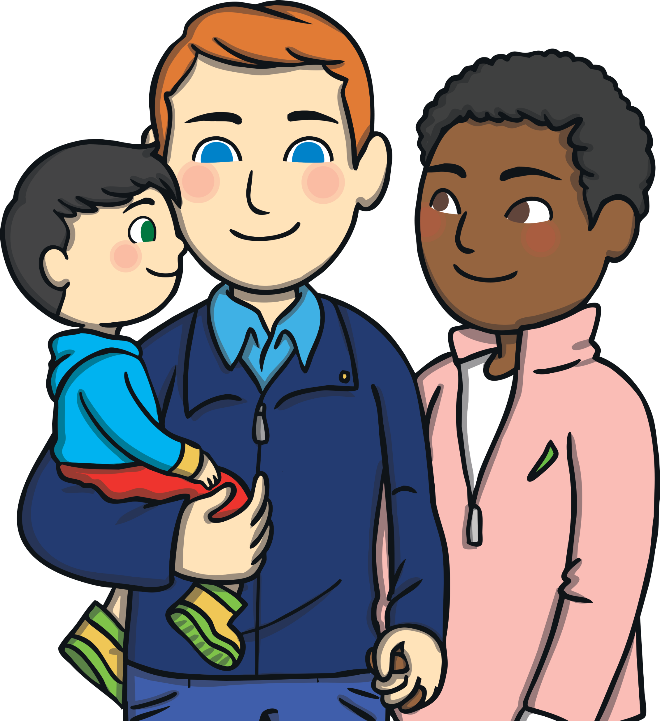
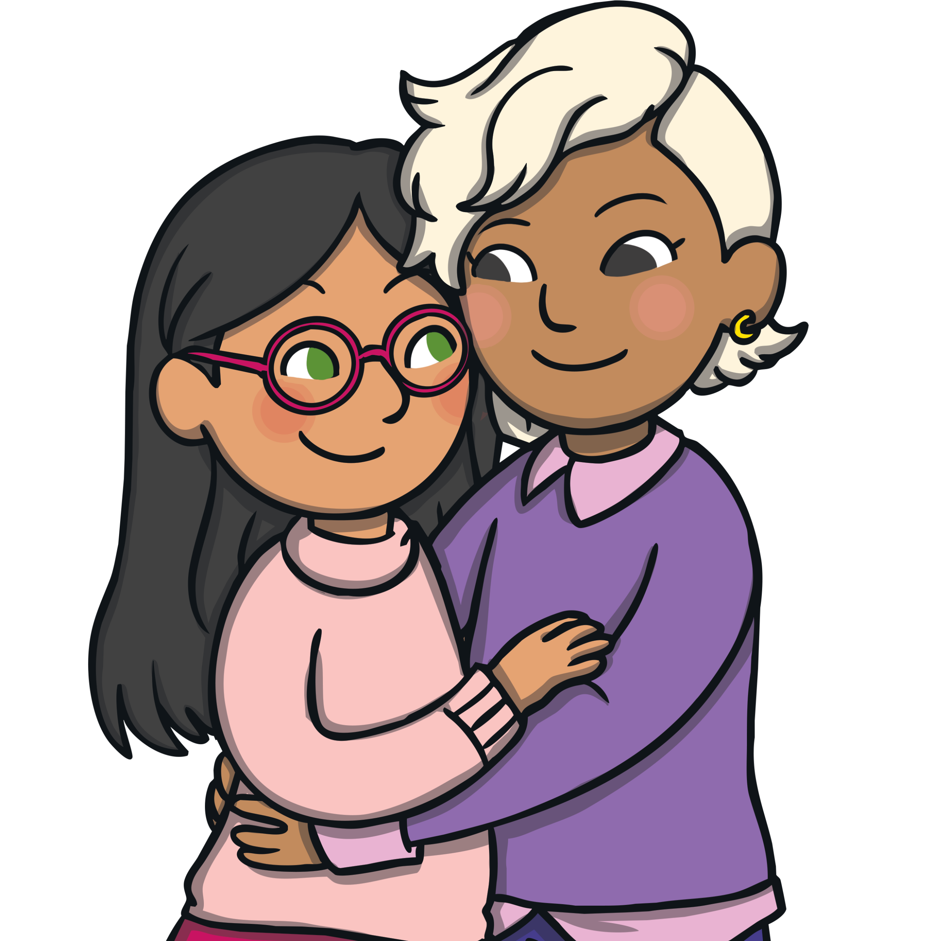
Ways of Being Different
Talk About It
How can people be different from
each other?

Slide 5
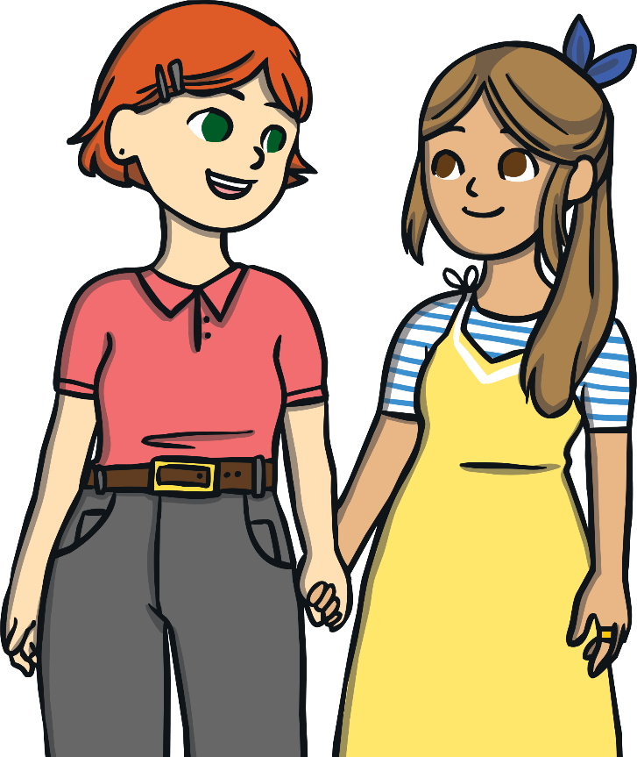
LGBT+
L
Lesbian
Some women love other women.
We call these people lesbians.

Slide 6
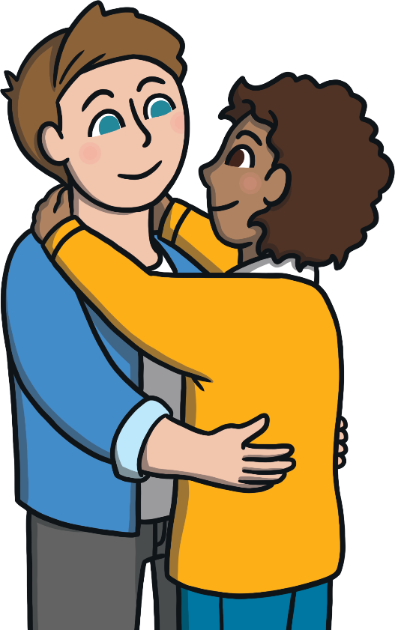
LGBT+
G
Gay
Some men love other men.
We call these people gay.

Slide 7
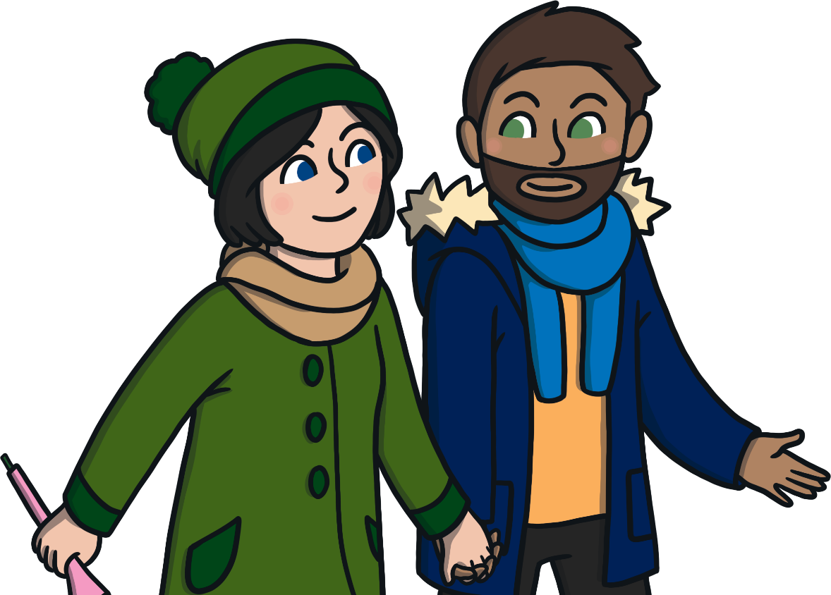
LGBT+
B
Bisexual
Some people love both men and women. We call these people bisexual.

Slide 8
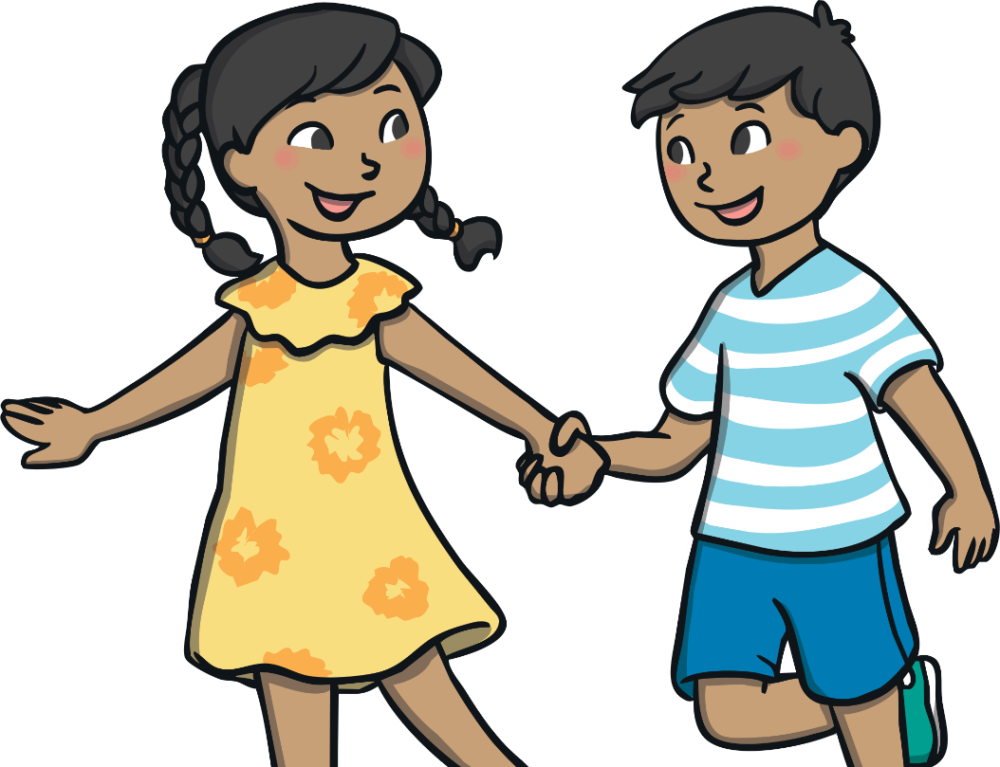
LGBT+
T
Transgender
Some people feel they weren’t born as the person they were meant to be.
So some people who were born girls actually feel they are boys. Some people who were born as boys feel like they are really girls.
We call these people transgender.

Slide 9
What Do We Mean?
Heterosexual or straight are words used to describe a person who has an emotional, romantic or sexual attraction to people of the opposite gender to them.
Homosexual or gay describes someone who has an emotional, romantic or sexual attraction to someone of the same gender
as them.
Lesbian is a word used to describe a female who has an emotional, romantic or sexual attraction to someone who is also female.
Bisexual is a word used to describe someone who has an emotional, romantic or sexual attraction to more than one gender.
Pansexual is a word used to
describe someone whose emotional, romantic or sexual attraction to others is not limited by sex, gender or gender identity.

Slide 10
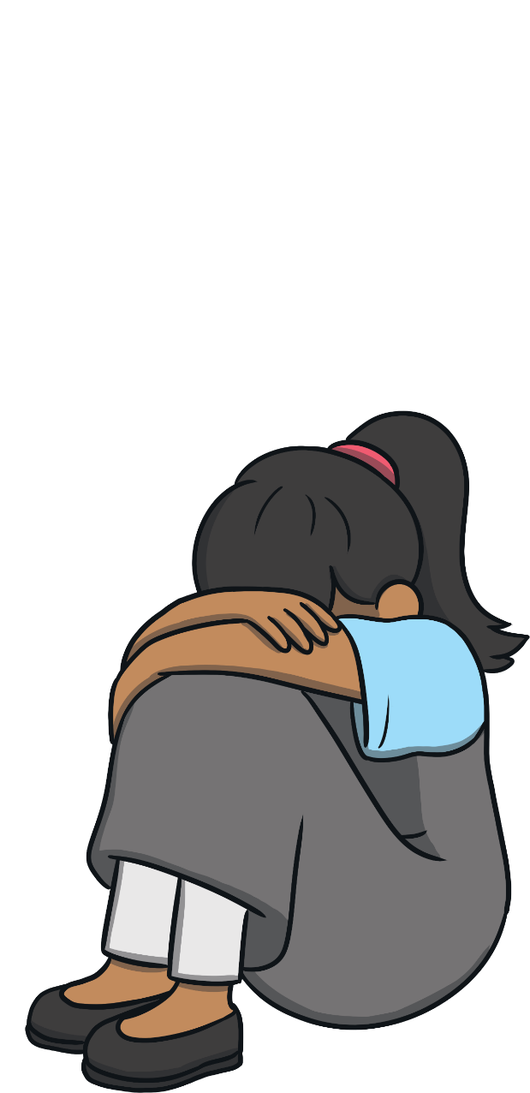
Sad Times for LGBTQ+ People
Today, most people know it is important to be kind and treat all people fairly.
Sadly, this wasn’t always the case.

Slide 11
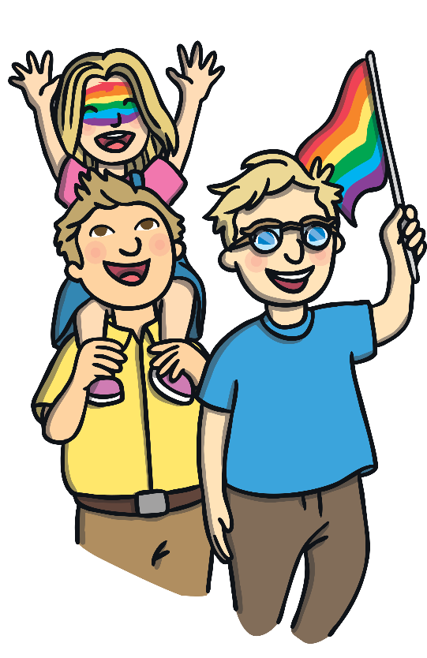
What is a History Month?
A History Month is a month that celebrates the history of a group of people.
It helps people find out about important people who belong to that group and the special things that have happened.

Slide 12
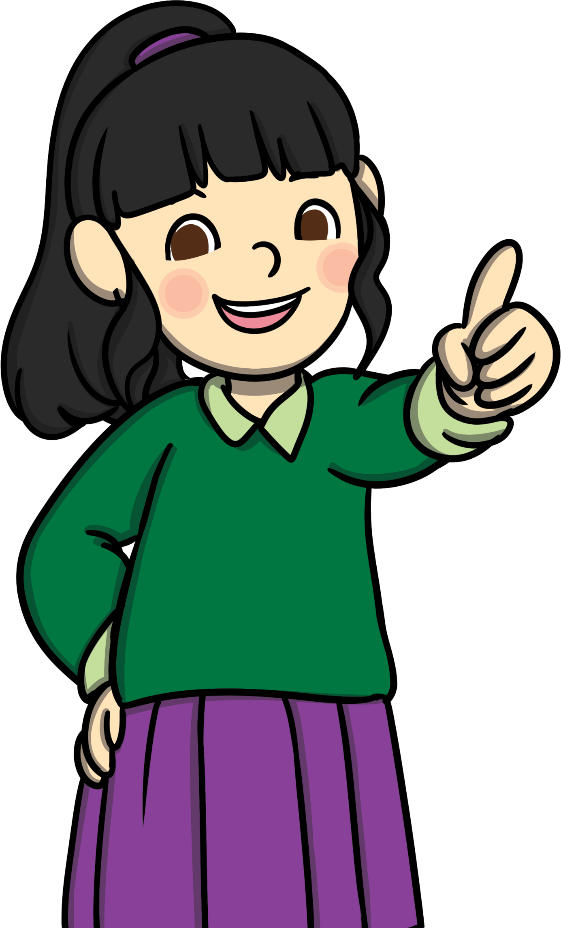
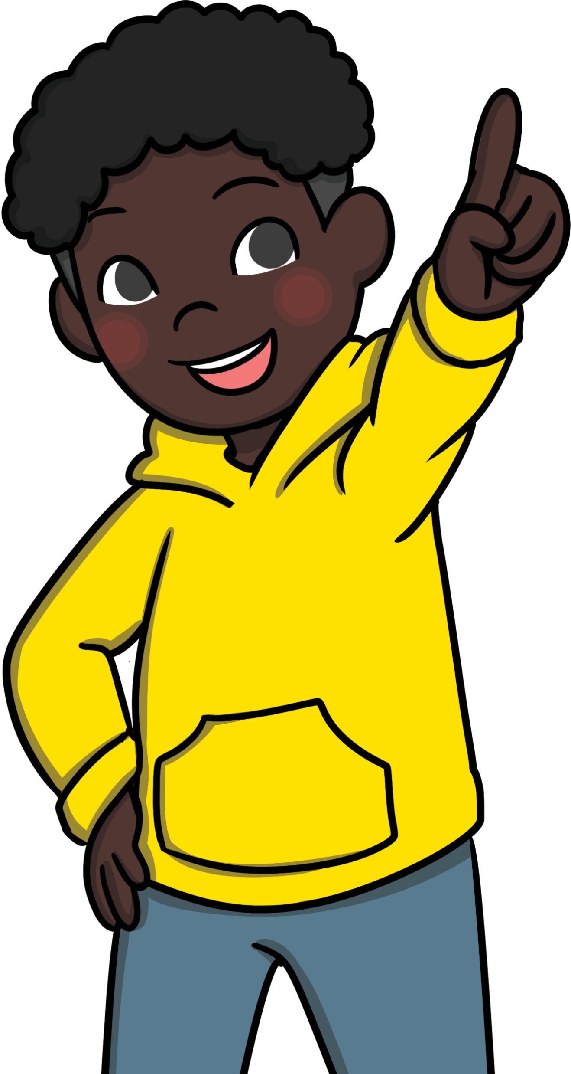
What is a History Month?
There is a Black History Month and a Women’s History Month.
LGBT+ History Month is celebrated in February each year.

Slide 13

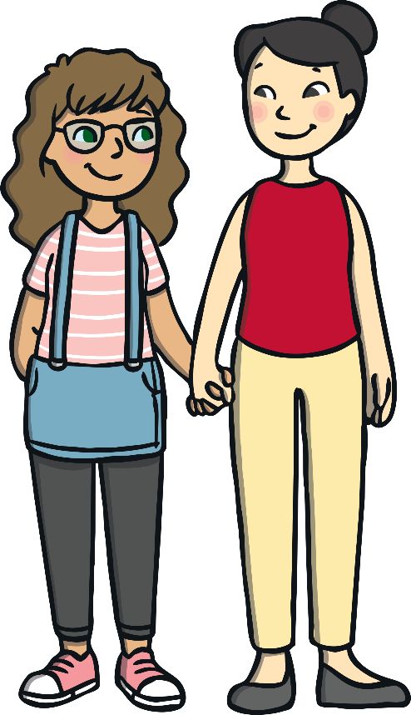
What Happens During LGBT+ History Month?
Well-known LGBT+ people are remembered and their stories are told.
The aim of LGBT+ History Month is help people be kind and accept LGBT+ people.
Each year, LGBT+ History Month has a theme.

Slide 14
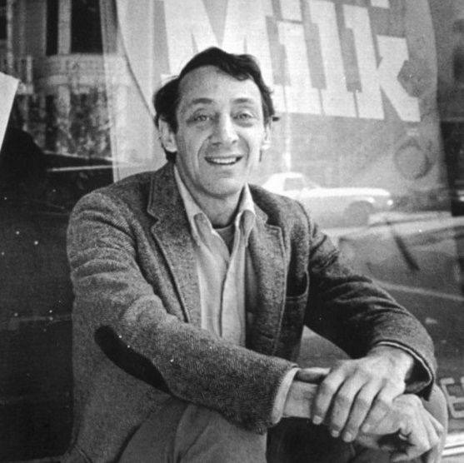
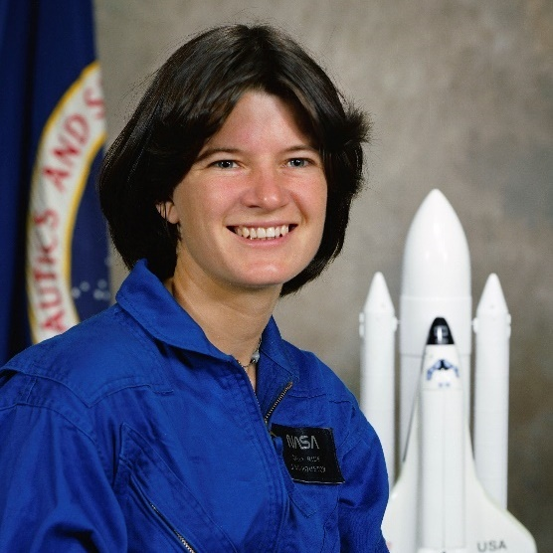
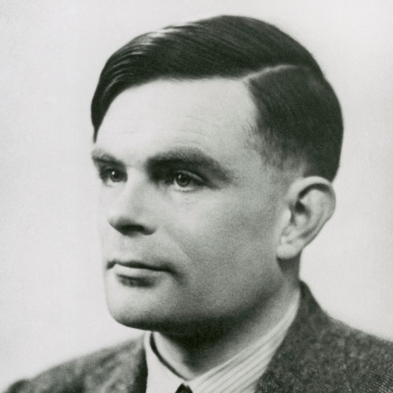
What Important People Might Be Talked About During LGBT+ History Month?
Harvey Milk was a politician who campaigned to make life better for LGBT people.
Sally Ride was an American astronaut.
Alan Turing was a scientist whose work helped the United Kingdom win World War Two.

Slide 15

Historically Speaking
1967 – Homosexual behaviour was made legal in the UK.
1988 – A law was passed making it illegal for people to talk positively
about homosexuality in schools. This law ended in 2003.
2000 – Gay and lesbian people were finally allowed to serve in the armed forces.
2002 – Equal rights were granted to same-sex couples applying for adoption.
2004 – The Civil Partnership Act was passed, which gave same-sex couples in relationships the same legal rights as heterosexual couples.
In some countries, including Sudan, Saudi Arabia, Pakistan and Yemen, being gay or bisexual is still illegal and can be punishable by death.

Slide 16
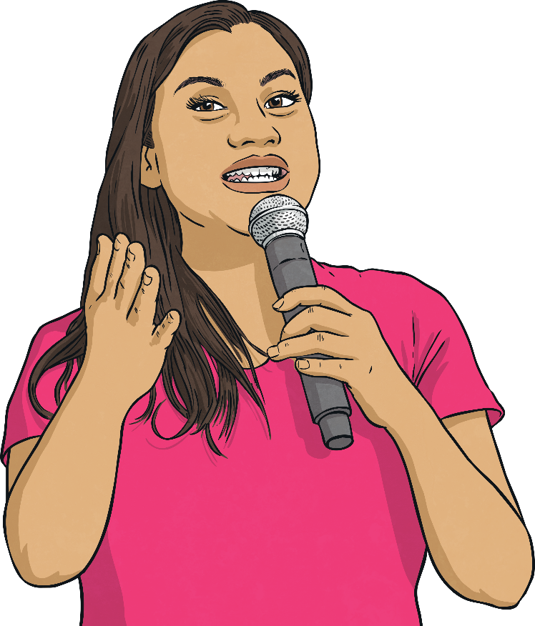
Having Some Pride
Pride was started to raise awareness of LGBT and promote equal rights to all people.
Pride includes all people, regardless of:
sexuality;
race;
faith;
disability;
gender.

Slide 17
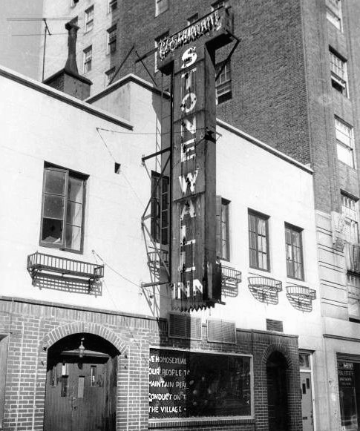
The Start of Pride
Being gay used to be illegal in the United States. Anyone who was suspected of being gay was arrested.
In June 1969, riots broke out between the police and LGBT people in New York City around the Stonewall Inn. This was a bar where gay people socialised and the bar was frequently targeted by the authorities.
In June 1970, to remember the Stonewall riots and celebrate the changes they made, the first Pride march took place in Chicago.

Slide 18
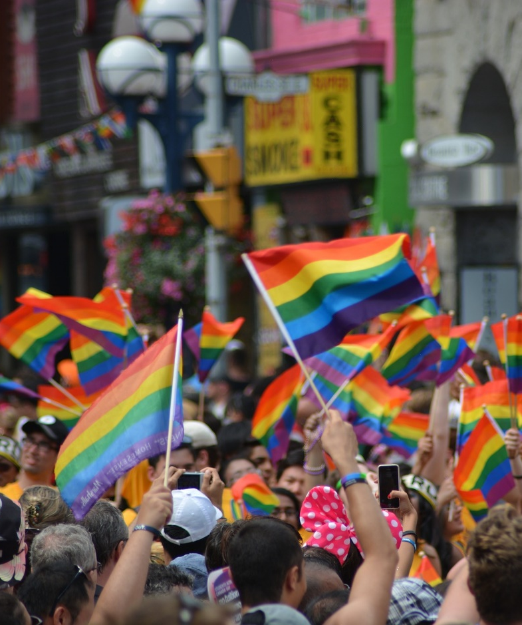
The Rainbow Flag
The rainbow flag was first used at the San Francisco Gay Freedom Day Parade in 1978.
The gay rights civil movement did not have a symbol at the time, so Gilbert Baker was asked to design one.
He chose the rainbow because…
‘We are all the colours and all the genders and all the races. The rainbow is a magical part of nature.’

Slide 19


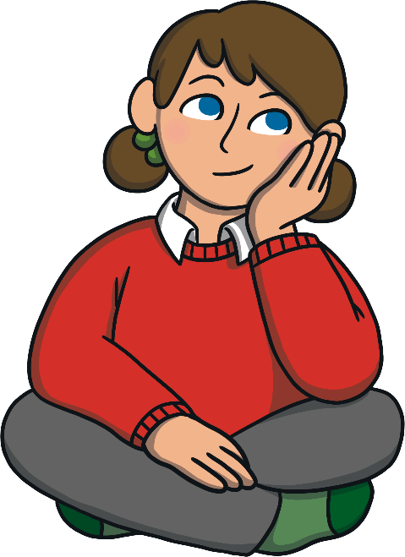
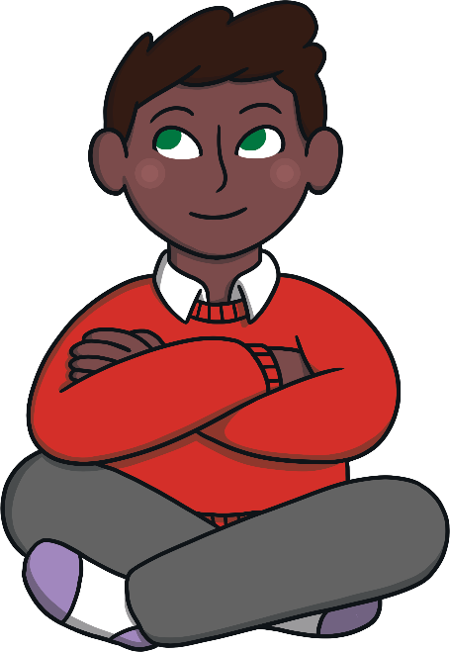
Time to Think
Why was it important for these changes to have happened?

Slide 20
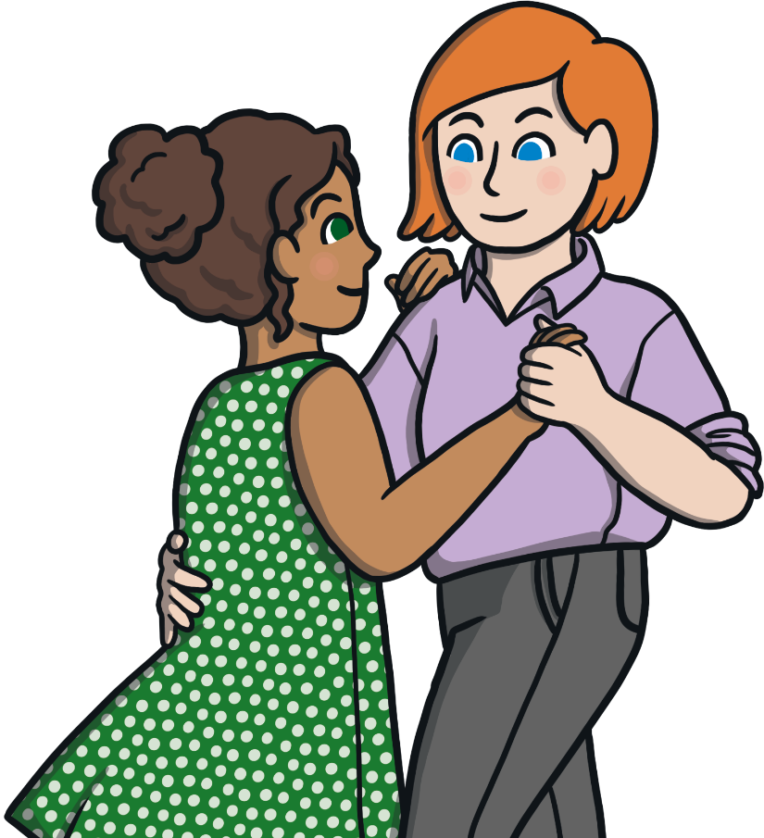
Aim
To learn what the letters LGBT+ stands for.
To learn about LGBT+ History Month and how it is celebrated.

