Slide 1

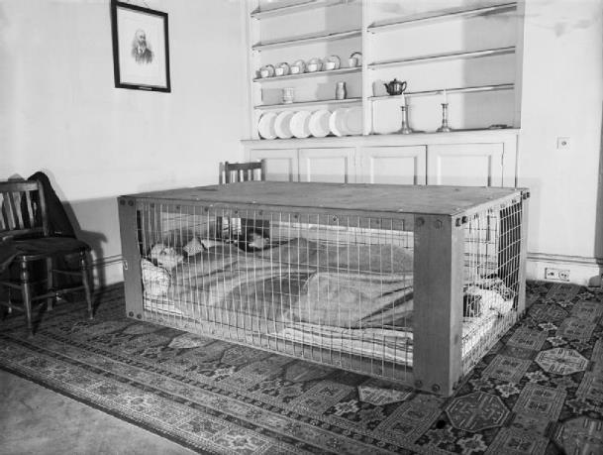
Staying Safe Shelters
From 1941 onwards, people could have a Morrison shelter which was kept indoors. It looked like a cage with steel mesh around the sides and a thick sheet of steel on the top. People would sleep inside it, although it was quite squashed.
The Morrison shelter was very strong and even if the ceiling collapsed above, usually the people inside would be safe.

Slide 2
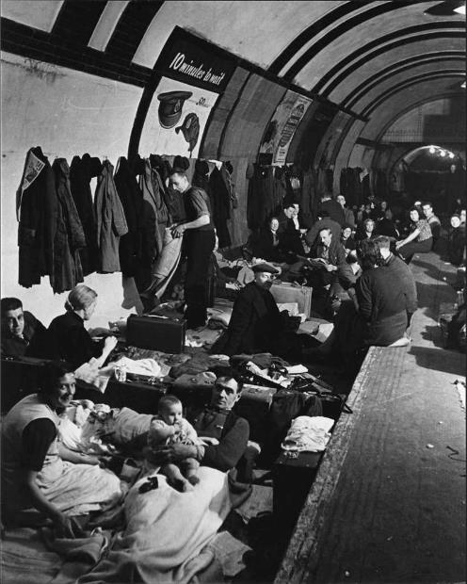

Staying Safe
There were also public shelters which were made of brick. They were often dark and smelly.
People in London spent the nights in the underground shelters, sleeping on the platforms.

Slide 3

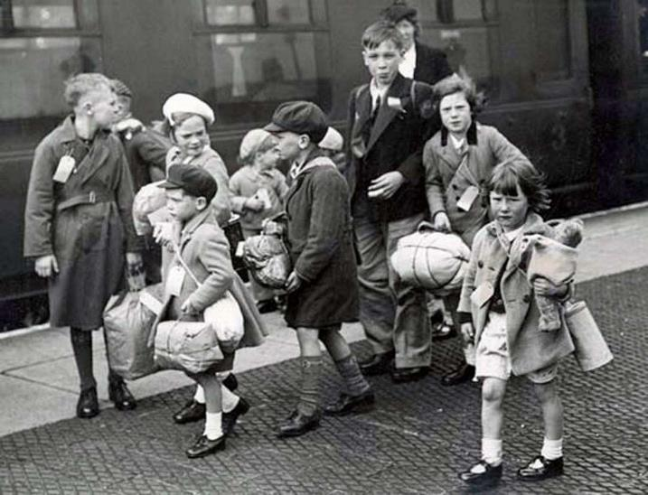
Staying Safe
Children were evacuated and had to leave their parents. They were sent to live in the countryside where they were safer from the raids than in the cities.

Slide 4

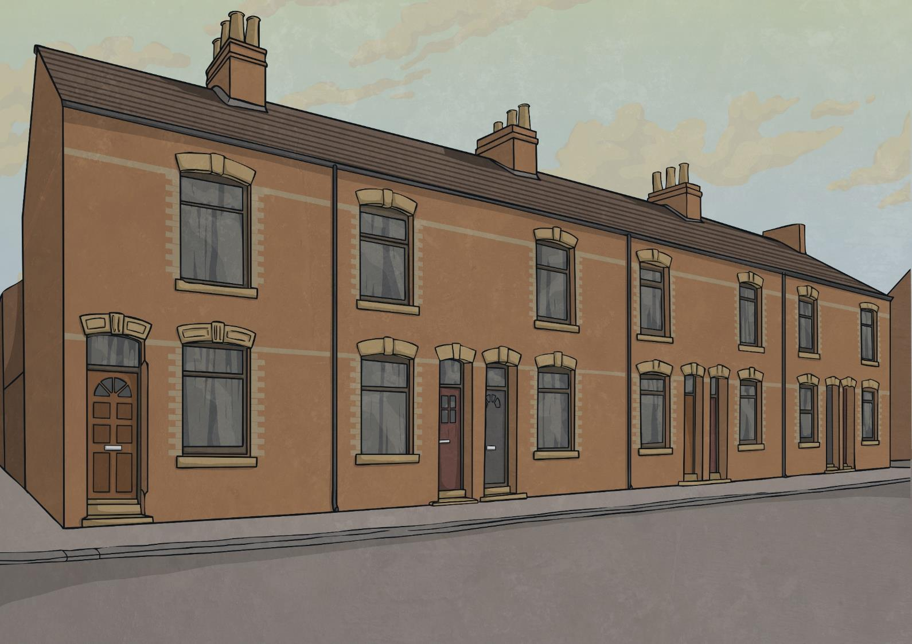
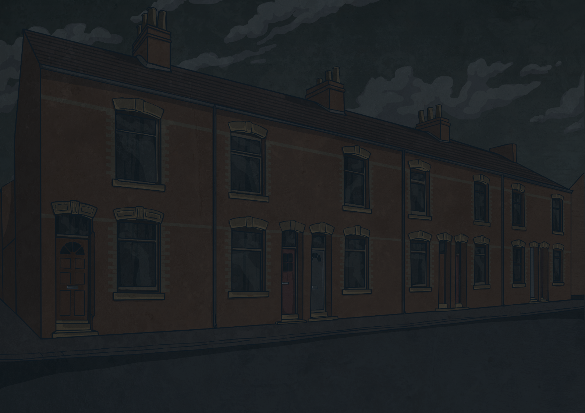
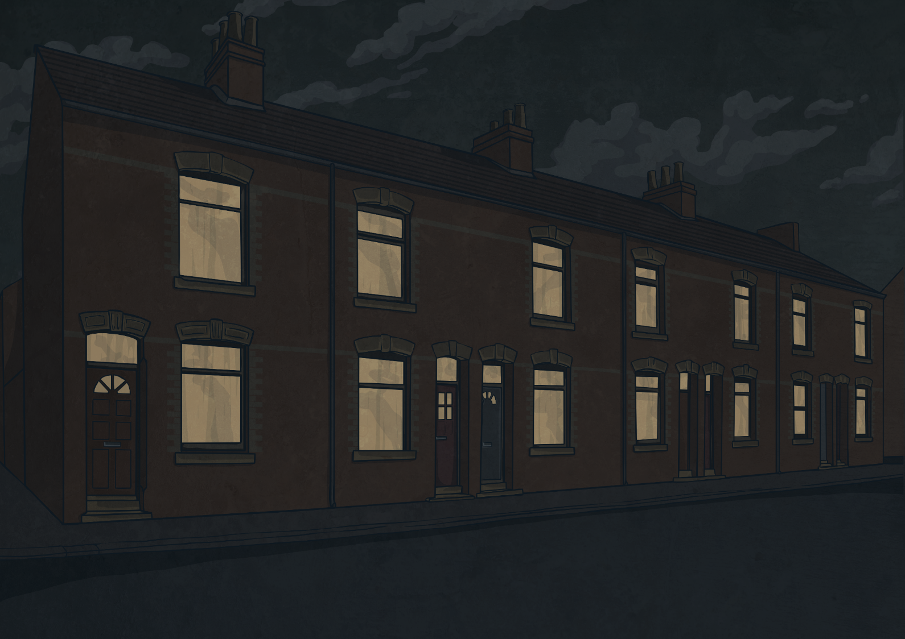
Staying Safe
The government ordered that after dark, street lights must be turned off, cars had to have special headlamps and people had to cover their windows and doors to stop any light so that German bombers did not know where they were.

Slide 5



Life During the Blitz
Thousands of people lost their lives during the Blitz and thousands more were seriously injured.
Shelters were cold and uncomfortable, which meant that people did not sleep well.
The emergency services, such as the fire fighters and ambulance crews, had to try to save people while bombs were being dropped around them and buildings were collapsing.
Sometimes, unexploded bombs would be left in the streets and had to be made safe before anyone could go near them.
Crime rates rose sharply and many places were looted during blackouts.

Slide 6

Why Did the Raids Stop?
The Blitz ended on 16th May 1941 when the German bombers were ordered to fly to Russia. Germany was planning to invade Russia next.
Russia
UK
Germany

Slide 7
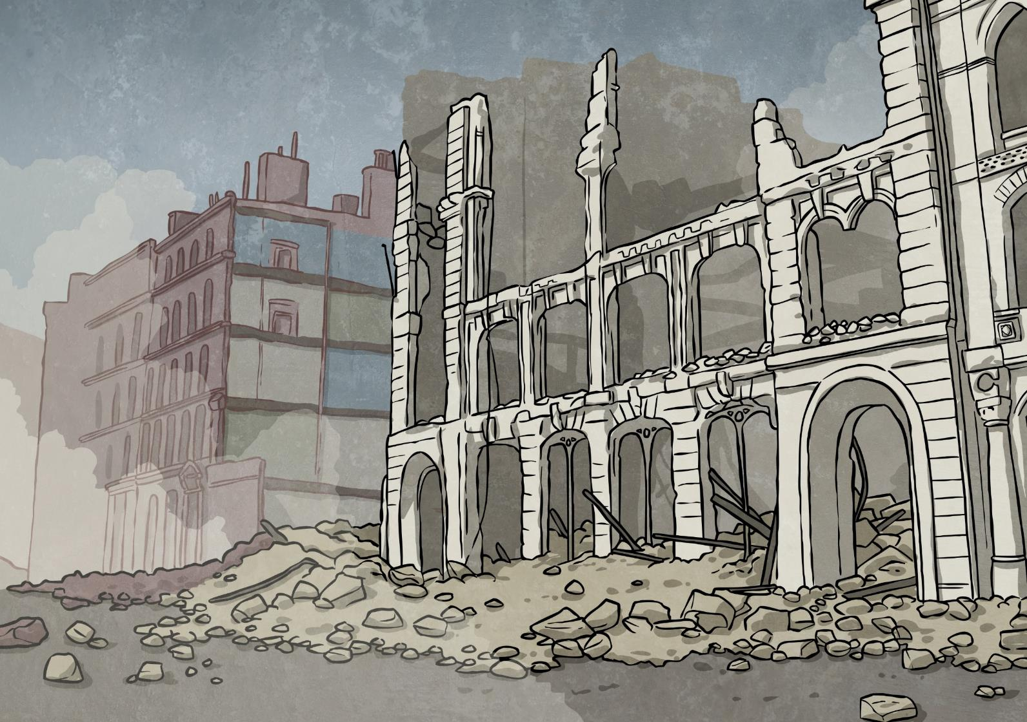

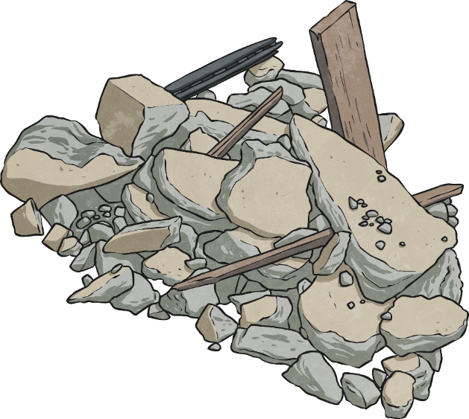
Life After the Blitz
Adolf Hitler had planned that the raids would scare Britain so that they would give into defeat. He was wrong.
Cities had suffered terrible damage with homes and buildings destroyed. However, people worked together over the years that followed to rebuild houses, homes and their cities.

