Slide 1
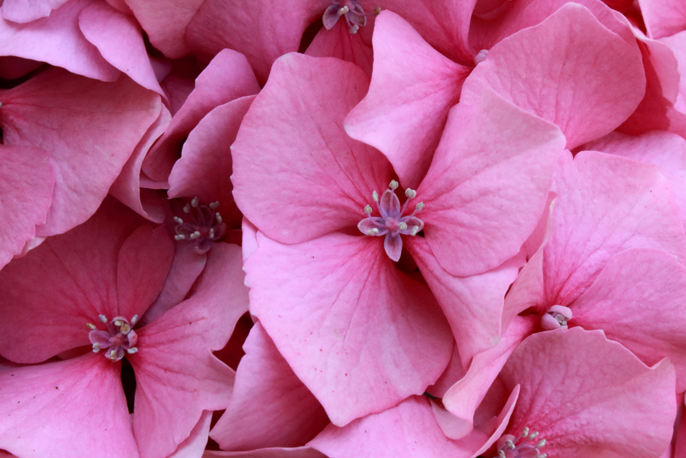
Plants
LO: to name the main parts and
functions of plants.

Slide 2

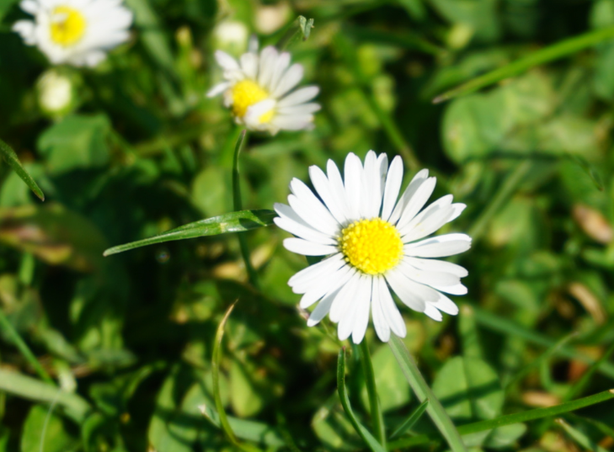
Plants
What are the main parts and functions of plants?
Key Learning
Many plants, but not all, have roots, stems/trunks, leaves and flowers/blossom.
The leaves use sunlight and water to produce the plant’s food.
Some plants produce flowers which enable the plant to reproduce.
TIBBA
identify the main parts of a plant and describe their purpose.

Slide 3
Explore, review, think, talk…
What do you already know about plants?
How many different plants can you name (can you remember what evergreen and deciduous mean?)
How do plants and seeds grow?
What do seeds and plants need to stay healthy?
Watch these videos to help remind you: Linked OPPOSITE
https://www.bbc.co.uk/bitesize/topics/zy66fg8/articles/zcmtk2p
https://www.bbc.co.uk/bitesize/topics/zpxnyrd/articles/zxxsyrd

Slide 4
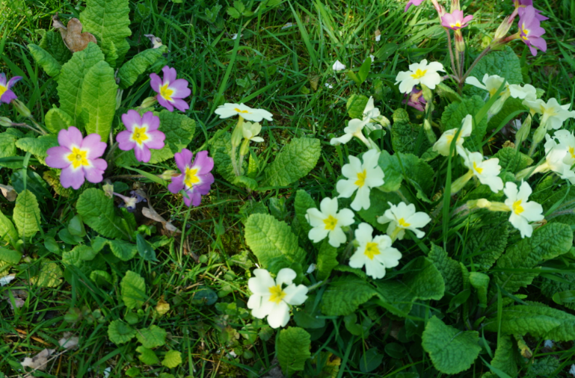

Watch, read, listen…
What are the different parts of a plant?
Watch this video telling you all about the different parts of a flowering plant: https://www.bbc.co.uk/bitesize/topics/zy66fg8/articles/zcjnp39
Why do you think some plants have flowers, and others do not?
The different parts of a plant have different functions.
The roots of a plant take up water and nutrients from the soil. The roots also keep the plant steady and upright in the soil.
The stem carries water and nutrients to different parts of the plant.
The leaves use light from the sun, along with carbon dioxide from the air and water to make food for the plant. This process is called photosynthesis.
Some plants have flowers. These are involved in reproduction and produce seeds from which new plants grow.

Slide 5
Parts of the plant
The flower of the plant produces seeds that can make new plants.
The stem is like a straw, it sucks up water from the plant roots and moves it through the plant
The leaves make food for the plants. They use in carbon dioxide from the air, sunlight and water to make food for the plant. This is called Photosynthesis.
The roots take in water and minerals from the soil. It also helps keep the plant in the ground during strong winds

Slide 6
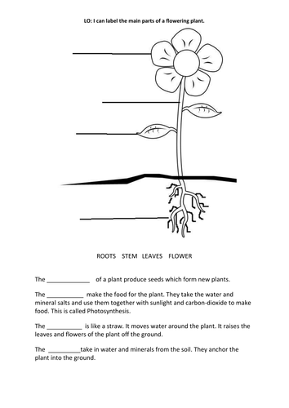

Parts of the plant
,
The flower of the plant produces seeds that can make new plants.
The roots take in water and minerals from the soil. It also helps keep the plant in the ground during strong winds
Notes:
7

Slide 7

Glossary of terms
Root: A root is a part of a plant that grows downward.
Bud: A bud is an undeveloped shoot, leaf, or flower.
Bulb: A bulb is a part of the plant which can grow into a new plant.
Stem: A stem is a part of a plant that transports water and nutrients from the roots to the buds, leaves and flowers.
Leaf: A leaf is a flat part of a plant that makes food for the plant using sunlight, water and carbon dioxide from the air, in a process called photosynthesis.
Photosynthesis: Photosynthesis is the process by which leaves convert sunlight, water and carbon dioxide into food for the plant.
Nutrient: A nutrient is a substance that is needed for healthy plant growth, development and functioning.
Flower: A flower has petals that produce perfume and colour to attract insects.
Evergreen: An evergreen plant keeps its leaves throughout the year. These leaves may have a variety of colour.
Deciduous: A deciduous plant sheds the parts that it no longer needs to survive for the season (leaves and flowers for example).
8

Slide 8
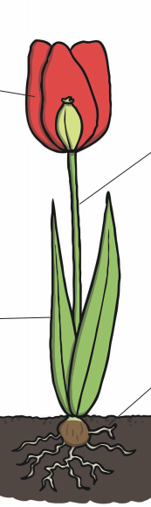
On paper, draw and label a picture of a flower.
Make sure you include
- The flower
- The roots
- The stem
- The leaves
Using your own words, write a sentence describing the job each part in the plant.

