Slide 1
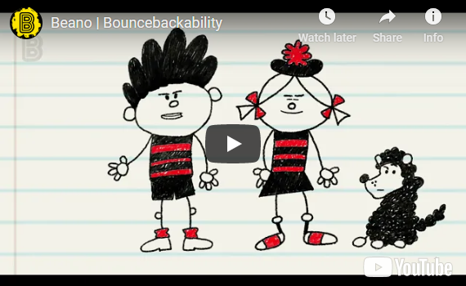
BOUNCEBACKABILITY
2. Being Brave and Becoming Resilient

Slide 2
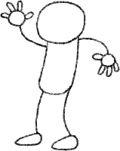
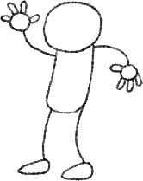
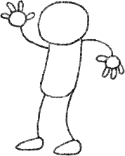
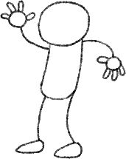
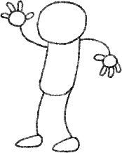
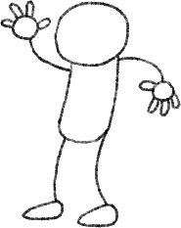
Yes
Yes
Yes
Yes
Yes
NO!

Slide 3


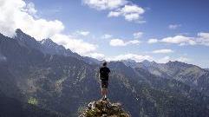
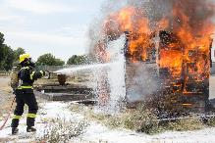

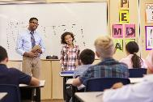

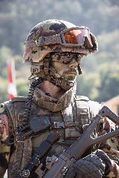




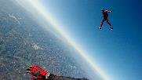
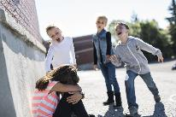
Which of these people do you think is brave?
What makes them brave?

Slide 4







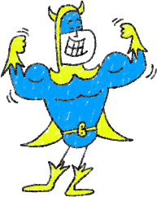

What makes people brave?
Knowing others care about them and are rooting for them.
Being strong on the inside. Having self-belief.
Being willing to try new things and aim high.
They might still be afraid, but they won’t let fear stop them.
Having the capacity to ask for help from those around them – knowing they’re not alone.
Knowing what they’re good at and using it to their advantage.
Understanding the things they’re not so good at but not letting this hold them back.

Slide 5

We all find some things difficult and will all feel sad, scared or worried at times.
Being brave and picking ourselves up again is an important skill that will help us hugely when times are tough.
There is a word to describe this idea of ‘bouncing back’ and not letting things overcome us….does anybody know it?
Let’s guess the word!
_ _ _ _ _ _ _ _ _ _

Slide 6
Success
What people think it looks like
What it looks really like

Slide 7
What can help you to be more resilient at school?
Understanding areas of your learning you are good at and using them.
Not being put off by challenges but finding ways to overcome them.
Having self-belief.
Having high aspirations.
Remembering that you are not alone and that people are here to support you. Being brave can sometimes mean asking for help.
Resilience is not about being tough, but managing how you feel.

Slide 8

WELL DONE!

