Slide 2
In Fewer Than 200 Words
Your challenge is to continue the story that has already been started using no more than 200 words.
Have fun!
Back to Main Categories
Continue to Challenges

Slide 3
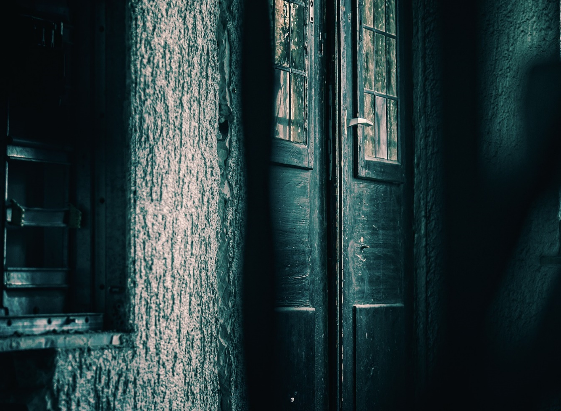
In Fewer Than 200 Words
1
2
3
4
As I approached the battered, old door, I saw a tarantula scuttle across the handle and disappear through a crack in the wall.
What’s on the other side of
the door?
Is it creepy?
Are there any noises?
Describe the different emotions that you’re feeling.
Explain what happens next.
Back to Main Categories
Next
Challenge

Slide 4
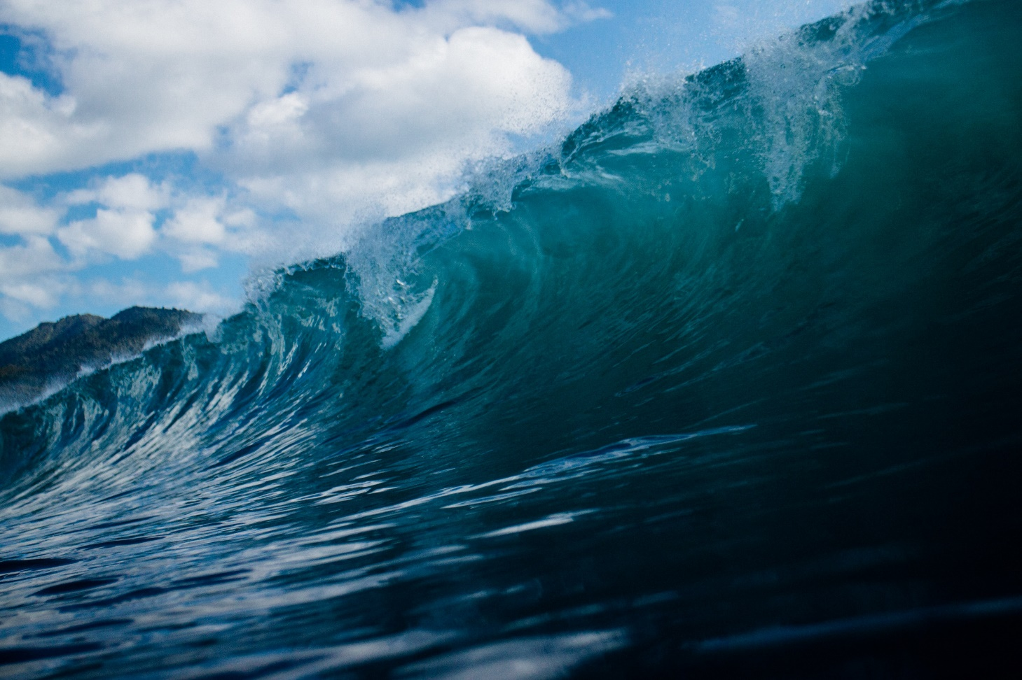
In Fewer Than 200 Words
1
2
3
4
I gripped onto the paddleboard and squeezed my eyes shut. The huge, curling wave was heading straight towards me.
How are you feeling?
What sounds are there?
What happens when the
wave arrives?
Describe the different emotions that you’re feeling.
Explain what happens next.
Back to Main Categories
Next
Challenge

Slide 5
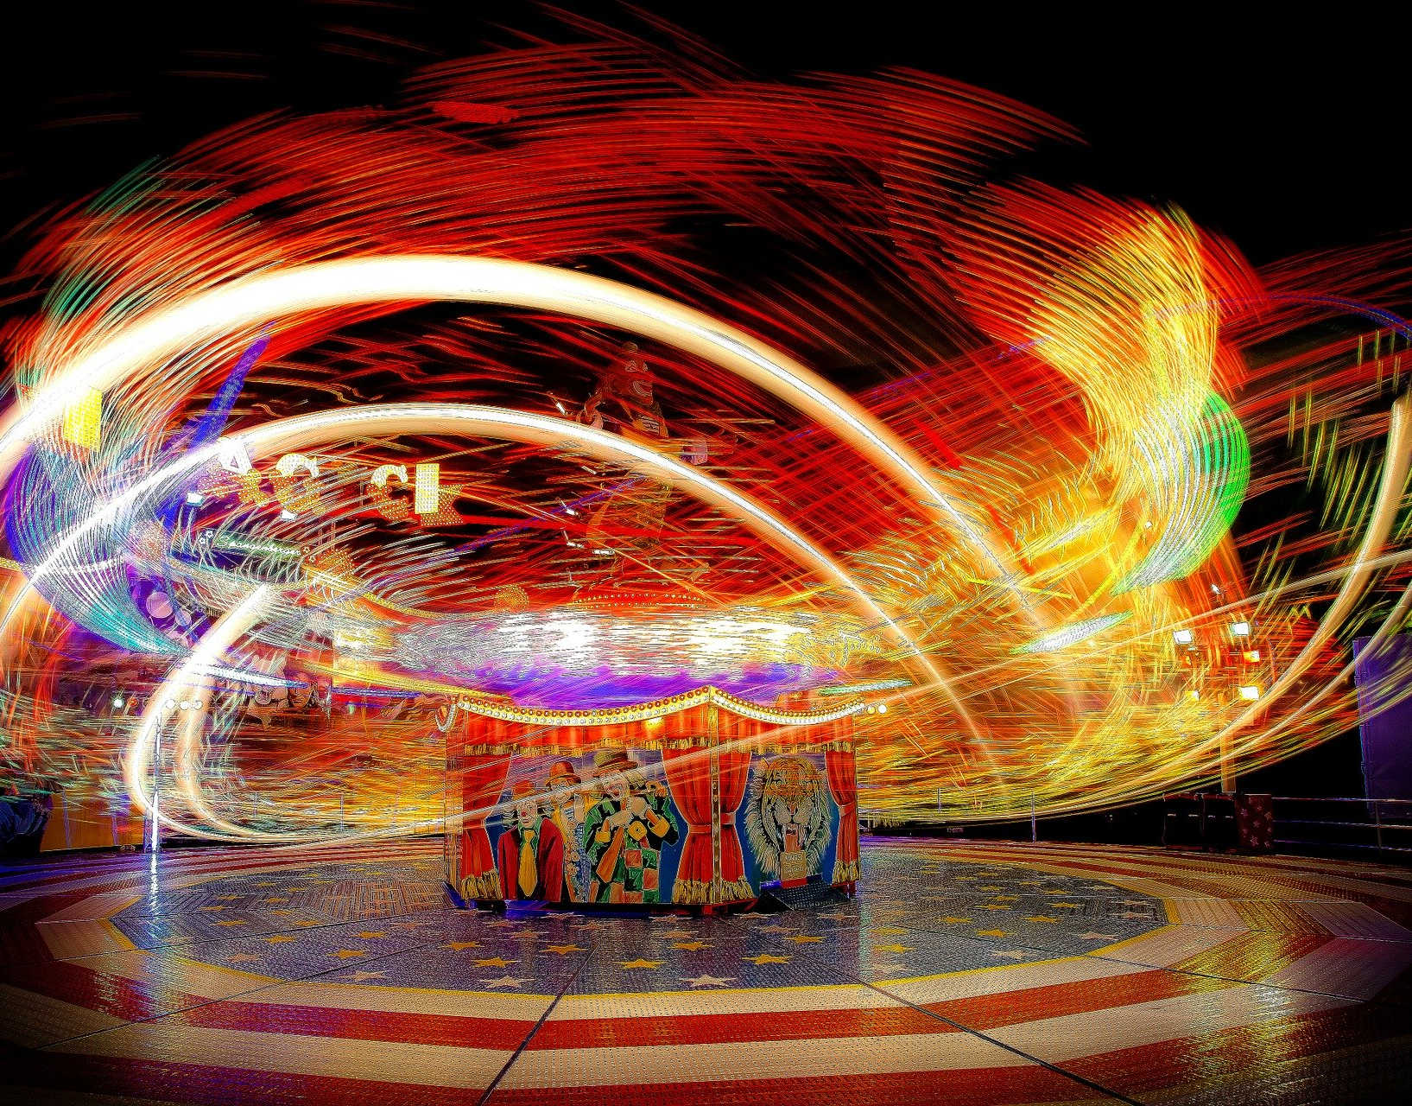
In Fewer Than 200 Words
1
2
3
4
You’re at a theme park and you suddenly become invisible for one hour.
How do you find out that you’re invisible?
Are you scared, excited or both?
What do you do first?
Describe the different emotions
that you feel when you’re invisible.
Explain what you do for that hour.
Back to Main Categories
Next
Challenge

Slide 6
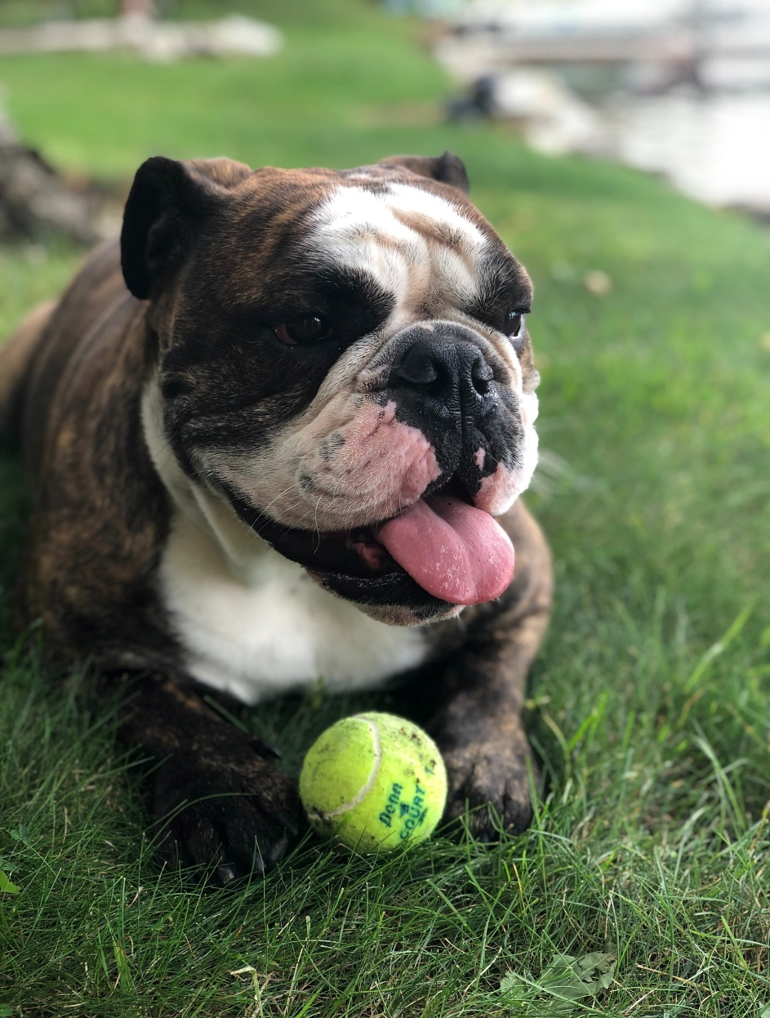
In Fewer Than 200 Words
1
2
3
4
When Dottie fetched the tennis ball for the fifth time, I was stunned by what happened next. Unbelievably, she looked into my eyes and said…
How do you react?
Does Dottie say anything else?
What do you say back to her?
Describe the different emotions
that you’re feeling.
Explain what happens next.
Back to Main Categories

