Slide 1
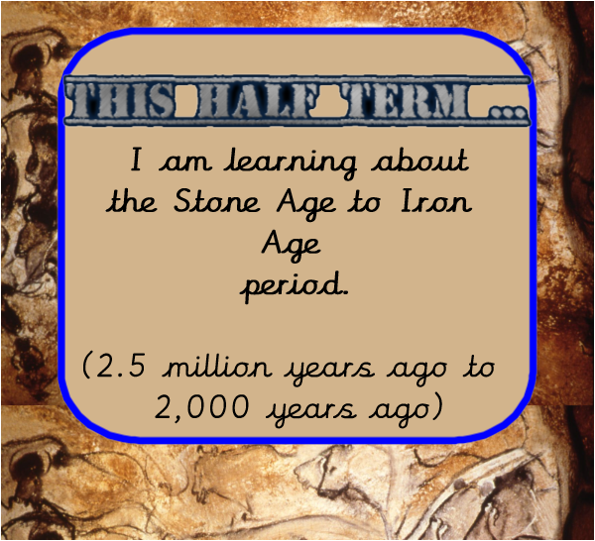

Slide 2
LO: I am learning to use timelines to describe the important events that happened in the past.
Write the timeline and underline or highlight the keywords and circle any words that you don’t understand.

Slide 3
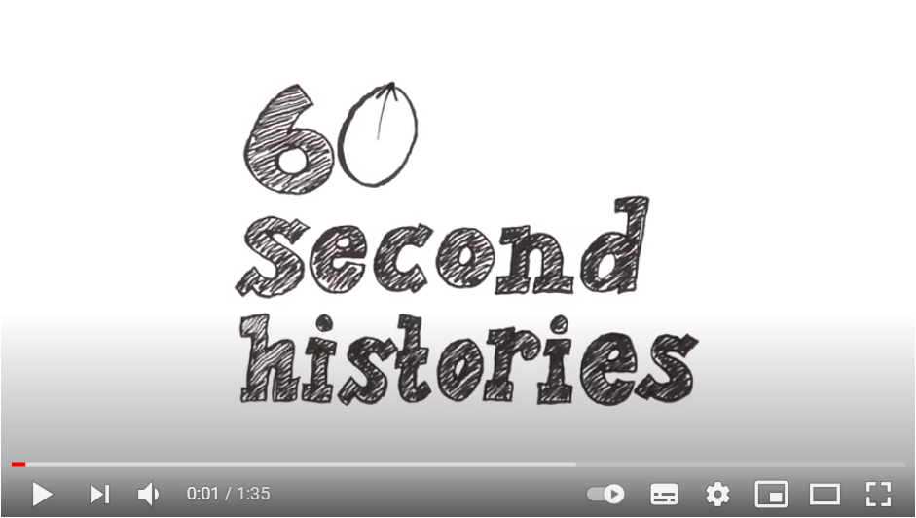
What is a timeline?
https://www.youtube.com/watch?v=xc64qurhFng

Slide 4
Write a definition of a timeline and describe why they are useful. Challenge - use all the words in the wordbank as part of your definition.
A timeline is….
Timelines are useful because….
Wordbank
Timeline, chronological order, events, significant, dates, past

Slide 5
Introducing a timeline
A timeline shows significant events from the past and by using dates we are able to put these in a chronological order and compare when the events happened.

Slide 6
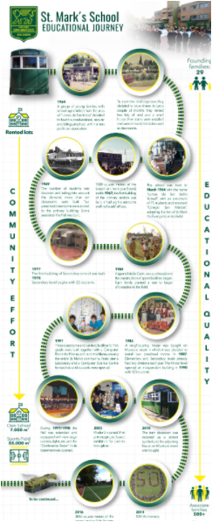
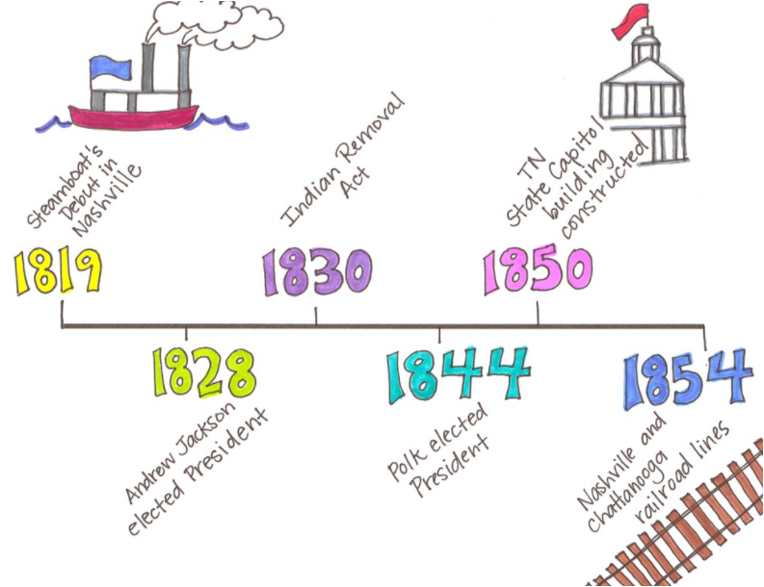
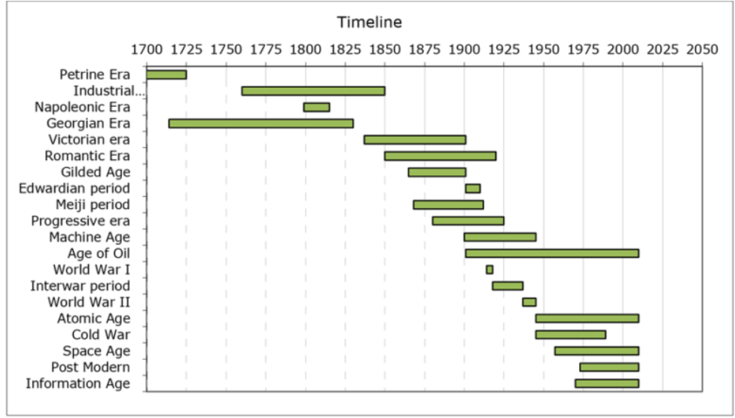
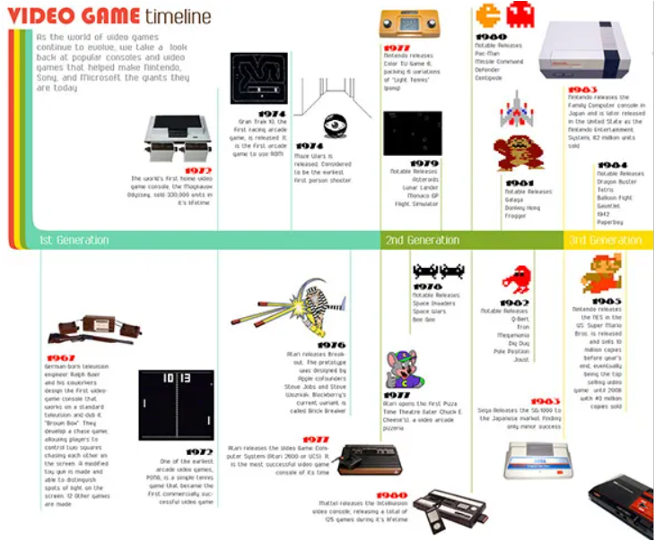
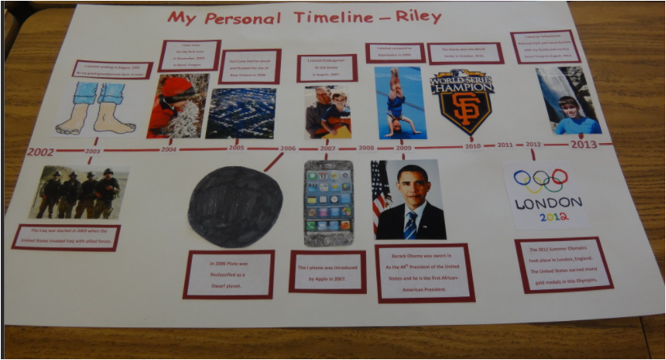
Discuss the similarities and differences in these timelines.

Slide 7
Draw a timeline of your day so far.
Creating a timeline in a history lesson
Woke up

Slide 8
We will now look at a much bigger timeline that will stretch back to the Stone Age.

Slide 9
Creating a timeline - What do you notice on this timeline?
Year 0
When Jesus was born
Present day
0
2021

Slide 10
Creating a timeline - What is the “ Common Era”?
Year 0
When Jesus was born
Present day
0
2021
Common Era
(CE)
The time after Jesus was born (or year 0) up to the present day

Slide 11
Creating a timeline - What is “Before Common Era”?
Year 0
When Jesus was born
Stone Age
Present day
2.5 million years
BCE
0
2021
Before Common Era
(BCE)
The time before Jesus was born (or year 0)
Common Era
(CE)
The time after Jesus was born (or year 0) up to the present day

Slide 12
Creating a timeline - What is “Before Common Era”?
Year 0
When Jesus was born
Stone Age started
Present day
2.5 million years
BCE
0
2021
Before Common Era
(BCE)
The time before Jesus was born (or year 0)
Common Era
(CE)
The time after Jesus was born (or year 0) up to the present day
Why does this timeline show the BCE as a much longer period than CE?
Were you born in the BCE period or the BC period. Can you explain why?

Slide 13
Writing dates on a timeline.
10,000
BCE
1000
BCE
100
BCE
1
BCE
1
CE
100
CE
1000
CE
0
2021
CE
What do you notice about the dates that have been put on the timeline?
Why have the dates been spaced out?

Slide 14
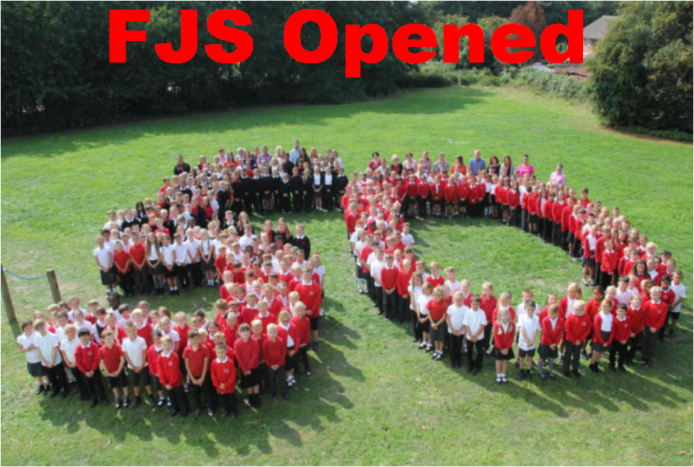
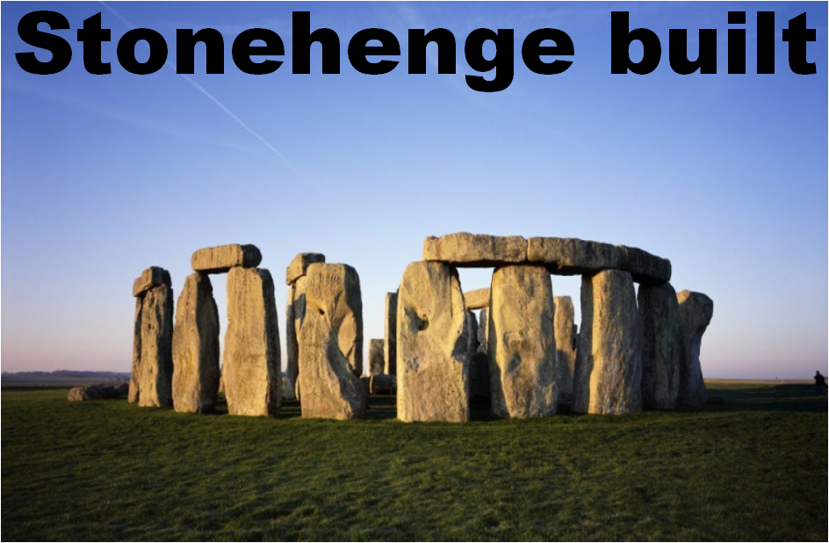

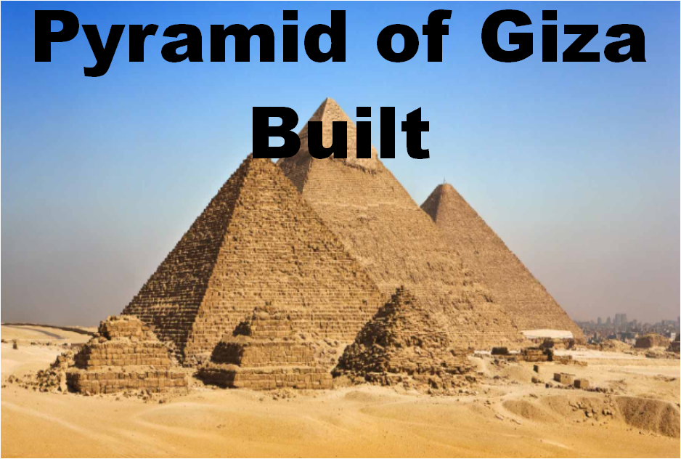
Where would you put these events on this timeline?
Did they happen in the BCE period or the CE period?
2.5 million years
BCE
0
2021
CE
1969 CE
3,000 BCE
1912 CE
2,500 BCE

Slide 15
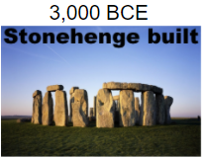
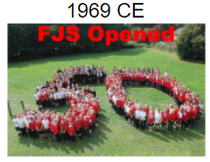
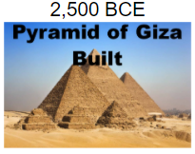
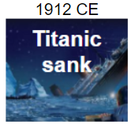
Where would you put these events on this timeline?
Did they happen in the BCE period or the CE period?
2.5 million years
BCE
0
2021
CE

Slide 16
Discuss with someone what you need to think about when you’re creating a timeline.

Slide 17
Let’s create our own timeline!
Be clear about what the important events are and what information you think is important to include on the timeline.
Order the events in chronological order.
Use their dates to work out which are BCE and which are CE.
Then space them out along a timeline!

Slide 18
Let’s create our own timeline!

Slide 19












These events are NOT in chronological order, can you arrange them on the timeline in the order that they happened.
15,000
BCE
2021
CE
0

Slide 20
Place these time periods on the timeline
15,000
BCE
2021
CE
0

Slide 21
2. Place these events in Chronological order on the timeline
15,000
BCE
2021
CE
0

Slide 22
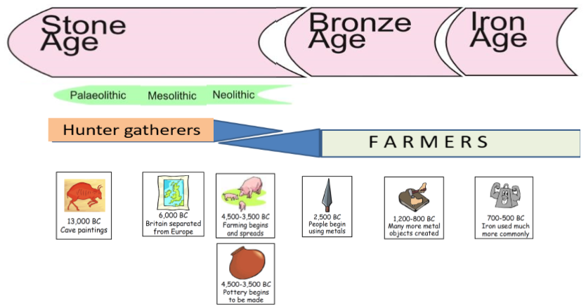
3. What does this timeline tell us?

Slide 23
Why does the hunter-gatherer period and the farming period overlap?

Slide 24
Challenge : Add these events to your timeline.
2021
0
CE, BCE
Egyptian Pyramids built 2500 BCE
Stonehenge built 3000 BCE

Slide 25
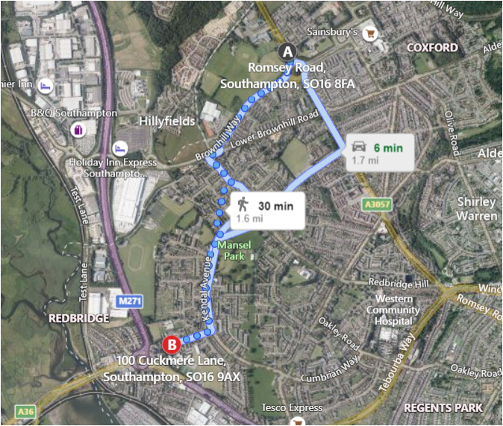
If every metre you walked was like going back 10,000 years in the past you would need to walk from FJS to Redbridge School to get to the beginning of the Stone Age 2.5km away!
Your challenge is to make a timeline that takes you back to the Stone Age. Use the resources on the next slide to help you. You will need a grown up and something to measure your distance like a fitbit or an app on a phone.

Slide 26

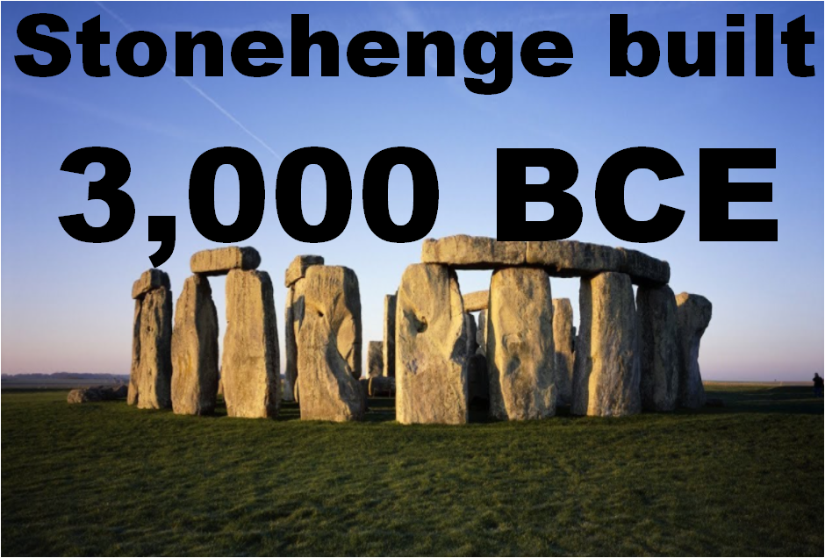
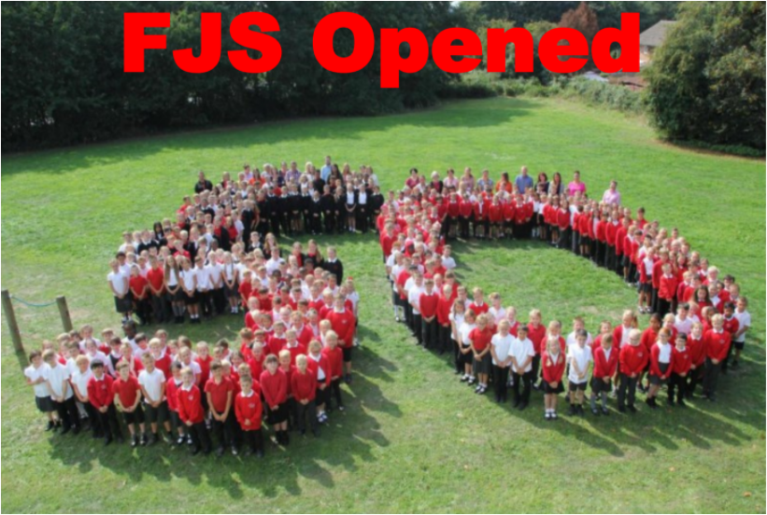
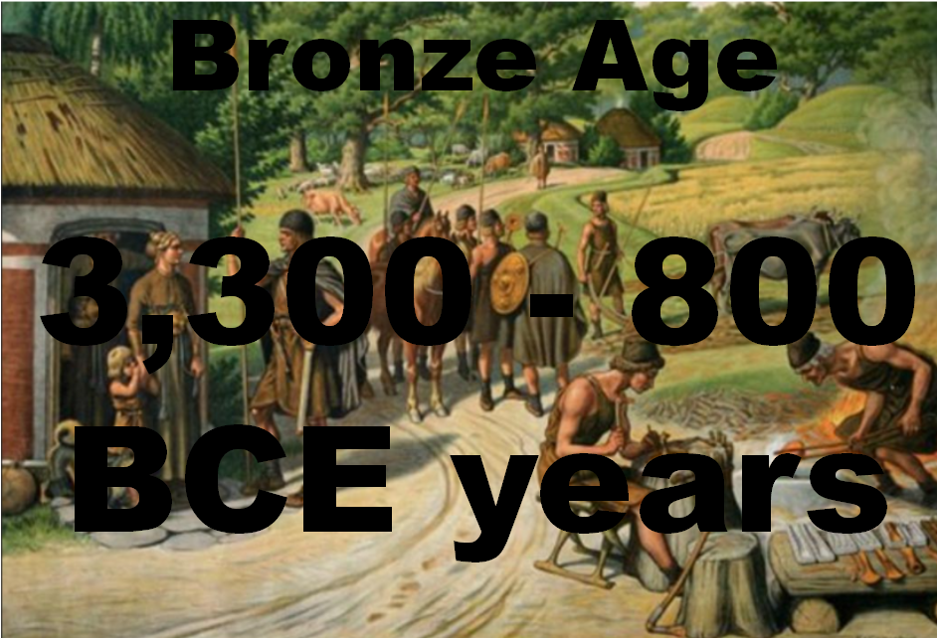
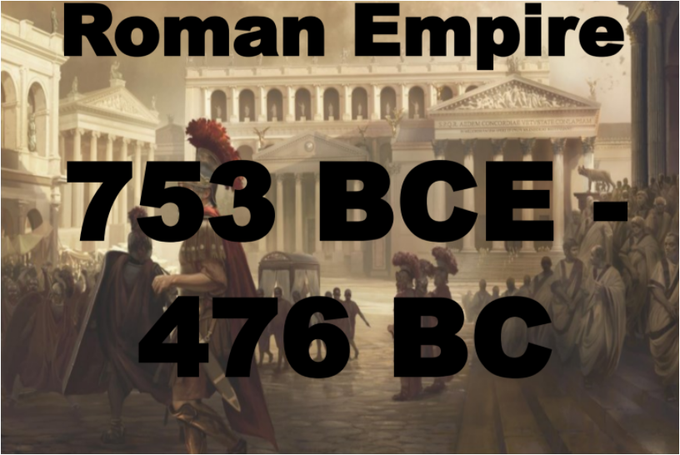
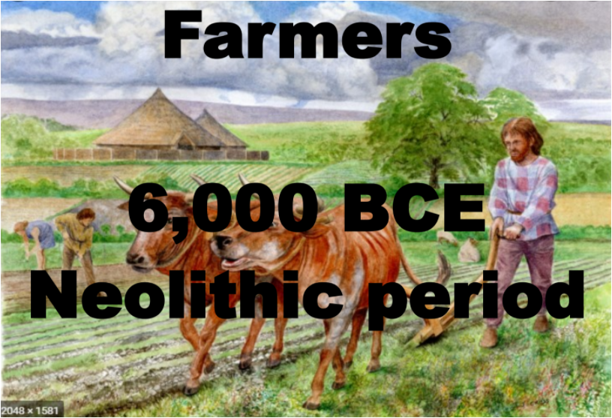
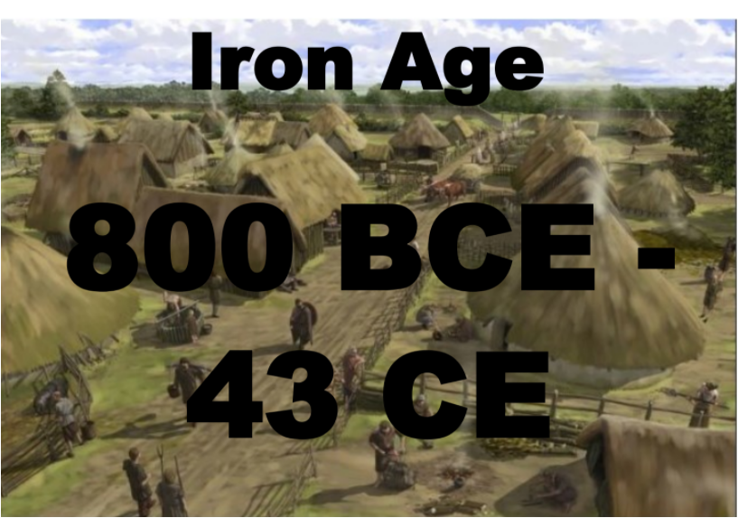
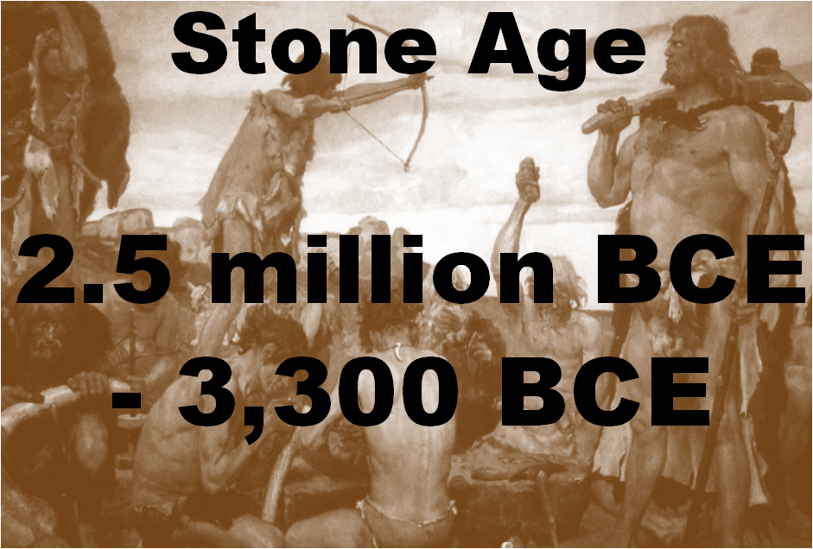
= 3,000 years ago , 300 metres
= 0 years ago , 0 metres
= 3,300 years ago , 330 metres
= 52 years ago , 0.5cm
= 2,774 years ago , 277cm
= 6000 years ago , 600 metres
= 2.5 million years ago , 2,500 metres
= 2,821 years ago , 282cm

Slide 27
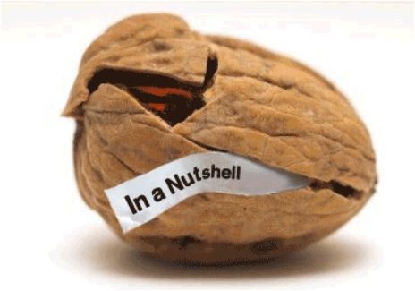
Describe what you have learnt today about timelines.
What is your favourite fact?
What fact do you think no-one else will remember from the lesson?
What do you think the most important piece of learning was?

