Slide 2


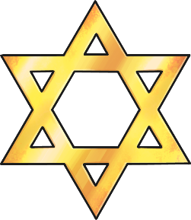

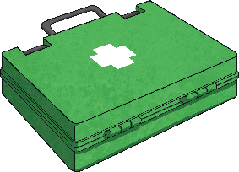
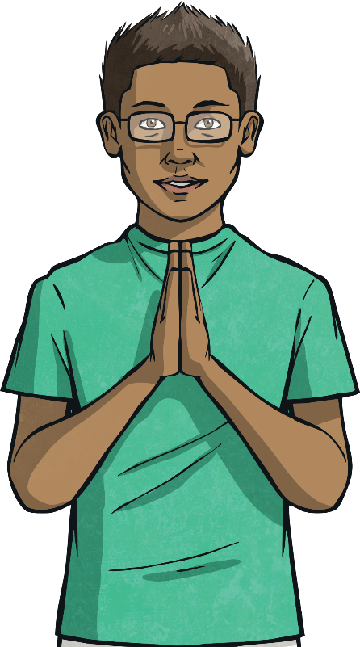
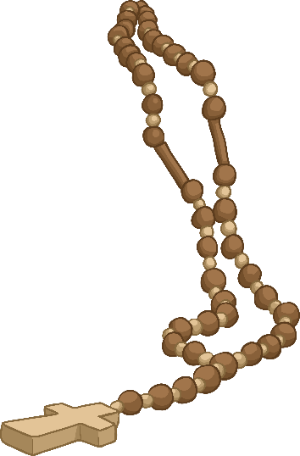
The Sign of the Cross
Do you recognise these signs and symbols?
The cross is an important Christian symbol.
When some Christians pray, they
make a sign of the cross, touching
their hand to their forehead, heart
and shoulders.

Slide 3
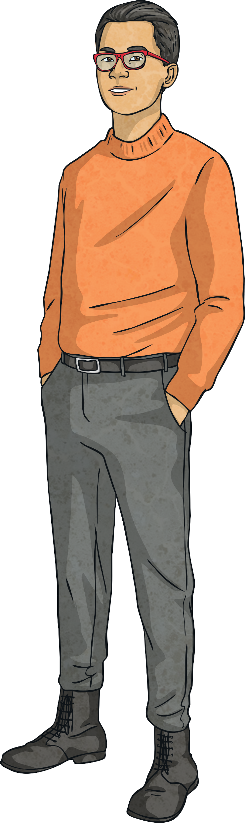
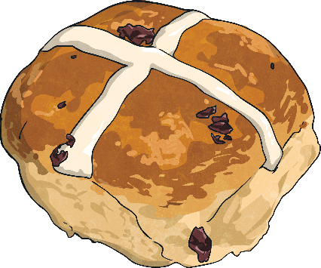
The Sign of the Cross
At Easter time, you’ll often see hot cross buns in the shops.
These are sweet buns with dried fruit and a cross marked on the top.
Do you know what the cross represents?
Did You Know?
There are lots of superstitions around hot cross buns:
Buns baked on Good Friday will not go mouldy for a year.
Hot cross buns are said to protect
against shipwrecks.

Slide 4
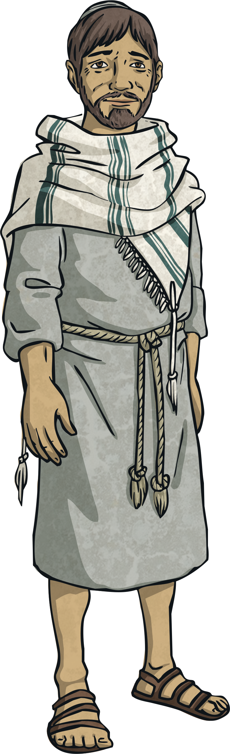
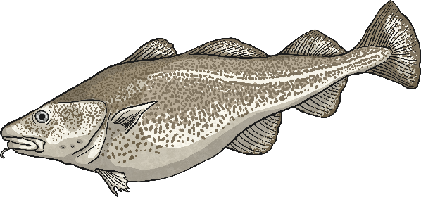
Good Friday
The story of Good Friday is a sad one. It is the day during Holy Week on which Jesus died. Good Friday is two days before Easter Sunday.
Some Christians often fast and do not eat meat. Fish is a traditional Good Friday meal.
In many churches, Christians retell the story of Jesus’ crucifixion through the ‘Stations of the Cross’.

Slide 5
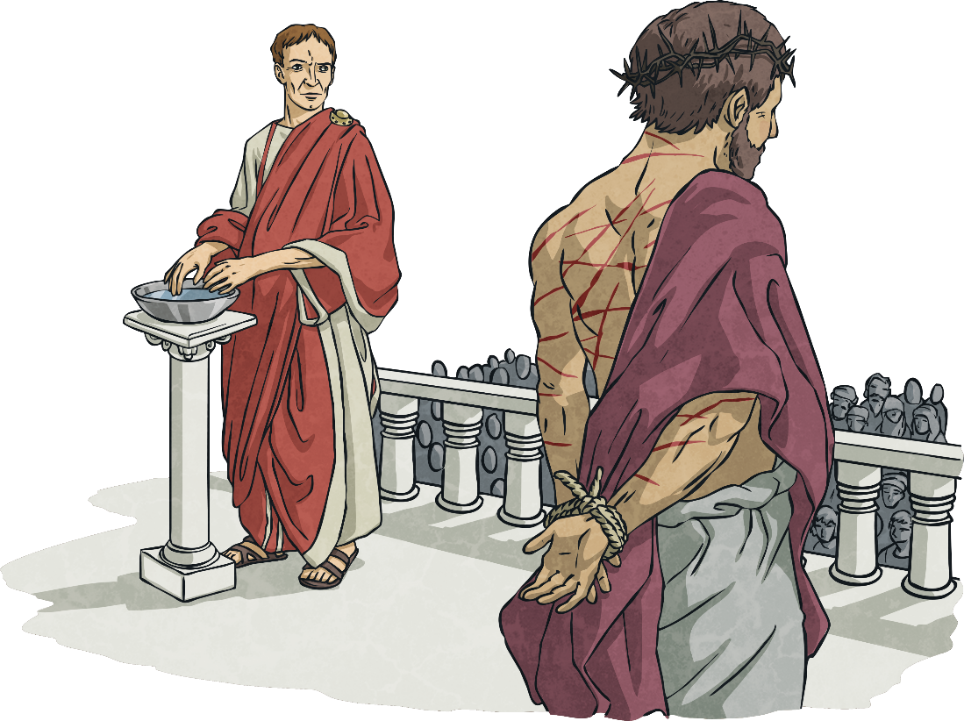
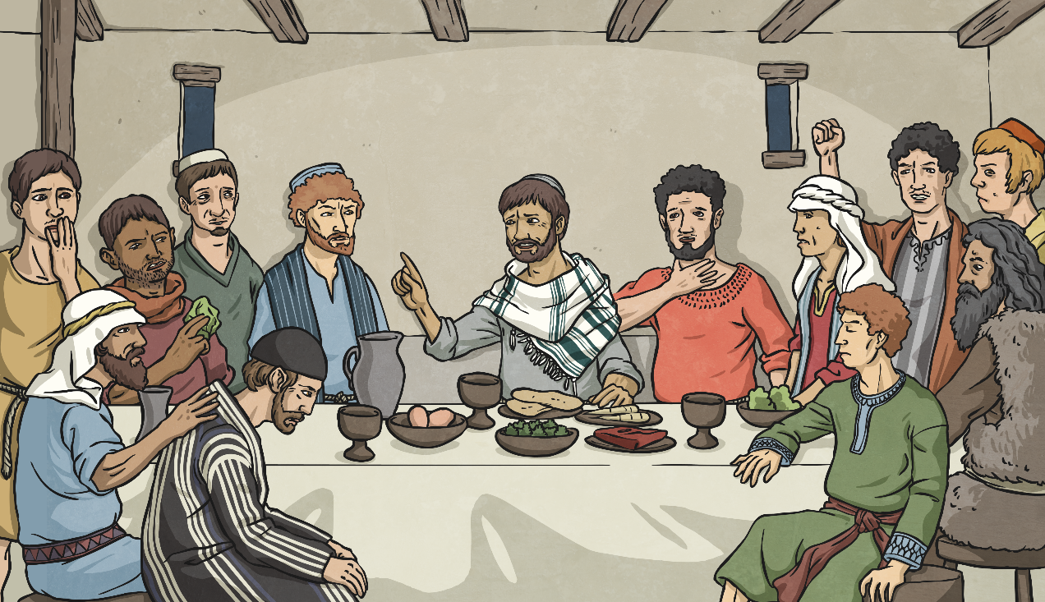
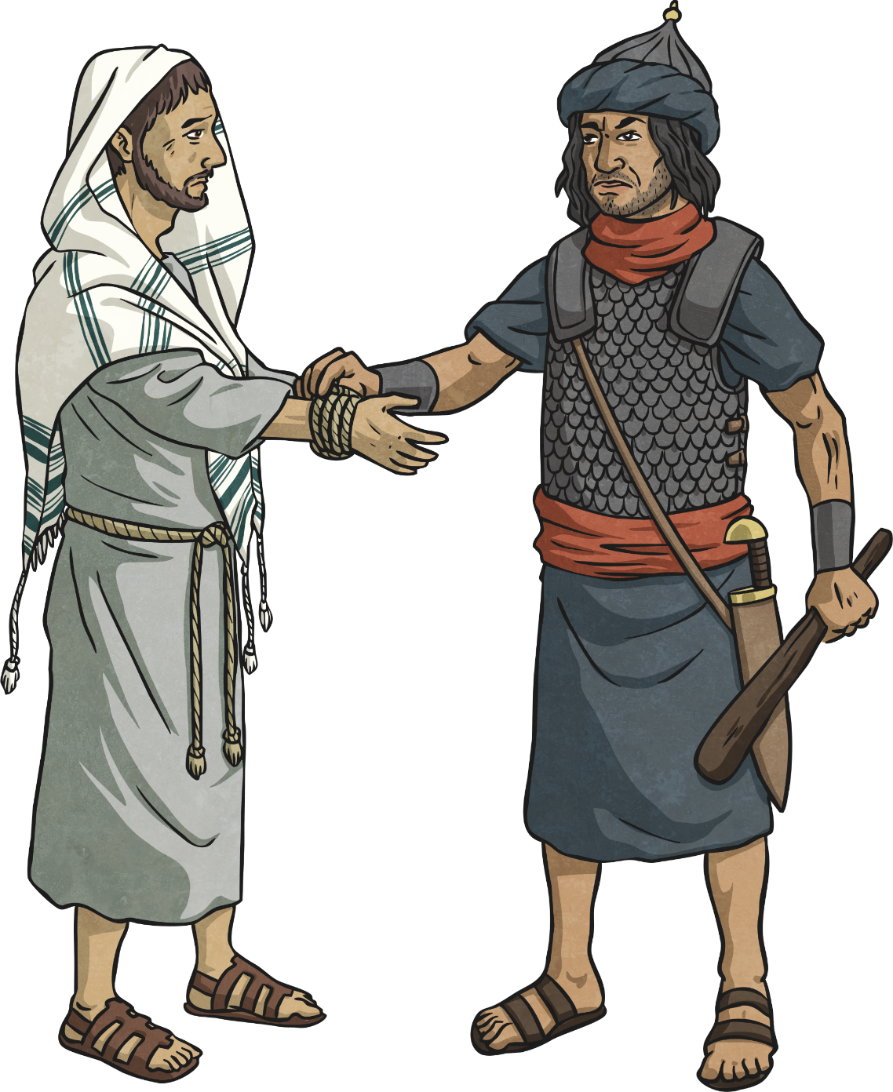
The Story of Holy Week
Maundy Thursday
Jesus shared the Last Supper with his friends. He knew he would be betrayed by one of his closest friends and be arrested. Jesus shared bread and wine, telling his disciples, “This is my body. This is my blood. Share this in memory of me.”
Palm Sunday
Jesus was welcomed into Jerusalem. Crowds of people
waved palm branches and shouted ‘Hosanna!’. But not
everyone was happy to see Jesus and a few plotted to kill him.
After, in the Garden of Gethsemane, Jesus was betrayed by Judas Iscariot and taken away by Roman soldiers.

Slide 6
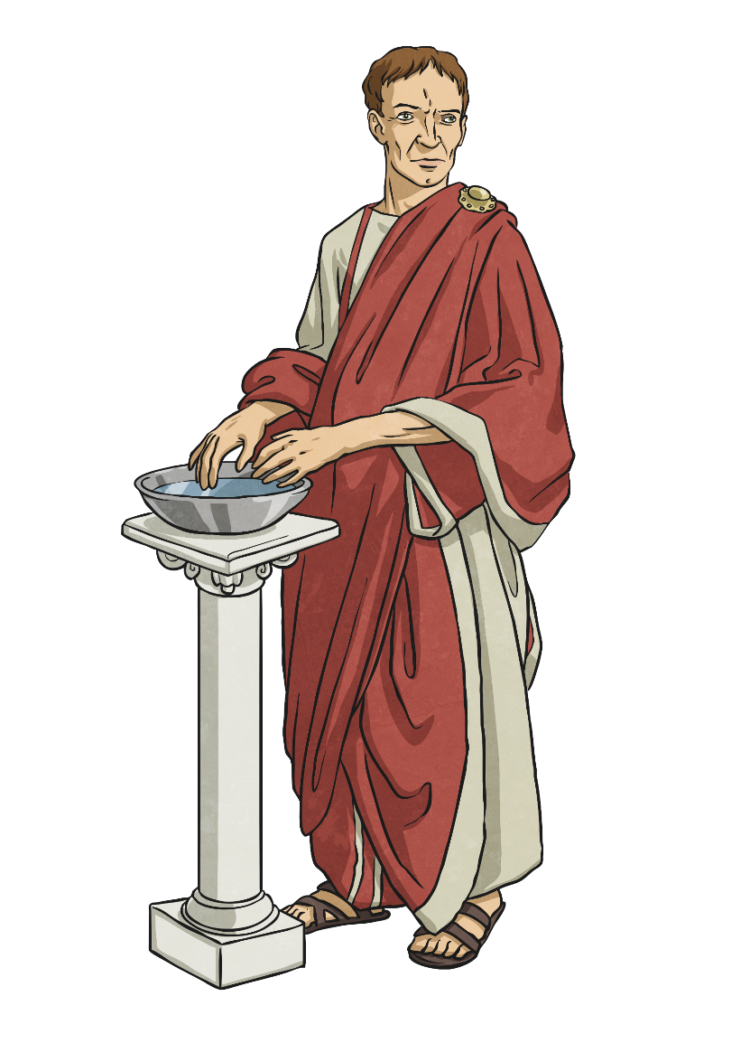
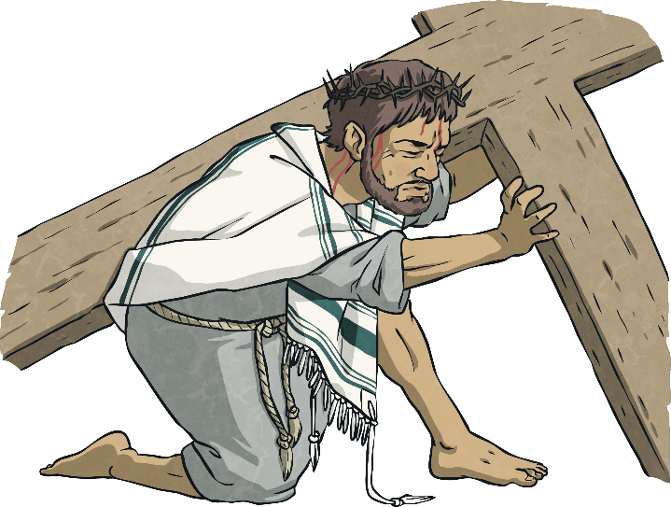
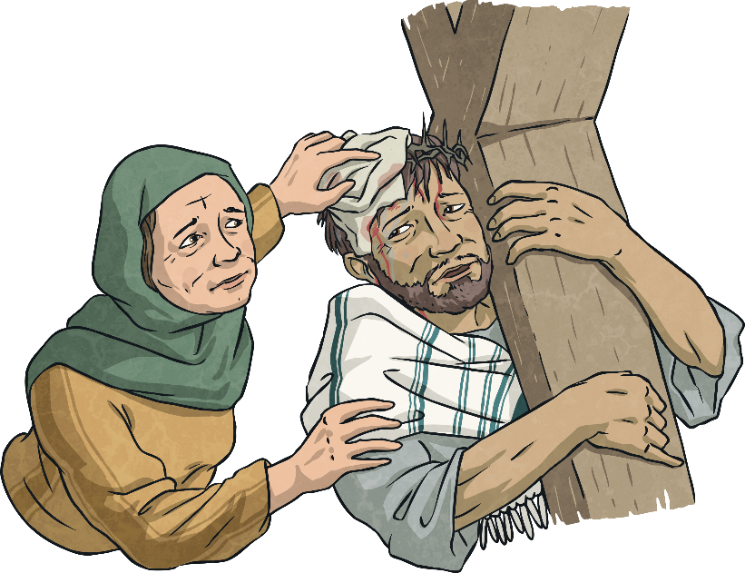
The Story of Good Friday
The Roman Governor, Pontius Pilate, asked the crowd what he should do. The enemies of Jesus shouted, “Crucify him!” so Pilate gave the order.
Jesus was mocked and made to wear a crown of thorns. He had to carry his cross to a hill outside of the city.
Some people helped Jesus. A lady believed to be named Veronica stopped to wipe his face and Simon of Cyrene was forced to help carry Jesus’ cross by the Roman soldiers.

Slide 7
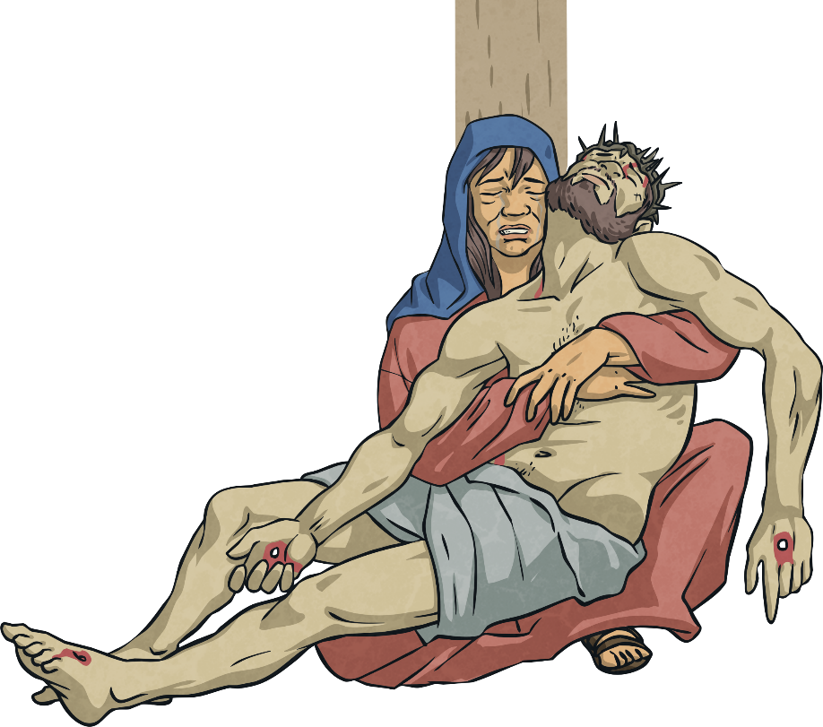
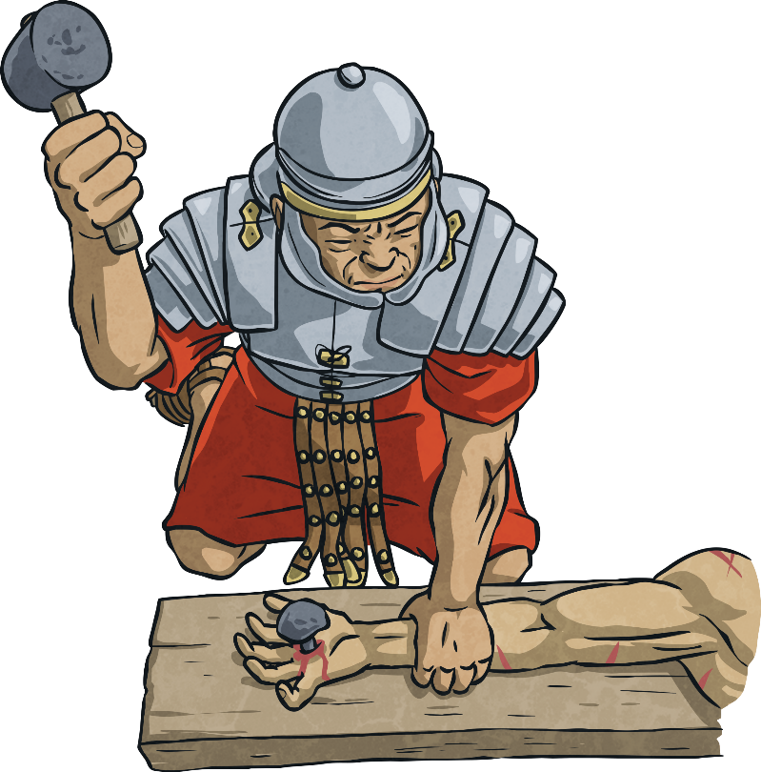
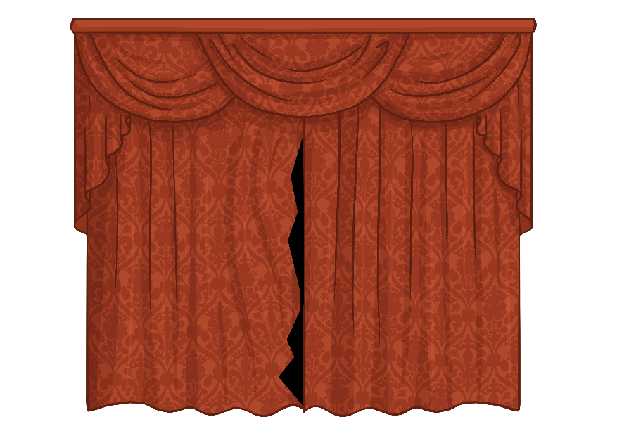
The Story of Good Friday
The Roman soldiers nailed Jesus to the cross. He was crucified alongside two thieves. One thief mocked Jesus, saying that if he was the Son of God, he should save himself. The other thief, however, begged for forgiveness and was truly sorry for his crime. Jesus said that this man would be forgiven and enter heaven with him.
The Bible says that it grew very dark and the curtain in the temple tore in two at the moment Jesus died.
Jesus’ body was taken down from the cross and placed in a stone tomb.

Slide 8
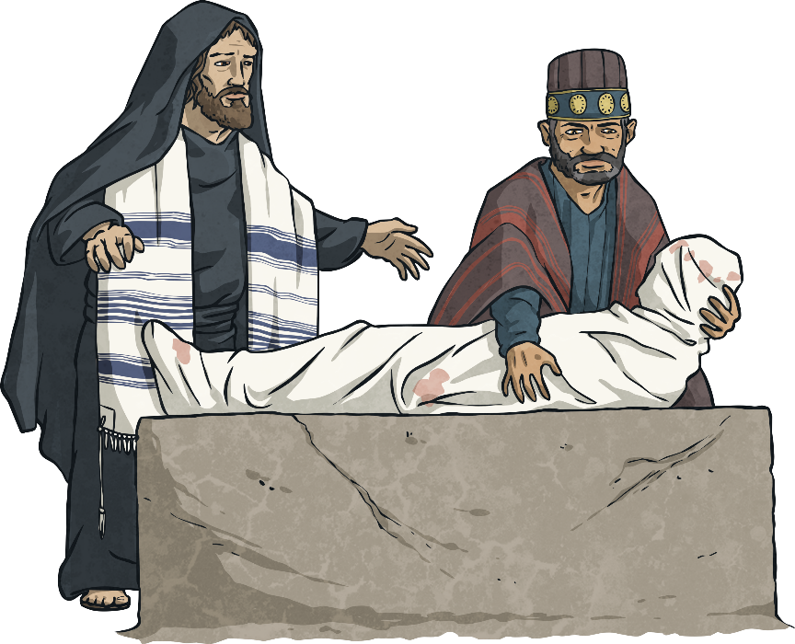
After Good Friday
For Christians, this is not the end of the Easter story.
Something very special would happen on Easter Sunday.
Good Friday is a time when Christians remember the sacrifice Jesus made. They believe Jesus gave his life for the good of everyone. The Bible tells how if people are truly sorry for what they have done wrong, just like the second thief, they will be forgiven by God.

Slide 9
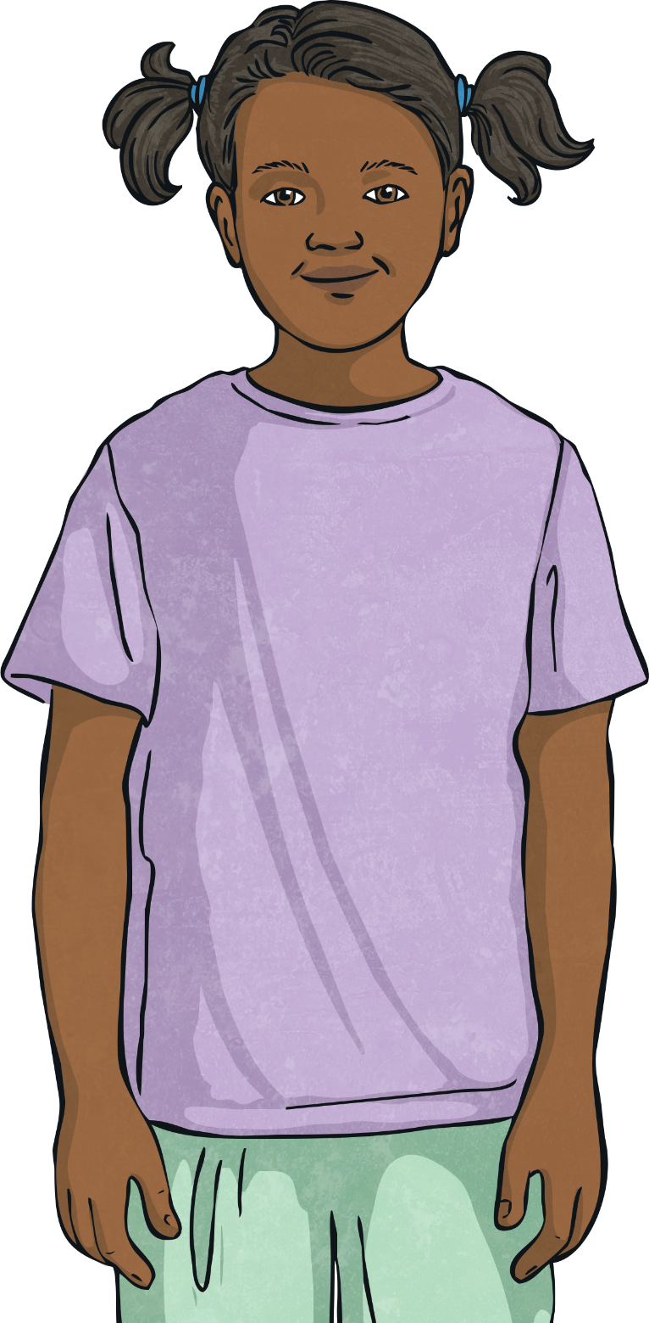
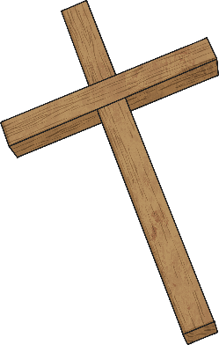

Reflect in books
Why is Good Friday referred to
as ‘good’?
Why do you think Christians have the cross as their special symbol?
Can you explain the symbolism of the hot cross bun?

