Slide 1



Slide 2
LO: I am learning to spell the names of family members in French

Slide 3
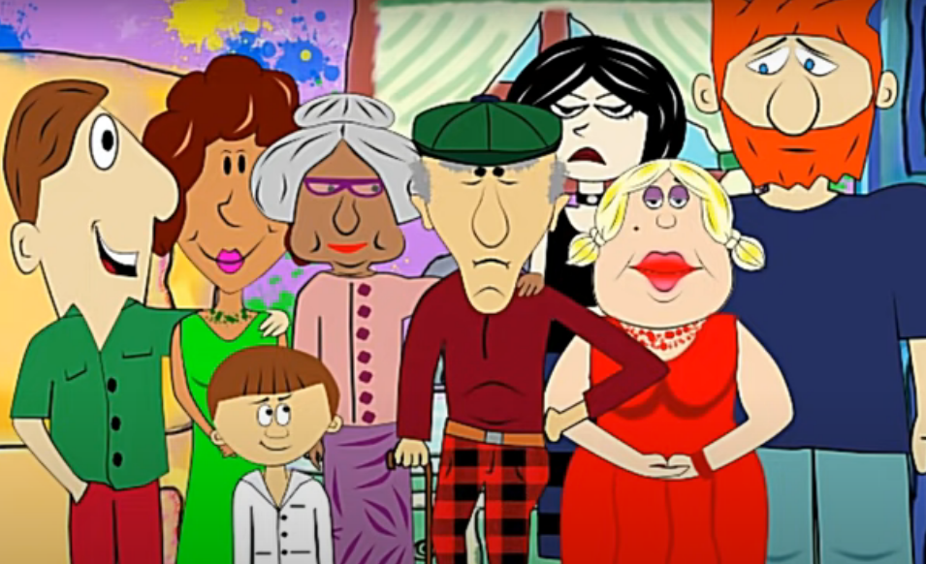
Let’s recap family member names… remember to join in.
Notes:
https://www.youtube.com/watch?v=MFk9YmJv-jc

Slide 4

l’alphabet français
Notes:
https://www.youtube.com/watch?v=_LYy3P2okyw
Alphabet chant to music

Slide 5
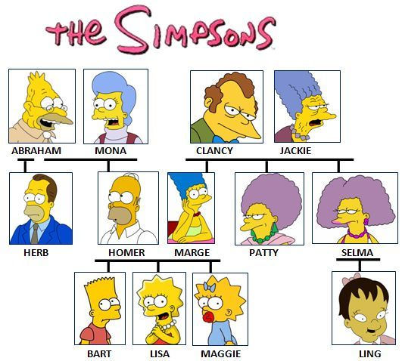
___________, comment ça s’écrit?
Notes:
Pupils have seen this slide once already but it makes a good recapping activity to start the lesson.
Comment il s’appelle? Comment elle s’appelle (What is he/she called?
Comment ca s’écrit? (How do you spell that?
Alphabet introduction
A - a, B - bay, C - say, D - dé, E - euh, F - eff, G - jay, H - aash, I - ee, J - gee, K - ka, L - ell, M - emm, N - enn, O - oh, P - pay, Q - koo, R - air, S - ss, T - tay, U - u, W - dooblé vay, X - eeks, Y - egrek, Z - zed

Slide 6

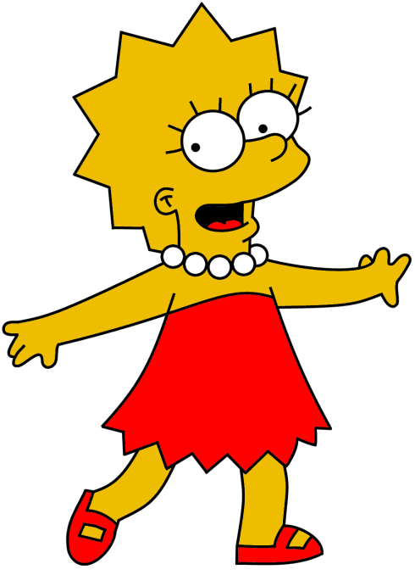
Ça s’écrit
H – O – M – E – R.
Homer, comment ça s’écrit?
Notes:
H – ash
O - oh
M – em
E – euh
R - aire

Slide 7

Ça s’écrit
A – B - E.
Abe, comment ça s’écrit?
Notes:
A - a, B - beuh, E – euh

Slide 8
Task
Ask a partner how to spell their name.
Then they will ask you to spell yours.
Take your time and use the resource sheet to support you.

Slide 9


