Slide 2

Aim
I can understand and make fact families using multiplication and division.

Slide 3
Fact Family Triangles
There are 24 students in year 4.
Sometimes the students work in groups of 4 and, sometimes in groups of 6.
24
4
6

Slide 4

Fact Family Triangles
In Science, the year 4 students work in 6 groups of 4.
24
6 x 4 = 24
4
6

Slide 5
Fact Family Triangles
In Science, the year 4 students have 6 tables to work at.
24
24 ÷ 6 = 4
4
6

Slide 6

Fact Family Triangles
In Art, the year 4 students work in 4 groups of 6.
24
4 x 6 = 24
4
6

Slide 7
Fact Family Triangles
In Art, the year 4 students have 4 tables to work at.
24
24 ÷ 4 = 6
4
6

Slide 8


Fact Family Triangles
24
4
6
24 ÷ 6 = 4
24 ÷ 4 = 6
6 x 4 = 24
4 x 6 = 24

Slide 9
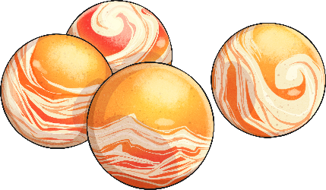
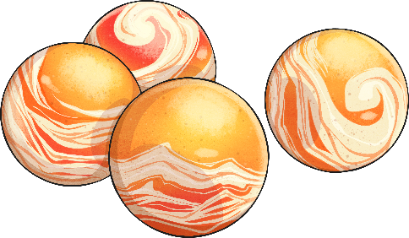

Fact Family Triangles
Jimmy has 12 marbles.
He wants to share them evenly between himself and his 2 friends.
12
4
3

Slide 10
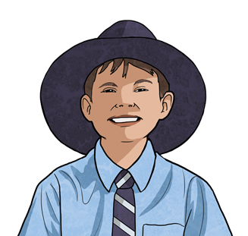
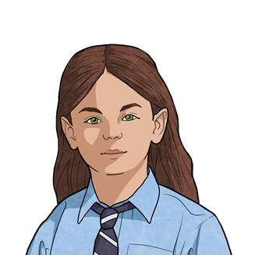
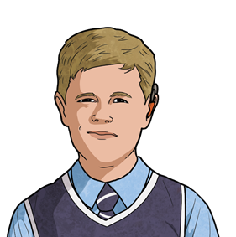

Fact Family Triangles
Jimmy has 12 marbles and 2 friends. He shares his marbles evenly between all 3 people.
12
12 ÷ 3 = 4
3
4

Slide 11
Fact Family Triangles
All 3 kids have 4 marbles each to play a game with.
12
3 x 4 = 12
3
4

Slide 12
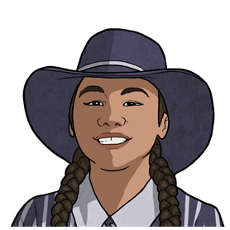
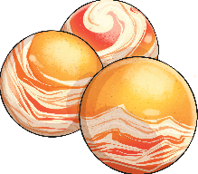
Fact Family Triangles
Another friend comes to join them. Now Jimmy shares the marbles evenly with all 4 people.
12
12 ÷ 4 = 3
3
4

Slide 13
Fact Family Triangles
All 4 friends have 3 marbles each to play a game.
12
4 x 3 = 12
3
4

Slide 14
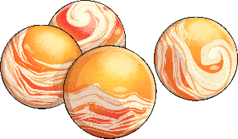

Fact Family Triangles
12
3
4
12 ÷ 3 = 4
12 ÷ 4 = 3
3 x 4 = 12
4 x 3 = 12

Slide 15

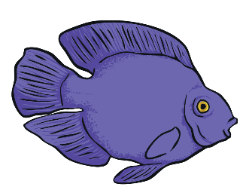


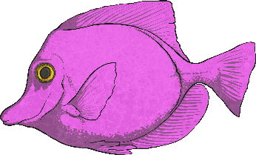
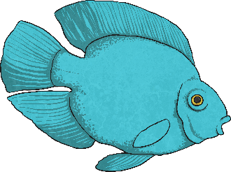
Fact Family Triangles
The zoo has 30 fish swimming around in different tanks.
The fish can be divided into groups of 5 or 6.
30
5
6

Slide 16







Fact Family Triangles
The zoo has 30 fish and 5 tanks to divide the fish into.
30
30 ÷ 5 = 6
5
6

Slide 17
Fact Family Triangles
When the year 3 students visit the zoo, they see 5 tanks with 6 fish in each.
30
5 x 6 = 30
5
6

Slide 18
Fact Family Triangles
The zoo still have 30 fish but add a fish tank to give them more room to swim. The fish are now in 6 tanks with 5 fish in each.
30
30 ÷ 6 = 5
5
6

Slide 19
Fact Family Triangles
When the year 4 students visit the zoo, they see 6 tanks with 5 fish in each.
30
6 x 5 = 30
5
6

Slide 20
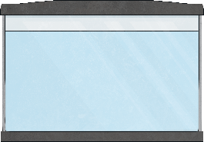






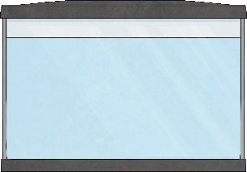





Fact Family Triangles
30
5
6
30 ÷ 5 = 6
30 ÷ 6 = 5
5 x 6 = 30
6 x 5 = 30

Slide 21
Fact Family Triangles
Can you match the triangle with the correct fact family?
3 x 6 = 18
6 x 3 = 18
45
18 ÷ 6 = 3
18 ÷ 3 = 6
9
5
9 x 5 = 45
5 x 9 = 45
45 ÷ 5 = 9
45 ÷ 9 = 5
22 ÷ 2 = 11
22 ÷ 11 = 2
11 x 2 = 22
Next Question
2 x 11 = 22

Slide 22
Fact Family Triangles
Can you match the triangle with the correct fact family?
3 x 6 = 18
6 x 3 = 18
18
18 ÷ 6 = 3
18 ÷ 3 = 6
6
3
9 x 5 = 45
5 x 9 = 45
45 ÷ 5 = 9
45 ÷ 9 = 5
22 ÷ 2 = 11
22 ÷ 11 = 2
11 x 2 = 22
Next Question
2 x 11 = 22

Slide 23
Fact Family Triangles
Can you match the triangle with the correct fact family?
3 x 6 = 18
6 x 3 = 18
22
18 ÷ 6 = 3
18 ÷ 3 = 6
11
2
9 x 5 = 45
5 x 9 = 45
45 ÷ 5 = 9
45 ÷ 9 = 5
22 ÷ 2 = 11
22 ÷ 11 = 2
11 x 2 = 22
2 x 11 = 22

Slide 24
Fact Family Triangles
Write your own fact families for these triangles.
20
32
24
5
4
8
4
12
2
5 x 4 = 20
8 x 4 = 32
2 x 12 = 24
Reveal Answers
Reveal Answers
Reveal Answers
4 x 5 = 20
4 x 8 = 32
12 x 2 = 24
20 ÷ 5 = 4
32 ÷ 4 = 8
24 ÷ 2 = 12
20 ÷ 4 = 5
32 ÷ 8 = 4
24 ÷ 12 = 2

