Slide 1


Slide 3


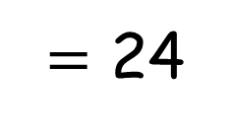
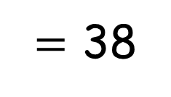
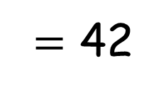

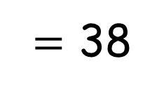
Which of the calculations will need an exchange and which will not?
30 $−$ 6
47 $−$ 5
$=$ 24
$=$ 42
45 $−$ 7
$=$ 38
$=$ 38

Slide 4

How many solutions will need to cross 10?
3
4
5
$$−$$

Slide 5

How many solutions will need to cross 10?
3
4
5
$$−$$

Slide 6


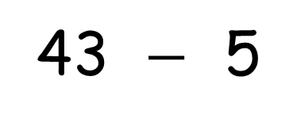
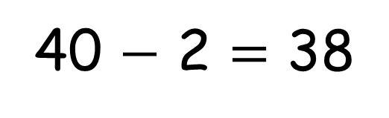
How many solutions will need to cross 10?
3
4
5
$$−$$
43 $−$ 5
40 $−$ 2 $=$ 38
3
2

Slide 7
How many solutions will need to cross 10?
3
4
5
$$−$$
I must have found them all

Slide 8
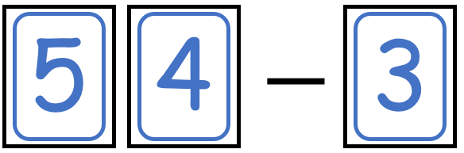
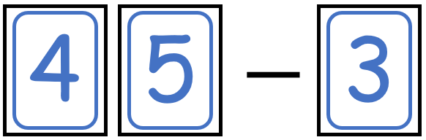
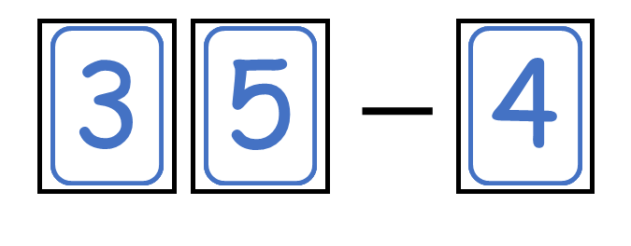

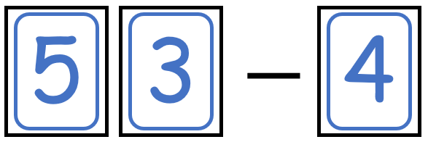
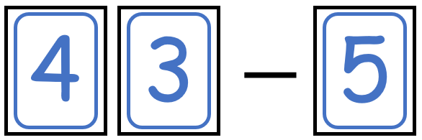
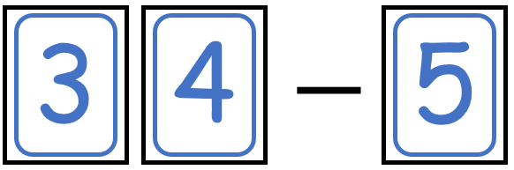

How many solutions will need to cross 10?
5
4
3
4
5
5
$$−$$
3
3
4
What do you notice?

Slide 9
Have a go at question 6 on the worksheet

Slide 10

How many solutions will cross 10 and have a difference that is even?
1
2
3
4
5
$$−$$
Have a think

Slide 11
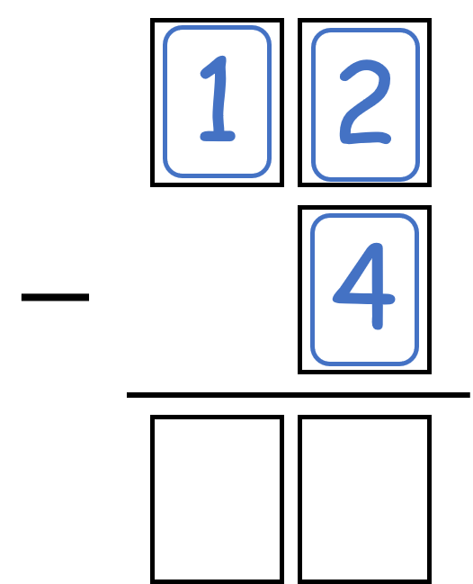
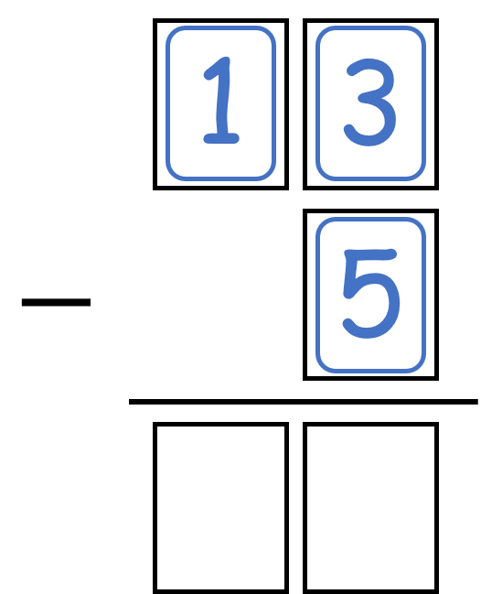
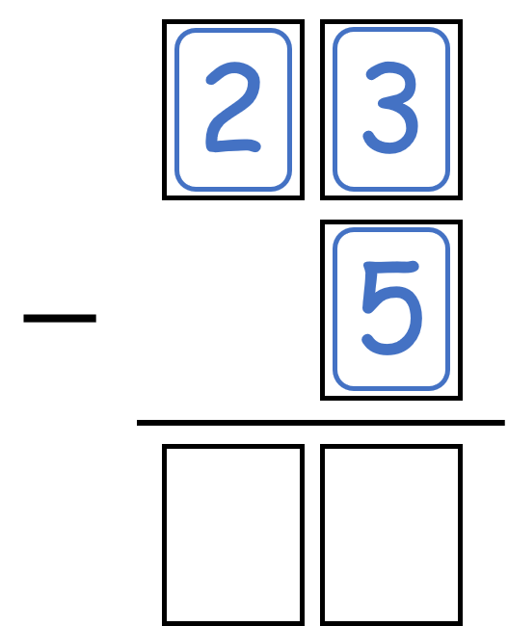
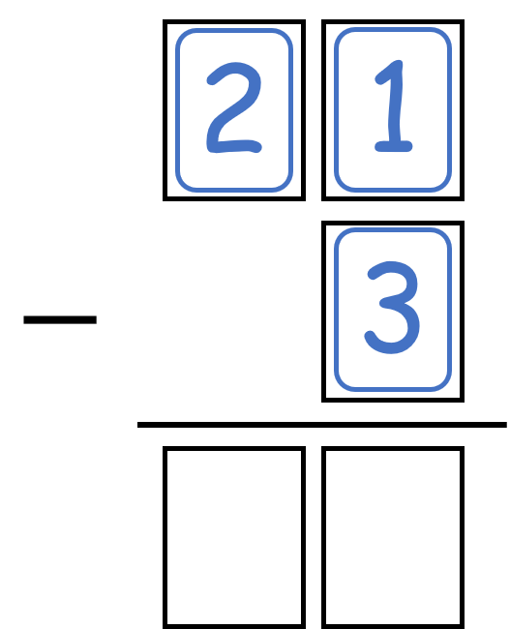
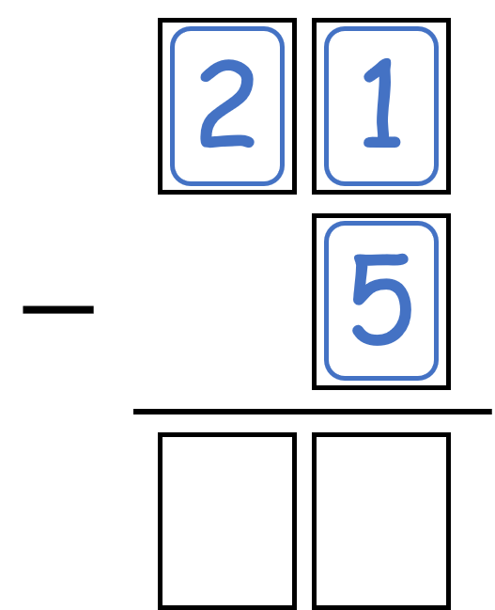
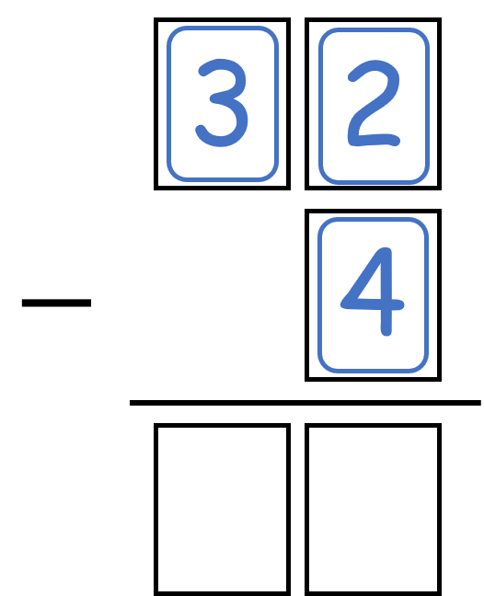
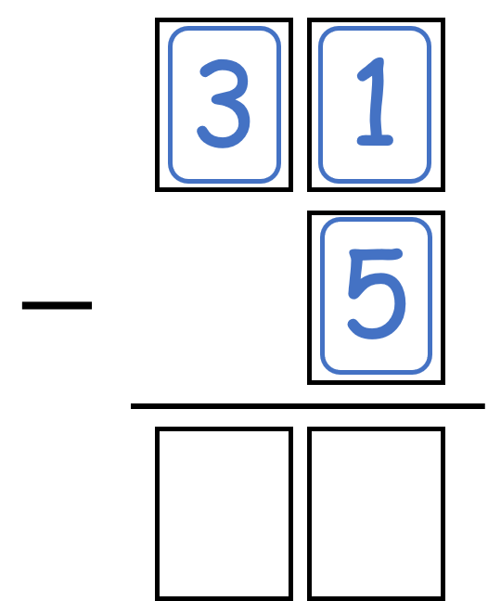
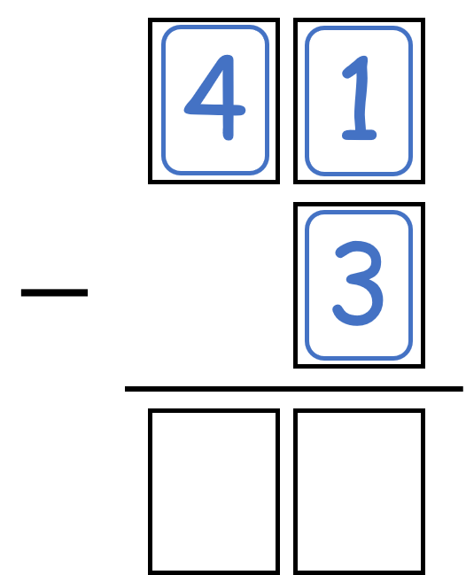
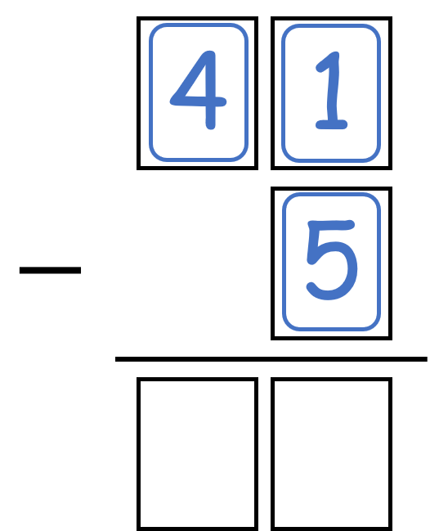
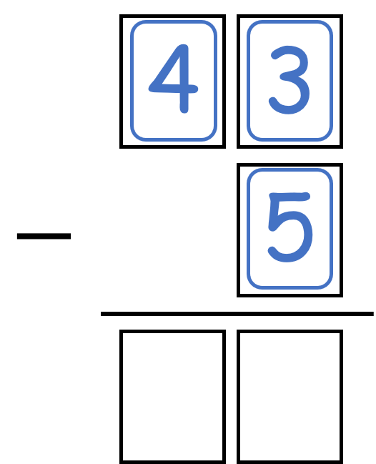
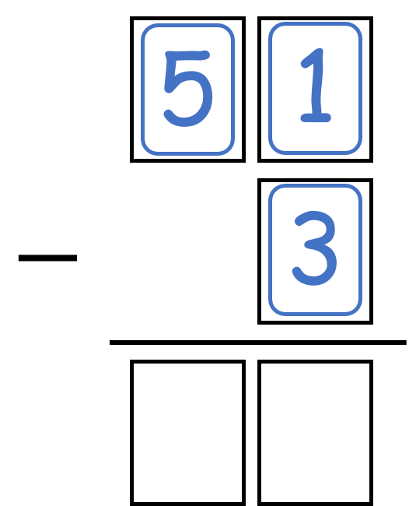
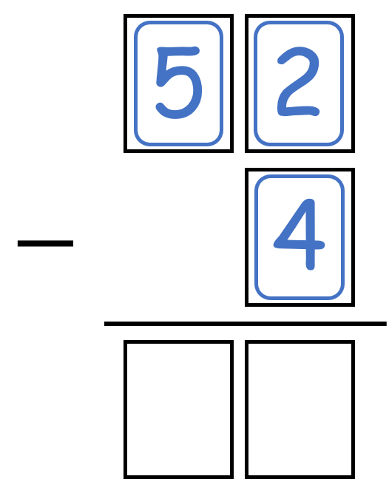







How many solutions will cross 10 and have a difference that is even?
$$−$$
$$−$$
$$−$$
$$−$$
$$−$$
Are there more or less solutions that give an odd difference?
What would happen if we added in a 6 digit card?
Are there more or less solutions that do not cross 10?
$$−$$
$$−$$
$$−$$
$$−$$
$$−$$
$$−$$
$$−$$

