Slide 1
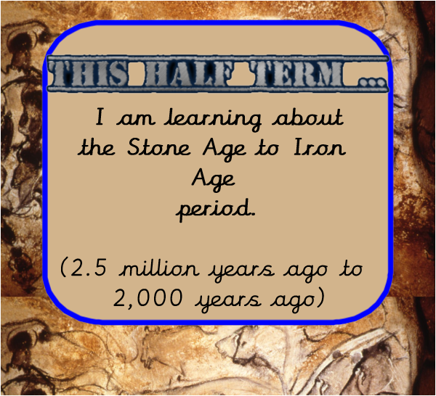

Slide 2
Underline or highlight the keywords in the LO and circle any words you don’t know the meaning of.
LO: I understand that events are significant if they result in changes to the way people used to live.

Slide 3
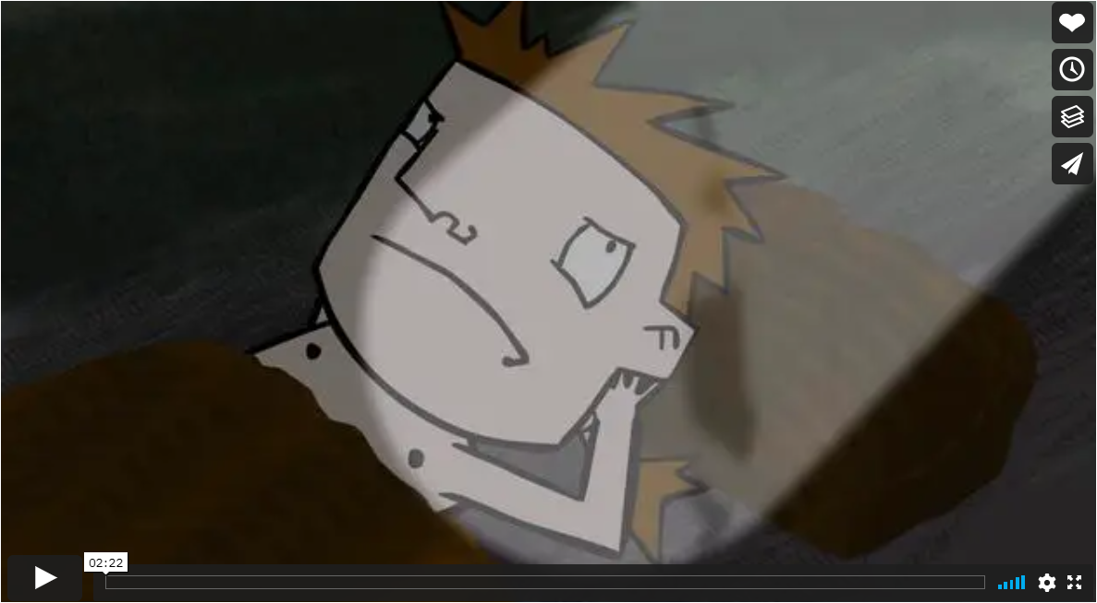
We are going to find out some more about the Paleolithic and Mesolithic Stone Age.
As you watch the video, write down one thing you already knew, one thing that you learnt and anything that surprised you.
https://vimeo.com/21927963

Slide 4
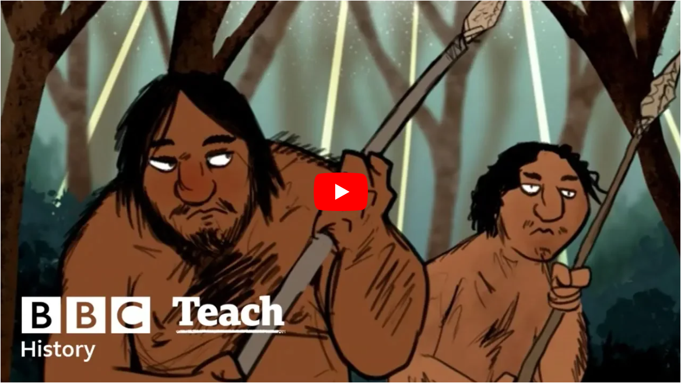
We are going to find out some more about the Paleolithic and Mesolithic Stone Age.
As you watch the video, write down one thing you already knew, one thing that you learnt and anything that surprised you.
https://www.youtube.com/watch?v=-DkXHi-udxg&t=22s&list=PLcvEcrsF_9zL7eufSRIWUYiC80khLsqZ7

Slide 5
The aim of today’s lesson is to understand what significant events happened in the Stone Age (significant means important).
As historians we look at important events and try to understand what impact they had on how people lived their lives. Big and important events usually result in big changes!
What important events do you think happened in the Stone Age?

Slide 6
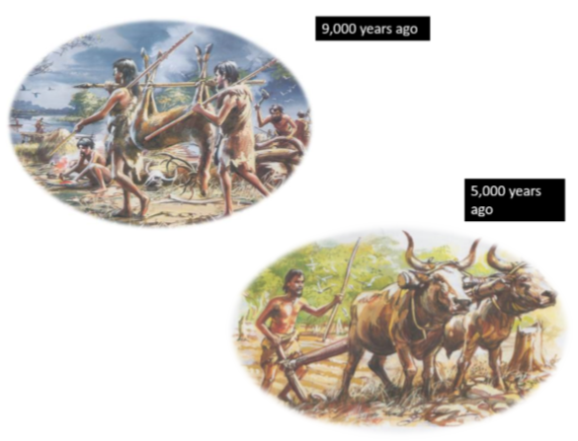
Things began to change when we entered the Neolithic era (New Stone Age).
Look at the pictures and think about what you see, think and wonder.
Remember to look carefully because the more you look the more you see!
Now discuss with someone at home or in school….
What is happening in the first picture and what is happening in the second picture?
(there’s a bigger picture on the next page)

Slide 7
Describe...
What you can san see.
What they are doing now.

Slide 8
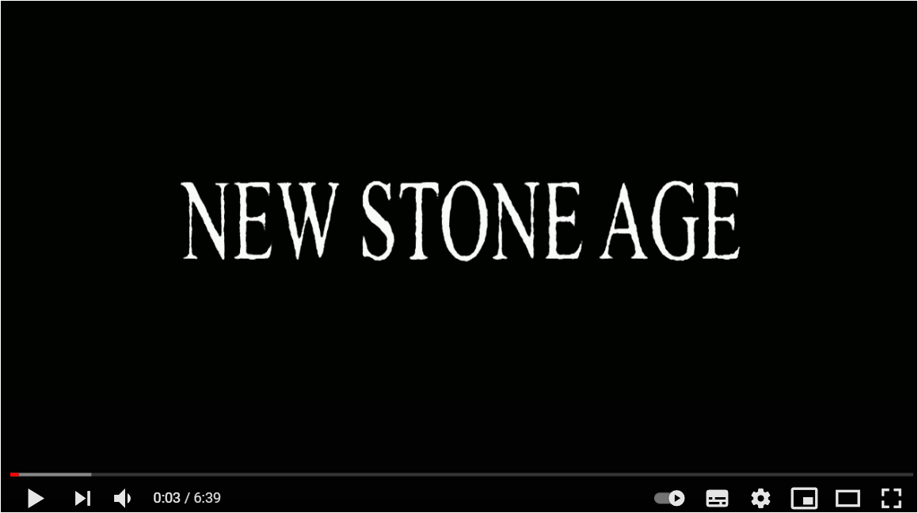
Let's find out a little more about the changes. Why do you think it was called the New Stone Age?
As you watch the video, write down one thing you already knew, one thing that you learnt and anything that surprised you.
https://www.youtube.com/watch?v=pWHCyyWCCLc

Slide 9
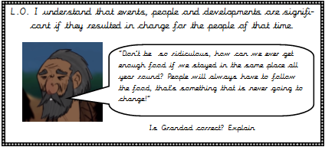
Explain why farming improved the lives of Stone Age people.
Use this stem sentence to help.
The Stone Age grandad is not correct because ….

Slide 10
Historians look for significant events to help explain how people used to live in the past.
A significant event is something important. When we explain what’s happened during a day we don’t often talk about the small things (such as brushing our teeth), instead we tell people about the big things (what we learnt at school today). This is the same for historians. They want to know what the big changes were that affected how people lived their lives.
Your next task is to look at some of the changes that happened during the Stone Age and decide if it’s a big point or a small point.
A big point would create a big change in how people lived their lives and a small point might only change a Stone Age person’s life a little.

Slide 11
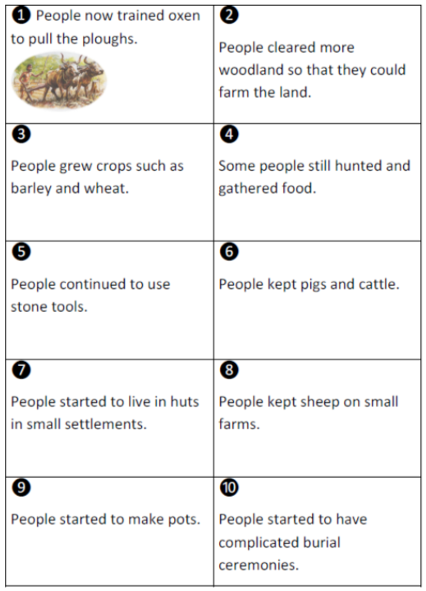
Here is a mixture of big and little points.
Which of these events did you know about already?
Are there any events that you know about, but aren’t included here?
Are there any events that surprised you?

Slide 12
Order the events from the MOST important to the LEAST important.
Place the events in order from what you think is the MOST significant event to the one you think is the LEAST significant event.
You need to ask yourself, would this have had a BIG impact on how Stone Age people lived their lives?
There’s no right or wrong answer but you will be asked to explain your choices.

Slide 13
Now you will need to explain your choices.
Write down what you think the MOST important event is using this stem sentence,
The event that’s the most important is….
Then explain why you think it’s important.
This is a big point because….

Slide 14
Now you will need to explain your choices.
Write down what you think the LEAST important event is using this stem sentence,
The event that’s the least important is….
Then explain why you think it’s important.
This is a little point because….

Slide 15
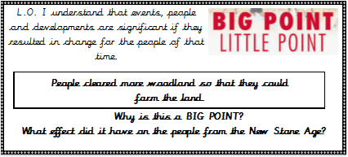
Explain how the lives of Stone Age People changed as they became farmers.

Slide 16
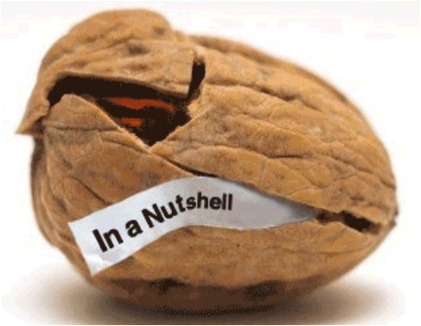
Finally, using some of the examples you’ve learnt about can you discuss why historians want to understand significant events that have happened in the past.

