Slide 1


Slide 2
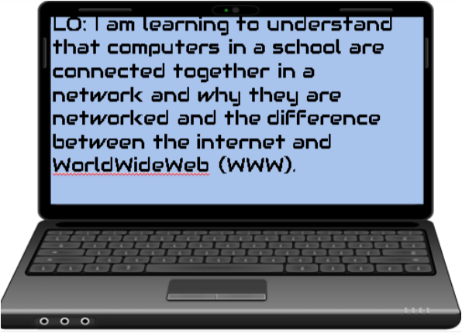
Underline the important words in the LO
Are there any words that you’re unfamiliar with?

Slide 3
What is a Computer?
Discuss this with someone at home or in school.
Write down as many examples of computers as you can think of.

Slide 4
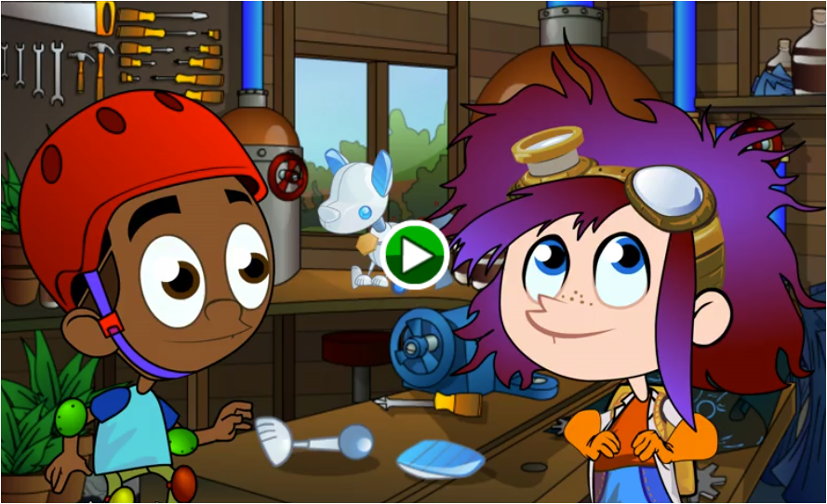
Play this game and see if you can find all the items that contain computers.
Now add to your list of computers from what you discovered in the game.
https://toybox-assets.files.bbci.co.uk/activities/legacy-bitesize-games/recycling/computers/index.html

Slide 5
How would you describe a computers someone?

Slide 6
How would you describe a computers someone?
AA computer is a device for working with information. The information can be numbers, words, pictures, movies, or sounds. Computer information is also called data. Computers can process huge amounts of data very quickly.
How are computers useful?

Slide 7
What do you think these words mean?
Network
Internet
World-Wide-Web
Discuss these terms with someone at home or at school.

Slide 8
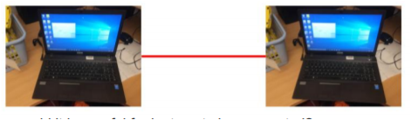
When computers are connected to each other it’s called a network.
Think about and discuss why it’s useful for computers to be connected.
A network is a group or system of interconnected people or things

Slide 9

Networks also allow computers to connect to the same device
Think about and discuss why it’s useful for computers to be connected to the same devices, like a printer.

Slide 10
Networks also allow computers to connect to the same device
Think about and discuss why it’s useful for computers to be connected to the same devices, like a printer.

Slide 11
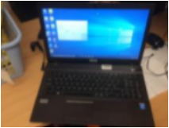
If there’s lots of computers connected in a network, it can become very complicated connecting them!

Slide 12

A Switch can be used to simplify the connections in the network

Slide 13
The benefits of a network are..
File sharing - you can easily share information between different computers.
Resource sharing - Share other devices like printers, scanners and copiers to save money
Internet connection - Able to share one internet connection

Slide 14

When devices are not always connected with wires, this is called wireless
Think about and discuss why it’s useful for computers to have wireless connections.

Slide 15
The benefits of a wireless network are...
Cheaper to set up because no wires are needed
Wires can be unsightly
Able to connect mobile phones, tablets and other devices that don’t use wires
But they can be slower than wired networks

Slide 16
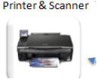
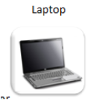



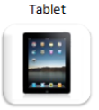

Connecting to the internet
Can you think about all the devices you have at home and draw how they are connected to the internet.
Think about which ones have wires that connect them to the internet and which are wireless and show this using a dotted line for wireless and a normal line for a wired connection.
A router connects a network to the internet.
Extension: Why do the arrows have a double arrow head.

Slide 17
What is the internet?
It might surprise you to know that the internet has been around since the 1960s, when the first computers were joined together.
Today the internet has grown into a huge spider’s web where millions of computers, networks, phones and tablets are all joined together.
The Internet works the same way a network would in a home or office but has millions of more computers, routers, and switches.
The internet means we can share files and email each other.

Slide 18

The internet is not the World-Wide-Web!
Tim Berners-Lee invented the Internet and made it free for everyone.
The World Wide Web is part of the Internet where we can visit web pages and websites.
It is a massive collection of digital pages, which are put on our screens by the Internet, we see the web through programs called web browsers.

Slide 19
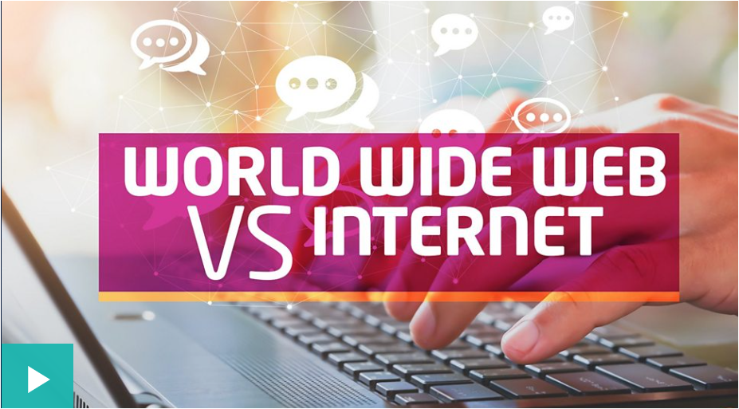
Watch the video and think about one thing that you already knew, one thing you learnt and one thing that surprised you.
https://www.bbc.co.uk/newsround/47523993

Slide 20
Why is the web so important?
The world wide web opened up the internet to everyone.
It connected the world in a way that was not possible before and made it much easier for people to get information, share ideas and communicate.
It allows people to share their work and thoughts through social networking sites, blogs and video sharing, keep up to date with news and events instantly. We can play games with others around the world and our smartphones and smart TVs connect to the web.

Slide 21
Draw or write a mind-map to describe what you’ve learnt today. Use the word bank to help.
Internet
Network
Computing
W.W.W
Word bank
Network, devices, computer, switch, router, wireless, Wired, internet, world-wide-web,

