Slide 1
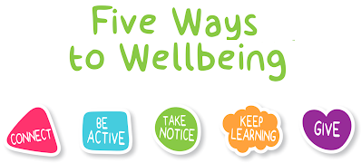
Let’s talk about our wellbeing!

Slide 2
There are 5 steps me can take to improve our mental health and wellbeing. These 5 steps can make us feel more positive!
Mental health is all about how we feel on the inside. We cannot see these feelings which is why it is important to talk about them!
Connecting with others
Being active (moving our bodies)
Taking notice (mindfulness/ not worrying about the past or the future).
Learning new life skills
Giving to others (showing kindness)

Slide 3



Today we are going to be focusing on:
Connecting with others
Learning new life skills
Giving to others (showing kindness)

Slide 4
We all have different strengths: that’s what makes us unique. Think about some of your strengths and how you could use them to help others.
mathematical artistic musical creative
athletic confident mechanical articulate sensitive
a good writer a talented dancer a nurturing gardener
independent

Slide 5
The strengths game
One person from the class goes and stands outside the door, the rest of the children inside the class lists strengths that the children who is outside the door has
e.g. they are very helpful, they are great at football, they are a good friend
The child from outside then comes back into the class, the class teacher chooses one of the strengths that was mentioned and the child has to try and guess who said it.

Slide 6
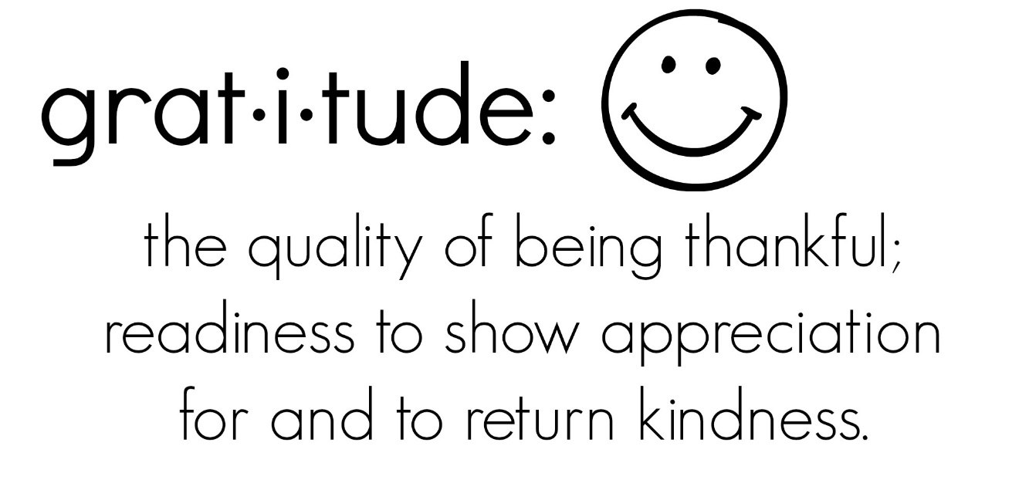
This game lets us share our gratitude towards our classmates, it also allows us to celebrate our individual strengths and shows us that we are appreciated within the class.
We all have different skills and are all good at different things! We should celebrate these!

Slide 7
When times are hard and things get difficult it is important to remember what we are thankful for.
Practising gratitude means you are regularly thinking about all the things you are grateful for in your life.
Practising gratitude can improve our mental health (how we feel on the inside).
For example:
I am grateful for the time I spent with my family during lockdown.
I am grateful for sunny days.

Slide 8
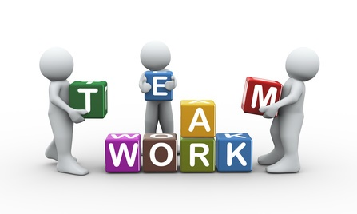
Now we are going to learn a new skill!
Learning new skills can help us to connect with others and also raise our confidence and self esteem.

Slide 9
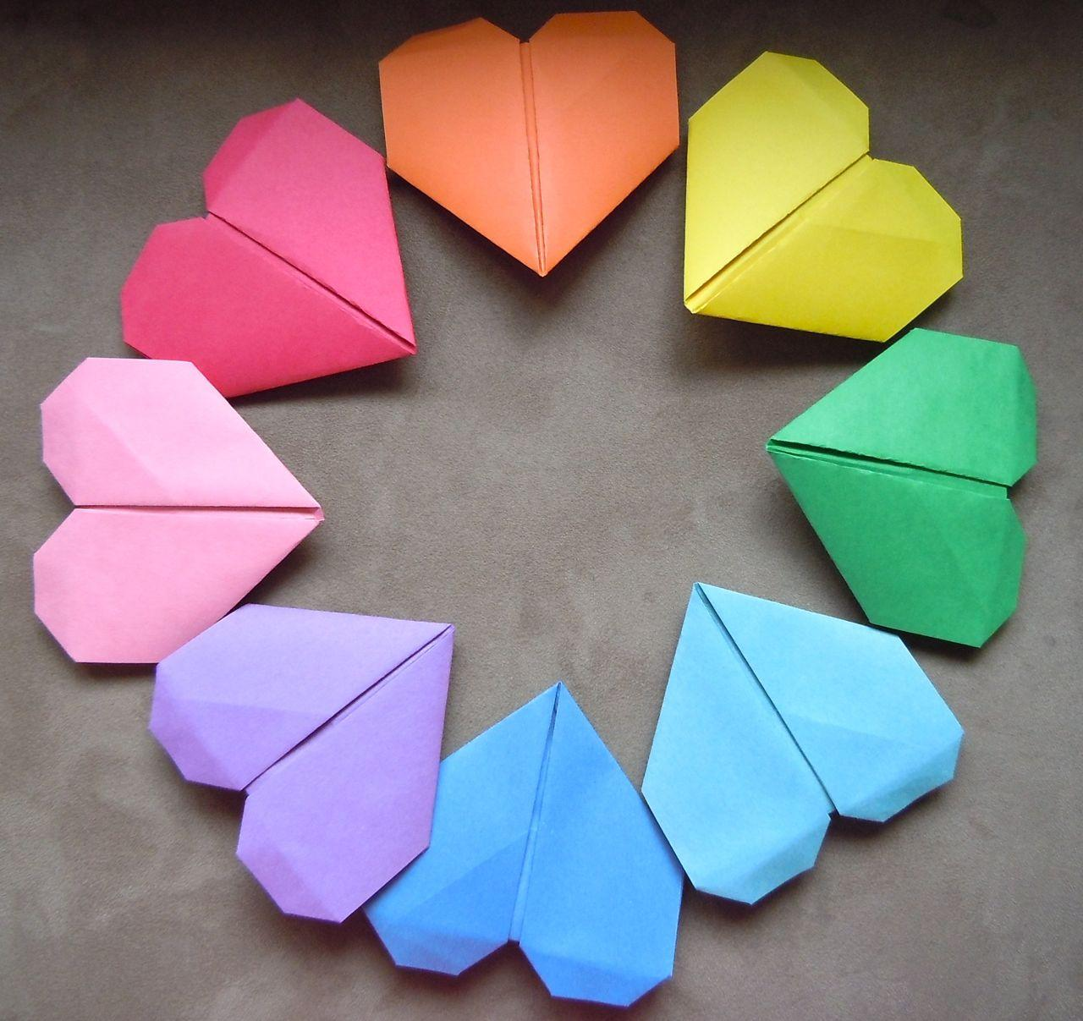
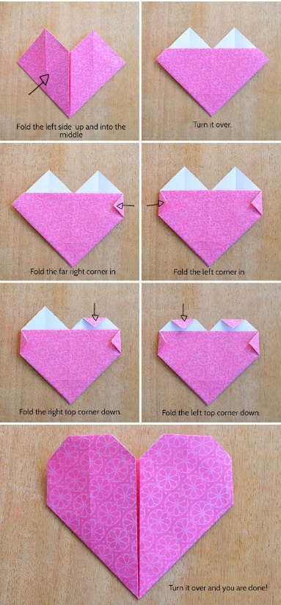
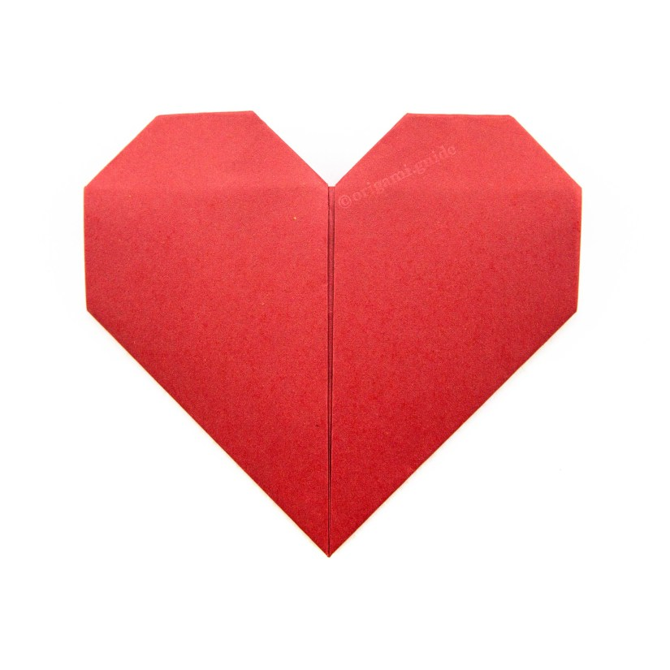
We are going to learn how to make an origami heart.
Before we start, it is important for us to remember that sometimes we will find tasks a little tricky, but the most important thing is that we try our best!

Slide 10
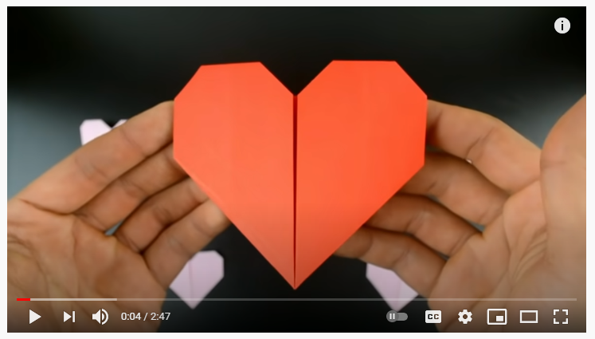
https://www.youtube.com/watch?v=Z-BIL6p1Te8
Follow along with the YouTube video!

Slide 11
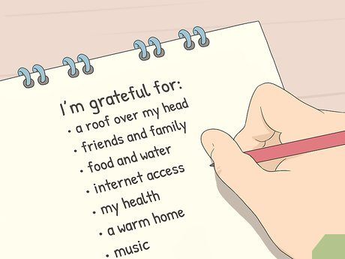
Everyone is unique and special, we learnt from our game a the beginning that we all have different strengths!
On one half write a STRENGTH that you have
I am a good friend.
I am good at helping others.
I am kind.
On one half write something you are GRATEFUL for
I am grateful for my friends.
I am grateful for my family.

Slide 12


