Slide 1
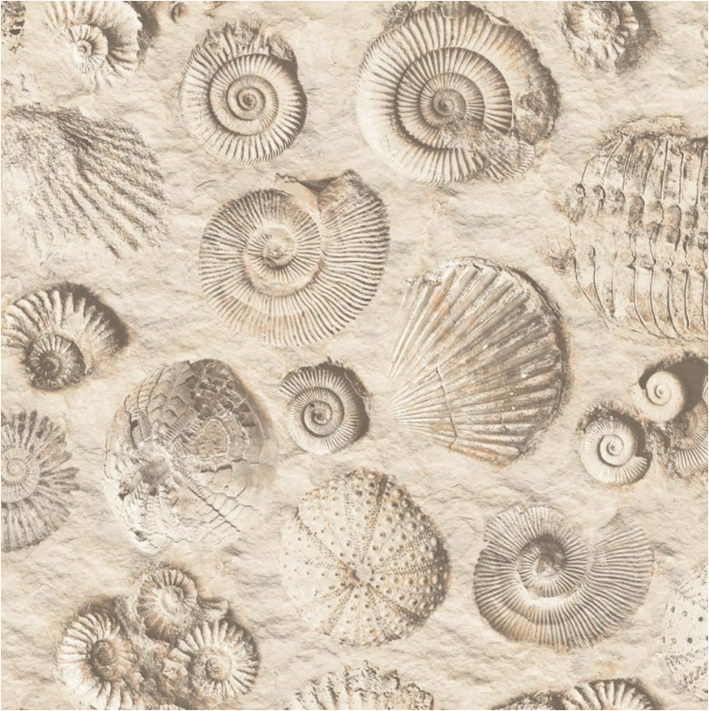
How are
dinosaur fossils
made?

Slide 2
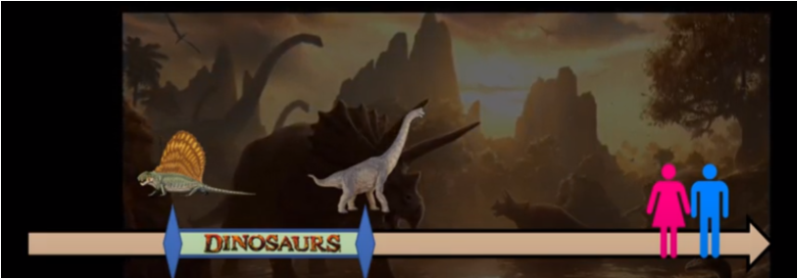
Dinosaurs lived for 155 million years and died out 62.5 million years before the Stone Age began. They lived for a much longer period that humans have.
Stone Age
2.5 million years ago
220 million years ago
65 million years ago

Slide 3
We know a lot about dinosaurs from clues left behind (these are called historical sources). Using fossils, paleontologists like Mary Anning uncovered different species of dinosaurs and worked out how they used to live.

Slide 4
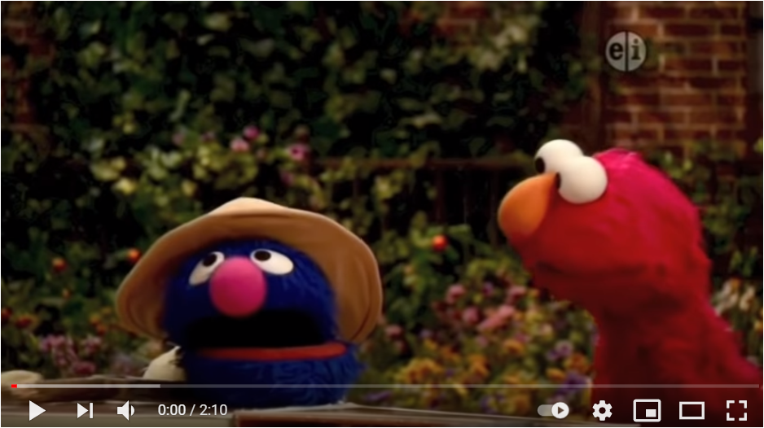
Listen to the Muppets Paleontologist song!
https://www.youtube.com/watch?v=vsx0gn8iTzg&feature=emb_logo

Slide 5
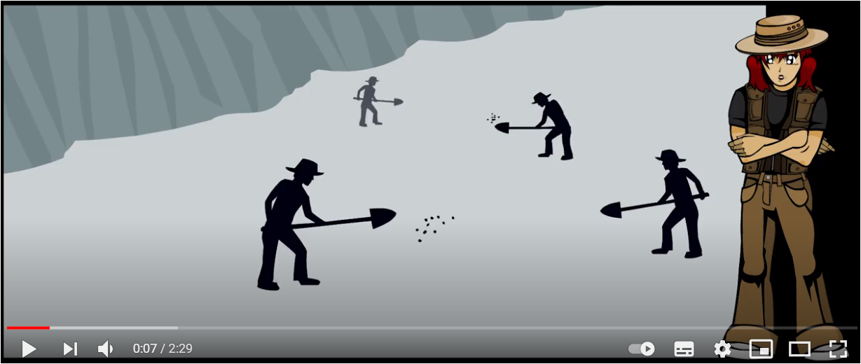
What do paleontologist do?
https://www.youtube.com/watch?v=wkXmdslDGe8&feature=emb_logo

Slide 6
Your challenge is to create your own fossil!!

Slide 7
There are different challenges to choose from.
Please use your own ideas and imagination, you don’t have to use the exact resources in the video!
You can use biscuits to show how the layers of rock create pressure and turn skeletons into fossils.
You can use layers of jelly to show how fossils formed in the ground.
You can create your own rock using ground coffee, salt, flour and sand and excavate the fossil.

Slide 8
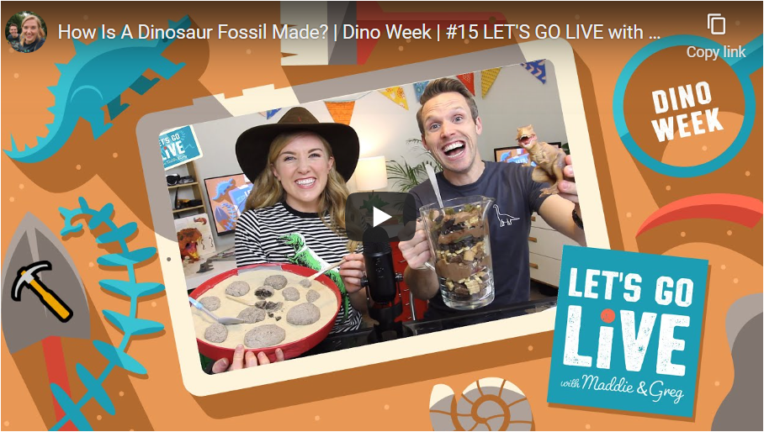
To do this you will need to watch the “Let’s Go Live” lesson which will show you exactly what you need to do.
https://letsgolivescience.com/activity/how-is-a-fossil-made-using-biscuit-layers/

Slide 9
Have fun making your fossil!
Once you’ve made your fossil take a picture and send it to your teacher.

