Slide 1
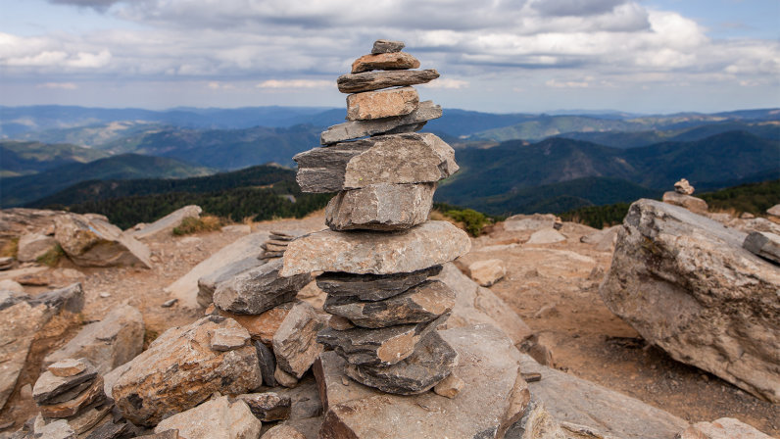
Rocks

Slide 2
This half term you will become geologists.
Geologists are scientists that study what makes up the Earth. We will be focusing on rocks.

Slide 3
L.O. I am learning to compare and group together different kinds of rocks.

Slide 4
What is a rock?
Rock is a hard material made up of one or more minerals. Rock makes up the outer layer of Earth, called the crust. The lower parts of this layer are solid rock, or bedrock. Broken bits of rock lie on top. The tiniest bits of rock make up sand and soil. Rocks are naturally occurring and not man-made, although they can be shaped by humans and used for difference purposes.

Slide 5
Do you know any famous rocks?

Slide 6
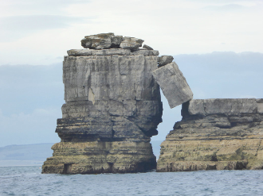
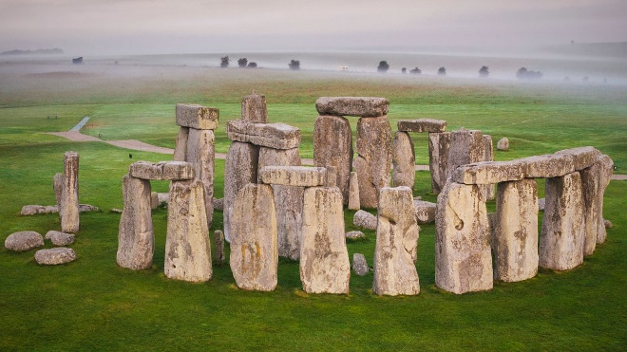
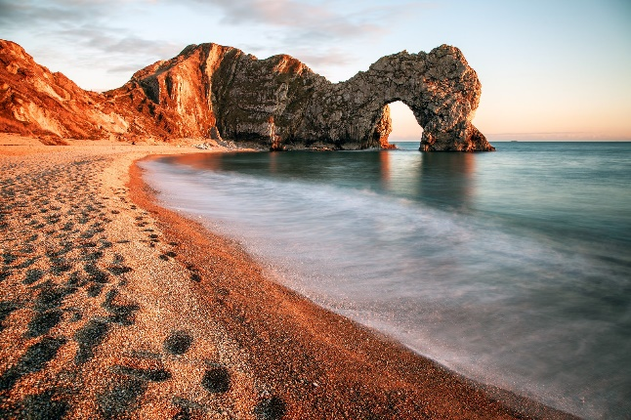
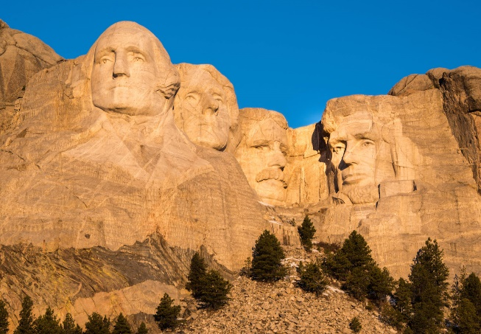
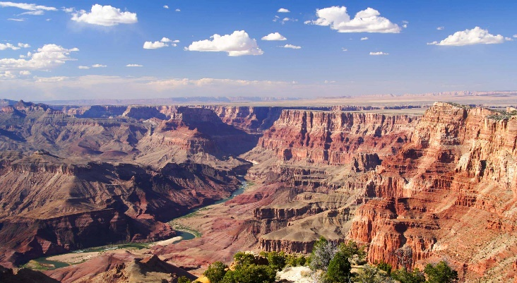
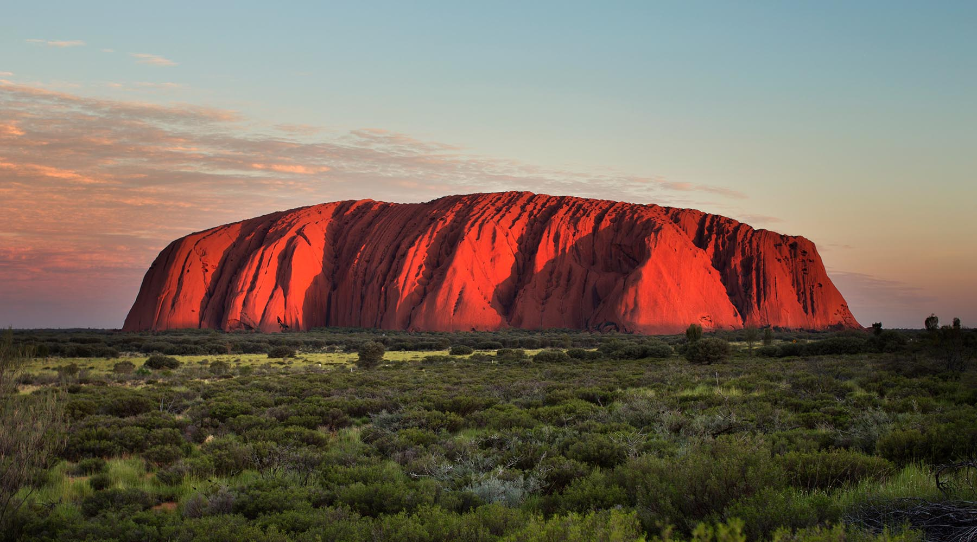
Pulpit Rock, Portland Bill, Dorset
Stonehenge,
Wiltshire
Durdle Door,
Dorset
Mount Rushmore,
South Dakota, USA
Uluru (Ayers Rock), Australia
Grand Canyon,
Arizona, USA

Slide 7
Rocks come in all shapes and sizes.
What types of rock do you know?

Slide 8
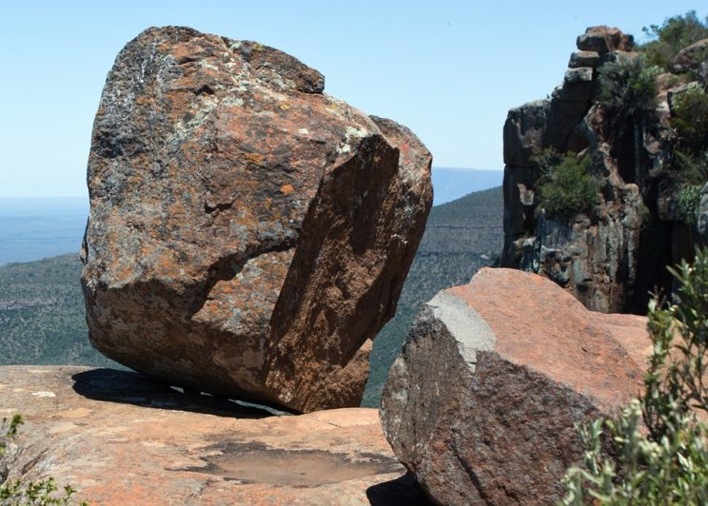
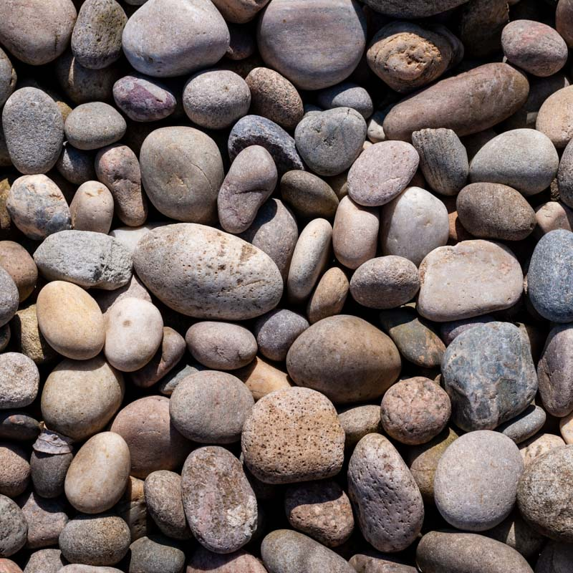
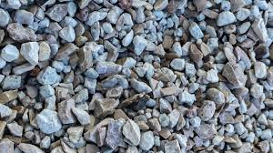
Boulder (a large rock)
Pebble (a small rock that has been made smooth by water or wind)
Stone (smaller and rougher than a pebble)

Slide 9
However, vocabulary like boulder, pebble and stone are not scientific enough for geologists.
They needs words that are more specific to the type of rock so they can group them in ways that allow them to study their similarities and differences carefully.

Slide 10
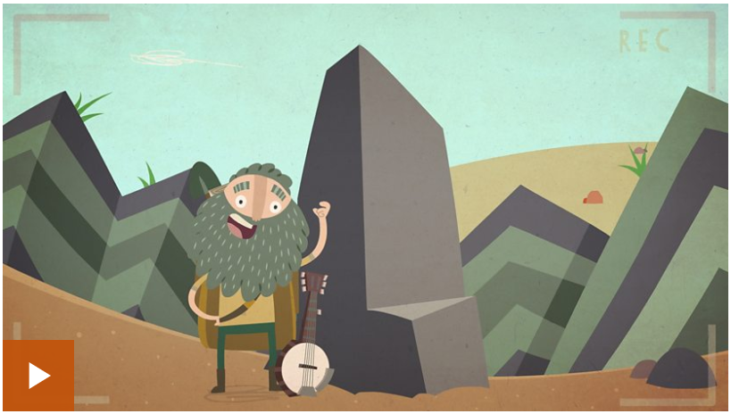
What is a rock?
Click on the picture to find out more. Watch the clip, read the information and complete the quizzes.

Slide 11
How can we tell the difference between sedimentary, igneous and metamorphic rocks?
What clues could we look for to help?

Slide 12
Sedimentary Rocks
Sedimentary rock is often found in layers. One way to tell if a rock sample is sedimentary is to see if it is made from grains. Some samples of sedimentary rocks include limestone, sandstone, coal and shale.

Slide 13
Igneous Rocks
Igneous rocks form when magma from inside the Earth moves toward the surface, or is forced above the Earth’s surface as lava and ash by a volcano. Here it cools and crystallizes into rock. Look for crystals scattered throughout igneous rocks. Examples of igneous rocks are gabbro, granite, pumice and obsidian.

Slide 14
Metamorphic Rocks
Metamorphic rocks are rocks that have become changed by intense heat or pressure while forming. One way to tell if a rock sample is metamorphic is to see if the crystals within it are arranged in bands. Examples of metamorphic rocks are marble, schist, gneiss, and slate.

Slide 15
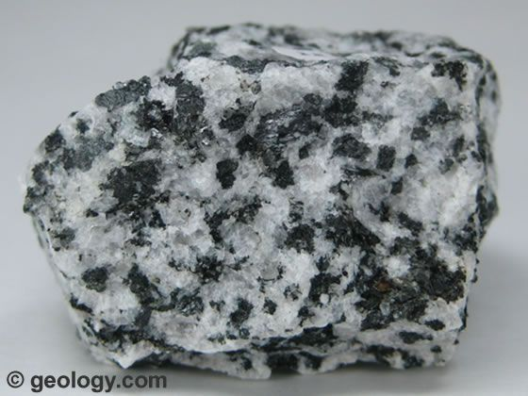
What type of rock is this?
Sedimentary, igneous or metamorphic?

Slide 16
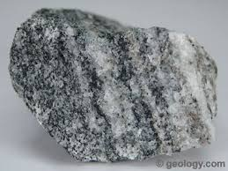
What type of rock is this?
Sedimentary, igneous or metamorphic?

Slide 17
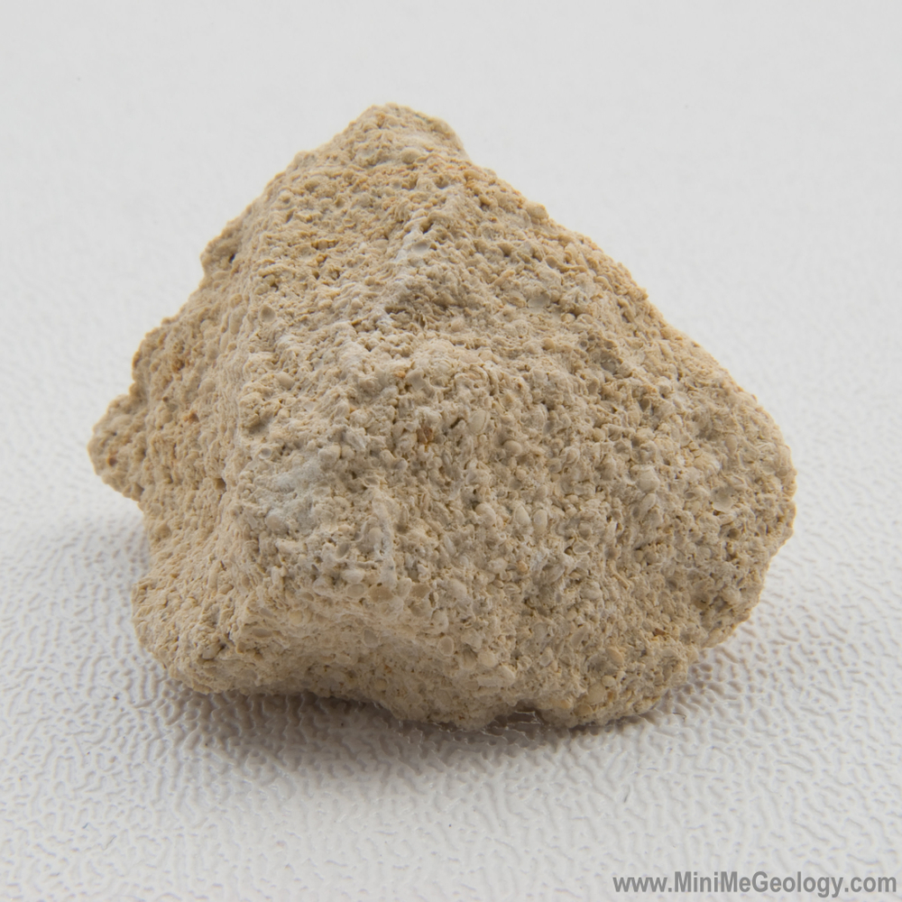
What type of rock is this?
Sedimentary, igneous or metamorphic?

Slide 18
Igneous rock
Scattered crystals

Slide 19
Metamorphic rock
Layered crystals

Slide 20
Sedimentary rock
Grains

Slide 21
Your task, if you can, is to collect some rocks and sort them into groups. These can just be tiny pebbles you find in your garden or if you go out for a walk for exercise in your local area.
You can sort them however you like: size, shape, colour or type (it is unlikely you will find all types of rocks locally). Studying the rocks you find closely and looking at their features, makes you a geologist!

