Slide 1
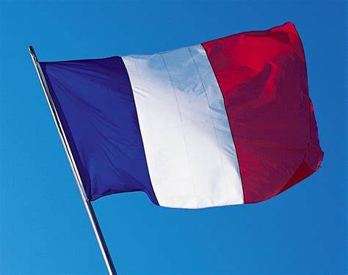
FRENCH

Slide 2
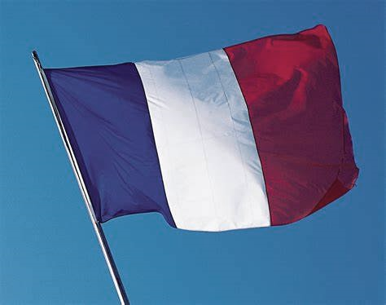




Slide 3

Va-t’en-grand monstre vert
https://www.youtube.com/watch?v=BwGzcbsaPyA

Slide 4
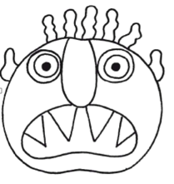
What have you learnt about the monster?
La tête est rouge.
Les yeux son jaunes.
Les dents sont verts.
Le nez est violet.
Les cheveux sont noirs.
La bouche est orange.
Les oreilles sont roses.
Notes:
Consolidation reading activity.
More able pupils could do their own monster face and describe it for a partner to colour.

Slide 5
Choose your task:
1) Create your own monster. Describe it in French!
2) Read and colour the monster.

Slide 6
Well done!
You have learnt to apply your French knowledge.

