Slide 1

FRENCH

Slide 2




Slide 3

la t___ t ___
les __p ___ ___ l ___ s
le b r ___ s
le c ___ ___d ___
la m ___ ___n
le d ___ ___gt
la j ___ mb___
le g ___ n ___ ___
le p ___ ___ d
l’ ___ s t ___ m ___ c
Notes:
Elicit the words and listen back to check.

Slide 4
la tete
les epaules
le bras
le coude
la main
le doigt
la jambe
le genou
le pied
l’ estpmac
Notes:
Elicit the words and listen back to check.

Slide 5
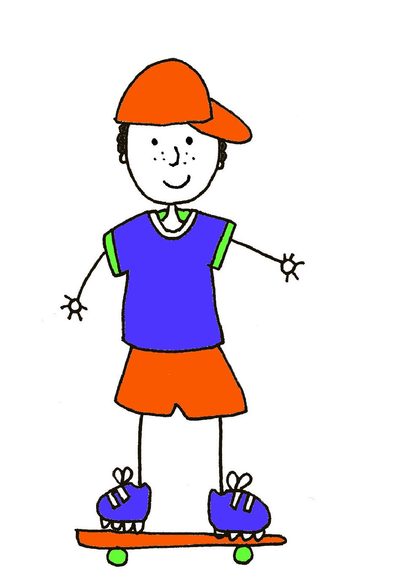
Le corps – how many labels can you remember?
1
2
4
3
5
6
7
8
9
10
Notes:
Ask pupils to name the parts of the body. The words do not come up – the coloured numbers give the gender clue.
1 = la tête
2 = les épaules (f)
3 = le bras
4 = le coude
5 = la main
6 = le doigt
7 = la jambe
8 = le genou
9 = l’estomac
10 = le pied

Slide 6

Va-t’en-grand monstre vert
https://www.youtube.com/watch?v=BwGzcbsaPyA
https://www.youtube.com/watch?v=0EFXCdryyRM

