Slide 1
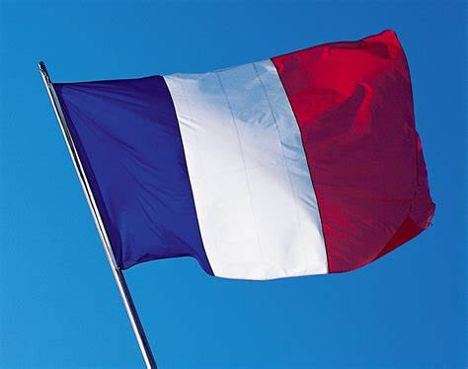
FRENCH

Slide 2
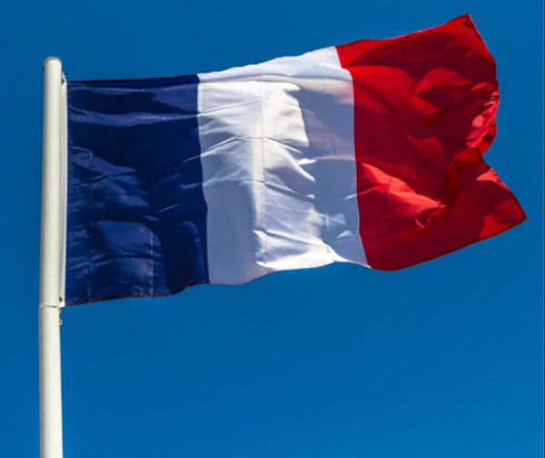




REVISIT
Click clock to open timer
1 minute to say numbers 1-10 in French
.
1 minute to hear your partner to say the numbers.
1 minute to say them again together.

Slide 3
LO: I am learning about singular
and plural nouns in French

Slide 4
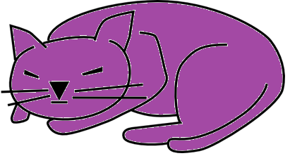
“Singular” sounds like single.
It means there is one.
Un chat
A cat
Le chat
The cat

Slide 5
“Plural”
It means there are more than one.
Des chats
Cats
Les chats
The cats

Slide 6

We need singular and plural nouds to make our sentences make sense
“A cats is missing”

Slide 7

Class work
On the next slide click on the words.
Listen carefully.
Repeat after each word.

Slide 8
In French, they have these words:
Singulier
Pluriel
un
une
le
la
(a)
(the)
des
des
les
les
(some)
(the)

Slide 9
Select the correct determiner for this picture. Remember French nouns can be feminine or masculine.
un
une
le
la
“Tant pis” – means “bad luck”

Slide 10
Translate the English
some cats =
des
chats
the cats =
les
chats

Slide 11
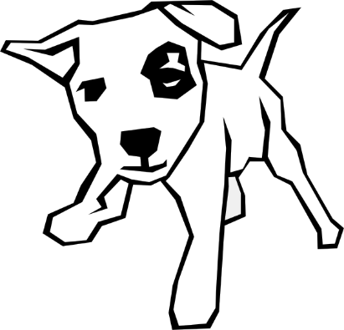
Select the correct determiner for this picture.
un
une
le
la
“Tant pis” – means “bad luck”

Slide 12
Translate the English
some dogs =
des
chiens
the dogs =
les
chiens

Slide 13

Select the correct determiner for this picture.
un
une
le
la
“Tant pis” – means “bad luck”

Slide 14
Translate the English
some fish =
des
poissons
the fish =
les
poissons

Slide 15

Select the correct determiner for this picture.
un
une
le
la
“Tant pis” – means “bad luck”

Slide 16
Translate the English
some ducks =
des
canards
the ducks =
les
canards

Slide 17
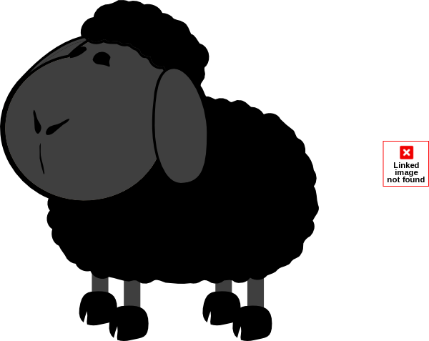
Select the correct determiner for this picture.
un
une
le
la
“Tant pis” – means “bad luck”

Slide 18
Translate the English
some sheep =
des
moutons
the sheep =
les
moutons

Slide 19
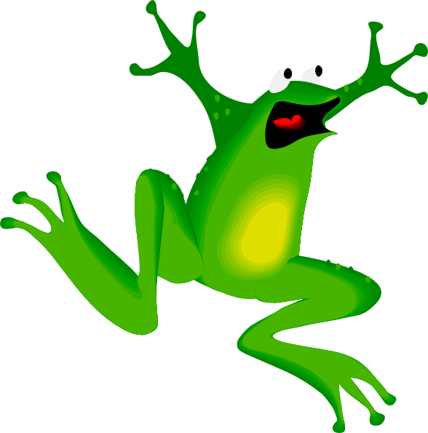
Select the correct determiner for this picture.
un
une
le
la
“Tant pis” – means “bad luck”

Slide 20
Translate the English
some frogs =
des
grenouilles
the frogs =
les
grenouilles

Slide 21

Select the correct determiner for this picture.
un
une
l’
la
“Tant pis” – means “bad luck”

Slide 22
Translate the English
some bears =
des
ours
the bears =
les
ours

Slide 23

Select the correct determiner for this picture.
un
une
l’
la
“Tant pis” – means “bad luck”

Slide 24
Translate the English
some birds =
des
oiseaux
the birds =
les
oiseaux

Slide 25
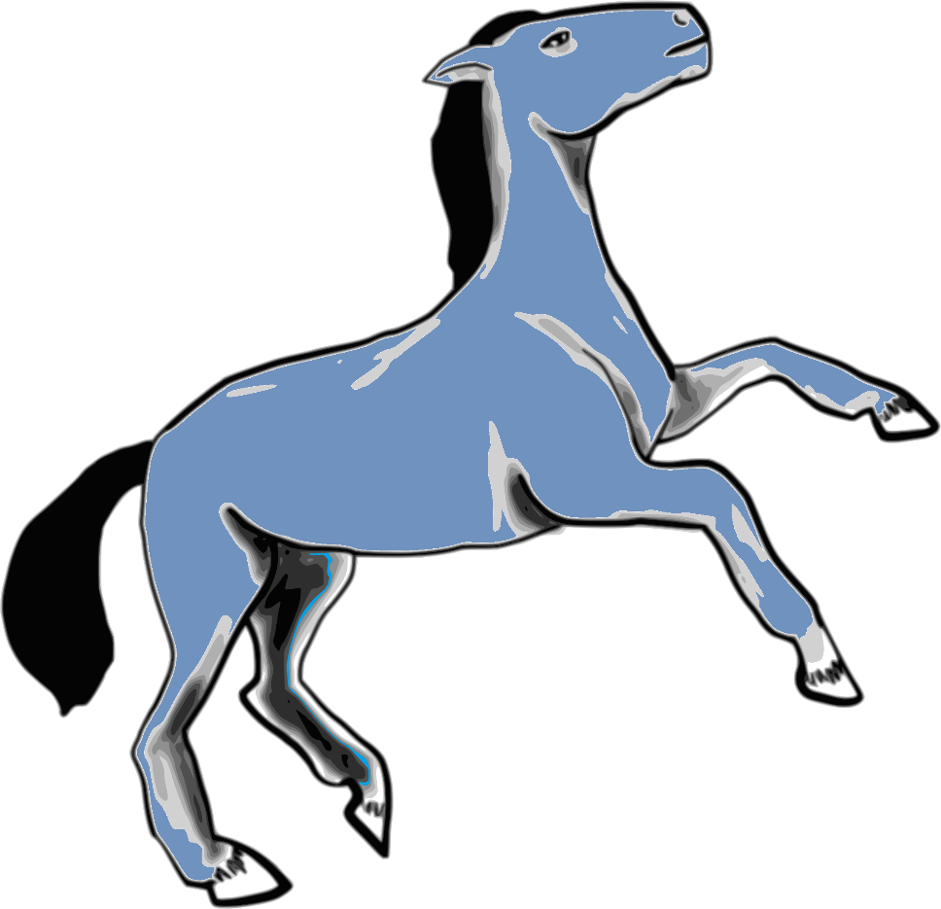
Select the correct determiner for this picture.
un
une
le
la
“Tant pis” – means “bad luck”

Slide 26


Translate the English
some horses =
des
chevaux
the horses =
les
chevaux

Slide 27
Click on the number to hear the French, then translate it into English
Comment dit-on en anglais…?
1
some ducks
des canards =
la grenouille =
les moutons =
les chevaux =
un chien =
2
the frog
3
the sheep
(more than one)
4
the horses
5
a dog

Slide 28
Click on the number to hear the French, then translate it into English
Comment dit-on en anglais…?
6
des oiseaux =
le chat =
un poisson rouge =
les ours =
un mouton =
some birds
7
the cat
8
a goldfish
9
the bears
10
a sheep

Slide 29
Click on the number to hear the French, then translate it into English
Comment dit-on en anglais…?
11
un canard =
des chats =
l’oiseau =
les chiens =
le cheval =
a duck
12
some cats
13
the bird
14
the dogs
15
the horse

Slide 30
Well done!
You have learnt about singular and plural words in French.

