Slide 1
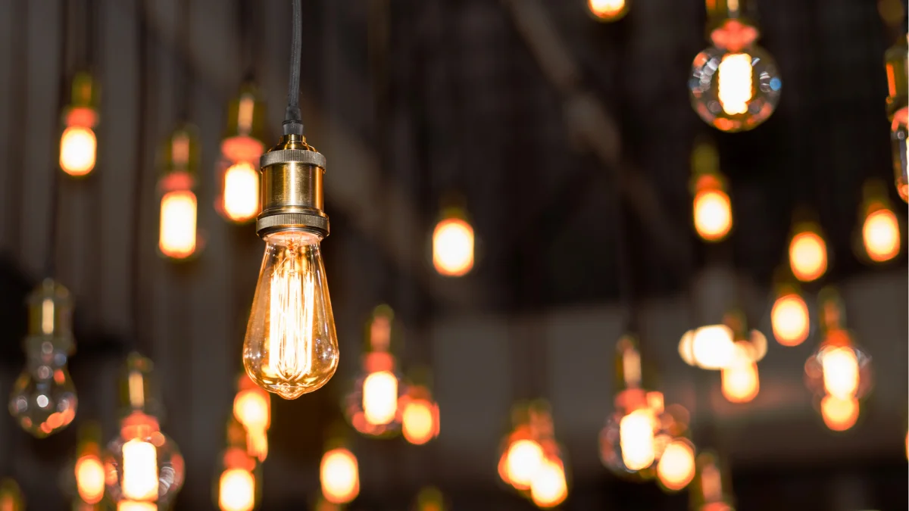
Year 3
Light

Slide 2
Today you will be creating your own moving shadow show to show everything you have learned about light.

Slide 3
What do you know about light?

Slide 4

You have learned all of these things about light this half term:
You need light to be able see things
Dark is the absence of light
Light is reflected from surfaces
Light from the sun can be dangerous and that there are ways to protect your eyes
Shadows are formed when the light from a light source is blocked by an opaque object
There are patterns in the way that the size of shadows change.

Slide 5
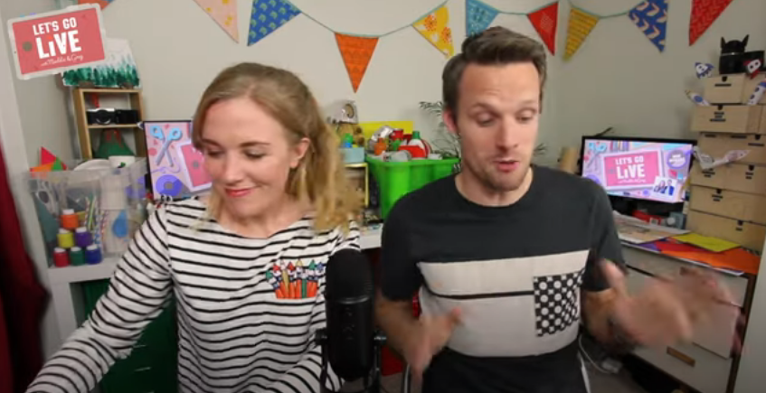
Click on the picture to finish watching Let’s Go Live to see another way of using shadows.
You can skip to start at 16:50 and then stop the video at 24:40.

Slide 6
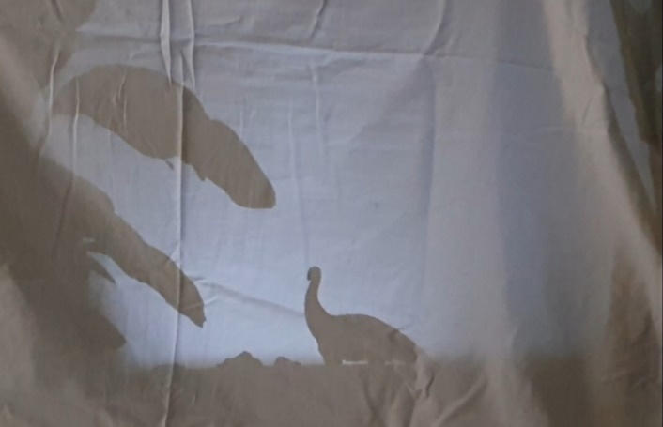
Your job today is to use what you have learned to create your own moving shadow puppet show. You can create a story of whatever you like and can either cut out puppet shapes or just use toys. If you are struggling with ideas, think about some of the books we have read this year and you can use one of their stories, or you could create a sun safety information show.
You don’t have to make a box theatre, a sheet draped over two chairs works just as well (or any other genius ideas you can think of!).
Challenges: Can you change the size of your shadow in parts of your show?
Can you mention or show some of the light facts you have learned?
This is a sheet hung over some chairs, a plant and a toy dinosaur.

