Slide 1
We are going to be learning all about nouns, verbs and adjectives.

Slide 2
Game of Scattergories – nouns starting with the letter B.
Gifts starting with B?
Things you find at a party starting with the letter B?
Breakfast foods starting with B?
Board game
Balloons
Bacon / bread

Slide 3
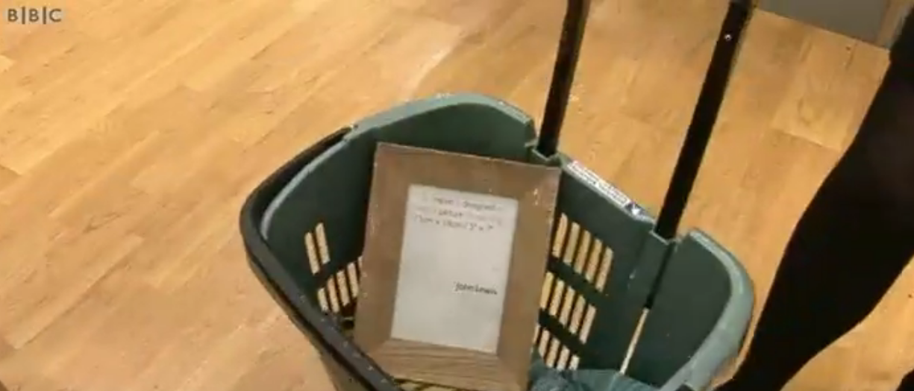
Watch this video about nouns.
https://www.bbc.co.uk/teach/skillswise/nouns/zb4jgwx

Slide 4
In a nutshell
Common nouns
These are the names of things (places or objects)
Proper nouns
These are names of a particular person, place or thing. They always begin with a capital letter.
Mr Phillips is a human and lives in a house.
Mr Phillips is a proper noun and human and house are common nouns.

Slide 5
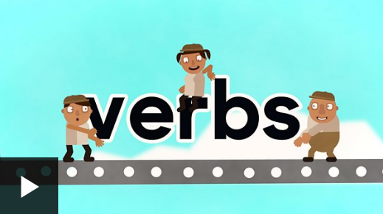
Watch this video all about verbs.
https://www.bbc.co.uk/bitesize/topics/zrqqtfr/articles/zpxhdxs#:~:text=A%20verb%20is%20a%20word,of%20being%2C%20that's%20feeling%20something.

Slide 6
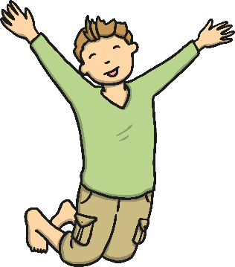

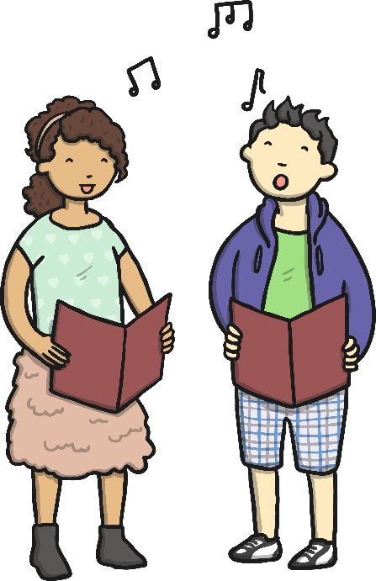

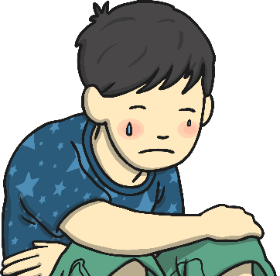
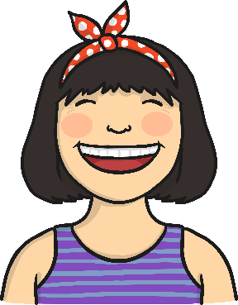
In a nutshell
A verb is a word used to describe an action. They describe what someone is doing.
Jump
Clap
Sing
Cry
Laugh

Slide 7
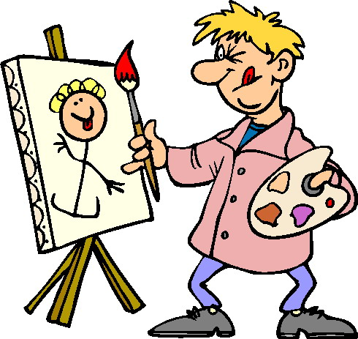
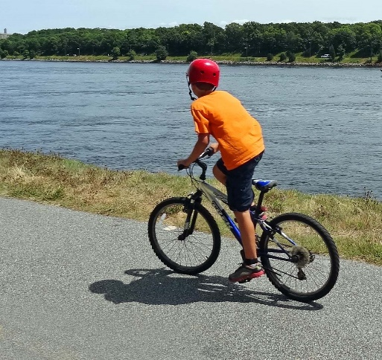
Can you spot the verb in this sentence?
Tom painted his picture.
Annie brushed her hair.
Neena swam without arm bands.
Ben rode his bike to school.

Slide 8

I have collected these words but can you sort them for me? (Click once you have worked them out)
Jump
Hide
Walk
Shoe
Car
Box
Door
Laugh
Verbs
Nouns
Jump
Walk
Box
Shoe
Hide
Laugh
Door
Car

Slide 9
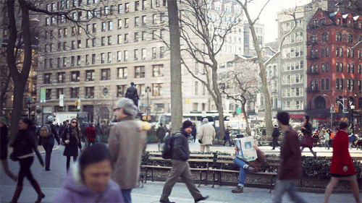
Challenge:
Can you create your own sentence using a noun and a verb.
Do not forget to use your full stops and capital letters.
Here is an image if you cannot think of any ideas.

