Slide 1
Capital letters and Full Stops

Slide 2
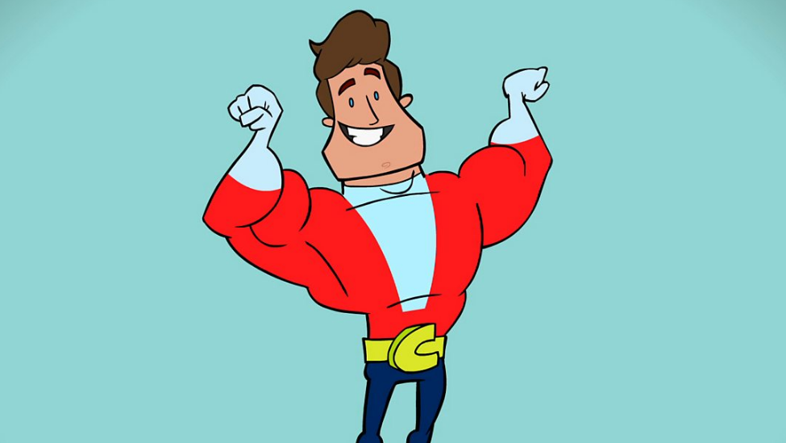
Watch this video on Capital Letters
https://www.bbc.co.uk/teach/class-clips-video/english-ks1--ks2-where-do-you-put-capital-letters/zkbhf4j

Slide 3
Which of the following do we need capital letters for? Colour them in.
Names of places
All nouns
Start of a sentence
The pronoun I
Names of countries
Names of people

Slide 4
Zara has forgotten to use capital letters in her writing. Can you rewrite her sentence?
i had a coffee this morning at my table and the coffee beans were from africa.

Slide 5
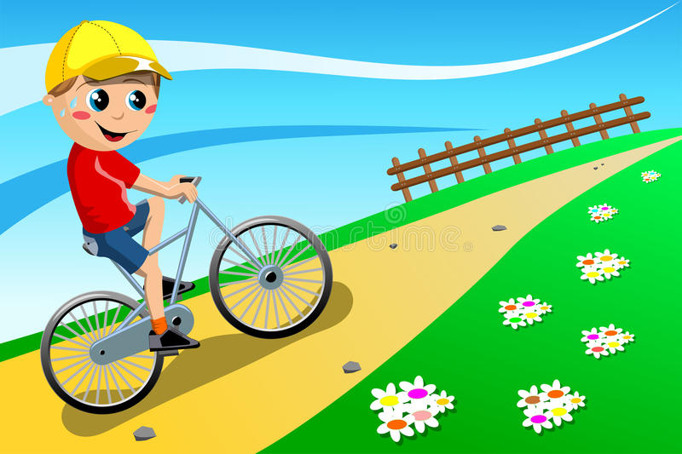
Can you write your own sentence using capital letters? Use the picture to help you.

Slide 6

Watch this video about full stops.
https://www.youtube.com/watch?v=IrqiehzpcTg&feature=emb_logo

Slide 7
The words in this sentence have been mixed around. Can you fix it?
bike The went down hill. the
Did you get it correct?
The bike went down the hill.

Slide 8
Can you spot the mistake?
We saw a black. Cat
Did you get it correct?
We saw a black cat.

Slide 9
Can you write your own sentence using a full stop? Use the picture to help you.

