Slide 1
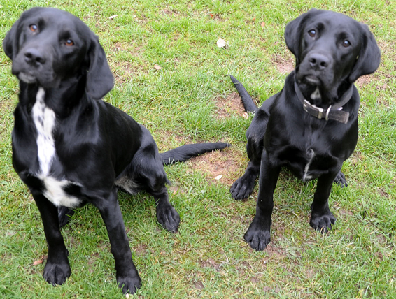
Apostrophes for contractions and
Apostrophes for possession
Apostrophes
Let’s revise what we know…

Slide 2
Apostrophes for Contractions
I’m
it’s
couldn’t
can’t
hasn’t
I’ll
don’t

Slide 3
Apostrophes are used to show contractions
Contractions are formed when letters are missed out.
I am | I’m
cannot | can’t
do not | don’t
it is | it’s
Can you spot which letters have been removed?

Slide 4
Apostrophes are used to show contractions
Contractions are formed when letters are missed out.
I am | I’m
cannot | can’t
do not | don’t
it is | it’s
Can you spot which letters have been removed?

Slide 5
Apostrophes are used to show contractions
Contractions are formed when letters are missed out.
I am | I’m | a
cannot | can’t | n & o
do not | don’t | o
it is | it’s | i
The apostrophe stands in the place of the missing letters.
Can you spot which letters have been removed?

Slide 6
ANSWERS
Contractions
I’m
it is
can’t
I am
Match the contractions to the words with the same meaning.
don’t
cannot
won’t
did not
didn’t
would not
it’s
do not

Slide 7
ANSWERS
Contractions
I’m
it is
can’t
I am
don’t
cannot
won’t
did not
didn’t
would not
it’s
do not

Slide 8
plural – s and possessive - ‘s
Apostrophes for possession
Now let’s agree the difference between…

Slide 9
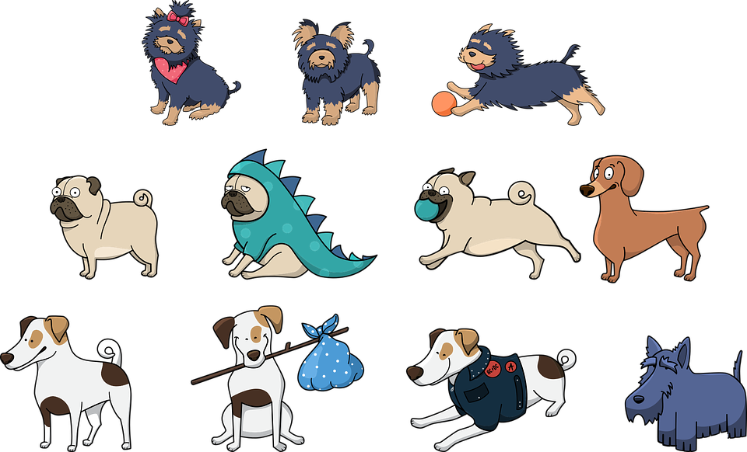
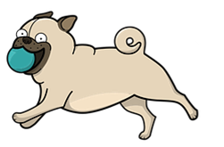
Plural - s
A noun names a person, place, idea, thing or feeling.
Rover
kennel
dog
fear
There are two Rovers at the vets.
All the kennels I saw were disgusting.
The dogs ran across the meadows.
My fears are all to do with big, scary wolves!
If there is more than one of the noun we say it is plural.
We show a noun is plural by adding an s.

Slide 10
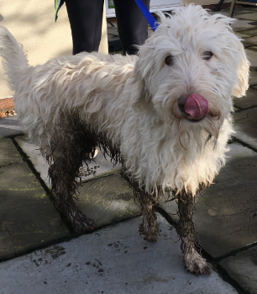
Possessive – ‘s
To show possession we add ‘s to the end of the noun.
Rover
kennel
dog
wolf
Rover’s lead has been lost.
The kennel’s floor is filthy!
The dog’s face is pleading.
The wolf’s howl was terrifying.
Possession means that something is owned by the noun.
The ‘s goes at the end of the noun.

Slide 11
Plural -s and possessive - ‘s

Six dogs raced across the meadow.
Six dog’s raced across the meadow.
Plural
- add s
The cats leg was broken.
The cat’s leg was broken.
Possessive
- add ‘s

Which sentence is correct?

Slide 12
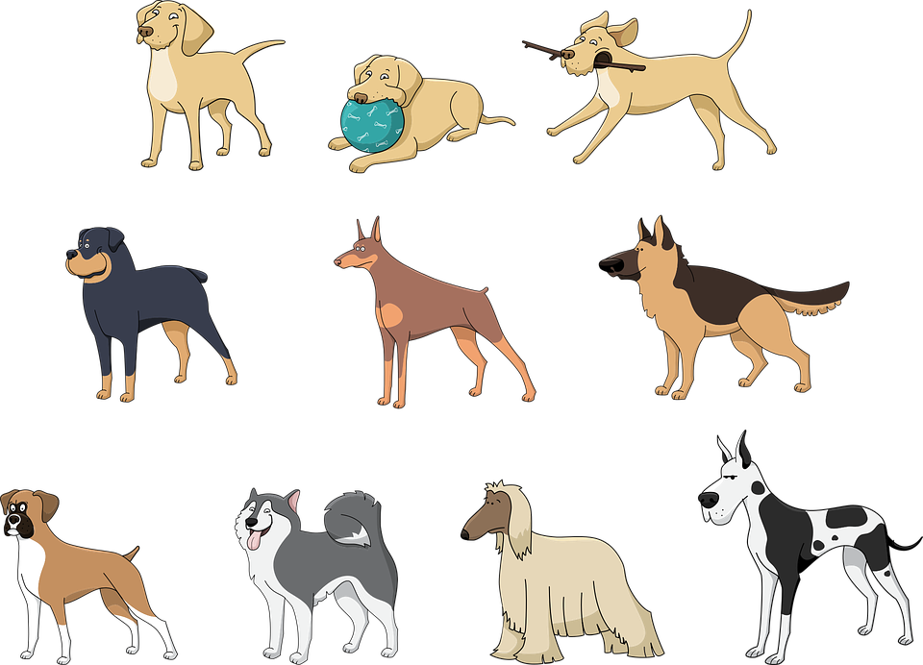

Apostrophes
Marking Plural Possession

Slide 13

Possessive - s
To show possession we add ‘s to the end of the noun.
hound
farmer
vet
dog
the hound’s pawprints
the farmer’s field
the vet’s desk
the dog’s ball
The ‘s goes at the end of the noun.
But what happens if the noun already ends in s?

Slide 14

Plural Possessive - s
If the noun already ends in s because it is plural…
add ’ to the end of that noun.
The ’ goes at the end of the noun.
hounds
farmers
vets
dogs
the hounds’ baying at the moon
the farmers’ market
the vets’ consulting rooms
the dogs’ ball
If we added another s to a plural noun it would be hard to say!

Slide 15
ANSWERS
Plural Possessive - s
The dogs’ home was funded by charity.
The dog’s home was funded by charity.
The home which belonged to one dog was funded by charity.
The home which belonged to all of the dogs was funded by charity.
The cat lurked under the bird’s table.
The cat lurked under the birds’ table.
The table which belonged to one bird had a cat lurking underneath.
The table which belonged to the garden birds had a cat lurking underneath.
Match the punctuation to the description.

Slide 16


Explore more Hamilton Trust Learning Materials at https://wrht.org.uk/hamilton/ .

