Slide 1

FRENCH

Slide 2

Today you will use your knowledge of the body parts to complete a task.

Slide 3



On the next slide you will see the parts of the body your learnt last lesson.
Listen carefully.
Repeat after each word.
How many do you remember?

Slide 4
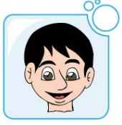
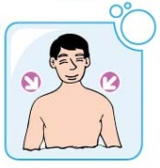
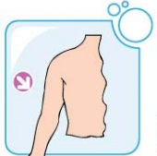
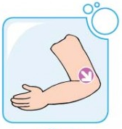
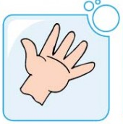
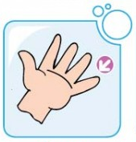
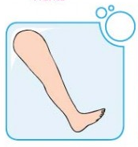
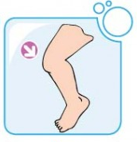
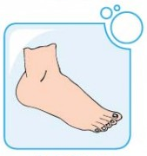
1 | 2 | 3
4 | 5 | 6
7 | 8 | 9
la tête
les épaules
le bras
le coude
la main
le doigt
la jambe
le genou
le pied

Slide 5

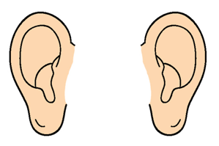

Slide 6
Now sing the song from last lesson.

Slide 7
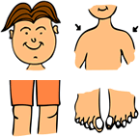
https://www.youtube.com/watch?time_continue=16&v=vRrN8FwBLXo
tête épaules genoux pieds
genoux pieds
tête épaules genoux pieds
genoux pieds
les yeux les oreilles la bouche et le nez
tête épaules genoux pieds
genoux pieds
Notes:
To the tune of Heads Shoulders Knees and Toes
Next slide has only the picture prompts
https://www.youtube.com/watch?time_continue=16&v=vRrN8FwBLXo

Slide 8
Challenge: can you sing the song without the words and using just the pictures on the next slide?

Slide 9

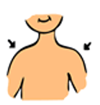
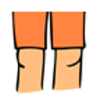
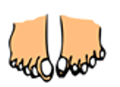
Notes:
Sing from just the pictures, doing the gestures too.

Slide 10
Task: Using what you have learnt, label the picture.
Take care to spell the words in French correctly.

Slide 11
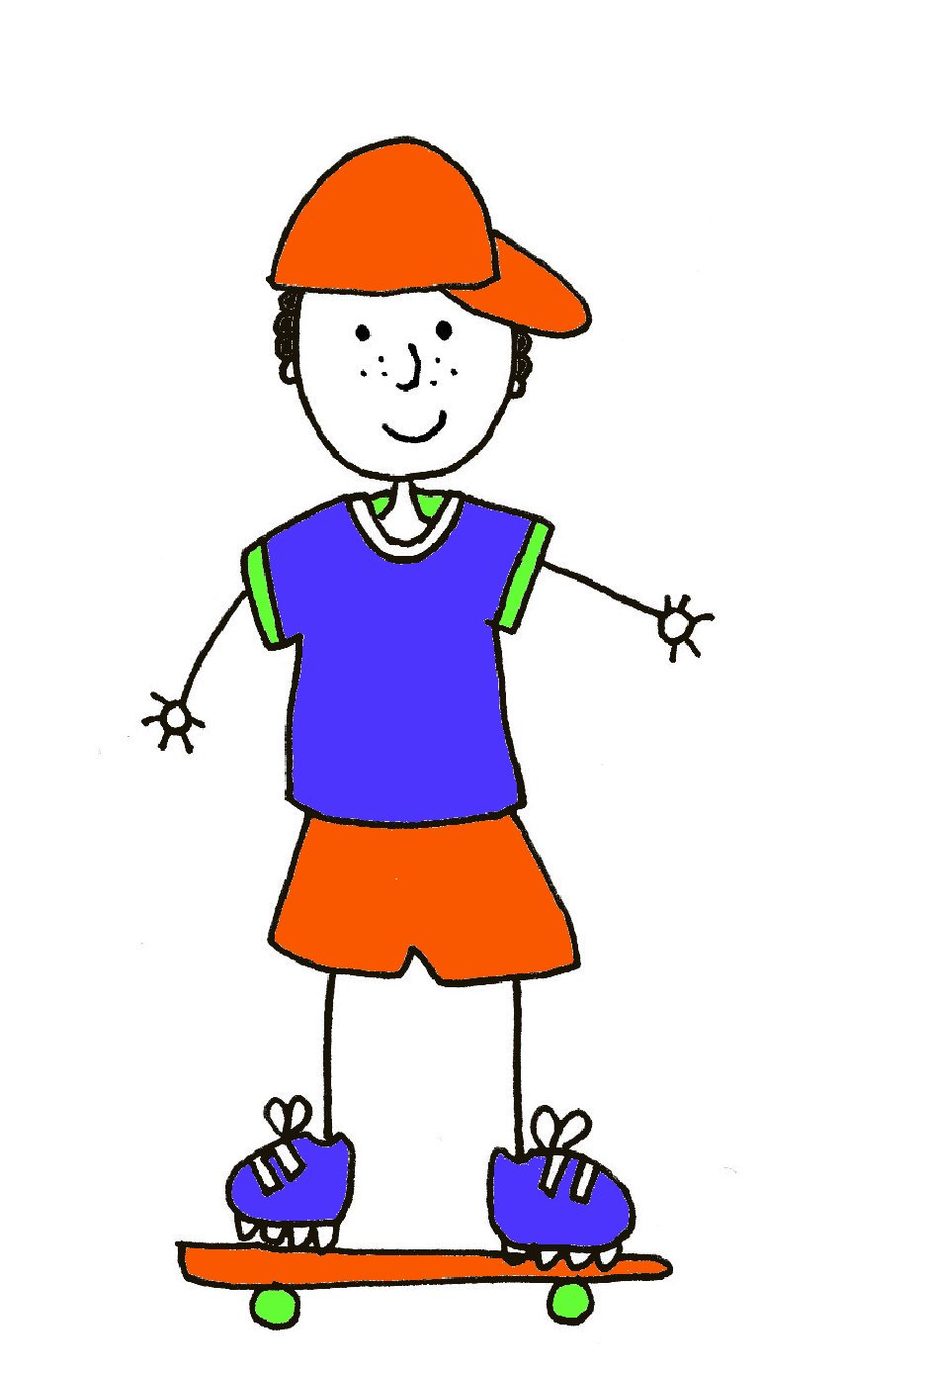
Le corps
Notes:
Just a slide to model what pupils will be learning in this lesson.
Teacher can gesture at the whole body and say ‘le corps’
and then reinforce ‘les parties du corps’ by pointing at the empty boxes and the different arrows pointing to different body parts.

