Slide 1
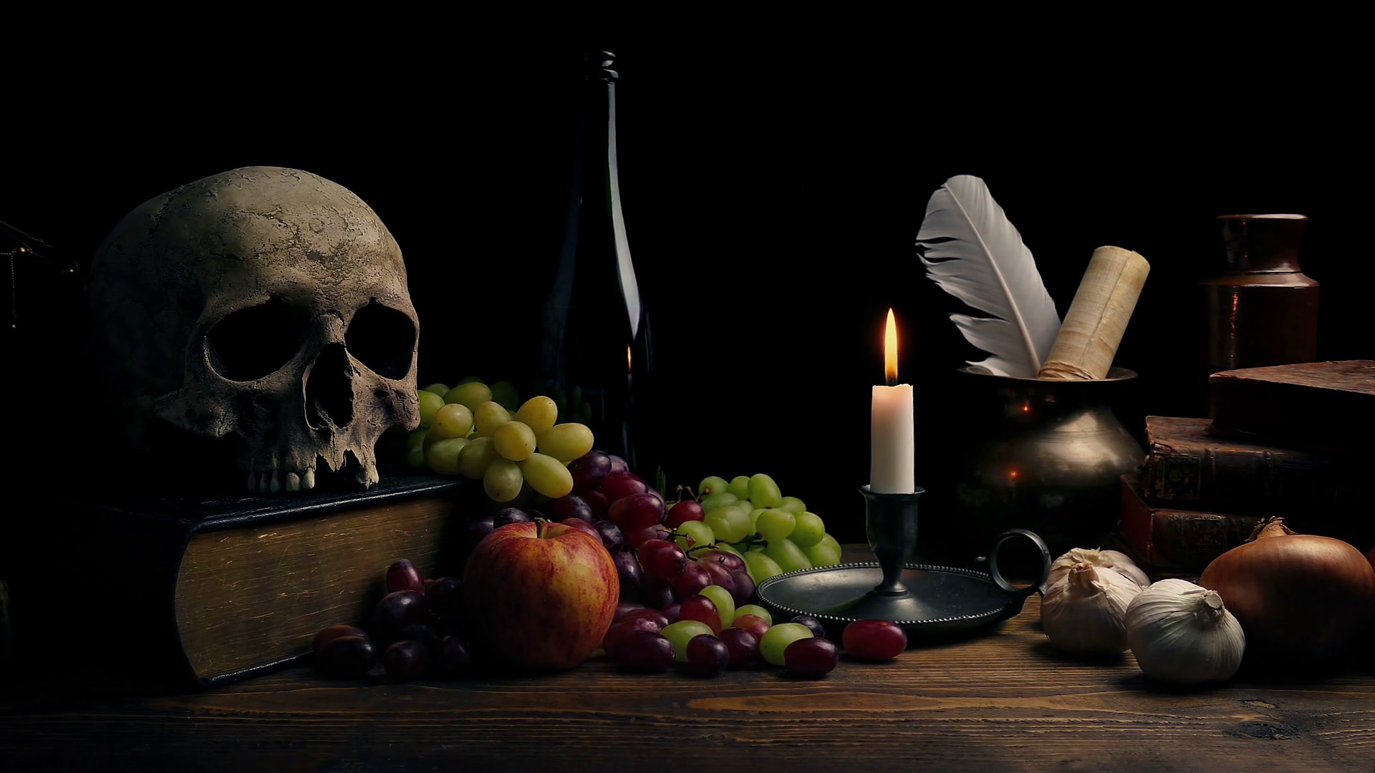
Noun Phrases and Expanded Noun Phrases

Slide 2

Nouns
A noun names a person, place, idea, thing or feeling.
a skull
the grapes
an apple
an arrangement
In front of a noun, we often have
a an the
determiners

Slide 3
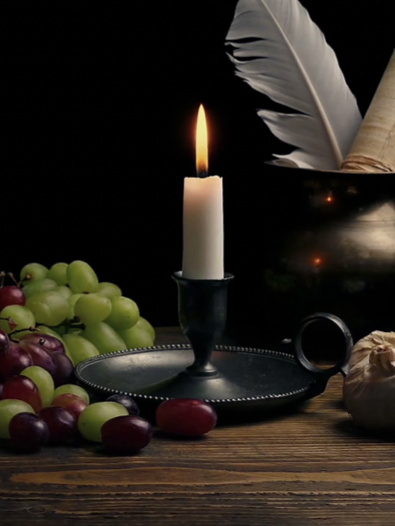
Adjectives
An adjective is a describing word.
It tells you more about a noun.
flame
a shining flame
the solitary flame
the steady flame
a bright flame
The light is unsteady.
Adjectives sometimes come next to ‘their’ nouns…
but sometimes they do not.

Slide 4
Noun Phrases
A noun phrase adds extra detail to the noun.
noun phrase
a bright candle
the spooky skull
a silver vase
a detailed description
Adverbs can also be part of a noun phrase.
a very bright candle
the extremely spooky skull
It can be made by adding an adjective or two.
The noun phrase includes the noun, adjectives and determiner.

Slide 5
Spotting a Noun Phrase
A noun phrase can be replaced by a pronoun.
A solitary flame burnt steadily.
The ripe grapes lay scattered over the table.
The satisfied artist studied the scene carefully.
The scene is part of the artist’s latest work.
It burnt steadily.
They lay scattered over the table.
She studied the scene carefully.
The scene is part of it.
We can use this fact to help us spot noun phrases.

Slide 6
ANSWERS
Remember: a noun phrase can be replaced by a pronoun.
Noun Phrases
A weathered, human skull is balanced on the book.
The rather unsteady candle light illuminated the scene.
I saw a thin glass vase hidden in the background!
The scene was completed by the casually strewn grapes.
them
it
he
she
Can you spot the extended noun phrase in each sentence?
Can you spot the head noun in each of these phrases?

Slide 7
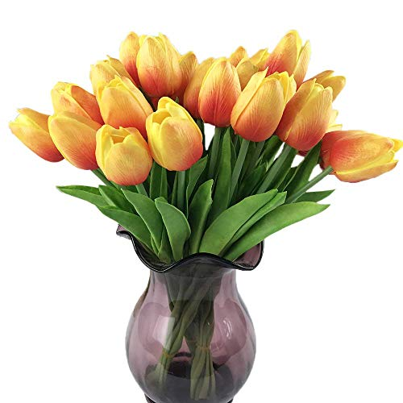
Expanding Noun Phrases using Prepositional Phrases
We can expand noun phrases by adding adjectives, adverbs and determiners.
the beautifully bright, jewel-like tulips
We can also expand noun phrases by adding a prepositional phrase after the head noun.
the jewel-like tulips in the coloured-glass vase

Slide 8
Prepositions
Prepositions tell us how words are related.
above
of
on
with
over
outside
Prepositions are useful for adding extra information about a noun.
without
in
between
from
inside
by
under
from
below

Slide 9
Expanded Noun Phrases
You can develop an expanded noun phrase by adding a
prepositional phrase.
an old, glass vase
an old, glass vase with tulips in
an old, glass vase on the table
Prepositions
with, of
by, from
on, under, below, between, inside, next to, over, by, in
an old, glass vase from Gran’s cupboard
The prepositional phrase modifies the noun.

Slide 10
Examples
Building Expanded Noun Phrases
the tall, straight vase
on the table
at the edge
the smaller, bent tulip
the frosted roses
on one side of the vase
under the water
the slender, pale-green stems
Prepositions
with, of, at
by, from
on, under, below, between, inside, next to, over, by, in
Choose a noun phrase. Expand it using a preposition.

Slide 11


Explore more Hamilton Trust Learning Materials at https://wrht.org.uk/hamilton/ .

