Slide 1
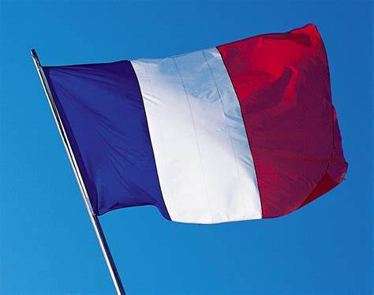
FRENCH

Slide 2
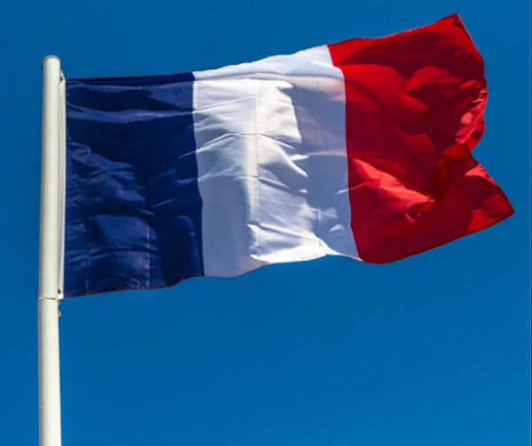
Last week, you learnt the names for the parts of the face in French.

Slide 3
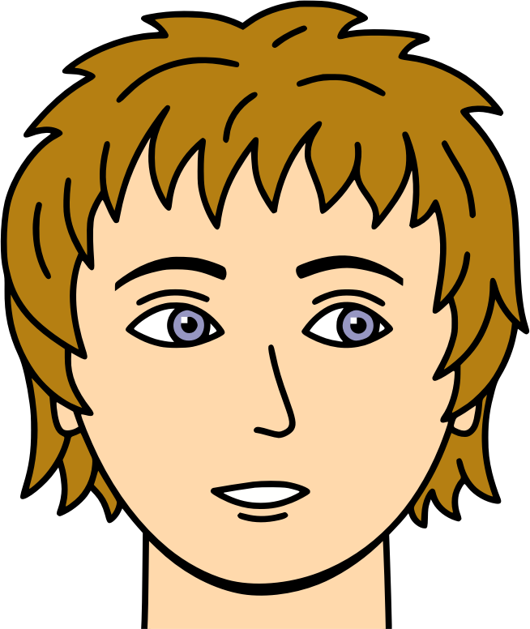
What can you remember?
4
1
2
5
3
6
les dents
les yeux
le visage
les cheveux
le nez
les oreilles
la bouche
Notes:
NO AUDIO for this slide. Pupils to pronounce from the text, identifying each feature in numbered order. Answers move on each click.

Slide 4
le visage
4
1
les cheveux
les yeux
2
5
le nez
la bouche
3
les oreilles
6
les dents
Notes:
Slide to practise the vocabulary of the face.
Image www.openclipart.org

Slide 5
Today you will learn the names of other parts body parts in French.

Slide 6
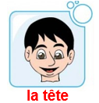


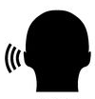

On the next slide you will see and hear some French spoken.
Press the play icon and click on the body part to hear it pronounced in French.
If you have trouble hearing the names, use google translate instead.
Repeat after each word.
You can repeat this process until you are confident with how to pronounce the parts of the body.

Slide 7
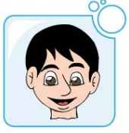
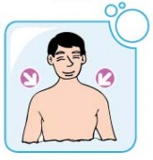
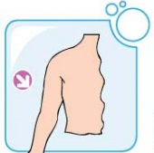
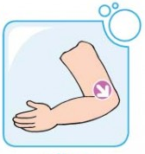
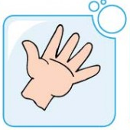
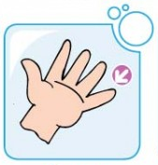
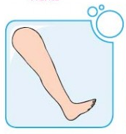
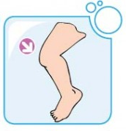
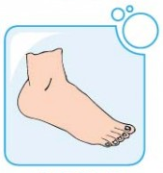
1 | 2 | 3
4 | 5 | 6
7 | 8 | 9
la tête
les épaules
le bras
le coude
la main
le doigt
la jambe
le genou
le pied

Slide 8

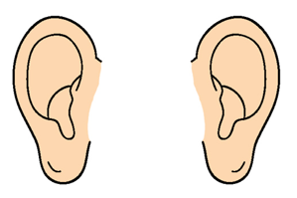
For the next activity, you will need to be able to name these parts of the face in French.

Slide 9
Time to sing!
Listen to the song, head, shoulders knees and toes.
https://www.youtube.com/watch?v=0EFXCdryyRM
Repeat to learn the song.

Slide 10
Challenge: can you sing the song without the video?

Slide 11
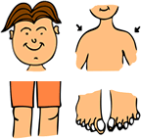
tête épaules genoux pieds
genoux pieds
tête épaules genoux pieds
genoux pieds
les yeux les oreilles la bouche et le nez
tête épaules genoux pieds
genoux pieds

