Slide 1
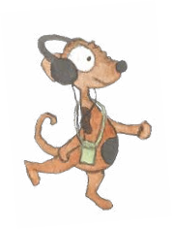
Commas
Commas are used to clarify meaning
    Commas separate items in a list
If you aren’t sure where to put a comma, read on….
  2. Commas indicate a pause and separate
  a clause or a phrase

Slide 2
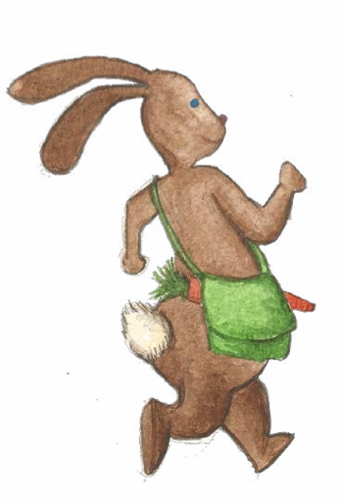
Commas separate items in a list
Use the sentence below to list the items. Don’t forget commas!
Rabbit went to the market and bought...
juicy tomatoes
carrots
pears
fresh eggs
red apples
Rabbit bought _____ ______ ______ ______ and ______.

Slide 3
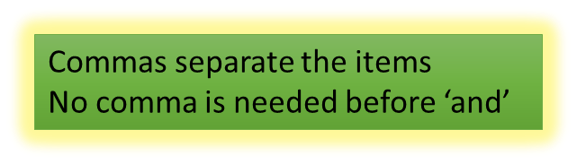
Commas separate items in a list
Rabbit went to the market and bought...
No comma needed here!
, , , .
Rabbit bought and
fresh eggs
carrots
pears
red apples
juicy tomatoes

Slide 4
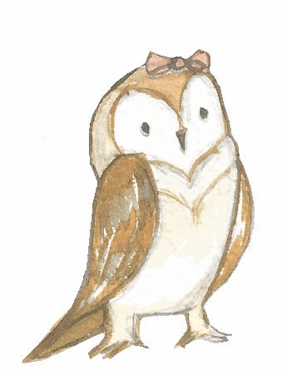
Commas separate items in a list
Sometimes commas separate adjectives in a list of descriptions.
Punctuate the sentence below. Don’t forget commas!
owl enjoys wearing a small light-pink silky and sparkly bow in the evening

Slide 5

Commas separate items in a list
Owl enjoys wearing a small, light-pink, silky and sparkly bow in the evening.
NO comma needed here!

Slide 6
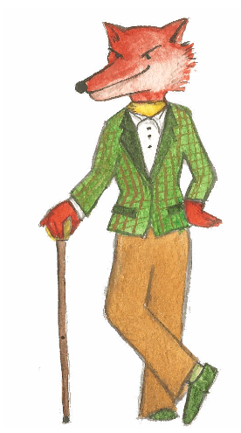
Commas separate clauses or phrases
Remember!
A clause has an active verb.
A phrase does not!
When he went out walking, the fox held a brown stick.
In the early afternoon, the fox wore a smart green jacket.
We need a comma when…
... the extra clause or phrase starts the sentence
… the clause or phrase is in the middle of the sentence
The fox, who was proud of his appearance, was always well dressed.

Slide 7
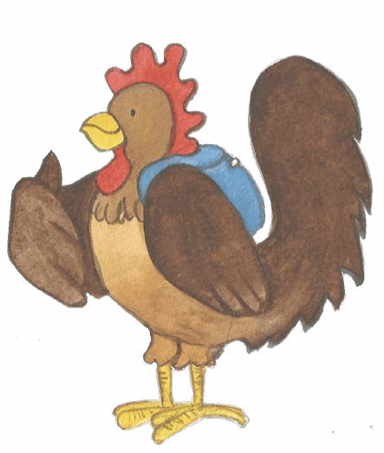
Commas separate clauses or phrases
We need a comma when…
… the extra clause or phrase starts the sentence
When the chicken wore his blue backpack, he felt excited.
… the clause or phrase is in the middle of the sentence
The chicken, getting ready to go on an adventure, carefully packed his bag.

Slide 8
Commas separate clauses or phrases
Think about …
Punctuate these sentences.
… where is the clause?
… where do the commas go?
when he listened to music through his headphones the dog felt really relaxed
the dog who enjoyed feeling relaxed listened to music through his headphones

Slide 9
Commas separate clauses or phrases
Punctuate these sentences.
When he listened to music through his headphones, the dog felt really relaxed.
The dog, who enjoyed feeling relaxed, listened to music through his headphones.

Slide 10
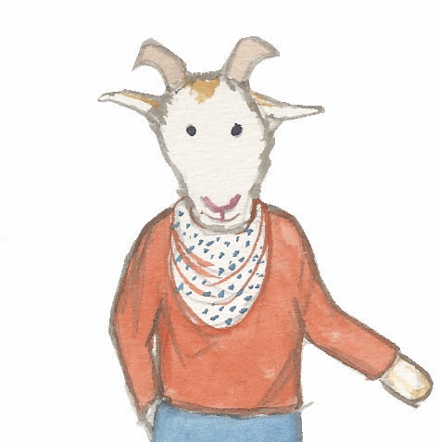
Commas clarify meaning
Punctuate these sentences.
1. goats have hooves soft fur ears and spiky horns
2. goats who like to climb have strong hooves to help them balance
3. from over the hill the white goat came slowly towards us
4. as the goat walked over the hill the birds above started to sing happily

Slide 11
Commas clarify meaning
1. Goats have hooves, soft fur, ears and spiky horns.
2. Goats, who like to climb, have strong hooves to help them balance.
3. From over the hill, the white goat came slowly towards us.
4. As the goat walked over the hill, the birds above started to sing happily.

Slide 12


Explore more Hamilton Trust Learning Materials at https://wrht.org.uk/hamilton/ .

