Slide 1

Year 3
Light

Slide 2
Today you will be learning about shadows.
What are shadows and how are they made?

Slide 3
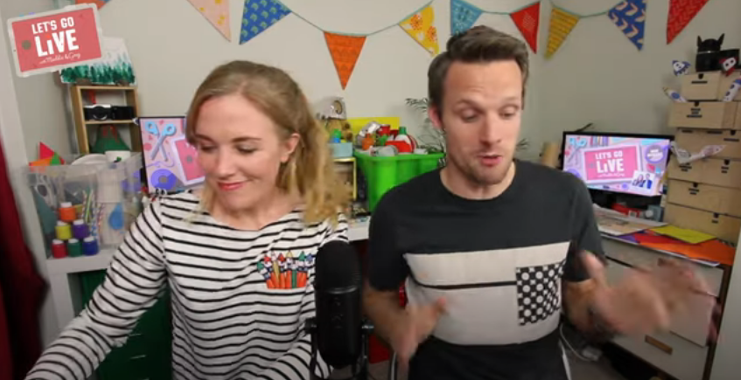
Click on the picture to watch a video which explains this really well.
You can skip to start at 3:36 and then stop the video at 6:55.
These shows are brilliant for so many cool science activities! When you have spare time, I highly recommend watching some of the other episodes!

Slide 4
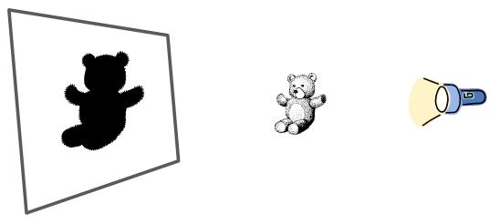
Light rays travel in straight lines from a light source but these rays cannot pass through an opaque object. Dark occurs when there is an absence of light so if an object blocks the light rays, it creates an area that is dark. As light rays travel in a straight line from the source, the area of dark will always be the same shape as the object that is causing it. We call this casting a shadow.

Slide 5
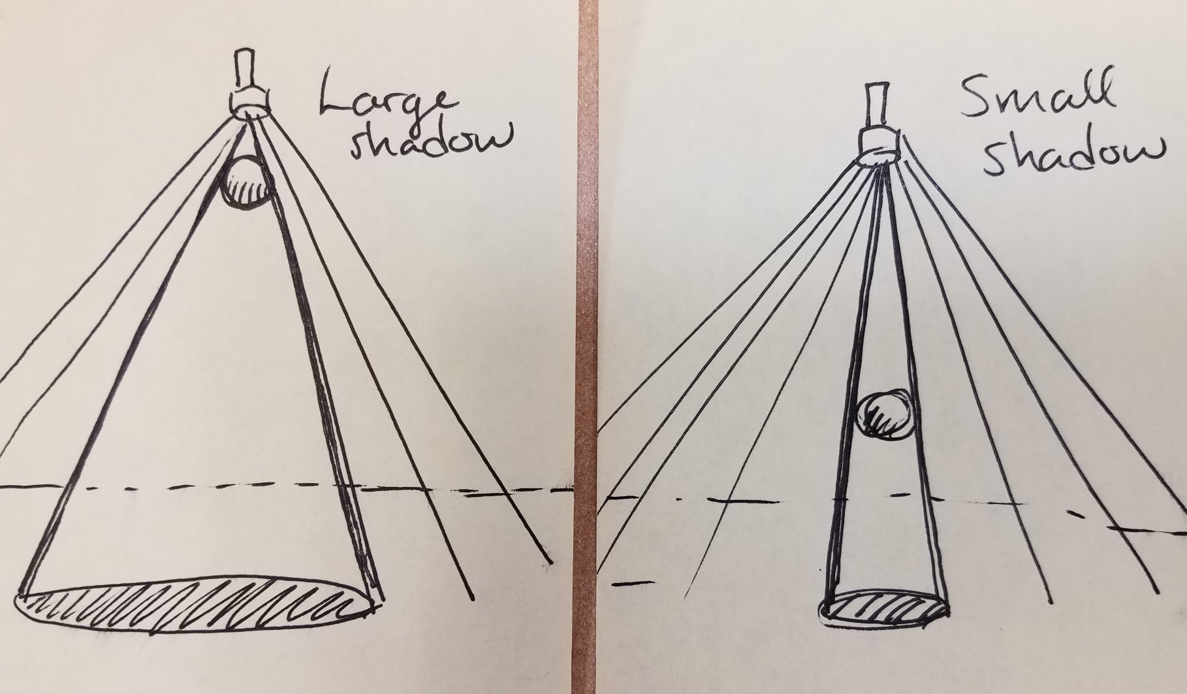
Although shadows are always the same shape as the object making them, they are not always the same size. The same shadow can change size. If the object is close to the light source, it will block more of the light rays and therefore the shadow will be larger. If the object is far from the light source, it will block less of the light and therefore the shadow will be smaller.

Slide 6
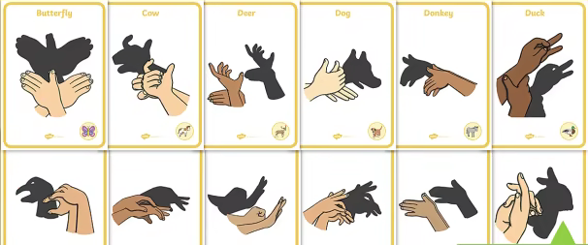
Your first task this lesson is to create your own shadow hand puppets! Investigate making the shadows smaller and bigger. Here are some ideas but you can create anything you want. Please send us some photos of your shadows.

Slide 7
Watch the next bit of Let’s Go Live, from 6:55 until 10:25.
(We will ask you to watch the rest of the episode next lesson, so don’t watch any further today).

Slide 8
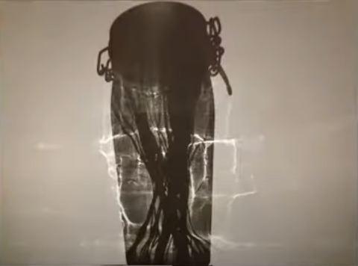
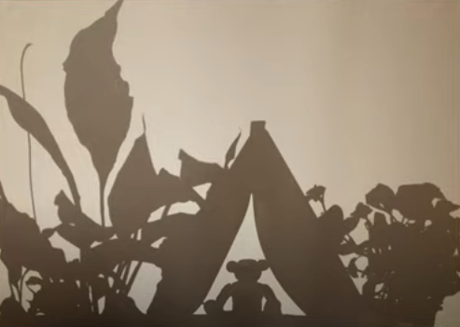
Your second task is to investigate different objects and the shadows they make, just like Maddie and Greg.
Your challenge, if you want to, is to create your own shadow picture, similar to the camping teddy.
Again, please email your teacher with some photos of your shadow learning. We really want to see your ideas.

