Slide 1


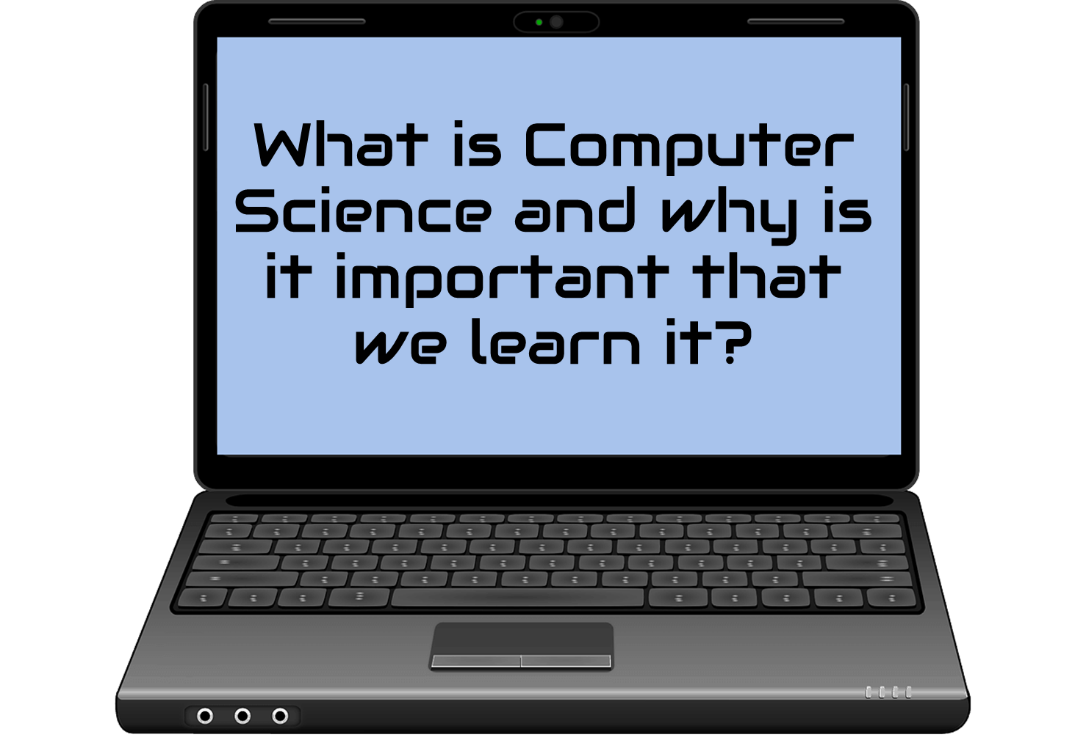
Computer Science is the study of how to manipulate, manage, transform and encode computers. There are many different areas of computer science.
Technology is all around us, and many of our day to day tasks require us to use technology. Learning computer science helps us to make our day-to-day lives easier.
.

Slide 2
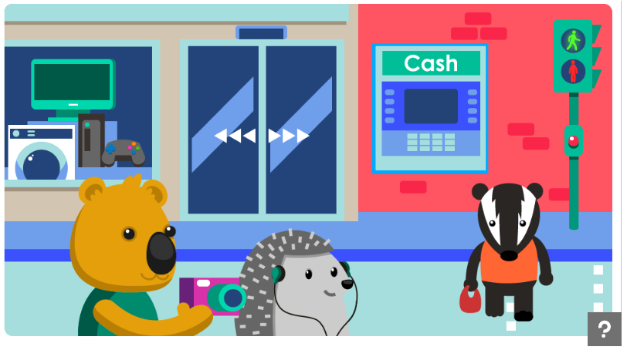
What objects can you find that contain computers? Click on them to learn more.
https://www.bbc.co.uk/bitesize/topics/zvsc7ty/articles/zc4x6sg

Slide 3
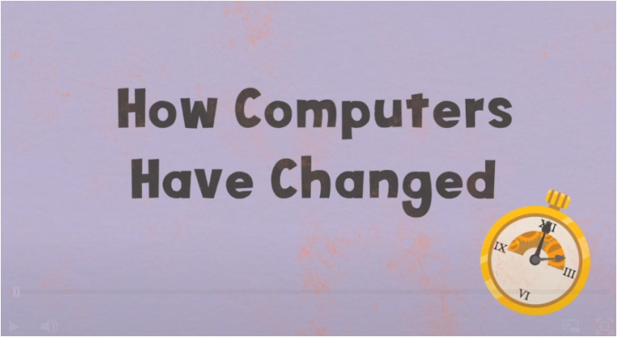
Watch this video to learn how computers have changed?
https://www.bbc.co.uk/bitesize/topics/zvsc7ty/articles/ztrq7ty

Slide 4
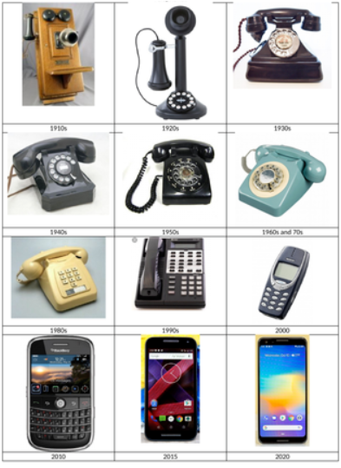
Even after something has been invented, it is often improved. Watch this video to find out more!
https://www.youtube.com/watch?v=VFcUgSYyRPg
Write a paragraph explain what technology has been improved. I have given the example of a phone. Why have they improved? Give your reasons as to whether you think it is a positive or negative difference that this form of technology has made.

Slide 5


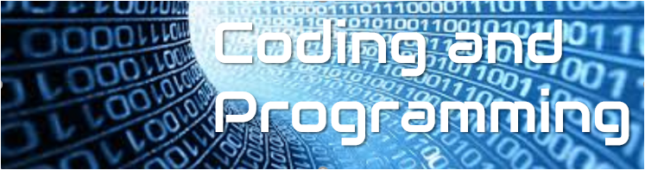
Learn to create computer programmes and understand how computer networks work.
A computer network is a group of two or more computers that are linked. It looks at how computers are connected and how the Internet and the WWW work.
Computational thinking involves solving problems effectively with or without a computer and thinking in a logical way.
Coding and programming use computational thinking to create computer programmes.

Slide 6

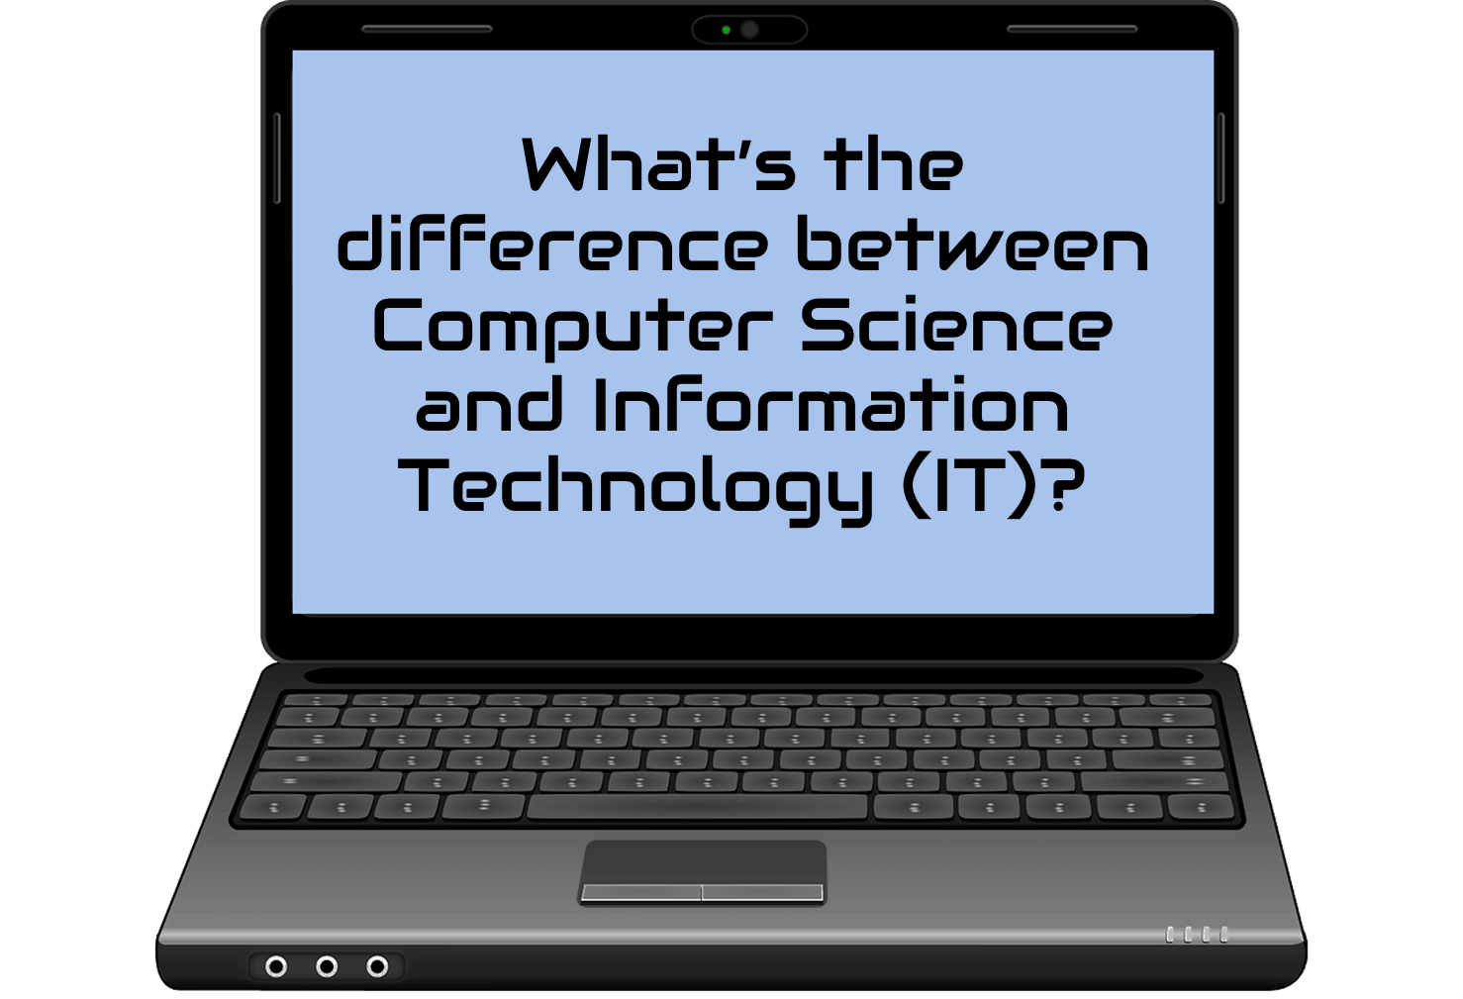
Information Technology is consuming (taking in) technology. However, Computer Science is learning how to create technology.
Having a good understanding of computer science will also help you understand how Information Technology works – you will become a better technology user if you understand the science behind it!

Slide 7

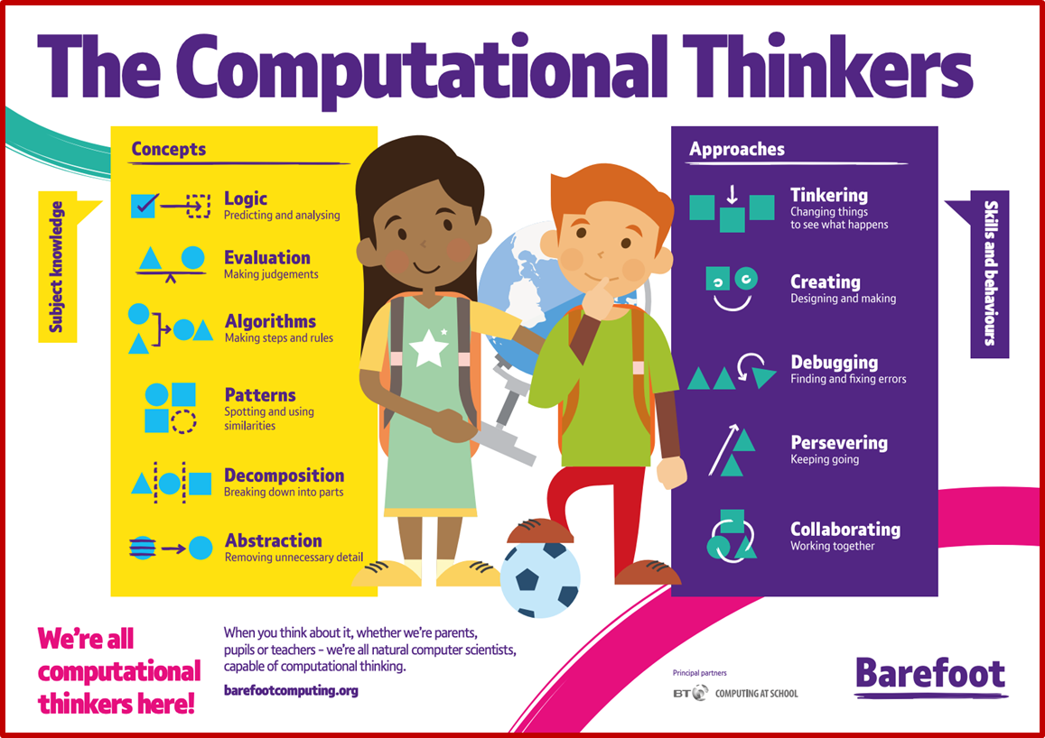
Computers don't think (yet) so we have to approach computing in a way that makes sense to them.
You will learn how to approach coding (not to think like a computer...!)
You will learn lots of skills (some you use already without thinking about it).

