Slide 1


Slide 3
1) Which unit could not be used to measure perimeter?
inch km ml mm
7 + 7 + 4 + 4 = 7 × + 4 ×
3) 8 + 6 + 6 + 8 = + 16
4) Which shape’s perimeter would be hardest to measure using only a ruler?
Circle Pentagon Trapezium Triangle

Slide 4
1) Which unit could not be used to measure perimeter?
inch km ml mm
7 + 7 + 4 + 4 = 7 × + 4 ×
3) 8 + 6 + 6 + 8 = + 16
4) Which shape’s perimeter would be hardest to measure using only a ruler?
Circle Pentagon Trapezium Triangle
2
2
12

Slide 6
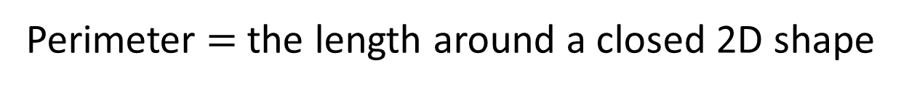
1 cm
6 cm
3 cm
3 cm
6 cm
Perimeter $=$ the length around a closed 2D shape
6 + 3 + 6 + 3 = 18 cm
6 + 3 =
9
6 × 2 + 3 × 2 = 18 cm
9 × 2 =
18 cm

Slide 7

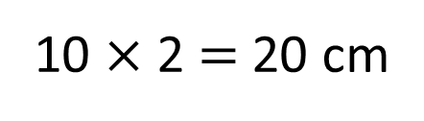
What is the perimeter of this rectilinear shape?
1 cm
2 cm
2 cm
4 cm
4 cm
2 cm
6 cm
Do I need to count all the squares?
Have a think
2 + 2 + 4 + 2 + 6 + 4 = 20 cm
20 cm
6 + 4 = 10
10 $×$ 2 = 20 cm

Slide 8
Have a go at questions
1 - 2 on the worksheet

Slide 9
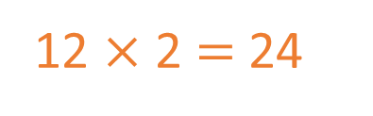
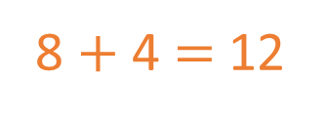
1 cm
2
2 cm
1
3
A
8 $+$ 4 $=$ 12
3
1
22 cm
12 $×$ 2 $=$ 24
1
3
1
1
2
1
1
8
1
1
B
4
24 cm
Have a think
Which shape has the greater perimeter?
Shape B

Slide 10
Have a think
Draw a rectangle with a perimeter of 20 cm
Two pairs of equal sides
× 2 + × 2 = 20
10
0
10
10

Slide 11
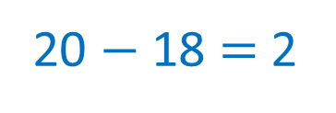
Have a think
Draw a rectangle with a perimeter of 20 cm
Two pairs of equal sides
1
1
× 2 + × 2 = 20
9
18
20 $−$ 18 $=$ 2
9
9
Have a think
8 and 2
7 and 3
6 and 4
5 and 5
1

Slide 12

1 cm
4 cm
1 cm
5 cm
3 cm
Have a think
9 cm
Is this closed shape’s perimeter greater than 22 cm?
9 + 3 + 1 + 4 + 5 =
Yes
9 + 1 + 3 + 4 + 5 =
22 cm

Slide 13
Have a go at questions
3 - 7 on the worksheet

