Slide 1
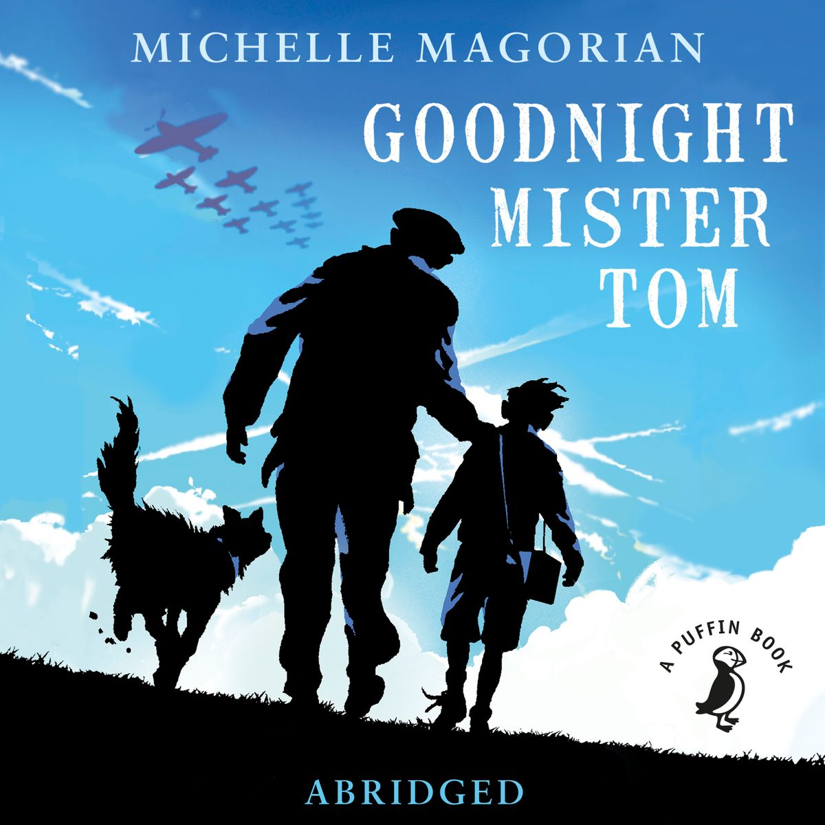
Chapter 16: The Search
Part 1

Slide 2

The cottage seemed very quiet without William. Tom missed the sound of his boots clattering along the tiled hallway and his chatter at night. In the days that followed his departure Tom found himself glancing at the table to share something he had read, only to realize that the chair where William usually sat was unoccupied. He felt the old familiar emptiness that he had experienced after the sudden loss of Rachel. At least he could console himself that William was alive. He listened to the news on the wireless with extra attentiveness, particularly when there were reports of bombing near London.
Hitler had by now invaded Norway and Denmark, and heavy units of the British fleet had been sent to help the invaded countries, but the war still left Little Weirwold unruffled except for those few who missed William. It was sad that he wasn't around to witness early spring. Already buttercups were appearing in the fields, and in the woods wet primroses and violets had burst through the soggy dark earth.
Tom waited patiently for a letter. After the first week when there was still no word from him he thought William was probably too busy to write, for he would probably have his hands full doing chores for his mother. He thought the same the second week, but by the third week he began to feel anxious. He himself had written four letters. He knew that Zach had sent several also, but there was no reply to any of them.
One night he awoke violently from a nightmare. In the dream, he had been locked into a tiny space with no air inside. It was as though he was being buried alive. But it was the voice that had woken him. He thought he had heard William calling out to him for help. He woke with a jerk only to find Sammy standing by his bedside, panting. He staggered out of bed and fumbled his way towards the bedroom window. Carefully easing the blackout curtains to one side he peered out. It was still dark. He opened the door, walked across the hallway to the living room and looked at the clock. It was three A.M. Almost time for his fire duty anyway.
He'd go and relieve Hubert Pullett early. He pulled his corduroys and thick jersey on over his pyjamas, got into his boots, and stepped outside into the damp night slinging his trench coat, cap and gas mask on as he walked. Sammy followed him dragging a bit of old blanket in his teeth.
The fire post was a makeshift platform on top of the village hall. A ridiculous piece of extravagance, Tom had thought, when it was being built. He climbed up the ladder that leaned onto it. Mr. Pullett was sitting with a blanket wrapped round him and was in the process of falling asleep in a chair. He woke up, pleased to see Tom so early. They chatted for a while until Mr. Pullett decided to leave for the warmth of his bed. Tom made himself as comfortable and as warm as was possible, and Sammy snuggled in between his legs.

Slide 3
As he stared at the sky he couldn't rid himself of the dream he had just had. If William was in need of help, surely he would write to him. He gazed out at the galaxy of stars and brooded. Two hours later the dawn injected its colors into the sky and Mrs. Butcher came and took his place.
On the way home he caught sight of Miss Thorne's sister, May, on her ancient bicycle. She was delivering the mail. He ran after her.
"Nothing for you, I'm afraid," she said. "I'm sorry."
She hesitated before moving off again.
"Mr. Oakley," she added anxiously, "I'm afraid I have a telegram. It's for Annie Hartridge." He looked up, startled. The last telegram had brought the news of Michael Fletcher's death.
"I'm a little worried," she went on, "what with her baby due so soon. I'd like to wait till the midwife is visitin' before delivering it, but it's against regulations."
Tom frowned thoughtfully. "You seen Mrs. Fletcher?"
She shook her head. "Didn't like to disturb her."
"I'll go and see her now, suggest she might pop in to see her."
"Thanks."
He watched her wobble off and head towards the farming area on the south side of the village. Turning sharply back, he walked in the direction of the Fletchers' cottage.

Slide 4
Mrs. Fletcher had just seen her husband and Edward off to work. The kitchen door was still open, and the light from it was casting a pale glow onto the still-glistening garden. She was standing in the doorway.
"You ent on dooty, is you?" she asked, glancing guiltily at the light.
"No, I ent," said Tom. "I jes' wanted to have a private word, like."
"George and David are asleep. They won't be botherin' us. Come on in and have some tea.
You's lookin' a little on the pale side."
He stepped into the cozy warmth of the kitchen. Sam padded after him and curled up on the floor in front of her stove. She sat down at the table and poured out two cups of tea.
"Sit down," she said, sliding a cup across to him. "What can I do for you?"
Tom looked surprised.
"There is somethin' you wants me to do, ent there? Is it Will?"
Tom shook his head. "Annie Hartridge has got a telegram."
Mrs. Fletcher put down her cup slowly. "David?" she asked.
"I don't know. I jes' thought with you havin' lost Michael and with her about to have her baby, she might need someone who could help, like."
"Of course," she said, and she stood up and hurriedly untied her apron.
"She ent got it yet," he added.

Slide 5
She rolled down her sleeves.
"I'd like to be there as soon as possible. In her state she might pass out or somethin'. I'll think of an excuse, like extra eggs from the Padfields, booties for the baby, that sort of thing."
Tom nodded. It sounded for the best. He watched her put her coat on.
"Them trains to London," he murmured.
"Yes?" she said, puzzled. "What about them?"
"They run on Fridees, don't they?"
"Yes. That's right."
"It's Fridee today, ent it?"
"Yis."
He stood up abruptly.
"I'm goin' to get on that train, Mrs. Fletcher, and what's more I'm goin' to get on it today."
Tom's journey to London was as bumpy and intermittent as William's had been. Dim blue lights lit the tightly packed carriages and the air was stifling. It was frustrating, too, not to be able to see the stations that they passed, but once it was evening it was too dangerous to attempt to peep through the blacks in spite of the faintness of the blue lights. Sammy, who had not only smuggled himself into the cart but had also jumped off it and followed Tom to the station, was now squashed onto his lap. A makeshift leash, made of rope, hung from between his teeth. Tom held him tightly even as he dozed on the long journey.

