Slide 1
Expressing time, place & cause

Slide 2
Prepositions

Slide 3
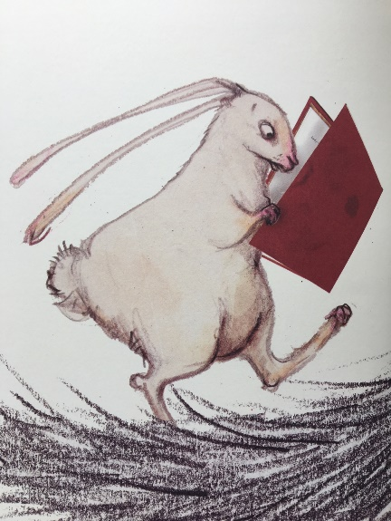
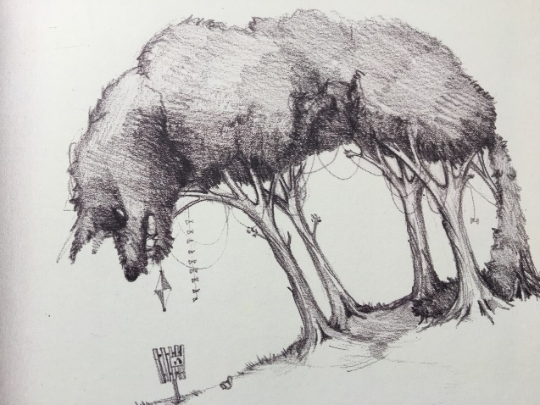
Verbs
Verbs indicate that someone or something is
doing, feeling or being.
She reads.
The wolf looms.
A shadow grows.
I lost!
Usually verbs have the name of a person or thing or a pronoun in front of them.
Revision

Slide 4
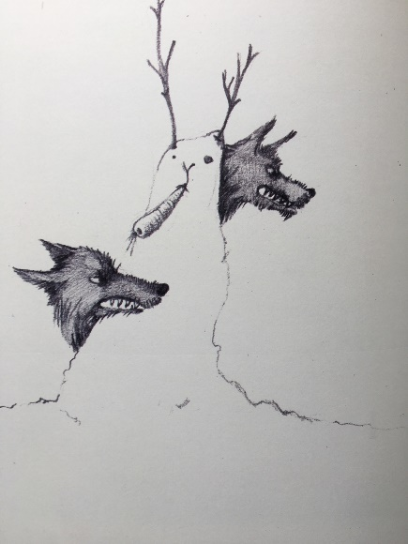

Phrases
A phrase is a group of words which adds meaning to a sentence.
behind the snowman
with my friends
in the day
because of the book
There is no active verb in a phrase.
Revision

Slide 5
Prepositions
Prepositions tell us how words are related.
above
on
over
because of
before
from
while
due to
between
in
since
outside
inside
during
under
from
below
on
at
after
for
Can you see a pattern in the grouping of these prepositions?

Slide 6
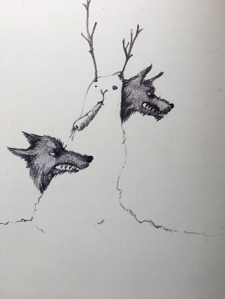

Prepositions
Prepositions link a phrase to a sentence.
I think there is someone
behind the snowman!
I read books
with my friends.
They followed the rabbit
in the day.
She did not notice
because of the book.

Slide 7
Prepositions
Prepositions help us express time, place and cause.
time
, place
and cause.
When?
We found the rabbit
at dawn.
We found the rabbit
during the day.
We found the rabbit
after breakfast.
Prepositions
while, since,
before, during, after, at, on
Try adding your own prepositional phrase to express time.

Slide 8
Prepositions
Prepositions help us express time, place and cause.
time,
place
and cause.
Where?
We found the rabbit
outside the library.
We found the rabbit
below the street-lights.
We found the rabbit
in the park.
Prepositions
above, below,
inside, outside, on, in, between
Try adding your own prepositional phrase to express place.

Slide 9
Prepositions
Prepositions help us express time, place and cause.
time,
place and
cause.
We found the rabbit
from our careful search.
How?
We found the rabbit
due to sheer luck.
Why?
We found the rabbit
because of the book.
How?
Prepositions
because of, due to,
from, for,
Try adding your own prepositional phrase to express cause.

Slide 10

Prepositions
Prepositions can be used at the beginning or end of a sentence.
Someone is hiding
someone is hiding.
behind the snowman.
Behind the snowman,
I read books
with my friends.
With my friends,
I read books.
They followed the rabbit
in the day.
In the day,
they followed the rabbit.
She did not notice
because of the book,
in her hands.
Can you make a new sentence by swapping the phrases?

Slide 11


Explore more Hamilton Trust Learning Materials at https://wrht.org.uk/hamilton/ .

