Slide 1
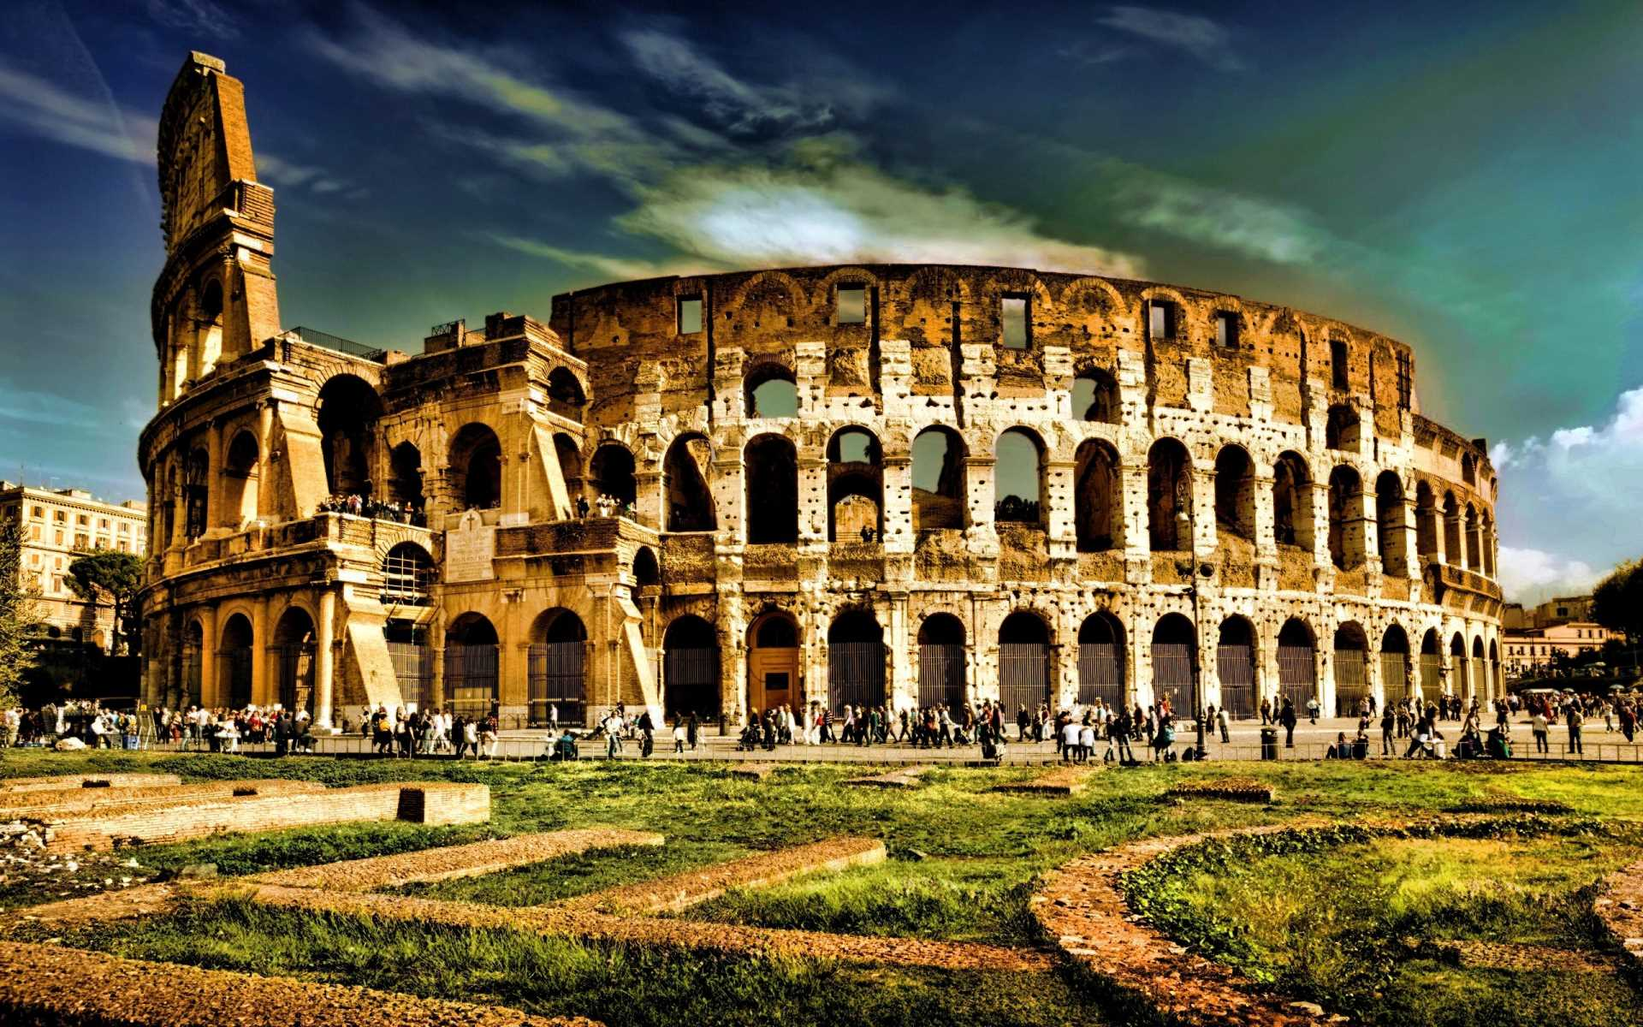
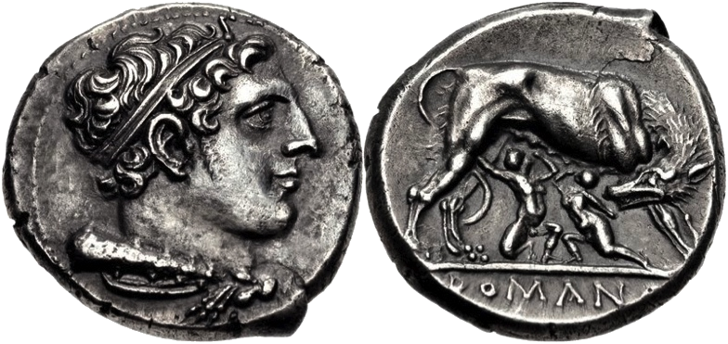
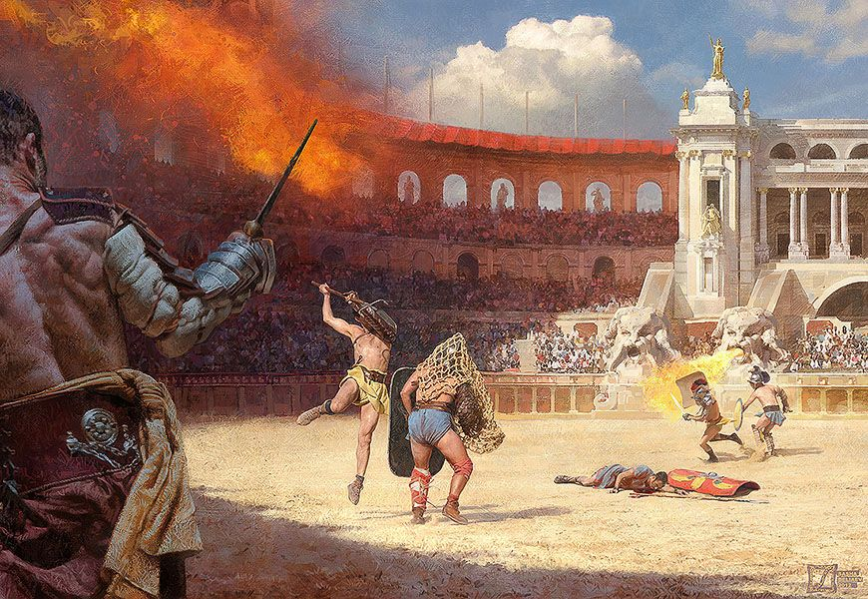
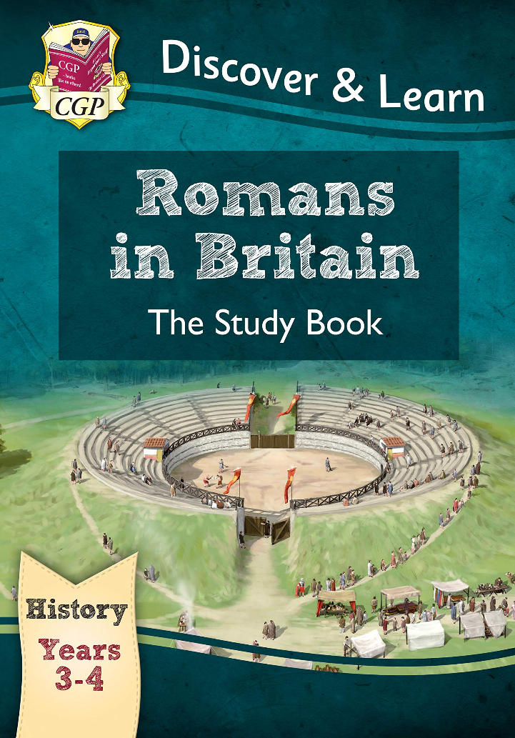
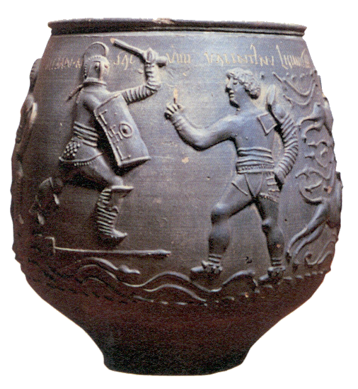
Starter
Which are primary or secondary sources?
How do your know?

Slide 2
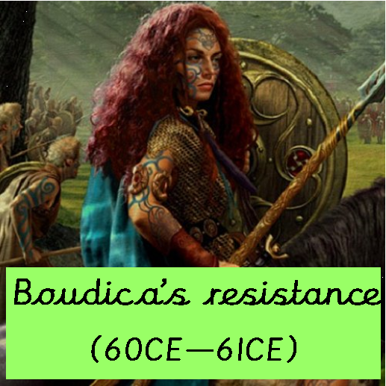
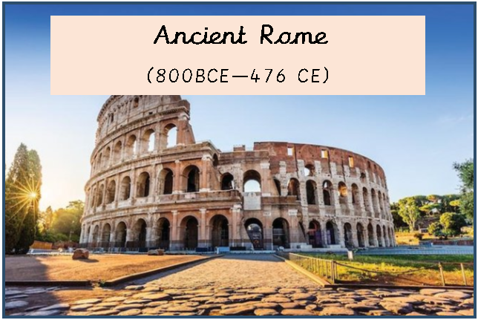
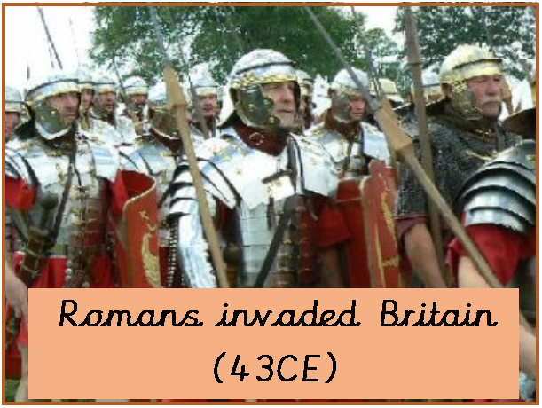
Let's look at our Roman timeline so far...
What do we know already about the Romans and their invasion on Britain?
These dates are important.
Can you think of a way to remember them?
You will be taking a quiz in week 6.
0

Slide 3
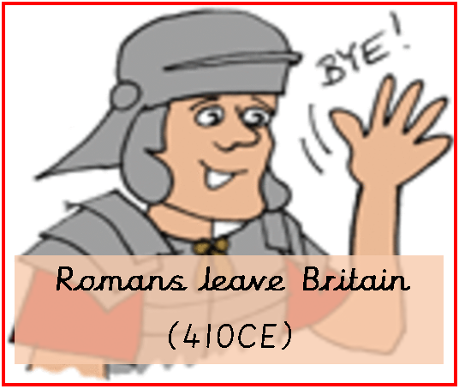
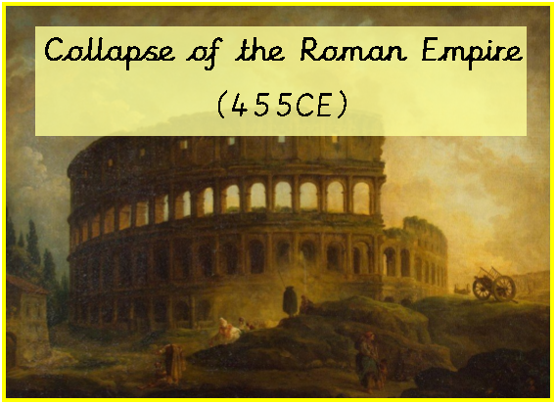
The Romans left Britain in 410CE and in 455CE the Roman Empire collapsed.
The Roman Empire ended its rule in Britain a long time ago but many of their legacies still remain!
0

Slide 4

Think: are these events World or British History?
0

Slide 5


L.O. I can identify the significance of a period in history on life today.
What do these words mean?
Use a dictionary to find the definitions.

Slide 6

Think about everything you know about the Romans so far.
On a piece of paper, list as many things as you can remember that the Romans introduced to Britain.

Slide 7
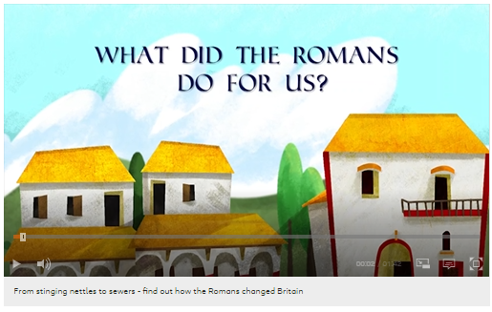
Click on the link to remind yourselves.
So, what ​changed in ​Britain when the ​Romans arrived?
https://www.bbc.co.uk/bitesize/topics/zqtf34j/ ​articles/z2dr4wx#:~:text=Many%20of%20the ​%20Roman%20towns,Britain'%20came%20from ​%20the%20Romans.

Slide 8

So, what ​changed in ​Britain when the ​Romans arrived?
Click on the link to find out more.
Take notes - these might come in handy for your English this week.
https://www.bbc.co.uk/bitesize/topics/zqtf34j/ ​articles/z2dr4wx#:~:text=Many%20of%20the ​%20Roman%20towns,Britain'%20came%20from ​%20the%20Romans.

Slide 9
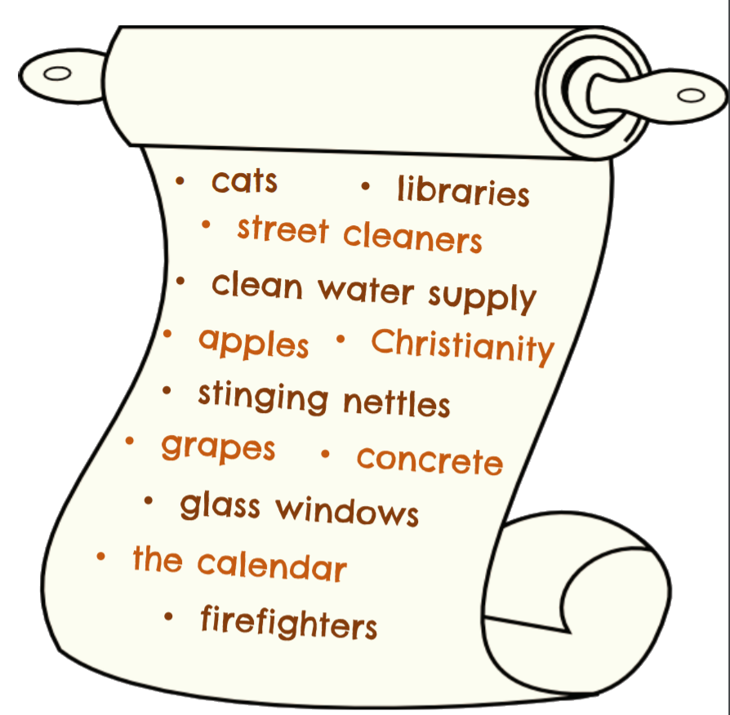
Which of these are Roman legacies?
Think!

Slide 10
Draw a table and place the items on the chart into the category that you think is correct
Challenge:
Can you explain your choices?
Legacies | Not legacies

Slide 11
These are all Roman legacies!
Did you realise?

Slide 12
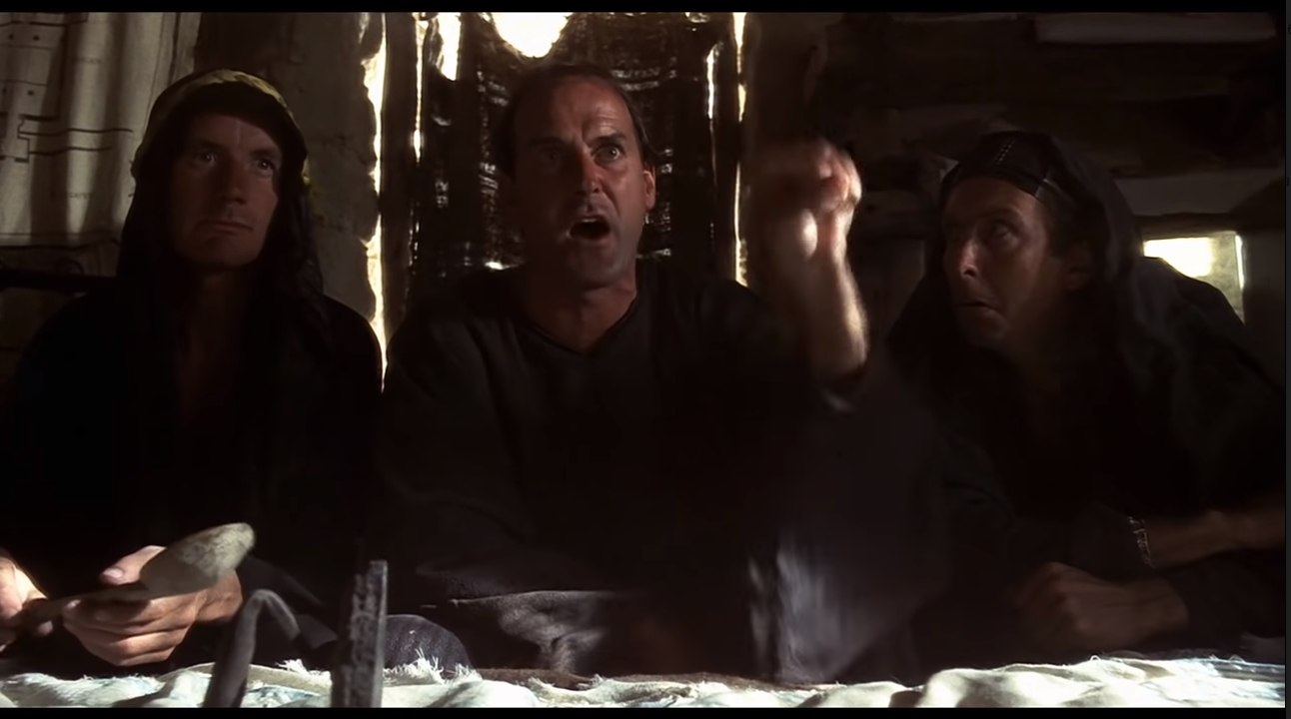
L.O. I can identify the significance of a ​period in history on life today.

Slide 13
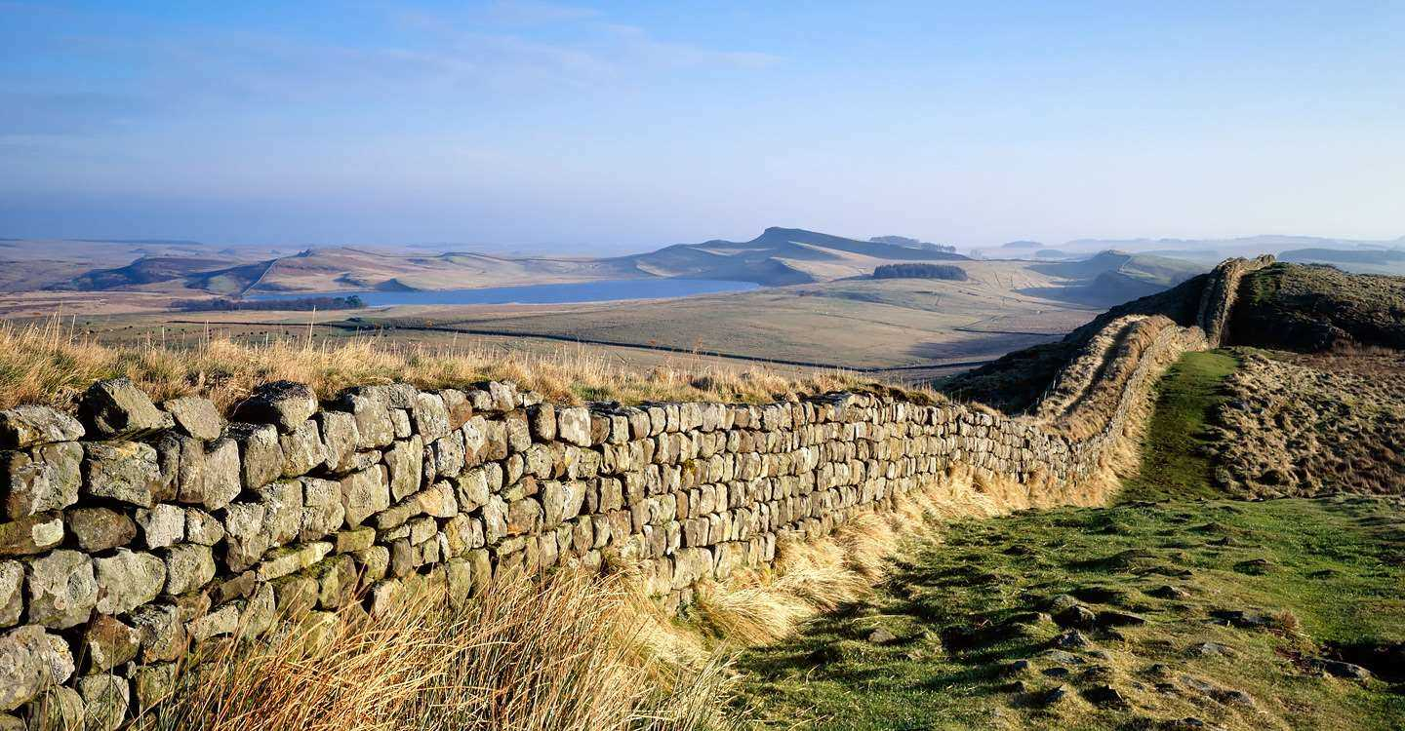
The Romans built roads
Britain had no ​proper roads ​before the ​Romans - ​there were just ​muddy tracks. ​So the Romans ​built new ​roads all ​across the ​landscape – ​over 16,000km ​(10,000 miles) ​in fact!
They built their roads on foundations ​of clay, chalk and gravel. They laid ​bigger flat stones on top. Roman ​roads bulged in the middle and had ​ditches either side, to help the ​rainwater drain off.
The Romans knew that the ​shortest distance from one ​place to another is a ​straight line. So they made ​all their roads as straight as ​possible to get around ​quickly.

Slide 14
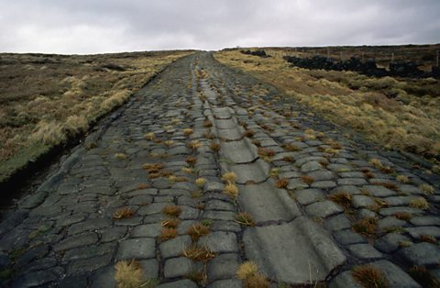
Roads
Bits of Roman ​road can still ​be seen. ​Soldiers and ​carts used ​this cobbled ​road to travel ​between ​Manchester ​and ​Yorkshire.
Some Roman roads have ​been converted into ​motorways and main roads ​we use today. You can still ​find a few places where the ​original Roman road is still ​visible, too.

Slide 15
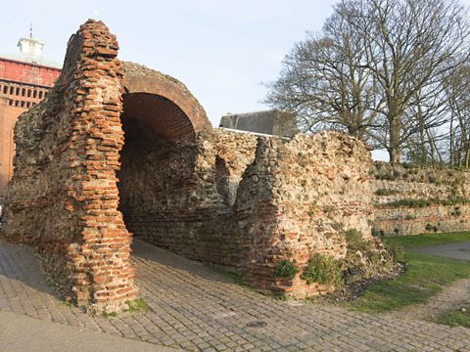
Roman Towns
The Romans introduced the idea of ​living in big towns and cities. Roman ​towns were laid out in a grid. Streets ​criss-crossed the town to form blocks ​called ‘insulae’. In the middle was ​the ‘forum’, a big market square ​where people came to trade.
The Romans built walls around ​many of their towns. Some are ​even standing today, like this ​one in Colchester.
London was a Roman city too, although they called it ​‘Londinium’. When the Romans invaded, they built a fort ​beside the River Thames. This was where traders came ​from all over the empire to bring their goods to Britain. It ​grew and grew, until it was the most important city in ​Roman Britain.

Slide 16
Roman Towns
If a place-name has 'chester', 'caster' or 'cester' ​in it, it's almost certainly Roman. The word ​‘chester’ comes from the Latin word ‘castrum’ ​which means ‘a fort’.

Slide 17
Roman
ruins - these are still around today and how we know so much about the Roman civilisation.
Hadrian's Wall
In AD122 the ​Emperor ​Hadrian ​ordered his ​soldiers to build ​a wall ​separating ​Roman Britain ​and Scotland.
It ran for 73 ​miles!
What am I?

Slide 18
Roman
ruins - these are still around today and how we know so much about the Roman civilisation.
Hadrian's Wall
In CE122 the ​Emperor ​Hadrian ​ordered his ​soldiers to build ​a wall ​separating ​Roman Britain ​and Scotland.
It ran for 73 ​miles!

Slide 19
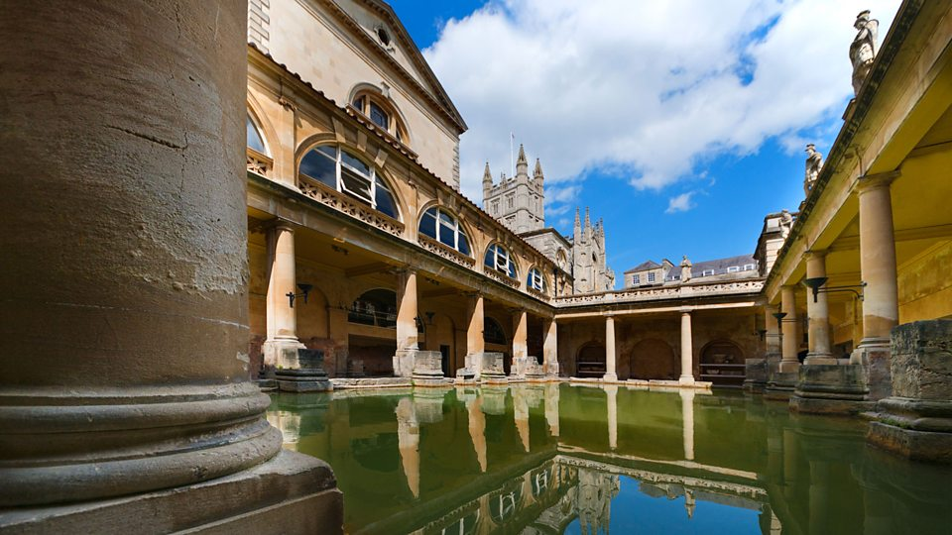
Roman
ruins
Roman Baths
These are in ​the town of ​Bath. People ​used to come ​here to get fit, ​get clean and ​to meet ​friends. The ​water naturally ​heated from ​the rocks ​below too.
What am I?

Slide 20
Roman
ruins
Roman Baths
These are in ​the town of ​Bath. People ​used to come ​here to get fit, ​get clean and ​to meet ​friends. The ​water naturally ​heated from ​the rocks ​below too.

Slide 21
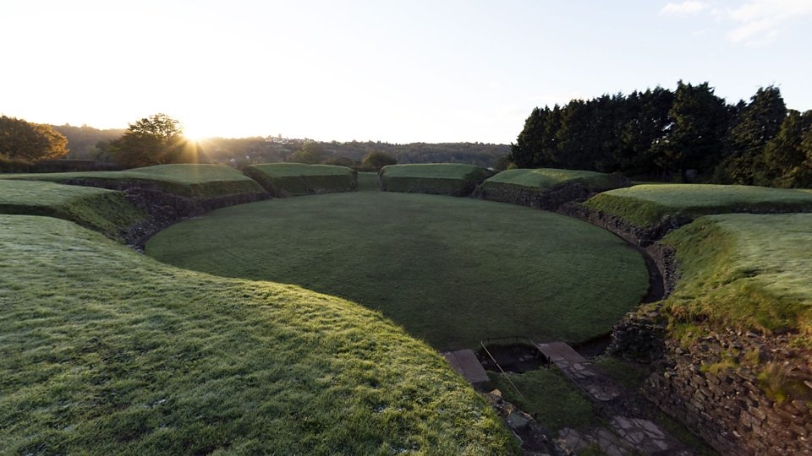
Roman
ruins
Caerleon, Wales
A 1st century fort ​called 'Isca'. ​Archaeologists ​have discoverd ​barracks and a ​bathhouse ​inside. Nearby, ​there was also a ​harbour and an ​amphitheatre ​where soldiers ​would be ​entertained by ​gladiator fights.
What am I?

Slide 22
Roman
ruins
Caerleon, Wales
A 1st century fort ​called 'Isca'. ​Archaeologists ​have discoverd ​barracks and a ​bathhouse ​inside. Nearby, ​there was also a ​harbour and an ​amphitheatre ​where soldiers ​would be ​entertained by ​gladiator fights.

Slide 23
Language, writing and numbers
Before the Romans came, very few ​people could read or write in Britain. ​Instead, information was usually ​passed from person to person by ​word of mouth.
The Romans wrote down their history, their ​literature and their laws. Their language was ​called Latin, and it wasn’t long before some ​people in Britain started to use it too. ​However, it only really caught on in the new ​Roman towns - most people living in the ​countryside stuck to their old Celtic ​language.
What language did the ​Roman's speak?

Slide 24
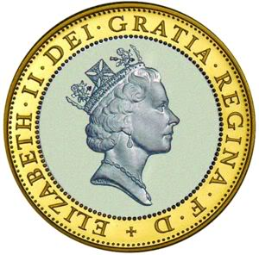
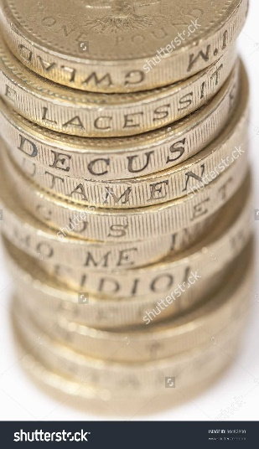
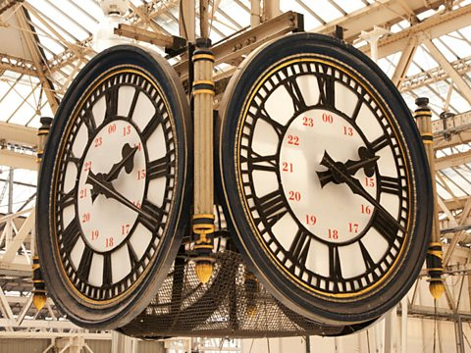
Language, writing and numbers
We've still got lots of words and ​phrases today that come from Latin. ​Words like ‘exit’, which means ‘he or ​she goes out’, and ‘pedestrian’, ​which means ‘going on foot’.
Our coins are based on a Roman design ​and some of the lettering is in Latin. Written ​around the edge of some £1 coins is the ​phrase 'decus et tutamen' which means ​'glory and protection'.

Slide 25
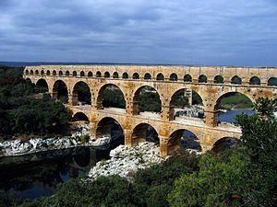
Technology
Although they didn’t ​invent the arch, the ​Romans were the first ​people to build arches ​into big buildings and ​aqueducts. Romans used ​aqueducts to supply towns with water from ​springs, rivers or lakes. ​Aqueducts were like a ​bridge with a stone ​channel to carry water ​on top.
What
is
this?

Slide 26
Technology
Although they didn’t ​invent the arch, the ​Romans were the first ​people to build arches ​into big buildings and ​aqueducts. Romans used ​aqueducts to supply towns with water from ​springs, rivers or lakes. ​Aqueducts were like a ​bridge with a stone ​channel to carry water ​on top.

Slide 27
Technology
The Romans liked to keep clean. Towns and forts had ​underground drains to take away dirty water and ​sewage. The drain pipes were flushed with water from ​the baths, so they didn't get too smelly.
Why were these
important?
Fresh water and ​sewers are ​important. Without ​them, people risk catching diseases.

Slide 28
The History Association needs your help!
The Queen wants to regenerate and modernise the UK.
You need to convince me of 3 legacies you think should be kept.
Which ones do you think are the most significant?
Why?

Slide 29
Decide which legacies you will argue are kept.
You will have to convince the Queen! She will want you to explain your reasons!

Slide 30
Task
You can choose to write a letter to the Queen or produce a poster/mindmap about 'what the Romans have done for us'. You must include information about your 3 most significant legacies and what makes them significant today.
If you choose to write a letter to the Queen arguing your case for our chosen legacy, explain why the legacy is so important, what it means to you, what life would be like without it and why it is important to preserve aspects of British History.

Slide 31
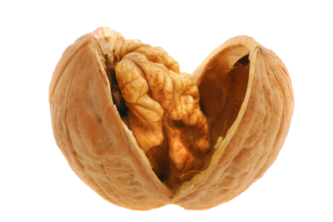
'Like a Roman'
Click on the link to learn the song!
You could film yourself performing and send it to me if you like - I would love to see you perform!
https://www.youtube.com/watch?v=pFz12iq6zTc

