Slide 1
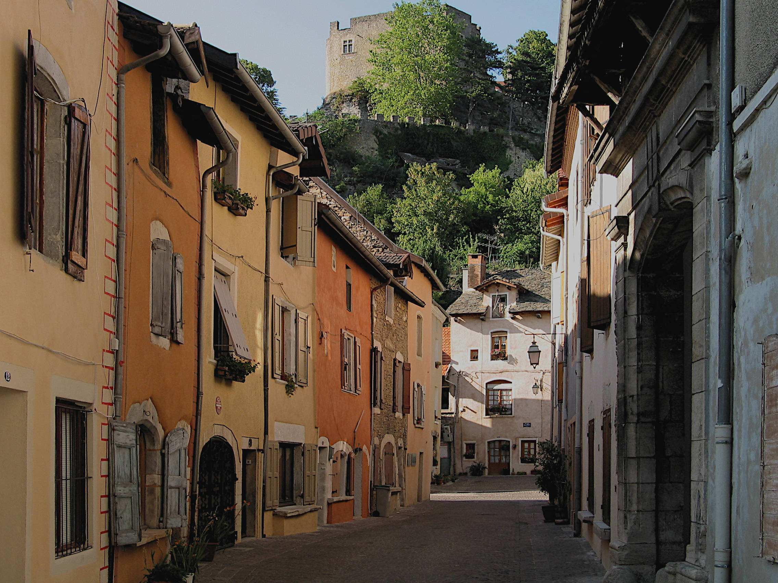
What type of place is this?
C’est en banlieue.

Slide 2
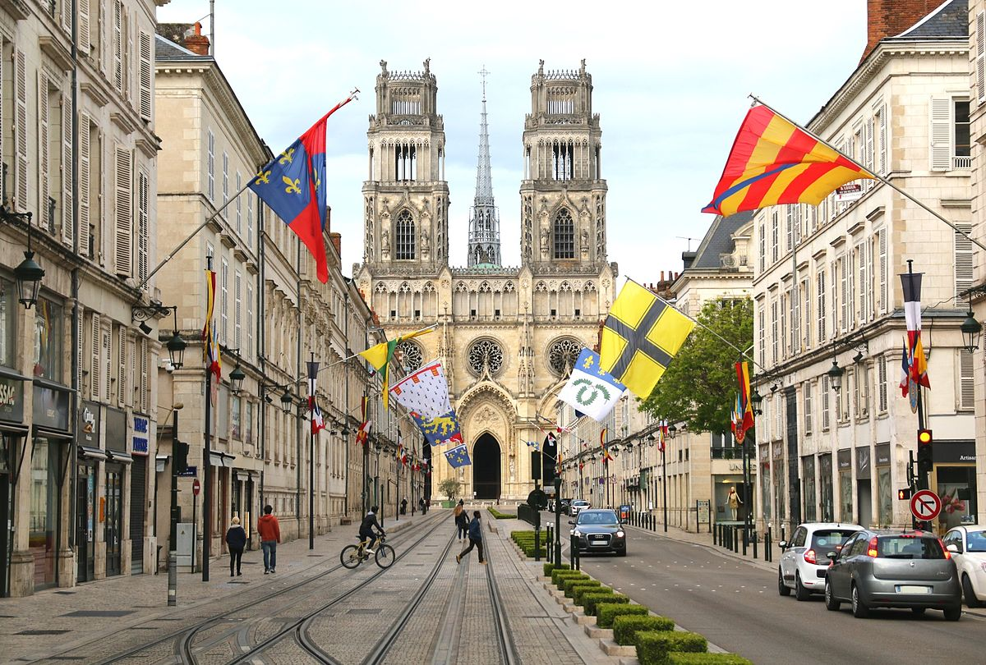
What type of place is this?
C’est en centre-ville.

Slide 3



Well done! Bien joue!
C’est fantastique!
You have learned some words for different types of places to live in French!
Click here!

