Slide 1
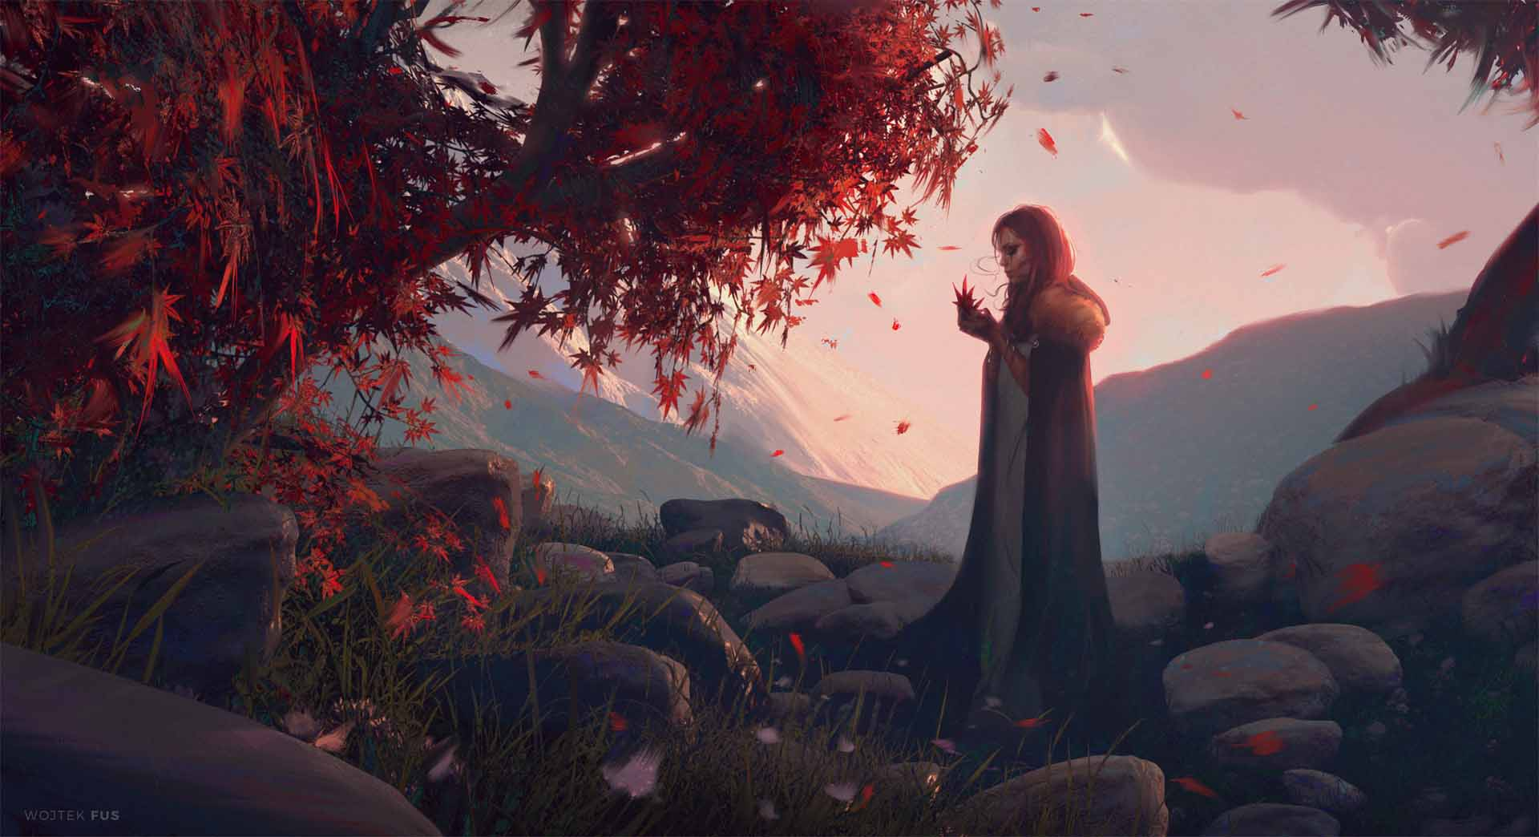

Answering historical questions.
Listen to my voice recordings about Ursula – then have a go at answering the questions.

Slide 2
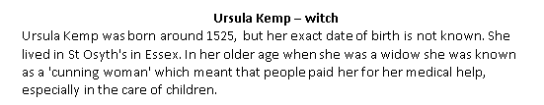

Slide 3
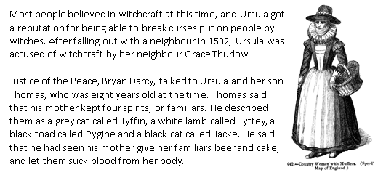

Slide 4


Slide 5
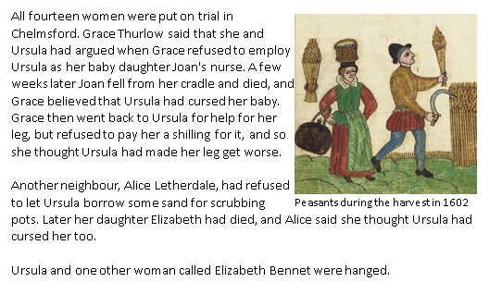

Slide 6


