Slide 1
L.O I am drawing a birds eye view.

Slide 2
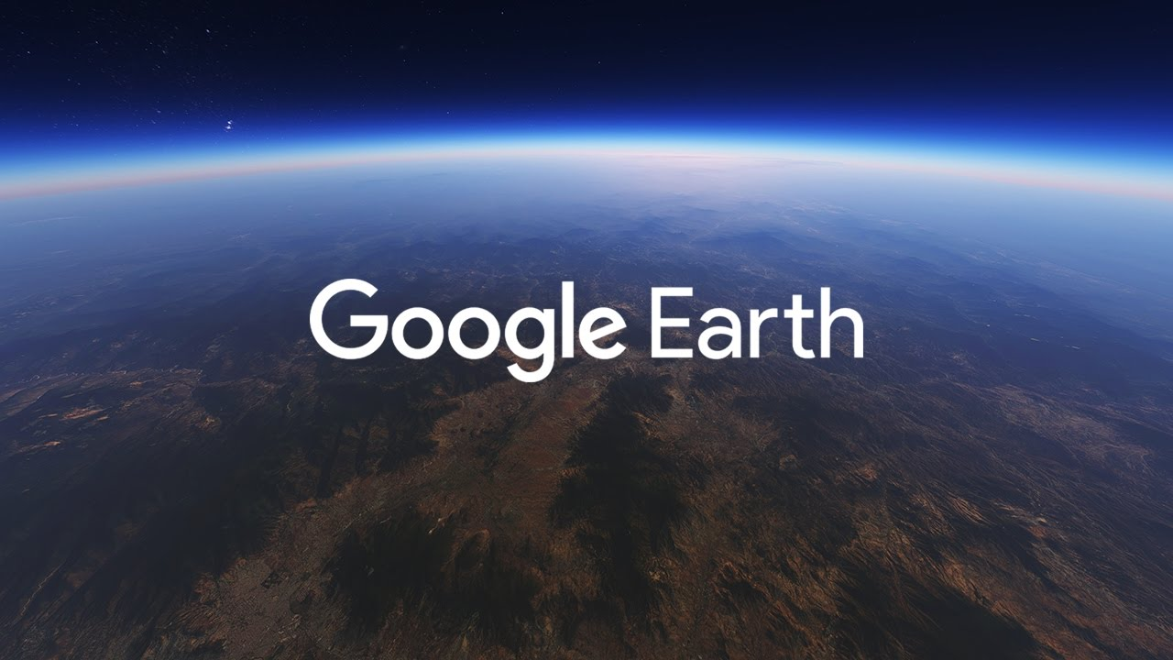
If you can download the Google Earth App, that would be great.
An adult will be able to help you with this.
It’s Free!
If you cannot download the App, go to slide 7.

Slide 3
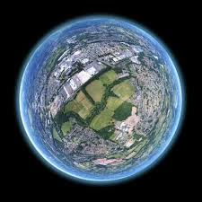
You are able to get a birds eye view different places on our planet.
Where would you search?

Slide 4
Search for a specific place: tap Search (the magnifying glass icon) .
Move around: Use one finger to tap and drag the screen.
Zoom in and out: Pinch the screen.
To zoom with one finger, double tap and hold, then slide your finger up or down.
How to use Google Earth

Slide 5
Have a play! Type in the Postcode!
SO16 8BY – Where does this take you?
Now try: SW1A 1AA – Who lives here?
Can you try your postcode?

Slide 6
Can you search these famous landmarks?
Statue of Liberty
Stonehenge
The Opera House Sydney
Eiffel Tower
The Great Pyramids of Giza
Once you have searched these, skip to slide 13.
If you do not have Google Earth go to the next slides.

Slide 7
Famous Landmarks

Slide 8
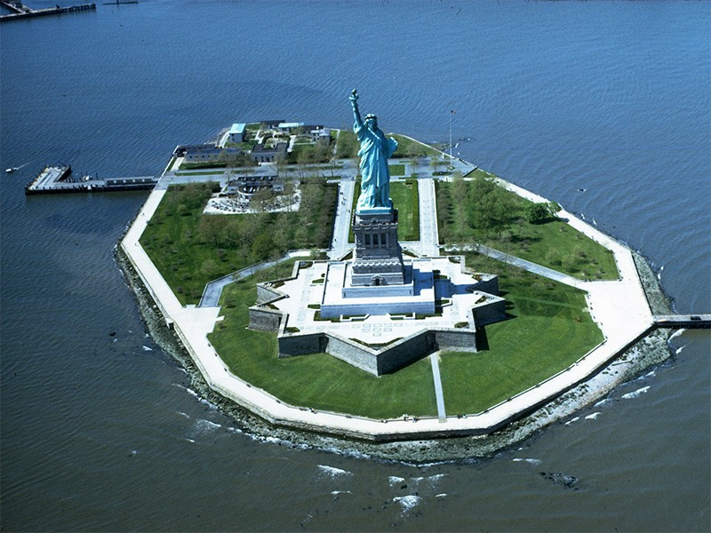
Statue of Liberty – America

Slide 9
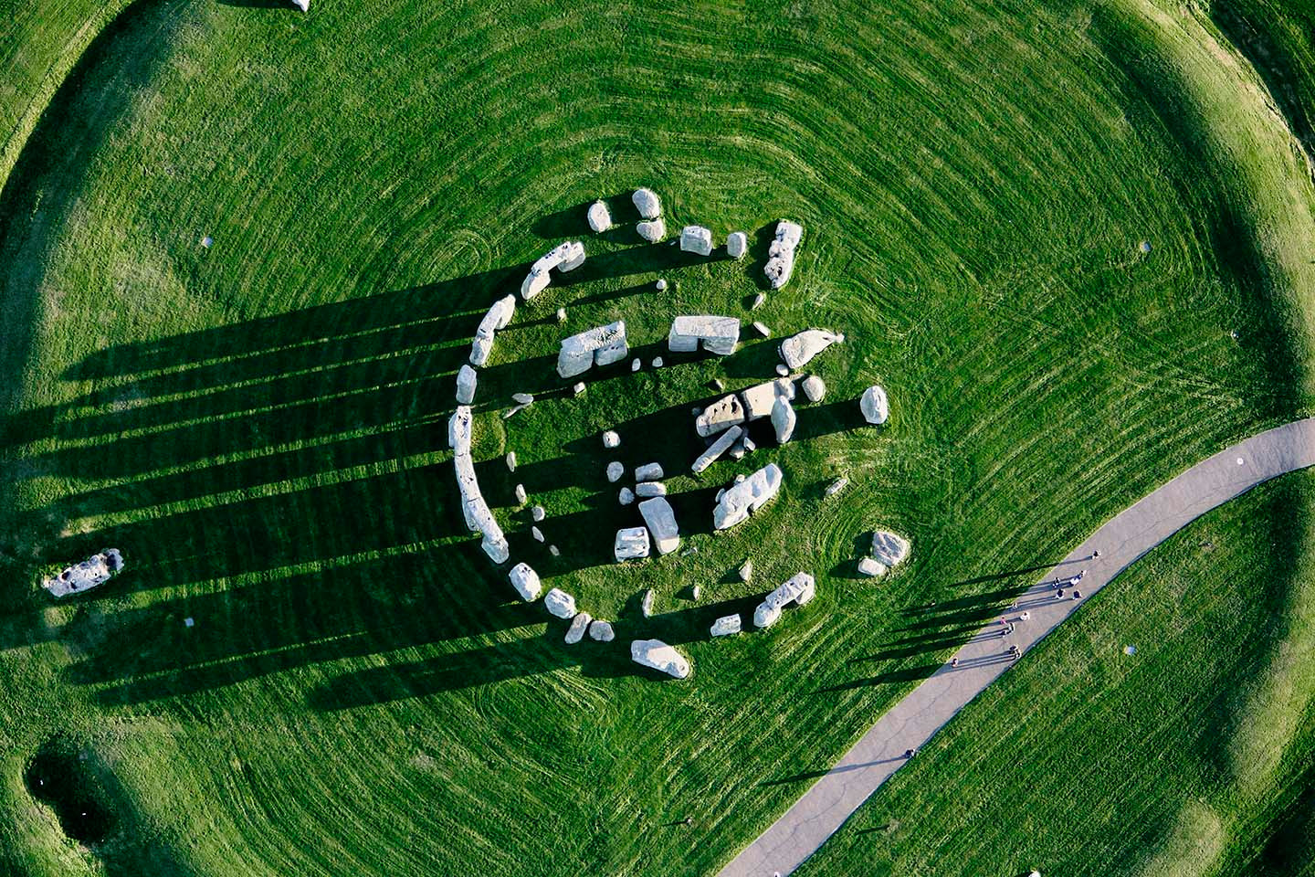
Stonehenge – England

Slide 10
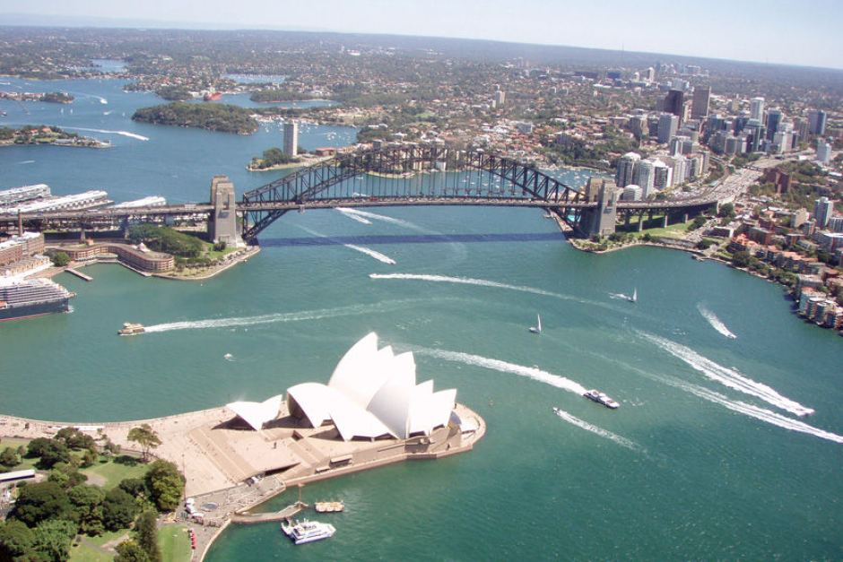
The Opera House – Sydney

Slide 11
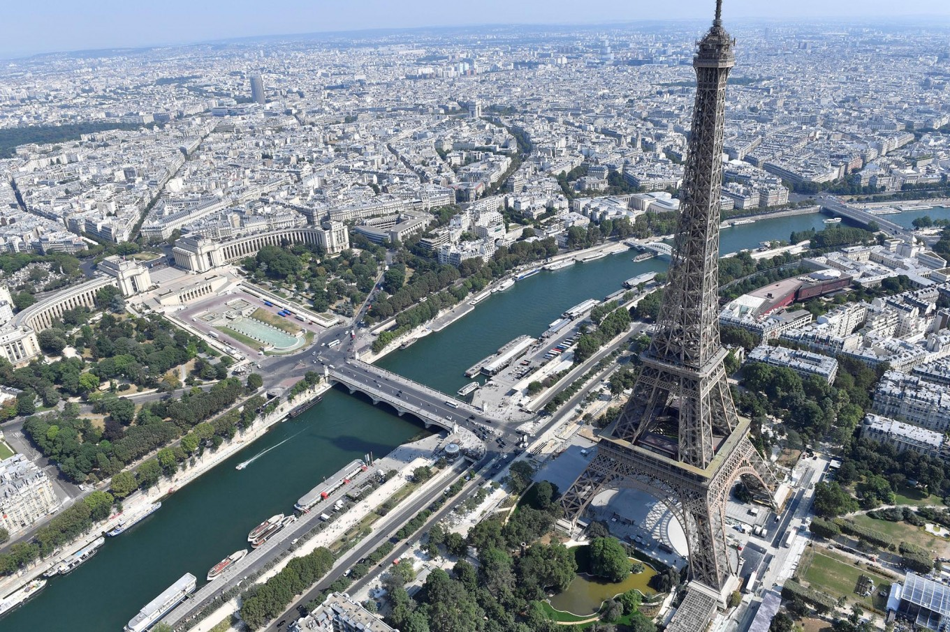
The Eiffel Tower - France

Slide 12
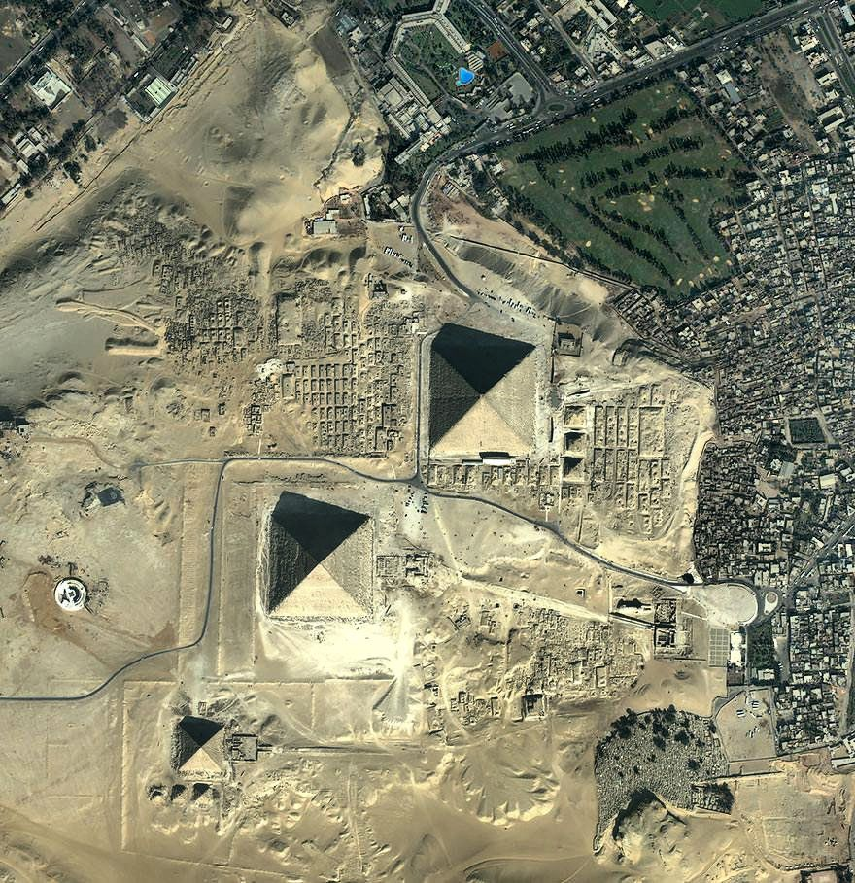
The Great Pyramids of Giza – Egypt

Slide 13

Draw a birds eye view of a famous landmark. You can use one of the ones we have already looked at, or you can find a different landmark.
We would love to see your pictures!
Imagine you are the King of the Sky from the book we have been reading. You have travelled the world.
If you do not have Google Earth, you can search famous landmarks and add the words birds eye view e.g Big Ben birds eye view.

