Slide 1

FRENCH

Slide 2

Part 1
LO: I am learning to say how old
I am in French.

Slide 3



Class work
On the next slide you will see and hear some French spoken.
Listen carefully.
Repeat after each word.

Slide 4
1
2
3
4
5
6
7
10
8
9
Notes:
Click. As number appears, audio is heard.

Slide 5







Quel âge as-tu ?
9
6
8
7
5
Notes:
Slide giving a clue about the aim of the lesson.

Slide 6
J’ai____________________ans.

Slide 7
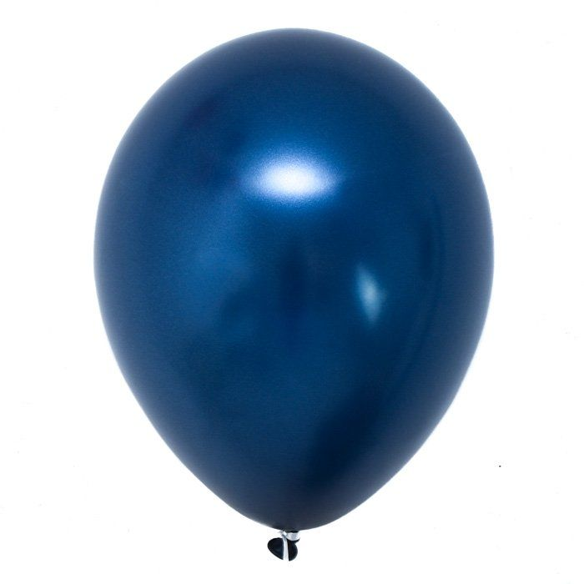
Your turn
Draw your own balloon and write your name and age inside.
Je m’appelle …… J’ai …… ans.
Je m’appelle Joe. J’ai neuf ans.

Slide 8
https://www.youtube.com/watch?v=4WksvcV6vU0
Watch the rap and change the lyrics to match your age.
Challenge
Could you have a conversation with your family member asking their age?

Slide 9
Well done!
You have learnt all about saying how old you are in French.

