Slide 1


Slide 3
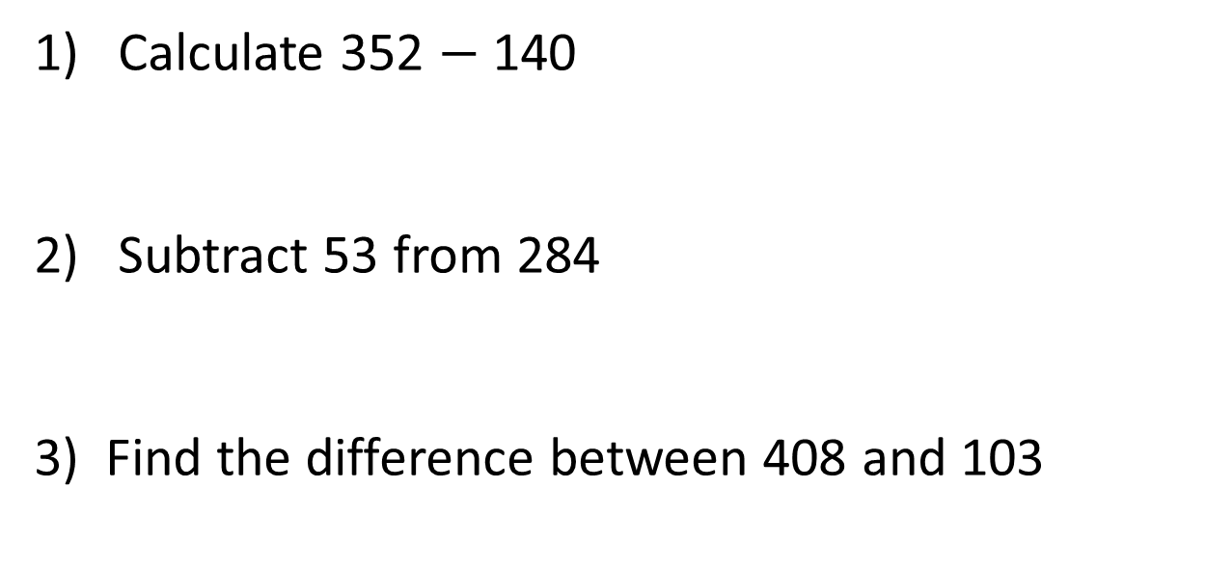
1) Calculate 352 $−$ 140
2) Subtract 53 from 284
3) Find the difference between 408 and 103

Slide 4
1) Calculate 352 $−$ 140
2) Subtract 53 from 284
3) Find the difference between 408 and 103
212
231
305

Slide 6





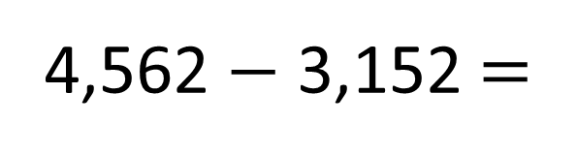
4,562 $−$ 3,152 =
1,410
Th | H | T | O
Th | H | T | O
4 | 5 | 6 | 2
3 | 1 | 5 | 2
$$−$$
1
4
1
0

Slide 7
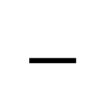
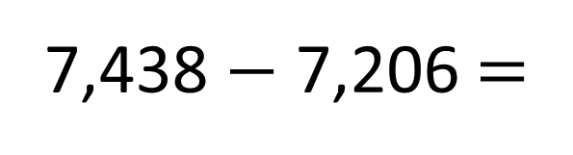
7,438 $−$ 7,206 =
232
Th | H | T | O
Th | H | T | O
7 | 4 | 3 | 8
7 | 2 | 0 | 6
$$−$$
0
2
3
2

Slide 8
Have a go at questions
1 – 3 on the worksheet

Slide 9
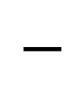
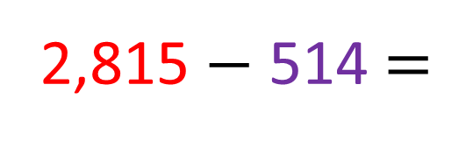
2,815 $−$ 514 =
2,301
minuend
subtrahend
difference
Th | H | T | O
Th | H | T | O
2 | 8 | 1 | 5
 | 5 | 1 | 4
$$−$$
2
3
0
1

Slide 10

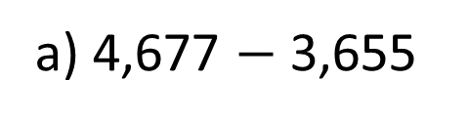
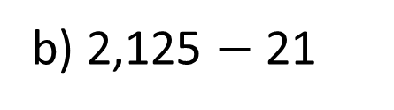
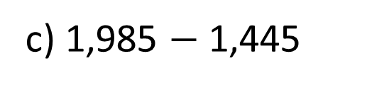
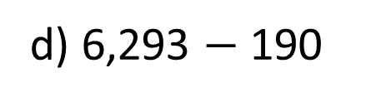
a) 4,677 $−$ 3,655
Have a think
b) 2,125 $−$ 21
c) 1,985 $−$ 1,445
d) 6,293 $−$ 190
0 hundreds | 0 tens | 0 ones

Slide 11
Have a go at questions
4 and 5 on the worksheet

Slide 12
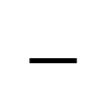
3,658 tickets are sold for a concert.
Before the night, 3,443 tickets are sold.
How many tickets are sold on the night of the concert?
215 tickets
Have a think
3,658 Tickets sold
Th | H | T | O
3 | 6 | 5 | 8
3 | 4 | 4 | 3
 | 2 | 1 | 5
$$−$$
3,443
?
Sold before night
Sold on the night

Slide 13

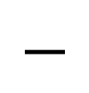
Mont Blanc is 4,810 m high.
Mount Everest is 8,850 m high.
How much higher is Mount Everest than Mont Blanc?
Mount Everest is 4,040 metres higher.
Th | H | T | O
8 | 8 | 5 | 0
4 | 8 | 1 | 0
4 | 0 | 4 | 0
?
Blanc
4,810 m
$$−$$
Everest
8,850 m

Slide 14
Have a go at the rest of the worksheet

