Slide 1

What do you remember about the features of a non-chronological report?
Where are you on your learning journey to writing your own?

Slide 2
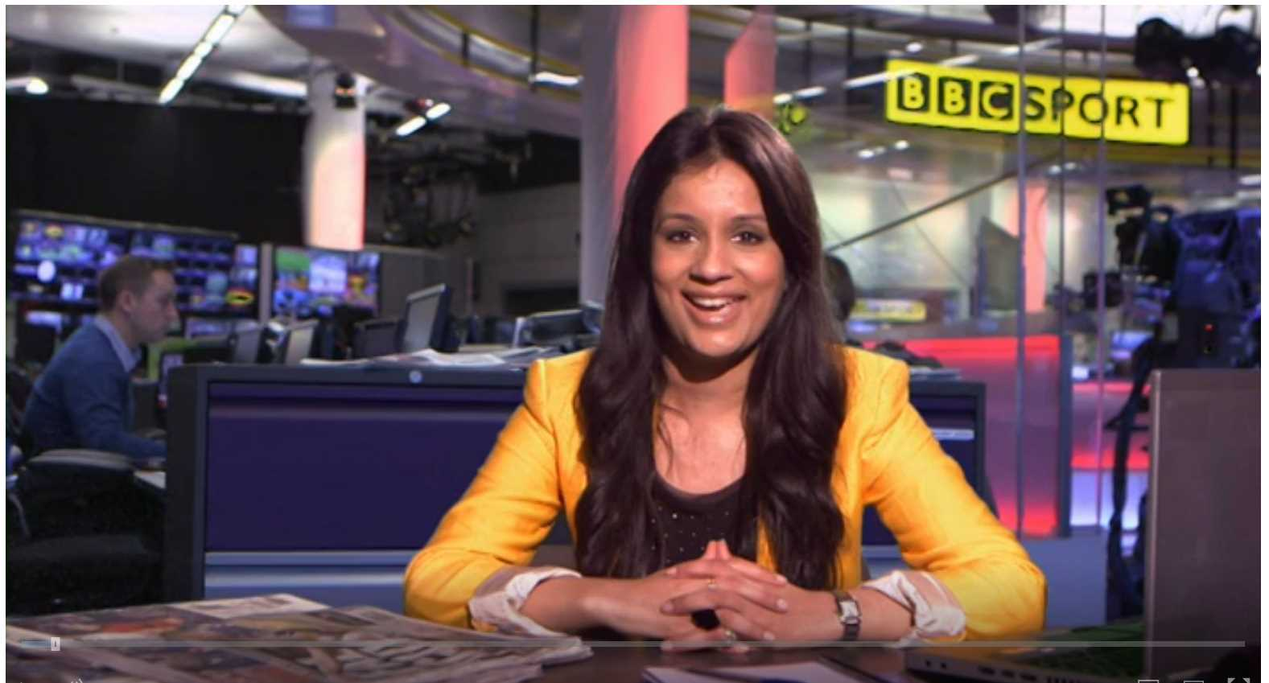

Click on the link to remind yourself of what a non-chronological report is.
Think…
What have you done so far?
https://www.bbc.co.uk/teach/class-clips-video/english-ks1-ks2-how-to-write-a-non-chronological-report/zvbtscw

Slide 3
A non-chronological report does not need to be written in a specific order but it does need an introduction and a conclusion!

Slide 4
Think…
An introduction…
Introduces the topic
Should be short and snappy and should not include specific details you will discuss later
Hook the reader in and make them want to find out more.

Slide 5
What do you think about my introduction?
The Romans were around a really really long time ago but their not here anymore. The Romans left lots of things and we still use them today. The Romans made straight roads and invented technology like computers. In my report you will find out more about the Romans.

Slide 6
What do you think about my introduction?
I agree!
I can do better!

Slide 7
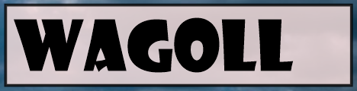
Roughly 2,000 years ago, the Romans began to build their empire. This was an incredibly long time ago - even before your teachers were born! The Roman Empire was vast and covered most of Europe and North Africa. They became the most powerful civilisation at that time and their legacy lives on today.

Slide 8
Think…
Tell someone at home 3 things that you like about my introduction.

Slide 9
Roughly 2,000 years ago, the Romans began to build their empire. This was an incredibly long time ago - even before your teachers were born! The Roman Empire was vast and covered most of Europe and North Africa. They became the most powerful civilisation at that time and their legacy lives on today.
Introduce the topic
Hook the reader in – I have used humour
Introduces the topic of the report without specific detail
Short and snappy

Slide 10

Remember to keep it short and snappy
- Read it aloud for sense and punctuation and improve it.

Slide 11
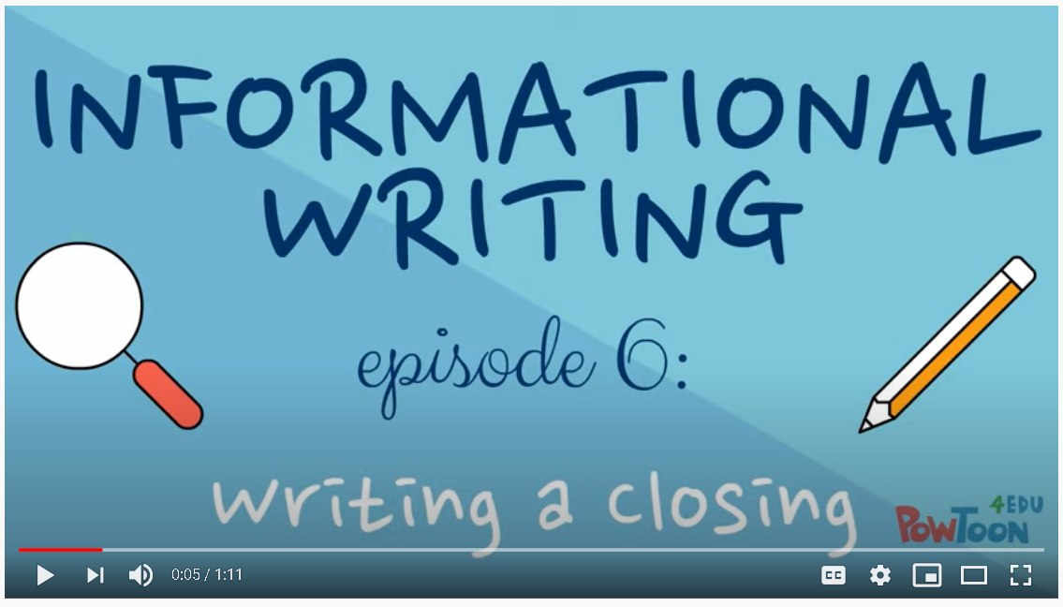
When writing your conclusion, you need to think about what you have included and summarise the main ideas.
Click on the link below to learn more.
https://www.youtube.com/watch?v=90TT0q2mHws

Slide 12
I have written a lot about the Romans, so in my conclusion I want the reader to decide how they feel about this civilisation.
I will summarise the benefits and the disadvantages of Roman Rule that I have discussed.

Slide 13
Despite their many inventions, the Romans were an arrogant bunch who truly believed they were more powerful and superior to any other nation. Although, if they had not perceived themselves this way, what would life have been like for us today? Can you imagine a world without straight roads, swimming pools and central heating?
I will let you decide: Rotten Romans or ingenious inventors?

Slide 14
Remember to refer to and summarise the main points you have written about.
Ask a rhetorical question
Don’t introduce a new point
- Read it aloud for sense and punctuation and improve it.

Slide 15
Reflection
You have now completed your draft report on the Romans.
Teach a family member.
Read your report to them and edit your work to make sure it makes sense.

