Slide 1

Last lesson you began to draft you report.
Today you will continue to write independently.

Slide 2

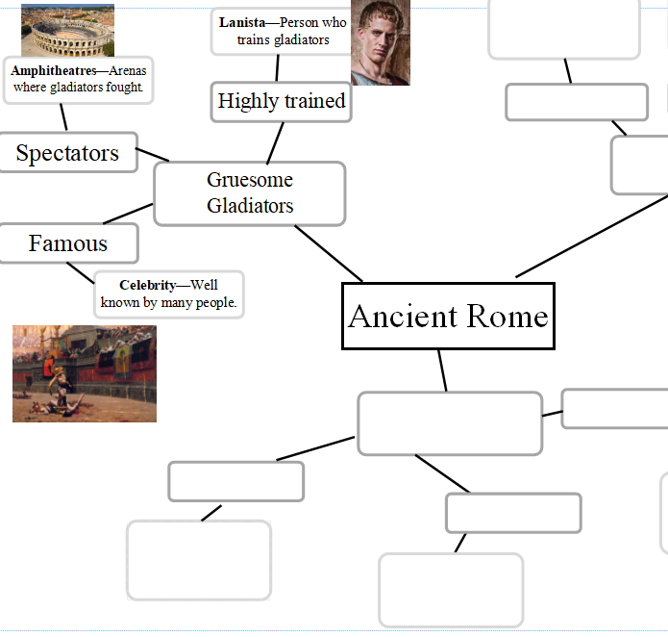
Think…
Refer to your plan.
What are the main points you will include in your next paragraph?

Slide 3

- Choose the paragraph you want to write about next.
Write your subheading and draft the paragraph.
Remember to include a range of different sentences.
- Read it aloud for sense and punctuation and improve it.

Slide 4
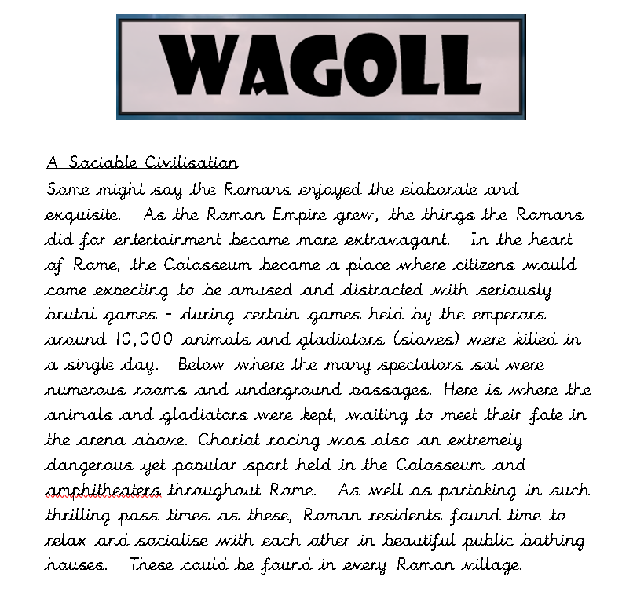
If you need additional support, you can find good examples of other paragraphs in today’s folder.

Slide 5

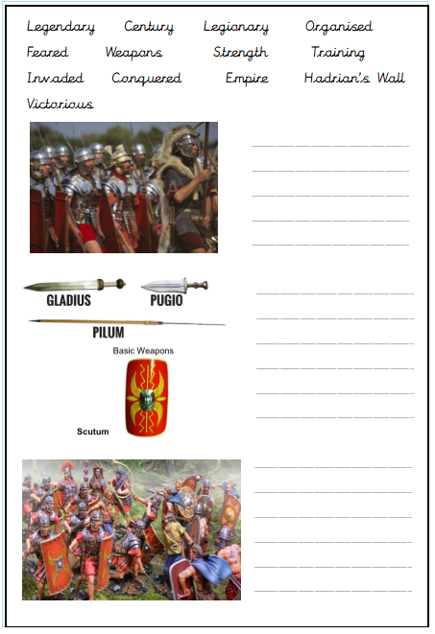
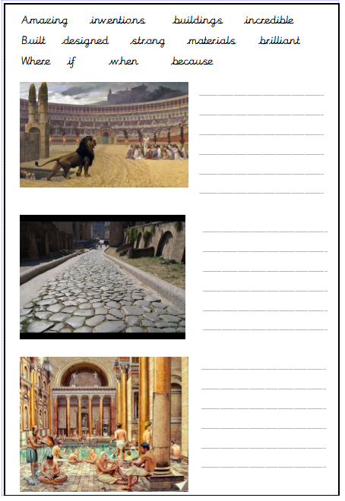
If you are finding it difficult to structure your paragraphs, use the scaffold sheets to guide you.

Slide 6

Now repeat the process for your third and final main paragraph.
Challenge:
If you have time and would like to write another paragraph, do it!

Slide 7
Reflection
Underline your simple, compound and complex sentences in a different colour.
Have you included at least one of each?

