Slide 1
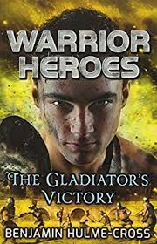

What you learnt about non-chronological reports so far?
Think… tell someone at home 3 features you would find in this type of writing.
.
.
.

Slide 2
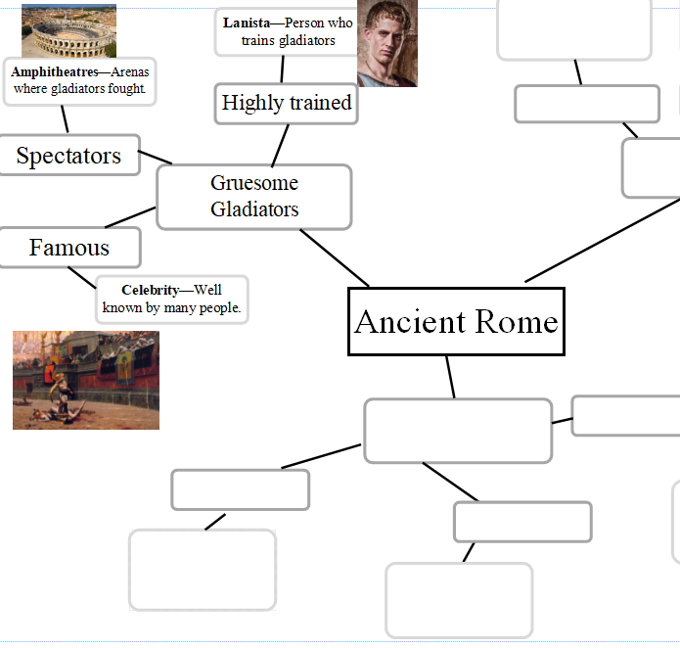
You have created your plans and added conjunctions and a variety of sentences that you will use today to help you begin to write your reports.

Slide 3
When writing a non-chronological report, it is sometimes easier to write your main paragraphs before your introduction and conclusion so you will be writing these in the next two lessons.

Slide 4
Now, you should look at your plan to remind yourself of the main points you want to include.

Slide 5

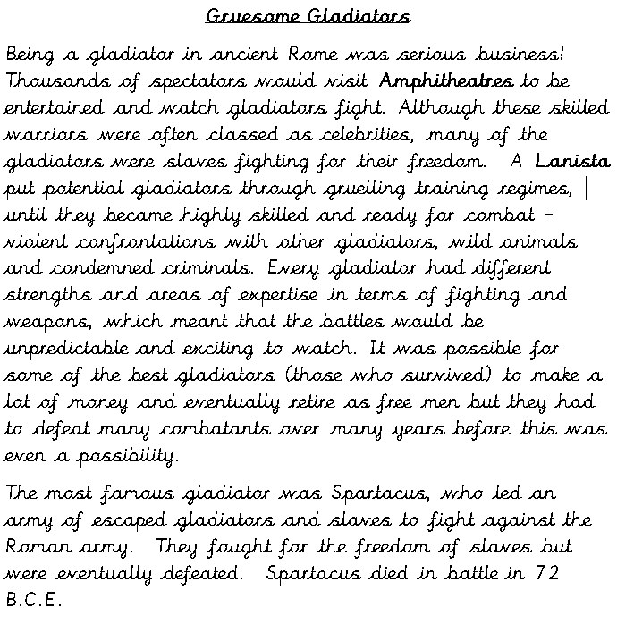
Read my example out loud.

Slide 6
Think
Have I included the main points from my plan?

Slide 7
What about the features and skills we have been learning?
Can you find any?
Gruesome Gladiators
Being a gladiator in ancient Rome was serious business! Thousands of spectators would visit Amphitheatres to be entertained and watch gladiators fight. Although these skilled warriors were often classed as celebrities, many of the gladiators were slaves fighting for their freedom. A Lanista put potential gladiators through gruelling training regimes, until they became highly skilled and ready for combat – violent confrontations with other gladiators, wild animals and condemned criminals. Every gladiator had different strengths and areas of expertise in terms of fighting and weapons, which meant that the battles would be unpredictable and exciting to watch. It was possible for some of the best gladiators (those who survived) to make a lot of money and eventually retire as free men but they had to defeat many combatants over many years before this was even a possibility.
The most famous gladiator was Spartacus, who led an army of escaped gladiators and slaves to fight against the Roman army. They fought for the freedom of slaves but were eventually defeated. Spartacus died in battle in 72 B.C.E.
Subheadings
Complex sentences – subordinating conjuctions to make a subordinating clause
Simple sentences
Compound sentences

Slide 8
What about the features and skills we have been learning?
Gruesome Gladiators
Being a gladiator in ancient Rome was serious business! Thousands of spectators would visit Amphitheatres to be entertained and watch gladiators fight. Although these skilled warriors were often classed as celebrities, many of the gladiators were slaves fighting for their freedom. A Lanista put potential gladiators through gruelling training regimes, until they became highly skilled and ready for combat – violent confrontations with other gladiators, wild animals and condemned criminals. Every gladiator had different strengths and areas of expertise in terms of fighting and weapons, which meant that the battles would be unpredictable and exciting to watch. It was possible for some of the best gladiators (those who survived) to make a lot of money and eventually retire as free men but they had to defeat many combatants over many years before this was even a possibility.
The most famous gladiator was Spartacus, who led an army of escaped gladiators and slaves to fight against the Roman army. They fought for the freedom of slaves but were eventually defeated. Spartacus died in battle in 72 B.C.E.
Subheadings
Complex sentences – subordinating conjuctions to make a subordinating clause
Simple sentences
Compound sentences

Slide 9
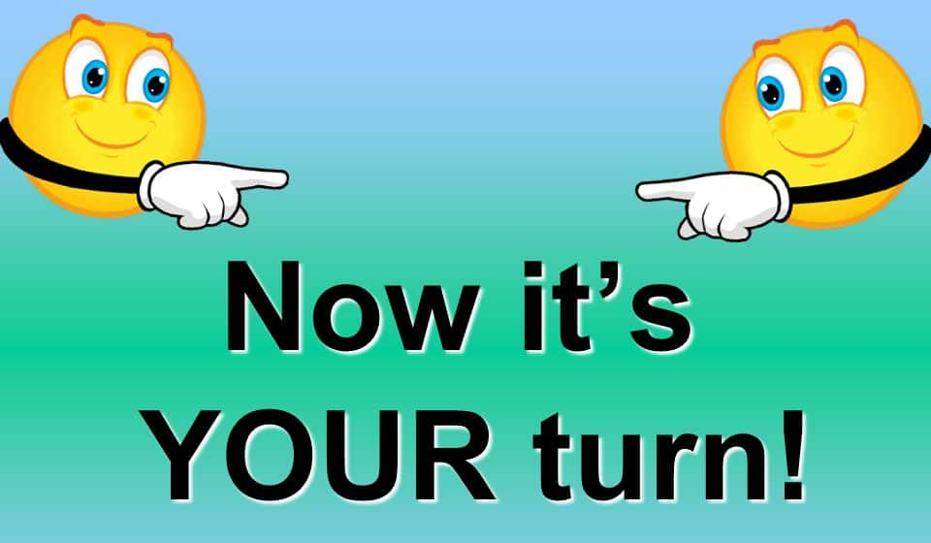
Now it’s your turn!
- Choose the paragraph you want to write about first.
- Write your subheading and draft the paragraph.
- Read it aloud for sense and punctuation and improve it.

Slide 10
Reflection
Underline your simple, compound and complex sentences in a different colour.
Have you included at least one of each?

