Slide 1

FRENCH

Slide 2

Part 1
LO: I am learning to describe
positions.

Slide 3

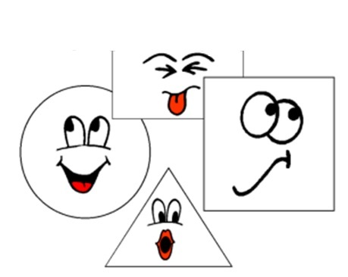
Les formes et les couleurs

Slide 4
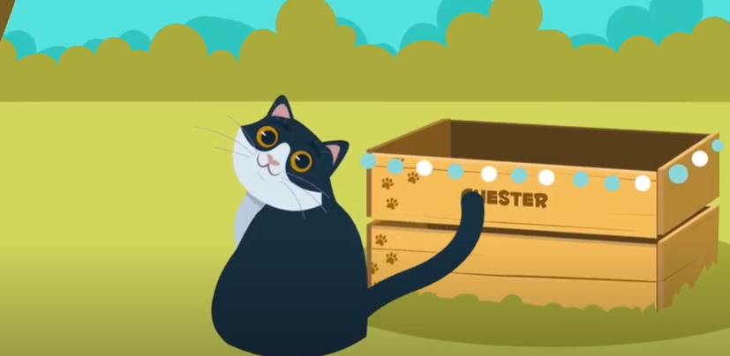
https://www.youtube.com/watch?v=mOhf1pUcHII
Notes:
Introduce and practise these positioning words. It is best to use hand gestures with them for recall, but of course pupils do need to know exactly what they mean, too.
sur – at the top / above
sous – at the bottom / below
à droite – on the right
à gauche – on the left

Slide 5
Ou est le cercle?
Where is the circle?
sur

Slide 6
Ou est le cercle?
Where is the circle?
sous

Slide 7
Ou est le cercle?
Where is the circle?
à droite

Slide 8
Ou est le cercle?
Where is the circle?
à gauche

Slide 9
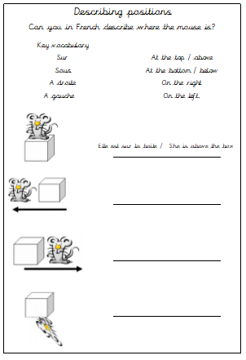

Slide 10
Part 2
LO: I am learning to describe
positions.

Slide 11
Watch this video again and pause it before they tell you the answer, can you tell me which position it will be?
https://www.youtube.com/watch?v=mOhf1pUcHII
Notes:
Introduce and practise these positioning words. It is best to use hand gestures with them for recall, but of course pupils do need to know exactly what they mean, too.
sur – at the top / above
sous – at the bottom / below
à droite – on the right
à gauche – on the left

Slide 12
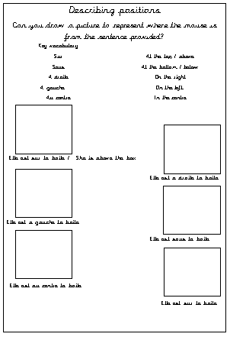
Allez-y
Your turn

