Slide 1




Slide 2
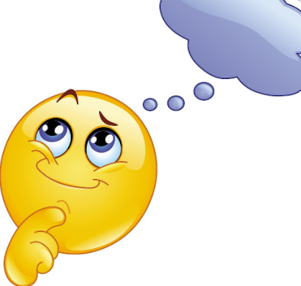
What do you think a prediction is?
Write down your ideas

Slide 3
Now, let’s watch a video on predictions.
https://www.youtube.com/watch?v=nsLD33rczFA

Slide 4
What is prediction?
In order to make a prediction, readers need to explain what they believe will happen in the text before reading. Predictions can be done at the beginning of the text or throughout reading.

Slide 5
What can we use to help us make a prediction?

Slide 6
How can we make a prediction?
Look at images in the book
Think about what we already know about the story and characters
Look at the text – what is happening

Slide 7
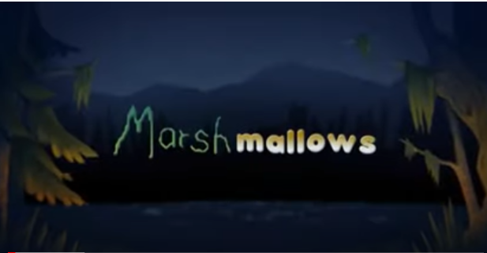
Let’s have a try together…
Please only watch to 21 seconds.
https://www.youtube.com/watch?v=GwXFVqKuH-w

Slide 8

In those 20 seconds we have seen a lot of information.
Some questions to think about:
What is happening?
Where is the boy?
Does the music give you any clues?
What about the colours used?

Slide 9
Let’s collect our ideas…
There is a boy by a fire
There is low music playing which sounds scary
Sounds like growling
The music speeds up when the boy turns around
Something is sneaking out of the water
It looks angry
Big teeth
Huge monster

Slide 10
What is prediction?
In order to make a prediction, readers need to explain what they believe will happen in the text before reading. Predictions can be done at the beginning of the text or throughout reading.
Look at images in the book
Think about what we already know about the story and characters
Look at the text – what is happening

Slide 11
Which prediction do you think is the best?
I predict that the boy will jump up and down and celebrate that Santa has arrived in the camp. He is so happy to see something else around him and have someone to share his fire with.
I think that something scary might happen next. The music makes me feel worried about the boy because the monster is slowly creeping up on the small boy by the fire. Also, I think because it is dark something bad will happen because everything is scarier when it is dark.
Why do you think that prediction is the best one?

Slide 12
Which prediction do you think is the best?
b) I think that something scary might happen next. The music makes me feel worried about the boy and the monster is slowly creeping up on the small boy by the fire. Also, I think it being dark means something bad will happen because everything is scarier when it is dark.
Why do you think that prediction is the best one?

Slide 13
Which prediction do you think is the best?
I predict that the boy will jump up and down and celebrate that Santa has arrived in the camp. He is so happy to see something else around him and the sun makes him feel cold.

Slide 14
Let’s collect our ideas…
There is a boy by a fire
There is low music playing to sound scary
Sounds like growling
The music speeds up when the boy turns around
Something is sneaking out of the water
It looks angry
Big teeth
Huge monster

Slide 15

Write a short prediction about what might happen next in the video.
Remember to use:
Look at images in the book
Think about what we already know about the story and characters
Look at the text – what is happening

Slide 16
Finally,
Let’s see what happens in Marshmallows.
https://www.youtube.com/watch?v=GwXFVqKuH-w
Was your prediction correct? Did anything surprise you?

