Slide 1


Slide 2
Warm up
Say the 3 times tables aloud
0 x 3 = 0
1 x 3 = 3
2 x 3 = 6
3 x 3 = 9
4 x 3 = 12
5 x 3 = 15
6 x 3 = 18
7 x 3 = 21
8 x 3 = 24
9 x 3 = 27
10 x 3 = 30
11 x 3 = 33
12 x 3 = 36
Extra challenge
Can you say them backwards
What patterns that you notice?

Slide 3
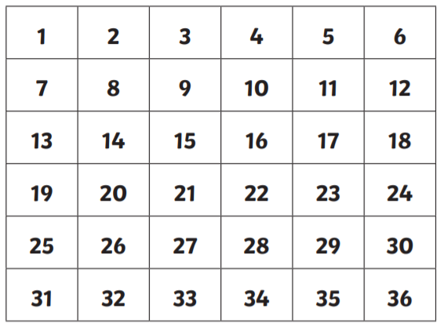
Starter
Write all the numbers that appearr in the 3 times table

Slide 4
Starter - answers

Slide 5
Click on the link to play the video for today’s lesson
Click the link or copy and paste the link into Google to watch today’s lesson
https://vimeo.com/476319270

Slide 7


1) How many pears?
2) How many fish?
3) Complete the number track.
3 | 6 | 9 |  |  | 18 |  | 24 |  | 30 |  | 36

Slide 8
1) How many pears?
2) How many fish?
3) Complete the number track.
18
9
3 | 6 | 9 |  |  | 18 |  | 24 |  | 30 |  | 36
12
15
21
27
33

Slide 10

3
6
9
12
15
18
21
24
27
30
33
36

Slide 11








How many groups of 3 teddies?
4
$$×$$
3
$$=$$
12
or
3
$$×$$
4
$$=$$
12
8
$$×$$
3
$$=$$
24
or
3
$$×$$
8
$$=$$
24

Slide 12







Have a think
6
$$×$$
3
$$=$$
18
3
$$×$$
6
$$=$$
18
18
$$÷$$
3
$$=$$
6
18
$$÷$$
6
$$=$$
3

Slide 13




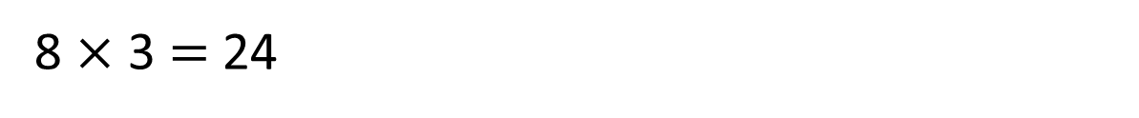


What number did Eva roll?
Eva rolled 11
12 | 3 | 18 | 24 | 15
24 | 30 | 21 | 18 | 9
15 | 24 | 6 | 30 | 36
9 | 33 | 12 | 21 | 6
$×$ 3 $=$ 33
11
8 $×$ 3 $=$ 24
Have a think

Slide 14
Have a go at questions
1 - 4 on the worksheet

Slide 15


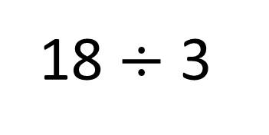

Which card has the greater value?
Have a think
$$<$$
5
18 $÷$ 3
18
6
6
6

Slide 16
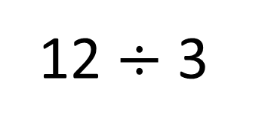
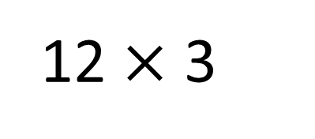

Which card has the greater value?
Have a think
$$>$$
12 $×$ 3
12 $÷$ 3
36
12 | 12 | 12
12
4
4
4

Slide 17
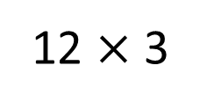
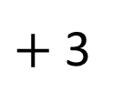
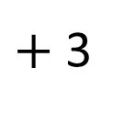
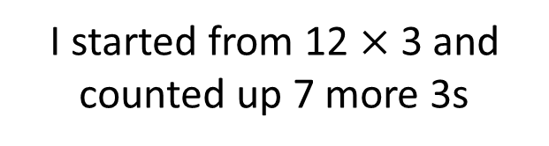
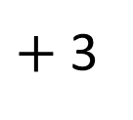
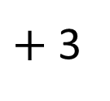
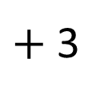
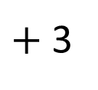
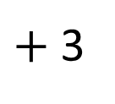
What is 19 $×$ 3?
Have a think
I started from 12 $×$ 3 and counted up 7 more 3s
12 $×$ 3
$+$ 3
$+$ 3
$+$ 3
$+$ 3
$+$ 3
$+$ 3
$+$ 3
0
36
39
42
45
48
51
54
57

Slide 18
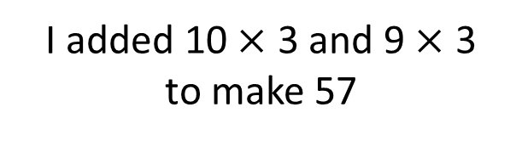
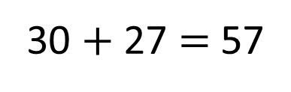
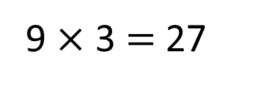
What is 19 $×$ 3?
I added 10 $×$ 3 and 9 $×$ 3
to make 57
9 $×$ 3 $=$ 27
10 $×$ 3 $=$ 30
30 $+$ 27 $=$ 57

Slide 19
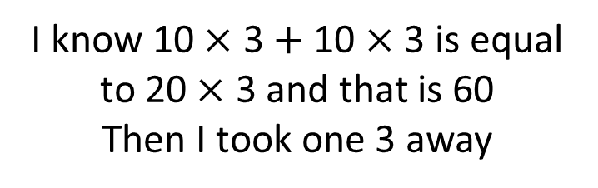
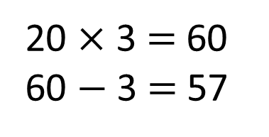
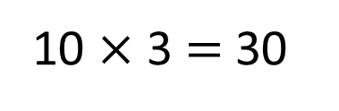
What is 19 $×$ 3?
I know 10 $×$ 3 $+$ 10 $×$ 3 is equal to 20 $×$ 3 and that is 60
Then I took one 3 away
10 $×$ 3 $=$ 30
10 $×$ 3 $=$ 30
20 $×$ 3 $=$ 60
60 $−$ 3 $=$ 57

Slide 20
Have a go at the rest of the questions on the worksheet

Slide 21
Extra practise

Slide 22
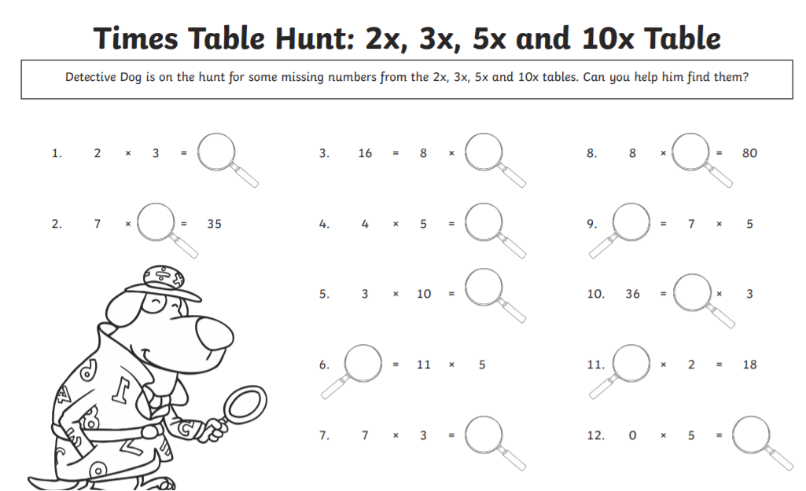

Slide 23


