Slide 1


Slide 2
Warm up
Say the 3 times tables aloud
0 x 3 = 0
1 x 3 = 3
2 x 3 = 6
3 x 3 = 9
4 x 3 = 12
5 x 3 = 15
6 x 3 = 18
7 x 3 = 21
8 x 3 = 24
9 x 3 = 27
10 x 3 = 30
11 x 3 = 33
12 x 3 = 36
Extra challenge
Can you say them backwards
What patterns that you notice?

Slide 3
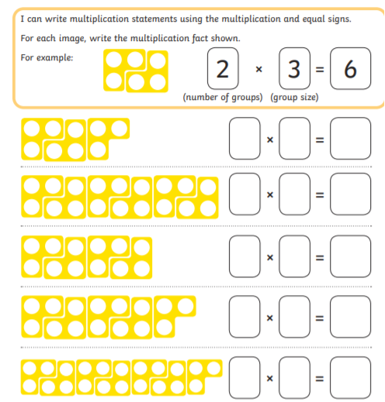
Starter
Write all the numbers that appearr in the 3 times table

Slide 4
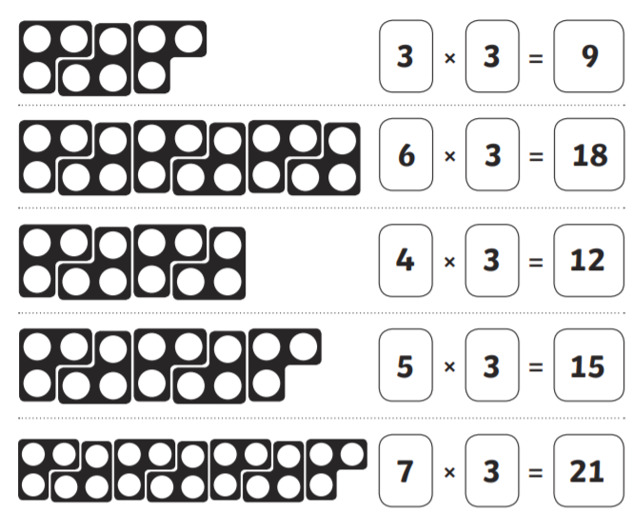
Starter - answers

Slide 5
Click on the link to play the video for today’s lesson
Click the link or copy and paste the link into Google to watch today’s lesson
https://vimeo.com/475444308

Slide 7

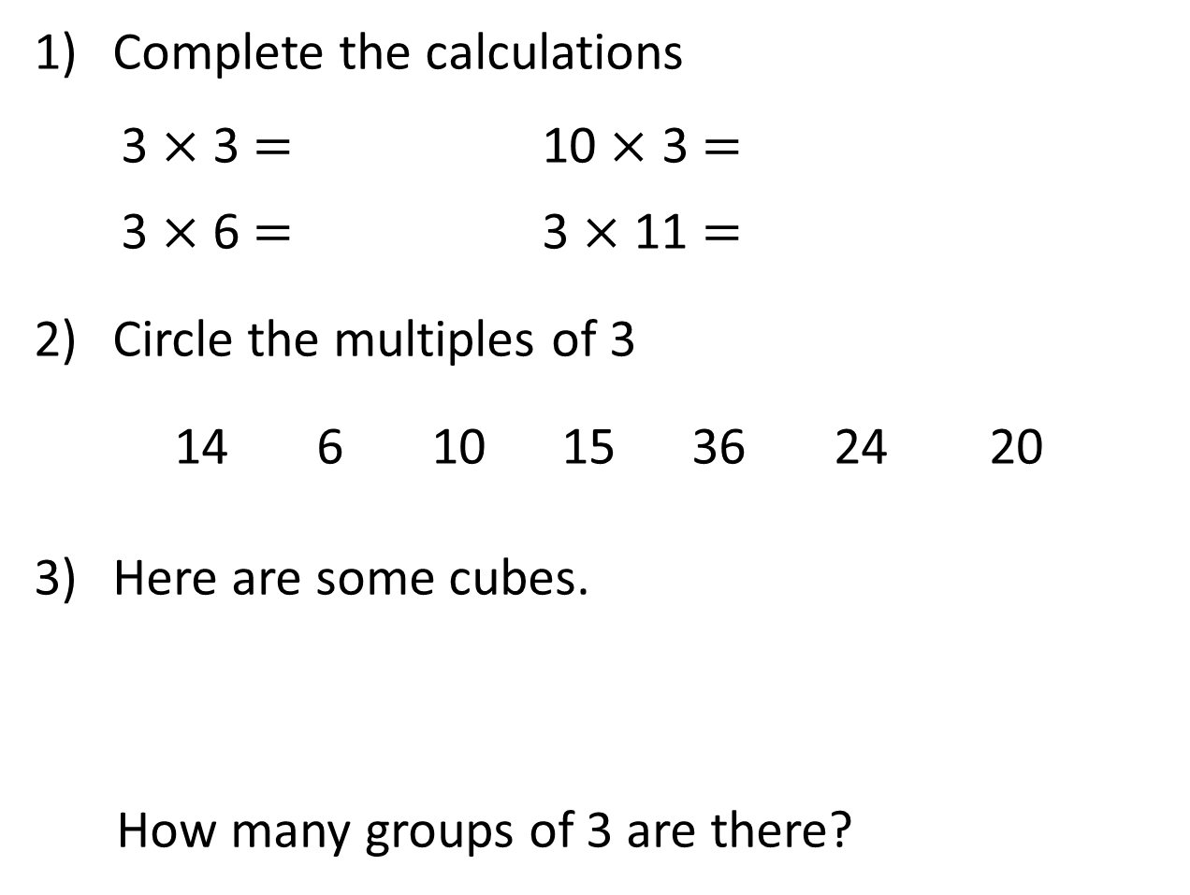
Complete the calculations
3 $×$ 3 $=$ 10 $×$ 3 $=$
3 $×$ 6 $=$ 3 $×$ 11 $=$
Circle the multiples of 3
14 6 10 15 36 24 20
Here are some cubes.
How many groups of 3 are there?

Slide 8
Complete the calculations
3 $×$ 3 $=$ 10 $×$ 3 $=$
3 $×$ 6 $=$ 3 $×$ 11 $=$
Circle the multiples of 3
14 6 10 15 36 24 20
Here are some cubes.
How many groups of 3 are there?
9
30
18
33
4

Slide 10






The children are playing a game.
They need to divide themselves into three teams.
How many will be in each team?

Slide 11
The children are playing a game.
They need to divide themselves into three teams.
How many will be in each team?
There are 2 children in each team.

Slide 12
Now the children need to get into teams of 3
How many teams of 3 will there be?

Slide 13
Now the children need to get into teams of 3
How many teams of 3 will there be?
There are 2 teams of 3 children.

Slide 14


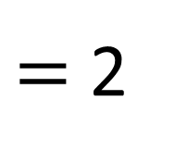
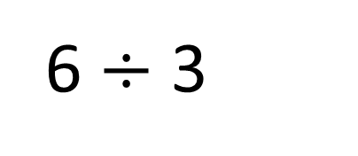
$=$ 2
6 $÷$ 3
Shared into 3 equal teams
There are 2 children in each team.
Grouped into teams of 3
There are 2 groups of 3 children.

Slide 15







Here are 21 cakes.
They are shared equally between 3 plates.
They are divided into groups of 3
Have a think

Slide 16

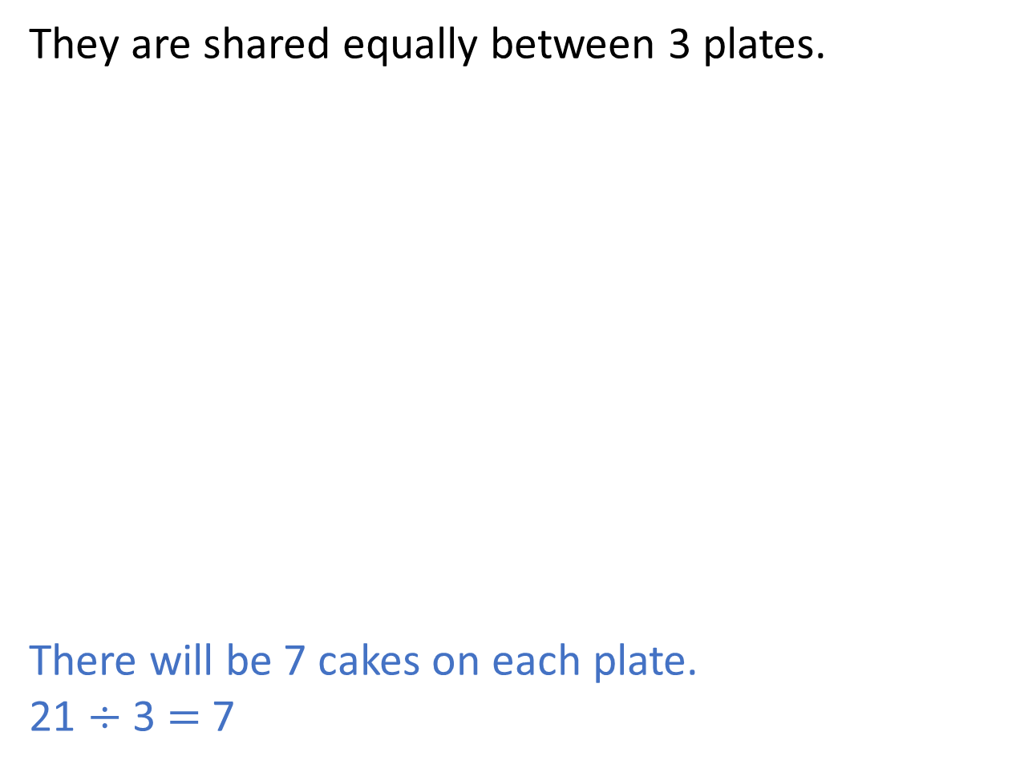
They are shared equally between 3 plates.
There will be 7 cakes on each plate.
21 $÷$ 3 $=$ 7

Slide 17
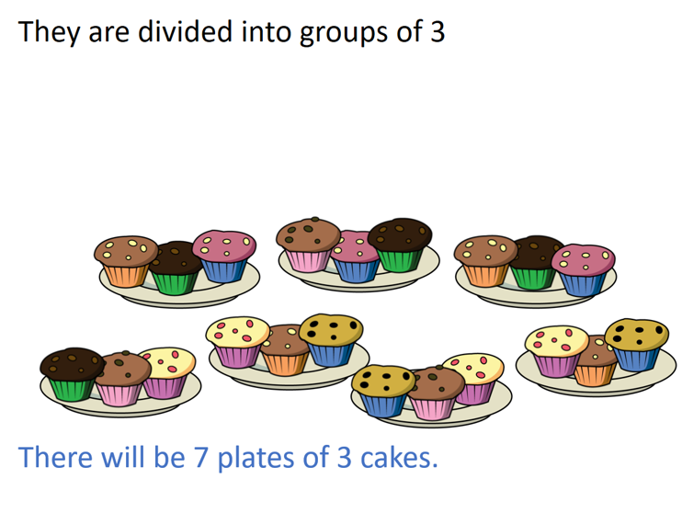

Slide 18
Have a go at questions
1 - 3 on the worksheet

Slide 19
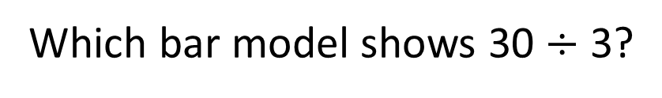
Which bar model shows 30 $÷$ 3?
30
3 | 3 | 3 | 3 | 3 | 3 | 3 | 3 | 3 | 3
Have a think
30
10 | 10 | 10

Slide 20
Which bar model shows 30 $÷$ 3?
30
3 | 3 | 3 | 3 | 3 | 3 | 3 | 3 | 3 | 3
30 divided into groups of 3
Have a think
30
10 | 10 | 10
30 divided into 3 equal parts

Slide 21
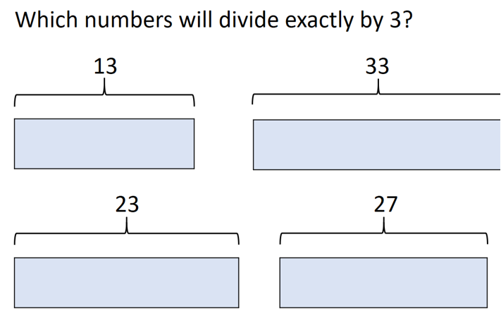

Slide 22
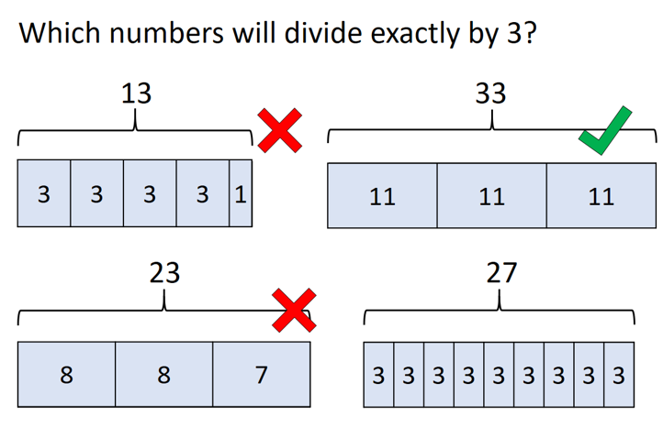

Slide 23



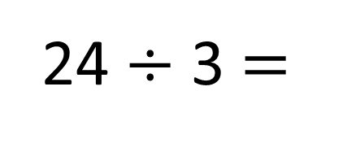
24 $÷$ 3 $=$
The baker has 24 tarts.
He puts 3 tarts into each box.
How many boxes can he fill?
8
$+$ 3
0
3
6
9
12
15
18
21
24
$−$ 3
0
3
6
9
12
15
18
21
24

Slide 24
Have a go at questions
4 - 7 on the worksheet

Slide 25
When you add three consecutive numbers, the total can always be divided equally by 3
Is this statement correct?

Slide 26
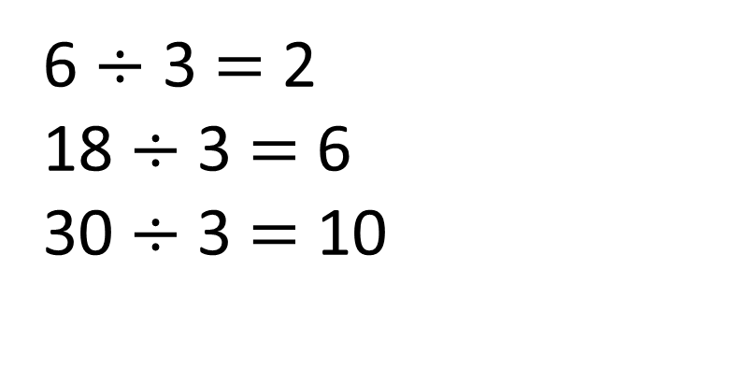
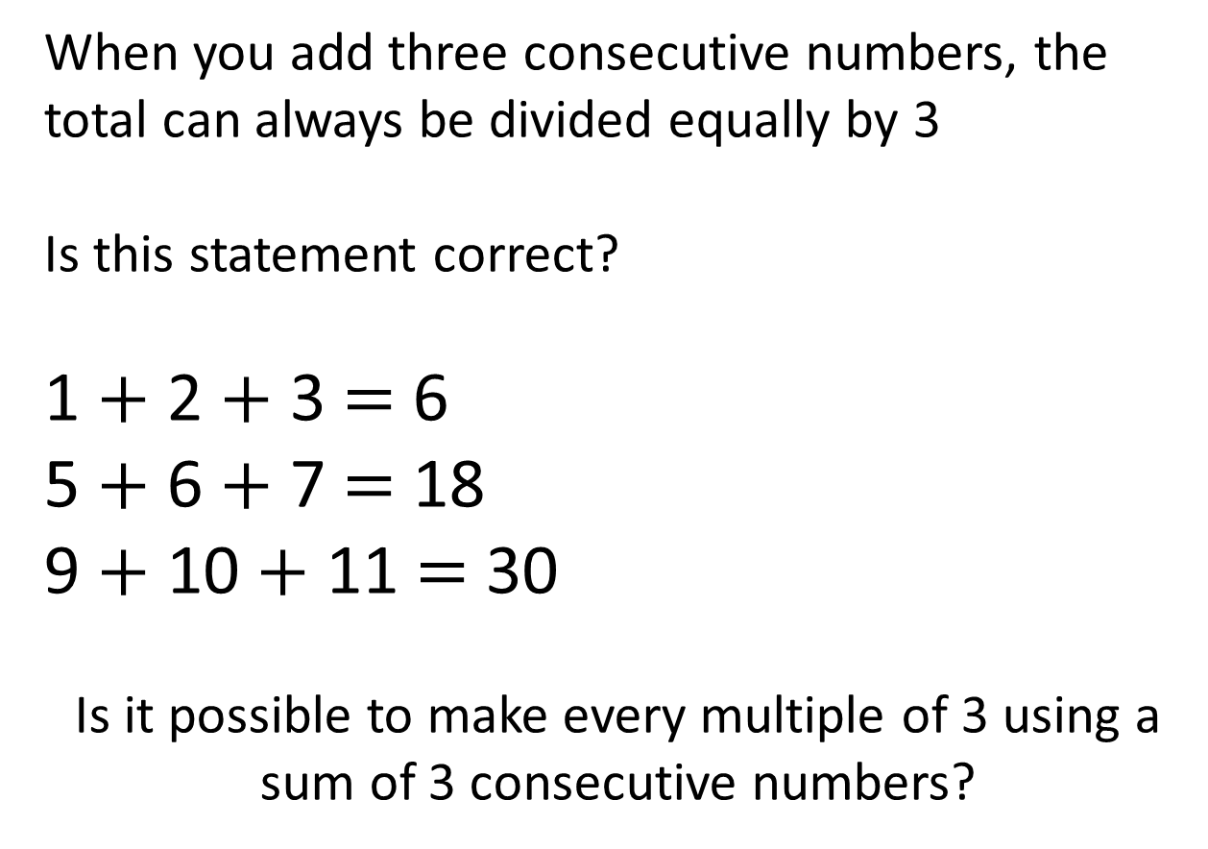
When you add three consecutive numbers, the total can always be divided equally by 3
Is this statement correct?
1 $+$ 2 $+$ 3 $=$ 6
5 $+$ 6 $+$ 7 $=$ 18
9 $+$ 10 $+$ 11 $=$ 30
Is it possible to make every multiple of 3 using a sum of 3 consecutive numbers?
6 $÷$ 3 $=$ 2
18 $÷$3 $=$ 6
30 $÷$3 $=$ 10

