Slide 1

FRENCH

Slide 2
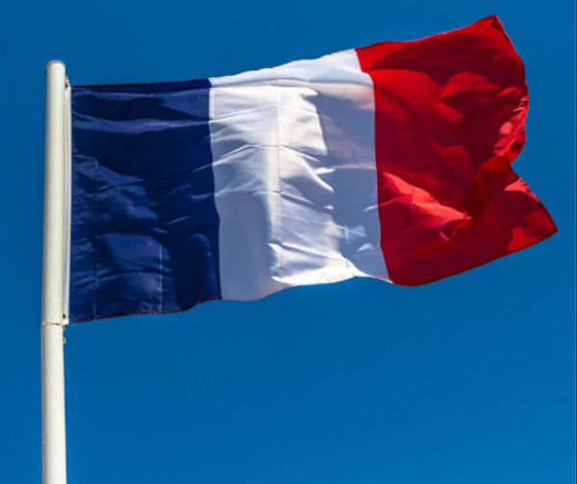




REVISIT
Click clock to open timer
1 minute to say numbers 1-10 in French
.
1 minute to hear your partner to say the numbers.
1 minute to say them again together.

Slide 3
Part 1
LO: I am learning about singular
and plural in French animals.

Slide 4

Class work
On the next slide you will see and hear some French spoken.
Listen carefully.
Repeat after each word.

Slide 5
un
une
le
la
Singulier et pluriel
(a, the, some)
des
des
les
les
Notes:
Here the pupils are introduced to all the words for a/some/the which remain colour-coded blue for masculine and red for feminine. The is an important skill to grasp as most sentences which contain a noun will also contain an article (definite or indefinite). The activity is designed to be interactive whereby pupils can come to the front and press/click on the buttons they believe to be appropriate to the animal featured. They will hear audio telling them whether they are correct or not. Pupils will hear ‘tant pis’ (bad luck) if they choose something inappropriate, or praise & a translation if they choose something appropriate (grammatically correct).

Slide 6
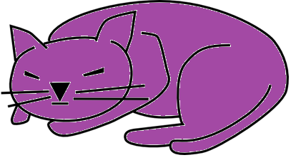
un
une
le
la
Notes:
Pupils should choose blue buttons because they have learnt that ‘un chat’ is masculine/blue. Because they have already learnt ‘un’ chat they should choose that button easily and then follow the blue pattern to get the correct word for ‘the’.

Slide 7
some cats =
des
chats
the cats =
les
chats
Notes:
In French some = des and the (plural) = les, irrespective of the gender.
It’s important that pupils have practice in recognising and producing the different plural articles, though, as misuse of direct/indirect articles is often something that causes errors, which can lead to miscommunication.

Slide 8

un
une
le
la
Notes:
Instructions as per slide 2&3.

Slide 9
some dogs =
des
chiens
the dogs =
les
chiens
Notes:
Instructions as per slide 2&3.

Slide 10

un
une
le
la
Notes:
Instructions as per slide 2&3.

Slide 11
some fish =
des
poissons
the fish =
les
poissons
Notes:
Instructions as per slide 2&3.

Slide 12
Well done!
You have learnt all singular and plural words in French.

